Slide 1

CSCE 222 Discrete Structures
Algorithms
Dr. Tim McGuire
Grateful acknowledgement to Professor Marc Pomplun, University of Massachusetts-Boston, for some of the material upon which these notes are adapted.

Slide 2
Based on Chapter 3 of Rosen Discrete Mathematics and its Applications 8th edition

Slide 3
Enough Mathematical Appetizers!
Let us look at something more interesting:
Algorithms

Slide 4
Algorithms (§ 3.1.1)
What is an algorithm?
An algorithm is a finite set of precise instructions for performing a computation or for solving a problem.
This is a rather vague definition. You will get to know a more precise and mathematically useful definition when you take CSCE 411.
But this one is good enough for now…

Slide 5
Algorithms
Properties of algorithms
(according to Don Knuth):
Input from a specified set,
Output from a specified set (solution),
Definiteness of every step in the computation,
Correctness of output for every possible input,
Finiteness of the number of calculation steps,
Effectiveness of each calculation step

Slide 6
Algorithm Examples -- Maximum finding
We will use a pseudocode to specify algorithms, which slightly reminds us of Ada or Pascal.
Example: an algorithm that finds the maximum element in a finite sequence
procedure max(a₁, a₂, …, a_{n}: integers)
max := a₁
for i := 2 to n
if max < a_{i} then max := a_{i}
endfor
{max is the largest element}

Slide 7
Algorithm Examples (§ 3.1.2)
Another example: a linear search algorithm, that is, an algorithm that linearly searches a sequence for a particular element.
procedure linear_search(x: integer; a₁, a₂, …, a_{n} : integers)
i := 1
while (i ≤ n and x ≠ a_{i}) do
i := i + 1
endwhile
if i ≤ n then location := i
else location := 0
endif
{location is the subscript of the term that equals x, or is zero if x is not found}

Slide 8
Algorithm Examples
If the terms in a sequence are ordered, a binary search algorithm is more efficient than linear search.
The binary search algorithm iteratively restricts the relevant search interval until it closes in on the position of the element to be located.

Slide 9
Algorithm Examples
procedure binary_search(x: integer; a₁, a₂, …, a_{n}: array of integers)
i := 1 {i is left endpoint of search interval}
j := n {j is right endpoint of search interval}
while (i < j) do
m := ⎣(i + j)/2⎦
if x > a_{m} then i := m + 1
else
j := m
endif
endwhile
if x = a_{i} then
location := i
else
location := 0
endif
{location is the subscript of the term that equals x, or is zero if x is not found}
Successively narrow down our search range until it contains only one element

Slide 10
Algorithm Examples
binary search for the letter ‘j’
search interval
a c d f g h j l m o p r s u v x z
center element

Slide 11
Algorithm Examples
binary search for the letter ‘j’
search interval
a c d f g h j l m o p r s u v x z
center element

Slide 12
Algorithm Examples
binary search for the letter ‘j’
search interval
a c d f g h j l m o p r s u v x z
center element

Slide 13
Algorithm Examples
binary search for the letter ‘j’
search interval
a c d f g h j l m o p r s u v x z
center element

Slide 14
Algorithm Examples
binary search for the letter ‘j’
search interval
a c d f g h j l m o p r s u v x z
center element
found !

Slide 15
Algorithm Examples
procedure binary_search(x: integer; a₁, a₂, …, a_{n}: array of integers)
i := 1 {i is left endpoint of search interval}
j := n {j is right endpoint of search interval}
while (i < j) do
m := ⎣(i + j)/2⎦
if x > a_{m} then i := m + 1
else
j := m
endif
endwhile
if x = a_{i} then
location := i
else
location := 0
endif
{location is the subscript of the term that equals x, or is zero if x is not found}
Could potentially make a successful search more efficient by breaking out of the while loop when finding a match.
But unless coded in machine language, would require two comparisons (in the worst case) per loop iterations instead of one

Slide 16
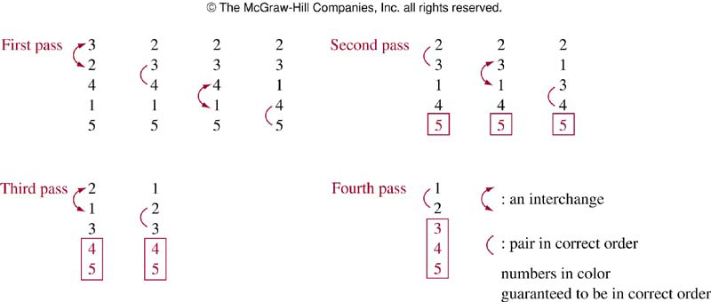
Sorting (§ 3.1.3)
Bubble sort: First pass guarantees the largest element is in correct position

Slide 17
Bubble sort
procedure bubble sort(a₁, a₂, …, a_{n}: real numbers with n≥2)
for i:=1 to n-1
for j:=1 to n-i
if a_{j}>a_{j+1} then interchange a_{j} and a_{j+1} endif endfor
endfor
{a₁, a₂, …, a_{n} is in increasing order}
What happens if n = 1 or n = 0?

Slide 18
Insertion sort
Start with 2nd term
Larger than 1st term, insert after 1st term
Smaller than 1st term, insert before 1st term
At this moment, first 2 terms in the list are in correct positions
For 3rd term
Compare with all the elements in the list
Find the first element in the list that is not less than this element
For j-th term
Compare with the elements in the list
Find the first element in the list that is not less than this element

Slide 19
Example
Apply insertion sort to 3, 2, 4, 1, 5
First compare 3 and 2 → 2, 3, 4, 1, 5
Next, insert 3rd item, 4>2, 4>3 → 2, 3, 4, 1, 5
Next, insert 4th item, 1<2 → 1, 2, 3, 4, 5
Next, insert 5th item, 5>1, 5>2, 5>3, 5>4→1, 2, 3, 4, 5

Slide 20
Insertion sort
procedure insertion sort(a₁, a₂, …, a_{n}: real numbers with n≥2)
i:=1 (left endpoint of search interval)
j:=1 (right end point of search interval)
for j:=2 to n do
i:=1
while a_{j}>a_{i} do
i:=i+1 endwhile
m:=a_{j}
for k:=0 to j-i-1 do
a_{j-k}:= a_{j-k-1} endfor
a_{i}:= m
endfor
{a₁ , a₂, …, a_{n} are sorted}

Slide 21
Omit § 3.1.4
String Matching algorithms

Slide 22
Greedy algorithms (§ 3.1.5)
Many algorithms are designed to solve optimization problems
Greedy algorithm:
Simple and naïve
Select the best choice at each step, instead of considering all sequences of steps
Once you find a feasible solution, either prove the solution is optimal or show a counterexample that the solution is non-optimal

Slide 23
Example
Given n cents change with quarters, dimes, nickels and pennies, and use the least total number of coins
Say, 67 cents
Greedy algorithm
First select a quarter (leaving 42 cents)
Second select a quarter (leaving 17 cents)
Select a dime (leaving 7 cents)
Select a nickel (leaving 2 cents)
Select a penny (leaving 1 cent)
Select a penny

Slide 24
Greedy change-making algorithm
procedure change(c₁, c₂, …, c_{n}: values of denominations of coins, where c₁>c₂>…>c_{n}; n: positive integer)
for i:=1 to r do
while n≥c_{i} do
add a coin with value c_{i} to the change
n:=n- c_{i}
endwhile
endfor

Slide 25
Example
Change of 30 cents
If we use only quarters, dimes, and pennies (no nickels)
Using greedy algorithm:
6 coins: 1 quarter, 5 pennies
Could use only 3 coins (3 dimes)
However, with nickels the greedy algorithm is optimal
(So it’s not always obvious whether greediness actually leads to an optimal solution. You’ll see examples of both outcomes when you take CSCE 411)

Slide 26
The halting problem (§ 3.1.6)
One of the most famous theorems in computer science
There is a problem that cannot be solved using any procedure
That is, we will show there are unsolvable problems
The problem is the halting problem

Slide 27
The halting problem
It asks whether there is a procedure that does this:
takes input as a computer program and input to the program, and
determines whether the program will eventually stop when run with the input
Useful to test certain things such as whether a program entered into an infinite loop

Slide 28
The halting problem
First note that we cannot simply run a program and observe what it does to determine whether it terminates when run with the given input
If the program halts, we have our answer
But if it is still running after any fixed length of time has elapsed, we do not know whether it will never halt or we just did not wait long enough for it to terminate

Slide 29
Turing’s proof
Halting problem is unsolvable
Proof by contradiction
The proof presented here is not completely rigorous
Proof: Assume there is a function which solves this halting problem called H(P,I) where P is a program and I is input
H(P,I) returns the string “halts” as output if H determines P stops when given I
Otherwise, H(P,I) returns the string “loops forever” as output

Slide 30
Turing’s proof
When a procedure is coded, it is expressed as a string of characters and can be interpreted as a sequence of bits
A program can be used as data, and thus a program can be thought of as input to another program, or even itself
H can take a program P as both of its inputs, which are a program and input to this program
H should be able to determine if P will halt when it is given a copy of itself as input

Slide 31
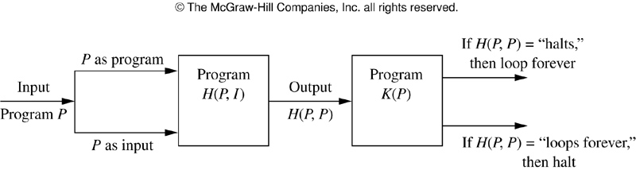
Turing’s proof
Construct a simple procedure K(P) that makes use of the output H(P,P) but does the opposite of H
If the output of H(P,P) is “loops forever”, then K(P) halts
IF the output of H(P,P) is “halts”, then K(P) loops forever

Slide 32
Turing’s proof
Suppose we provide K as input to K
We note that if the output of H(K,K) is “loops forever”, then by the definition of K, we see K(K) halts
Otherwise, if the output of H(K,K) is “halts”, then by the definition of K we see that K(K) loops, in violation of what H tells us
In both cases, we have contradiction
Thus H cannot always give the correct answers
No procedure solves the halting problem

Slide 33
“You know my methods. Apply them.”
– Sherlock Holmes, The Sign of Four
“It is of the highest importance in the art of detection to be able to recognize, out of a number of facts, which are incidental and which vital. Otherwise your energy and attention must be dissipated instead of being concentrated.”
Sherlock Holmes -The Reigate Puzzle

Slide 34
Algorithm Examples (§ 3.1.1)
Obviously, on sorted sequences, binary search is more efficient than linear search.
How can we analyze the efficiency of algorithms?
We can measure the
time (number of elementary computations) and
space (number of memory cells) that the algorithm requires.
These measures are called computational complexity and space complexity, respectively.

Slide 35
Complexity
What is the time complexity of the linear search algorithm?
We will determine the worst-case number of comparisons as a function of the number n of terms in the sequence.
The worst case for the linear algorithm occurs when the element to be located is not included in the sequence.
In that case, every item in the sequence is compared to the element to be located.

Slide 36
Algorithm Examples
Here is the linear search algorithm again:
procedure linear_search(x: integer; a₁, a₂, …, a_{n} : integers)
i := 1
while (i ≤ n and x ≠ a_{i}) do
i := i + 1
endwhile
if i ≤ n then location := i
else location := 0
endif
{location is the subscript of the term that equals x, or is zero if x is not found}

Slide 37
Complexity
For n elements, the loop
while (i ≤ n and x ≠ a_{i}) do i := i + 1 endwhile
is processed n times, requiring 2n comparisons.
When it is entered for the (n+1)th time, only the comparison i ≤ n is executed and terminates the loop.
Finally, the comparison if i ≤ n then … is executed, so all in all we have a worst-case time complexity of 2n + 2.

Slide 38
Reminder: Binary Search Algorithm
procedure binary_search(x: integer; a₁, a₂, …, a_{n}: array of integers)
i := 1 {i is left endpoint of search interval}
j := n {j is right endpoint of search interval}
while (i < j) do
m := ⎣(i + j)/2⎦
if x > a_{m} then i := m + 1
else
j := m
endif
endwhile
if x = a_{i} then
location := i
else
location := 0
endif
{location is the subscript of the term that equals x, or is zero if x is not found}
Successively narrow down our search range until it contains only one element

Slide 39
Complexity
What is the time complexity of the binary search algorithm?
Again, we will determine the worst-case number of comparisons as a function of the number n of terms in the sequence.
Let us assume there are n = 2^{k} elements in the list, which means that k = lg n.
If n is not a power of 2, it can be considered part of a larger list, where 2^{k} < n < 2^{k+1}.

Slide 40
Complexity
In the first cycle of the loop
while (i < j) do
m := ⎣(i + j)/2⎦
if x > a_{m} then
i := m + 1
else
j := m
endif
endwhile
the search interval is restricted to 2^{k-1} elements, using two comparisons.

Slide 41
Complexity
In the second cycle, the search interval is restricted to 2^{k-2} elements, again using two comparisons.
This is repeated until there is only one (2⁰) element left in the search interval.
At this point 2k comparisons have been conducted.

Slide 42
Complexity
Then, the comparison
while (i < j)
exits the loop, and a final comparison
if x = a_{i} then…
determines whether the element was found.
Therefore, the overall time complexity of the binary search algorithm is 2k + 2 = 2 ⎡lg n⎤ + 2.

Slide 43
Complexity
In general, we are not so much interested in the time and space complexity for small inputs.
For example, while the difference in time complexity between linear and binary search is meaningless for a sequence with n = 10, it is gigantic for n = 2³⁰.

Slide 44
Complexity
For example, let us assume two algorithms A and B that solve the same class of problems.
The time complexity of A is 5,000n, the one for B is ⎡1.1^{n}⎤ for an input with n elements.
For n = 10, A requires 50,000 steps, but B only 3, so B seems to be superior to A.
For n = 1000, however, A requires 5,000,000 steps, while B requires 2.5⋅10⁴¹ steps.

Slide 45
Complexity
Comparison: time complexity of algorithms A and B
Input Size
Algorithm A
Algorithm B
n
5,000n
⎡ 1.1^{n} ⎤
10
50,000
3
100
500,000
13,781
1,000
5,000,000
2.5x10⁴¹
1,000,000
5x10⁹
4.8x10⁴¹³⁹²

Slide 46
Complexity
This means that algorithm B cannot be used for large inputs, while algorithm A is still feasible.
So what is important is the growth of the complexity functions.
The growth of time and space complexity with increasing input size n is a suitable measure for the comparison of algorithms.

Slide 47
The Growth of Functions (§ 3.2.2)
The growth of functions is usually described using the big-O notation.
Definition: Let f and g be functions from the integers or the real numbers to the real numbers.
We say that f(n) ∈ O(g(n)) if there are constants C and k such that |f(n)| ≤ C|g(n)|
whenever n > k.

Slide 48
The Growth of Functions
When we analyze the growth of complexity functions, n, f(n) and g(n) are never negative.
Therefore, we can simplify the big-O requirement to
f(n) ≤ C⋅g(n) whenever n > k.
If we want to show that f(n) is O(g(n)), we only need to find one pair (C, k) (which is never unique).

Slide 49
The Growth of Functions
The idea behind the big-O notation is to establish an upper boundary for the growth of a function f(n) for large n.
This boundary is specified by a function g(n) that is usually much simpler than f(n).
We accept the constant C in the requirement
f(n) ≤ C⋅g(n) whenever n > k,
because C does not grow with n.
We are only interested in large n, so it is OK if f(n) > C⋅g(n) for n ≤ k.

Slide 50
The Growth of Functions
Example:
Show that f(n) = n² + 2n + 1 ∈ O(n²).
For n > 1 we have:
n² + 2n + 1 ≤ n² + 2n² + n²
⇒ n² + 2n + 1 ≤ 4n²
Therefore, for C = 4 and k = 1:
f(n) ≤ Cn² whenever n > k.
⇒ f(n) ∈ O(n²).

Slide 51
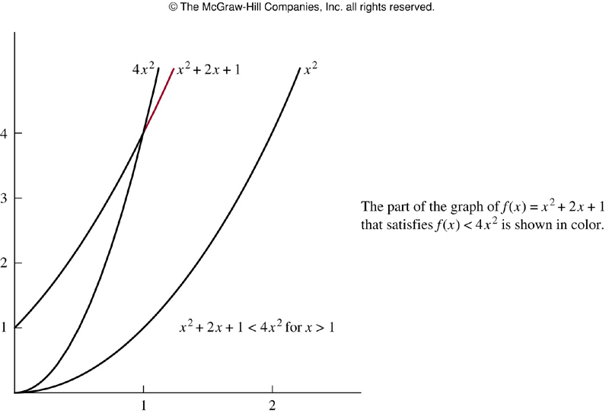
Example

Slide 52
The Growth of Functions
Question: If f(n) ∈ O(n²), is it also ∈ O(n³)?
Yes. n³ grows faster than n², so n³ grows also faster than f(n).
Therefore, we always have to find the smallest simple function g(n) for which f(n) ∈ O(g(n)).

Slide 53
Remark
We have written f(n) ∈ O(g(n)).
You may see this written as f(n) = O(g(n)).
Although this is common, it is not correct, since this notation does not represent a genuine equality.
O(…) does not represent a function, it represents a set of functions having the same property.

Slide 54
He is a fool who looks at the fruit of lofty trees, but does not measure their height. Quintus Curtius Rufus

Slide 55
The Growth of Functions (§ 3.2.3)
“Popular” functions g(n) are
n lg n, 1, 2^{n}, n², n!, n, n³, lg n
Listed from slowest to fastest growth:
1
lg n
n
n lg n
n²
n³
2^{n}
n!

Slide 56
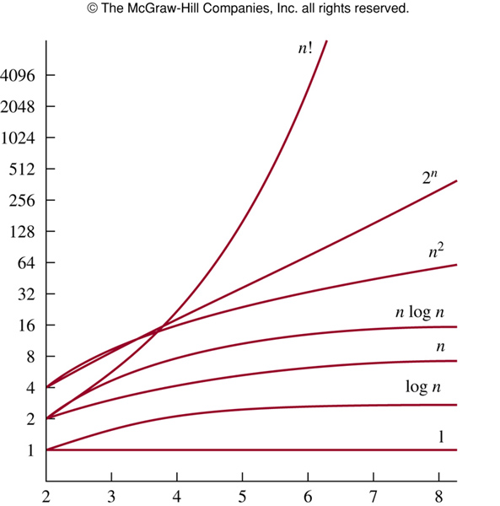
Growth of functions
vertical scale in logarithmic

Slide 57
The Growth of Functions
A problem that can be solved with polynomial worst-case complexity is called tractable.
Problems of higher complexity are called intractable.
Problems that no algorithm can solve are called unsolvable.
You will find out more about this in CSCE 411.

Slide 58
Useful Rules for Big-O (§ 3.2.4)
For any polynomial f(n) = a_{k}n^{k} + a_{k-1}n^{k-1} + … + a₀, where a₀, a₁, …, a_{k} are real numbers,
f(n) ∈ O(n^{k}).
If f₁(n) ∈ O(g₁(n)) and f₂(n) ∈ O(g₂(n)), then (f₁ + f₂)(n) ∈ O(max(g₁(n), g₂(n)))
If f₁(n) ∈ O(g(n)) and f₂(n) ∈ O(g(n)), then (f₁ + f₂)(n) ∈ O(g(n)).
If f₁(n) ∈ O(g₁(n)) and f₂(n) ∈ O(g₂(n)), then (f₁f₂)(n) ∈ O(g₁(n) g₂(n)).

Slide 59
Example
Big-O notation of f(n)=3n lg(n!)+(n²+3)lg n where n is a positive integer
We know lg(n!) is O(n lg n), so the first part is O(n² lg n)
As n²+3<2n² when n>2, it follows that n²+3 is O(n²), and the second part is O(n² lg n)
So f(n) is O(n² lg n)

Slide 60
Complexity Examples
What does the following algorithm compute?
procedure who_knows(a₁, a₂, …, a_{n}: integers)
m := 0
for i := 1 to n-1 do
for j := i + 1 to n do
if |a_{i} – a_{j}| > m then
m := |a_{i} – a_{j}|
endif
endfor
endfor
{m is the maximum difference between any two numbers in the input sequence}
Comparisons: n-1 + n-2 + n-3 + … + 1
= (n – 1)n/2 = 0.5n² – 0.5n
Time complexity is O(n²).

Slide 61
Complexity Examples
Another algorithm solving the same problem:
procedure max_diff(a₁, a₂, …, a_{n}: integers)
min := a1
max := a1
for i := 2 to n do
if a_{i} < min then
min := a_{i}
else if a_{i} > max then
max := a_{i}
endif
endfor
m := max - min
Comparisons: 2n - 2
Time complexity is O(n).

Slide 62
Big-Omega (§ 3.2.5)
Big-O notation does not provide a lower bound for the size of f(n) for large n
Let f and g be functions from the set of integers or the set of real numbers to the set of real numbers. We say f(n) ∈ Ω(g(n)) if there are positive constants C and k such that
|f(n)|≥C|g(n)| when n>k
read as f(n) is in big-Omega of g(n)

Slide 63
Example
f(n)=8n³+5n²+7 is 𝛺(g(n)) where g(n)=n³
It is easy to see as f(n)= 8n³+5n²+7≥8n³ for all positive numbers n

Slide 64
Big-Theta notation
We want a reference function g(n) such that f(n) ∈ O(g(n)) and f(n) ∈ Ω(g(n))
Let f and g be functions from the set of integers or the set of real numbers to the set of real numbers. We say that f(n) ∈ 𝛳(g(n)) if f(n) ∈ O(g(n)) and f(n) ∈ Ω(g(n))
When f(n) ∈ 𝛳(g(n)) , we say f is big-Theta of g(n), and we also say f(n) is of order g(n)

Slide 65
Big Theta-notation (§ 3.2.5)
When f(n) ∈ 𝛳(g(n)), g(n) ∈ 𝛳(f(n))
f(n) ∈ 𝛳(g(n)) if and only if f(n) ∈ O(g(n)) and g(n) ∈ O(f(n))
An alternant (but equivalent) definition of big-Theta:
𝛳(g(n)) = O(g(n)) ∩ Ω(g(n))

Slide 66
Example
Let f(n)=1+2+…+n. We know that f(n) is O(n²), to show that f(n) is of order n², we need to find C and k s.t. f(n)>Cn² for large n
Already know f(n) is O(n²), and f(n) is 𝛺(n²), thus f(n) is 𝛳(n²)

Slide 67
Big-Theta notation
We can show that f(n) is 𝛳(g(n)) if we can find positive real numbers C₁ and C₂ and a positive number k, such that
C₁|g(n)|≤|f(n)|≤C₂|g(n)|
when n>k
This shows f(n) is O(g(n)) and f(n) is 𝛺(g(n))

Slide 68
Example
Show that 3n²+8n lg n is 𝛳(n²)
As 0 ≤ 8n log n≤8n², it follows that
3n²+8n lg n ≤11n² for n>1
Consequently 3n²+8n lg n is O(n²)
Clearly 3n²+8n lg n is 𝛺(n²)
Consequently 3n²+8n lg n is 𝛳(n²)

Slide 69
Polynomial
One useful fact is that the leading term of a polynomial determines its order
E.g., f(x)=3x⁵+x⁴+17x³+2 is of order x⁵
Let f(x)=a_{n}x^{n}+a_{n-1}x^{n-1}+…+a₁x+a₀, where a₀, a₁, …, a_{n-1}, a_{n} are all real numbers, then f(x) is of order x^{n}

