Slide 1

CSCE 222 Discrete Structures
Sets
Dr. Tim McGuire
Grateful acknowledgement to Professor Bart Selman, Cornell University, and Prof. Johnnie Baker, Kent State, for some of the material upon which these notes are adapted.

Slide 2
Based on Chapter 2 of Rosen Discrete Mathematics and its Applications

Slide 3
… and now for something completely different…
Set Theory
Actually, you will see that logic and set theory are very closely related.

Slide 4
Set Theory
Set: Collection of objects (called elements)
a∈A “a is an element of A” “a is a member of A”
a∉A “a is not an element of A”
A = {a₁, a₂, …, a_{n}} “A contains a1, …, an”
Order of elements is insignificant
It does not matter how often the same element is listed (repetition doesn’t count). i.e., {1,3,3,5,5,5} is the same as {1,3,5}

Slide 5
Set Equality
Sets A and B are equal if and only if they contain exactly the same elements.
Examples:
A = {9, 2, 7, -3}, B = {7, 9, -3, 2} :
A = B
A = {dog, cat, horse}, B = {cat, horse, squirrel, dog} :
A ≠ B
A = {dog, cat, horse}, B = {cat, horse, dog, dog} :
A = B

Slide 6
Examples for Sets
“Standard” Sets:
Natural numbers N = {0, 1, 2, 3, …}
Integers Z = {…, -2, -1, 0, 1, 2, …}
Positive Integers Z⁺ = {1, 2, 3, 4, …}
Real Numbers R = {47.3, -12, π, …}
Rational Numbers Q = {1.5, 2.6, -3.8, 15, …}
(correct definitions will follow)

Slide 7
Examples for Sets
A = ∅ “empty set/null set”
A = {z} Note: z∈A, but z ≠ {z}
A = {{b, c}, {c, x, d}} set of sets
A = {{x, y}} Note: {x, y} ∈A, but {x, y} ≠ {{x, y}}
A = {x | P(x)} “set of all x such that P(x)”
P(x) is the membership function of set A
∀x (P(x) → x∈A)
A = {x | x∈ N ∧ x > 7} = {8, 9, 10, …} “set builder notation”

Slide 8
Examples for Sets
We are now able to define the set of rational numbers Q:
Q = {a/b | a∈Z ∧ b∈Z⁺}, or
Q = {a/b | a∈Z ∧ b∈Z ∧ b≠0}
And how about the set of real numbers R?
R = {r | r is a real number} That is the best we can do. It can neither be defined by enumeration nor builder function.

Slide 9
Subsets
A ⊆ B “A is a subset of B”
A ⊆ B if and only if every element of A is also an element of B.
We can completely formalize this:
A ⊆ B ⇔ ∀x (x∈A →x∈B)
Examples:
A = {3, 9}, B = {5, 9, 1, 3}, A ⊆ B ?
true
A = {3, 3, 3, 9}, B = {5, 9, 1, 3}, A ⊆ B ?
true
A = {1, 2, 3}, B = {2, 3, 4}, A ⊆ B ?
false

Slide 10
Subsets
Useful rules:
A = B ⇔ (A ⊆ B) ∧ (B ⊆A)
(A ⊆ B) ∧(B ⊆ C) ⇒ A ⊆ C (see Venn Diagram)
U
B
A
C

Slide 11
Subsets
Useful rules:
∅ ⊆ A for any set A
(but ∅ ∈ A may not hold for any set A)
A ⊆ A for any set A
Proper subsets:
A ⊂ B “A is a proper subset of B”
A ⊂ B ⇔ ∀x (x∈A → x∈B) ∧ ∃x (x∈B ∧ x∉A)
or
A ⊂ B ⇔ ∀x (x∈A → x∈B) ∧ ¬∀x (x∈B →x∈A)
A
B

Slide 12
Set Theory - Examples
Quick examples:
{1,2,3} ⊆ {1,2,3,4,5}
{1,2,3} ⊂ {1,2,3,4,5}
Is ∅ ⊆ {1,2,3}?
Yes! The empty set is a subset of every set
Is ∅ ∈ {1,2,3}?
No!
Is ∅ ⊆ {∅,1,2,3}?
Yes!
Is ∅ ∈ {∅,1,2,3}?
Yes!

Slide 13
Set Theory - Definitions and notation
A few more:
Is {a} ⊆ {a}?
Yes
Is {a} ∈ {a,{a}}?
Yes
Is {a} ⊆ {a,{a}}?
Yes
Is {a} ∈ {a}?
No

Slide 14
Cardinality of Sets
If a set S contains n distinct elements, n∈N, we call S a finite set with cardinality n.
Examples:
A = {Mercedes, BMW, Porsche}, |A| = 3
B = {1, {2, 3}, {4, 5}, 6}
|B| = 4
C = Ø
|C| = 0
D = { xϵN | x ≤ 7000 }
|D| = 7001
E = { x ϵ N | x ≥ 7000 }
E is infinite!

Slide 15
The Power Set
P(A) “power set of A” (also written as 2^{A})
P(A) = {B | B ⊆ A} (contains all subsets of A)
Examples:
A = {x, y, z}
P(A) = {∅, {x}, {y}, {z}, {x, y}, {x, z}, {y, z}, {x, y, z}}
A = ∅
P(A) = {∅}
Note: |A| = 0, |P(A)| = 1

Slide 16
The Power Set
Cardinality of power sets: | P(A) | = 2^{|A|} if A is finite
Imagine each element in A has an “on/off” switch
Each possible switch configuration in A corresponds to one subset of A, thus one element in P(A)
A
1
2
3
4
5
6
7
8
x
x
x
x
x
x
x
x
x
y
y
y
y
y
y
y
y
y
z
z
z
z
z
z
z
z
z
For 3 elements in A, there are 2x2x2 = 8 elements in P(A)

Slide 17
Power Set Examples
Remember: “P(S) is the set of all subsets of S.”
If S = {a},
2^{S} = {∅, {a}}.
If S = {a,b},
2^{S} = {∅, {a}, {b}, {a,b}}.
If S = ∅,
2^{S} = {∅}.
If S = {∅,{∅}},
2^{S} = {∅, {∅}, {{∅}}, {∅,{∅}}}.

Slide 18
Cartesian Product
The ordered n-tuple (a₁, a₂, a₃, …, a_{n}) is an ordered collection of n objects.
Two ordered n-tuples (a₁, a₂, a₃, …, a_{n}) and (b₁, b₂, b₃, …, b_{n}) are equal if and only if they contain exactly the same elements in the same order, i.e. a_{i} = b_{i} for 1 ≤ i ≤ n.
The Cartesian product of two sets is defined as:
A×B = {(a, b) | a∈A ∧ b∈B}

Slide 19
Cartesian Product
Example:
A = {good, bad}, B = {student, prof}
A×B = {
(good, student),
(good, prof),
(bad, student),
(bad, prof)}
BxA = {
(student, good),
(prof, good),
(student, bad),
(prof, bad)}
Example: A = {x, y}, B = {a, b, c} AxB = {(x, a), (x, b), (x, c), (y, a), (y, b), (y, c)}

Slide 20
Cartesian Product
Note that:
A×∅ = ∅
∅×A = ∅
For non-empty sets A and B: A≠B ⇔ A×B ≠ B×A
|A×B| = |A|⋅|B|
The Cartesian product of two or more sets is defined as:
A₁×A₂×…×A_{n} = {(a₁, a₂, …, a_{n}) | a_{i}∈A_{i} for 1 ≤ i ≤ n}

Slide 21
Set Operations
Union: A∪B = {x | x∈A ∨ x∈B}
Example: A = {a, b}, B = {b, c, d}
A∪B = {a, b, c, d}
Intersection: A∩B = {x | x∈A ∧ x∈B}
Example: A = {a, b}, B = {b, c, d}
A∩B = {b}
Cardinality: |A∪B| = |A| + |B| - |A∩B|
B
A
B
A

Slide 22
Set Operations
Two sets are called disjoint if their intersection is empty, that is, they share no elements:
A∩B = ∅
The difference between two sets A and B contains exactly those elements of A that are not in B:
A-B = {x | x∈A ∧ x∉B} Example: A = {a, b}, B = {b, c, d}, A-B = {a}
Cardinality: |A-B| = |A| - |A∩B|
B
A

Slide 23
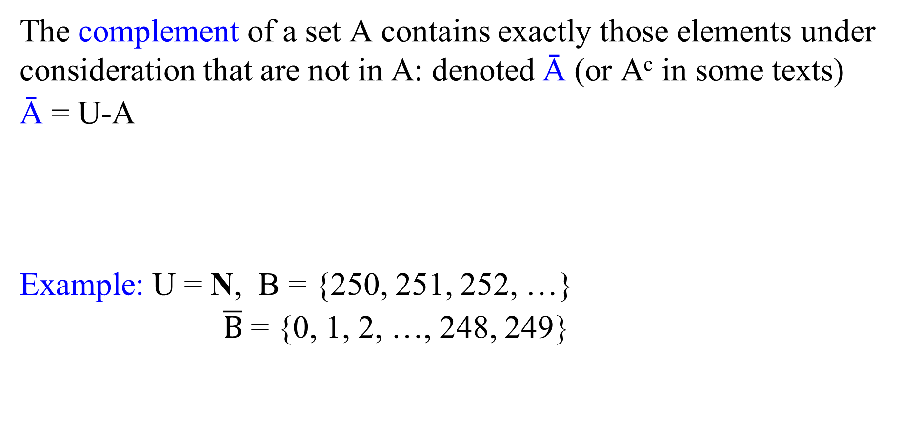
Set Operations
The complement of a set A contains exactly those elements under consideration that are not in A: denoted Ā (or A^{c} in some texts)
Ā = U-A
Example: U = N, B = {250, 251, 252, …}
$\overline{B}$ = {0, 1, 2, …, 248, 249}
U
A
= U and
U = ∅

Slide 24
Set Theory - Operators
The symmetric difference, A ⊕ B, is:
A ⊕ B = { x : (x ∈ A ∧ x ∉ B) v (x ∈ B ∧ x ∉ A)}
like “exclusive or”
= (A - B) U (B - A)
U
A
B

Slide 25
Set Theory - Operators
A ⊕ B = (A - B) U (B - A)
Theorem:
Proof:
A ⊕ B = { x : (x ∈ A ∧ x ∉ B) v (x ∈ B ∧ x ∉ A)}
= { x : (x ∈ A - B) v (x ∈ B - A)}
= { x : x ∈ ((A - B) U (B - A))}
= (A - B) U (B - A)
Q.E.D.

Slide 26
Set Theory - Identities
Directly from defns.
Semantically clear.
Identity
Domination
Idempotent
A ∩ U = A
A U ∅ = A
A ∪ U = U
A ∩ ∅ = ∅
A ∪ A = A
A ∩ A = A

Slide 27
Set Theory – Identities, cont.
Complement Laws
Double complement
A ∪ A = U
A ∩ A = ∅
A = A

Slide 28
Set Theory - Identities, cont.
Commutativity
Associativity
Distributivity
A U B =
B U A
A ∩ B =
B ∩ A
(A U B) U C =
A U (B U C)
(A ∩ B) ∩ C =
A ∩ (B ∩ C)
A U (B ∩ C) =
(A U B) ∩ (A U C)
A ∩ (B U C) =
(A ∩ B) U (A ∩ C)

Slide 29
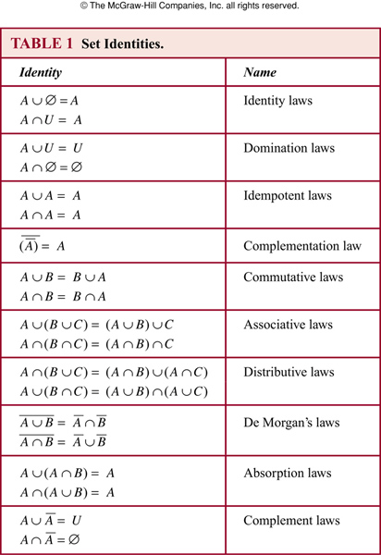
Table 1 from Section 2.2.2 of the text

Slide 30
DeMorgan’s I
DeMorgan’s II
(A U B) = A ∩ B
(A ∩ B) = A U B
Proof by “diagram” (useful!), but we aim for a more formal proof.
A
B

Slide 31
Proving identities
Prove that
(⊆) (x ∈ A U B)
⇒ (x ∉ (A U B))
⇒ (x ∉ A and x ∉ B)
⇒ (x ∈ A ∩ B)
(⊇) (x ∈( A ∩ B))
⇒ (x ∉ A and x ∉ B)
⇒ (x ∉ A U B)
⇒ (x ∈ A U B)
(A U B) = A ∩ B (De Morgan)

Slide 32
Alt. proof
A
B
(A U B) = A ∩ B
Prove that using a membership table.
0 : x is not in the specified set
1 : otherwise
A | B | A | B | A ∩ B | A U B | A U B
1 | 1 | 0 | 0 | 0 | 1 | 0
1 | 0 | 0 | 1 | 0 | 1 | 0
0 | 1 | 1 | 0 | 0 | 1 | 0
0 | 0 | 1 | 1 | 1 | 0 | 1
You may have seen this before if you’ve studied Boolean algebra

