Slide 1

CSCE 222 Discrete Structures
Sequences & Series
Dr. Tim McGuire
Grateful acknowledgement to Professor Marc Pomplun, University of Massachusetts-Boston, for some of the material upon which these notes are adapted.

Slide 2
Based on Chapter 2 of Rosen Discrete Mathematics and its Applications

Slide 3
Sequences (Rosen 2.4)
Sequences represent ordered lists of elements.
A sequence is defined as a function from a subset of N to a set S. We use the notation a_{n} to denote the image of the integer n. We call a_{n} a term of the sequence.
Example:
subset of N: 1 2 3 4 5 …
S: 2 4 6 8 10 …

Slide 4
Sequences
We use the notation {a_{n}} to describe a sequence.
Important: Do not confuse this with the {} used in set notation.
It is convenient to describe a sequence with a formula.
For example, the sequence on the previous slide can be specified as {a_{n}}, where a_{n} = 2n.

Slide 5
Sequences
A more formal definition:
A sequence {a_{i}} is a function f: A ⊆ N → S, where we write a_{i} to indicate f(i). We call a_{i} term I of the sequence.
Examples:
Sequence {a_{i}}, where a_{i} = i is just a₀ = 0, a₁ = 1, a₂ = 2, …
Sequence {a_{i}}, where a_{i} = i² is just a₀ = 0, a₁ = 1, a₂ = 4, …
Sequences of the form a₀, a₁, …, a_{n} are often used in computer science. (always check whether sequence starts at a₀ or a₁)
These finite sequences are also called strings. The length of a string is the number of terms in the string. The empty string, denoted by λ, is the string that has no terms.

Slide 6
The Formula Game
What are the formulas that describe the following sequences a₁, a₂, a₃, … ?
1, 3, 5, 7, 9, …
a_{n} = 2n – 1
-1, 1, -1, 1, -1, …
a_{n} = (-1)^{n}
2, 5, 10, 17, 26, …
a_{n} = n² + 1
0.25, 0.5, 0.75, 1, 1.25 …
a_{n} = 0.25n
3, 9, 27, 81, 243, …
a_{n} = 3^{n}

Slide 7
Strings
Finite sequences are also called strings, denoted by a₁a₂a₃…a_{n}.
The length of a string S is the number of terms that it consists of.
The empty string contains no terms at all. It has length zero.

Slide 8
Geometric and Arithmetic Progressions
Definition: A geometric progression is a sequence of the form
The initial term a and the common ratio r are real numbers
Definition: An arithmetic progression is a sequence of the form
The initial term a and the common difference d are real numbers
Note: An arithmetic progression is a discrete analogue of the linear function f(x) = dx + a

Slide 9
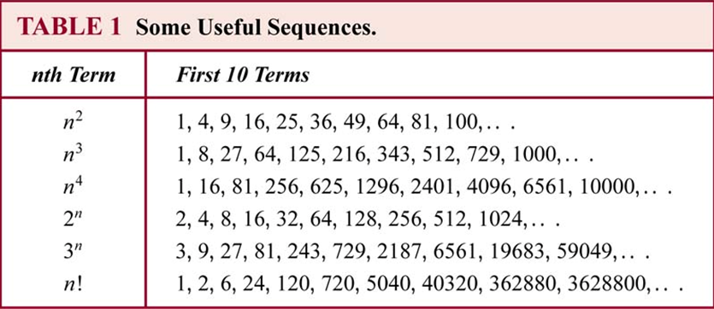
Table 1, section 2.4
Notice differences in growth rate.

Slide 10
Summation
The symbol ∑ (Greek letter sigma) is used to denote summation.
The limit:
i is the index of the summation, and the choice of letter i is arbitrary;
the index of the summation runs through all integers, with its lower limit 1
and ending upper limit k.

Slide 11
Summation
The laws for arithmetic apply to summations
Use associativity to separate the b terms from the a terms.
Use distributivity to factor the c’s.

Slide 12
Summations you should know…
(little) Gauss in 4th grade. ☺
What is S = 1 + 2 + 3 + … + n?
S | = | 1 | + | 2 | + | … | + | n
S | = | n | + | n-1 | + | … | + | 1
2s | = | n+1 | + | n+1 | + | … | + | n+1
Write the sum.
Write it again.
Add together.
You get n copies of (n+1). But we’ve over added by a factor of 2. So just divide by 2.
Why is the result a whole number?

Slide 13
Sum of first n odds.
What is S = 1 + 3 + 5 + … + (2n - 1)?

Slide 14
Sum of first n odds.
What is S = 1 + 3 + 5 + … + (2n - 1)?

Slide 15
Geometric Series
What is S = 1 + r + r² + … + r^{n}
Multiply by r
Subtract the summations
factor
divide
DONE!

Slide 16
What about:
If r ≥ 1 this blows up.
If r < 1 we can say something.
Try r = ½.

Slide 17
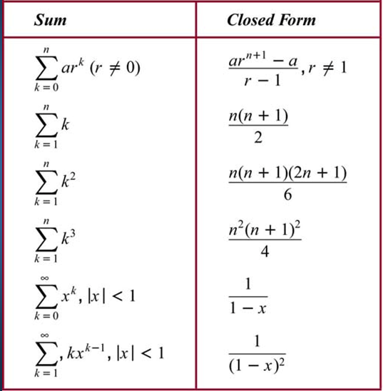
Useful Summations
Table 2, Section 2.4

Slide 18
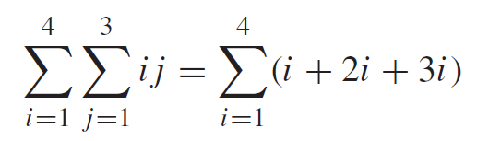
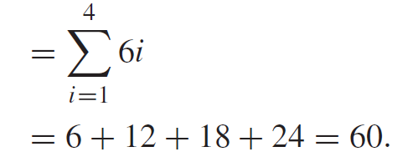
Double Summations
Corresponding to nested loops in C or Java, there is also double (or triple etc.) summation:
Example:

Slide 19
Cardinality of Sets (Rosen 2.5)
(Definition 4, Section 2.1)
Let S be a set. If there are exactly n distinct elements in S where n is a nonnegative integer, we say that S is a finite set and that n is the cardinality of S. The cardinality of S is denoted by |S|

Slide 20
Infinite Cardinality
We previously deﬁned the cardinality of a ﬁnite set as the number of elements in the set.
We use the cardinalities of ﬁnite sets to tell us when they have the same size, or when one is bigger than the other.
Now, we extend this notion to inﬁnite sets.
That is, we will deﬁne what it means for two inﬁnite sets to have the same cardinality, providing us with a way to measure the relative sizes of inﬁnite sets.

Slide 21
Infinite Cardinality
How can we extend the notion of cardinality to infinite sets?
Definition: Two sets A and B have the same cardinality if and only if there exists a bijection (or a one-to-one correspondence) between them, A ~ B.
We split infinite sets into two groups:
Sets with the same cardinality as the set of natural numbers
Sets with different cardinality as the set of natural numbers

Slide 22
Infinite Cardinality
Definition: A set is countable if it is finite or has the same cardinality as the set of positive integers.
Definition: A set is uncountable if it is not countable.
Definition: The cardinality of an infinite set S that is countable is denotes by א₀ (where א is aleph, the first letter of the Hebrew alphabet). We write |S| = א₀ and say that S has cardinality “aleph null”.
Note: Georg Cantor defined the notion of cardinality and was the first to realize that infinite sets can have different cardinalities. א₀ is the cardinality of the natural numbers; the next larger cardinality is aleph-one א₁, then, א₂ and so on.

Slide 23
Infinite Cardinality: Integers
Example: The set of integers is a countable set.
Lets consider the sequence of all integers, starting with 0: 0,1,-1,2,-2,….
We can define this sequence as a function:
f(n) =

Slide 24
Infinite Cardinality: Rational Numbers
Example: The set of positive rational numbers is a countable set. Hmm…

Slide 25
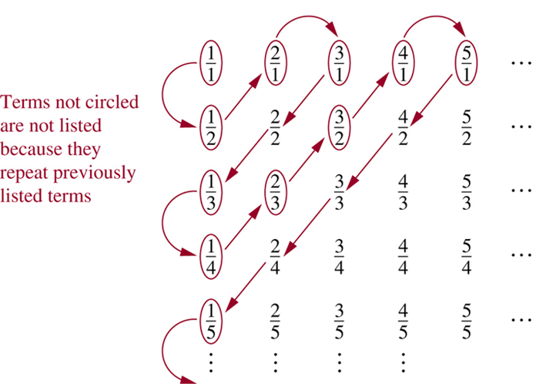
Infinite Cardinality: Rational Numbers
Example: The set of positive rational numbers is a countable set
Key aspect to list the rational numbers as a sequence – every positive number is the quotient p/q of two positive integers.
Visualization of the proof.
p+q=2
p+q=3
p+q=4
p+q=5
p+q=6
If you think about it, all possible fractions will be in the list. For example, 145/8793 will be in the table at the intersection of the 145th row and 8793rd column, and will eventually get listed in the "waiting line."
Since all positive rational numbers are listed once, the set of positive rational numbers is countable.

Slide 26
Uncountable Sets
The set of all infinite sequences of zeros and ones is uncountable.
The set of real numbers is an uncountable set.
The proof of this is beyond the scope of this course.
The text uses a diagonalization argument originated by Georg Cantor in 1891.

Slide 27
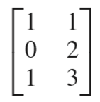
Matrices (Rosen 2.6)
A matrix is a rectangular array of numbers.
A matrix with m rows and n columns is called an m×n matrix.
Example: A =
is a 3 × 2 matrix.
A matrix with the same number of rows and columns is called square.
Two matrices are equal if they have the same number of rows and columns and the corresponding entries in every position are equal.

Slide 28
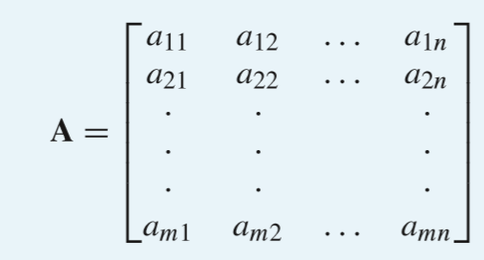
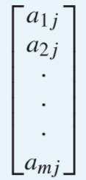

Matrices
A general description of an m×n matrix A = [a_{ij}]:
j-th column of A
i-th row of A

Slide 29
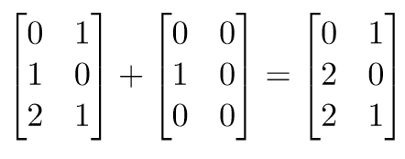
Matrix Addition (2.6.2)
Let A = [a_{ij}] and B = [b_{ij}] be m×n matrices.
The sum of A and B, denoted by A+B, is the m×n matrix that has a_{ij} + b_{ij} as its (i, j)th element.
In other words, A+B = [a_{ij} + b_{ij}].
Example:

Slide 30

Matrix Multiplication
Let A be an m×k matrix and B be a k×n matrix.
The product of A and B, denoted by AB, is the m×n matrix with (i, j)th entry equal to the sum of the products of the corresponding elements from the i-th row of A and the j-th column of B.
In other words, if AB = [c_{ij}], then

Slide 31
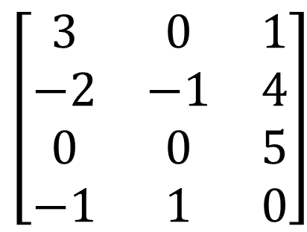
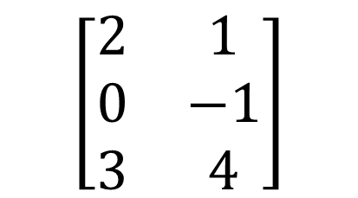
Matrix Multiplication
A more intuitive description of calculating C = AB:
$$\left[\begin{matrix}3 & 0 & 1 \\ −2 & −1 & 4 \\ 0 & 0 & 5 \\ −1 & 1 & 0\end{matrix}\right]$$
$$\left[\begin{matrix}2 & 1 \\ 0 & −1 \\ 3 & 4\end{matrix}\right]$$
Take the first column of B
Turn it counterclockwise by 90º and superimpose it on the first row of A
Multiply corresponding entries in A and B and add the products: 3 × 2 + 0 × 0 + 1 × 3 = 9
Enter the result in the upper-left corner of C

Slide 32
Matrix Multiplication
Now superimpose the first column of B on the second, third, …, m-th row of A to obtain the entries in the first column of C (same order).
Then repeat this procedure with the second, third, …, n-th column of B, to obtain to obtain the remaining columns in C (same order).
After completing this algorithm, the new matrix C contains the product AB.

Slide 33
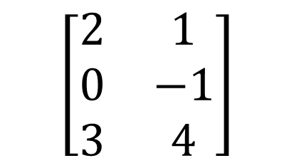
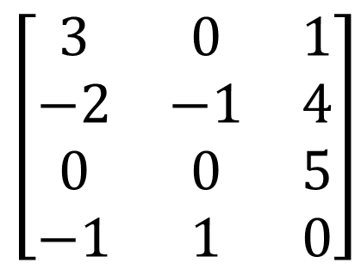
Matrix Multiplication
Let us calculate the complete matrix C:
$$\left[\begin{matrix}3 & 0 & 1 \\ −2 & −1 & 4 \\ 0 & 0 & 5 \\ −1 & 1 & 0\end{matrix}\right]$$
$$\left[\begin{matrix}2 & 1 \\ 0 & −1 \\ 3 & 4\end{matrix}\right]$$
9
7
8
15
15
20
-2
-2

Slide 34
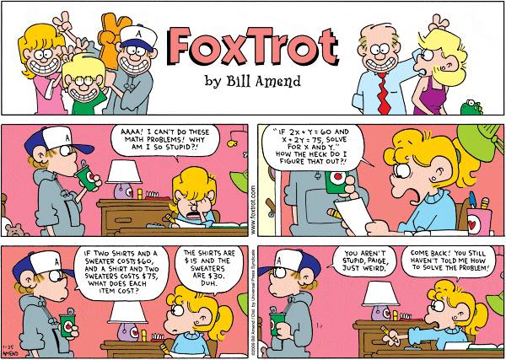

Slide 35
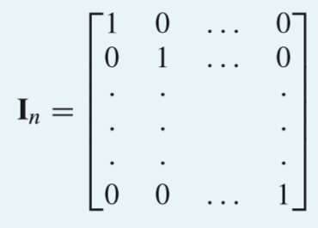
Identity Matrices (2.6.3)
The identity matrix of order n is the n×n matrix I_{n} = [δ_{ij}], where δ_{ij} = 1 if i = j and δ_{ij} = 0 if i ≠ j:
Multiplying an m × n matrix A by an identity matrix of appropriate size does not change this matrix:
AI_{n} = I_{m}A = A

Slide 36
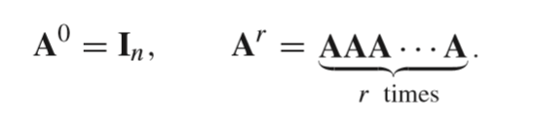
Powers and Transposes of Matrices
The power function can be defined for square matrices. If A is an n×n matrix, we have:
The transpose of an m×n matrix A = [a_{ij}], denoted by A^{t}, is the n×m matrix obtained by interchanging the rows and columns of A.
In other words, if A^{t} = [b_{ij}], then b_{ij} = a_{ji} for i = 1, 2, …, n and j = 1, 2, …, m.

Slide 37
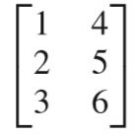

Powers and Transposes of Matrices
Example: A = A^{t} =
A square matrix A is called symmetric if A = A^{t}.
Thus A = [a_{ij}] is symmetric if a_{ij} = a_{ji} for all i = 1, 2, …, n and j = 1, 2, …, n.
A is symmetric, B is not.

Slide 38
Zero-One Matrices (2.6.4)
A matrix with entries that are either 0 or 1 is called a zero-one matrix. Zero-one matrices are often used like a “table” to represent discrete structures.
We can define Boolean operations on the entries in zero-one matrices:
a | b | a∧b
0 | 0 | 0
0 | 1 | 0
1 | 0 | 0
1 | 1 | 1
a | b | a∨b
0 | 0 | 0
0 | 1 | 1
1 | 0 | 1
1 | 1 | 1

Slide 39
Zero-One Matrices
Let A = [a_{ij}] and B = [b_{ij}] be m×n zero-one matrices.
Then the join of A and B is the zero-one matrix with (i, j)th entry a_{ij} ∨ b_{ij}. The join of A and B is denoted by A ∨ B.
The meet of A and B is the zero-one matrix with (i, j)th entry a_{ij} ∧ b_{ij}. The meet of A and B is denoted by A ∧ B.

Slide 40
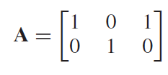
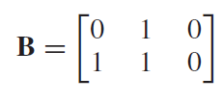
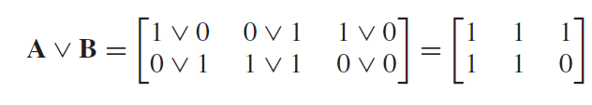
Zero-One Matrices
Example:
Join:
Meet:

Slide 41
Zero-One Matrices
Let A = [a_{ij}] be an m×k zero-one matrix and B = [b_{ij}] be a k×n zero-one matrix.
Then the Boolean product of A and B, denoted by A⊙B, is the m×n matrix with (i, j)th entry [c_{ij}], where
c_{ij} = (a_{i1} ∧ b_{1j}) ∨ (a_{i2} ∧ b_{2i}) ∨ … ∨ (a_{ik} ∧ b_{kj}).
Basically, Boolean multiplication works like the multiplication of matrices, but with computing ∧ instead of the product and ∨ instead of the sum.
In Boolean algebra, AND ≡ multiplication, and OR ≡ addition

Slide 42
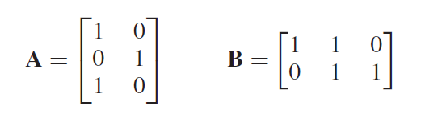
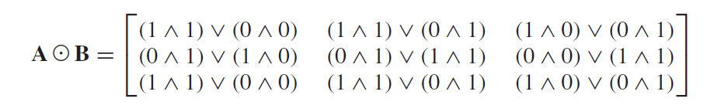
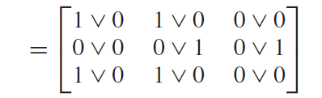
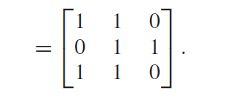
Zero-One Matrices
Example:

Slide 43
Zero-One Matrices
Let A be a square zero-one matrix and r be a positive integer.
The r-th Boolean power of A is the Boolean product of r factors of A. The r-th Boolean power of A is denoted by A^{[r]}.
A^{[0]} = I_{n},
A^{[r]} = A⊙A ⊙ … ⊙ A (r times the letter A)

