Slide 1

CSCE 222 Discrete Structures
Mathematical Induction
Dr. Tim McGuire
Grateful acknowledgement to Professor Bart Selman, Cornell University, and Prof. Johnnie Baker, Kent State, for some of the material upon which these notes are adapted.

Slide 2
Based on Chapter 5 of Rosen Discrete Mathematics and its Applications

Slide 3
What’s Induction About?
Many statements assert that a property is an universal true – i.e., all the elements of the universe exhibit that property;
Examples:
For every positive integer n: n! ≤ n^{n}
For every set with n elements, the cardinality of its power set is 2^{n}.
Induction is one of the most important techniques for proving statements about universal properties.

Slide 4
Induction (§ 5.1.1)
The principle of mathematical induction is a useful tool for proving that a certain predicate is true for all natural numbers.
It cannot be used to discover theorems, but only to prove them.

Slide 5
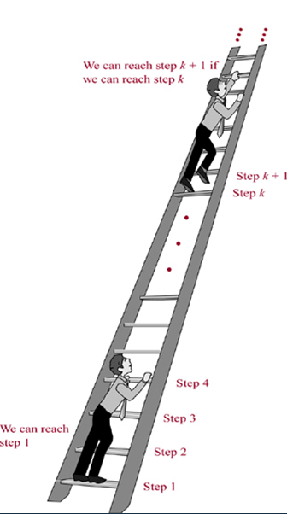
We know that:
We can reach the first rung of this ladder;
If we can reach a particular rung of the ladder, then we can reach the next rung of the ladder.
Can we reach every step of this infinite ladder?
Yes, using Mathematical Induction which is a rule of inference that tells us:
P(1)
∀k (P(k) → P(k+1))
--------------------------
∴ ∀n (P(n)

Slide 6
Induction (§ 5.1.2)
If we have a propositional function P(n), and we want to prove that P(n) is true for any natural number n, we do the following:
Show that P(0) is true. (basis step)
Show that if P(n) then P(n + 1) for any n∈N. (inductive step)
Then P(n) must be true for any n∈N. (conclusion)

Slide 7
Induction
Example:
Show that n < 2^{n} for all positive integers n.
Let P(n) be the proposition “n < 2^{n}.”
1. Show that P(1) is true. (basis step)
P(1) is true, because 1 < 2¹ = 2.

Slide 8
Induction
2. Show that if P(n) is true, then P(n + 1) is true. (inductive step)
Assume that n < 2^{n} is true.
We need to show that P(n + 1) is true, i.e. n + 1 < 2^{n+1}
We start from n < 2^{n}:
n + 1 < 2^{n} + 1 ≤ 2^{n} + 2^{n} = 2^{n+1}
Therefore, if n < 2^{n} then n + 1 < 2^{n+1}

Slide 9
Induction
Then P(n) must be true for any positive integer. (conclusion)
n < 2^{n} is true for any positive integer.
Q.E.D.

Slide 10
Mathematical Induction
Use induction to prove that the sum of the first n odd integers is n². What’s the hypothesis?
Prove a base case (n=1)
1 – Hypothesis: P(n) – sum of first n odd integers = n².
2 - Base case (n=1): the sum of the first 1 odd integer is 1².
Since 1 = 1^{2 ☺}
Prove P(k)→P(k+1)
3 - Assume P(k): the sum of the first k odd ints is k².
1 + 3 + … + (2k - 1) = k²
Inductive hypothesis
4 – Inductive Step: show that ∀(k) P(k) → P(k+1), assuming P(k).
How?
By inductive hypothesis
P(k+1)= 1 + 3 + … + (2k-1) + (2k+1) =
k² + (2k + 1)
= (k+1)²
P(k)
QED

Slide 11
Mathematical Induction
Prove a base case (n=?)
Use induction to prove that the 1 + 2 + 2² + … + 2^{n} = 2^{n+1} - 1 for all non-negative integers n.
1 – Hypothesis?
Prove P(k)→P(k+1)
P(n) = 1 + 2 + 2² + … + 2^{n} = 2 ^{n+1} – 1
for all non-negative integers n.
2 - Base case?
n = 0 1⁰ = 2¹-1.
not n=1! The base case
can be negative, zero,
or positive
3 – Inductive Hypothesis
Assume P(k) = 1 + 2 + 2² + … + 2^{k} = 2 ^{k+1} – 1
Inductive hypothesis

Slide 12
Mathematical Induction
4 – Inductive Step: show that ∀(k) P(k) → P(k+1), assuming P(k).
How?
By inductive hypothesis
P(k+1)= 1 + 2 + 2² + … + 2^{k}+ 2^{k+1} = (2^{k+1} – 1) + 2^{k+1}
P(k)
= 2 2^{k+1} - 1
P(k+1) = 2^{k+2} - 1
= 2^{(k+1)+1} - 1
QED

Slide 13
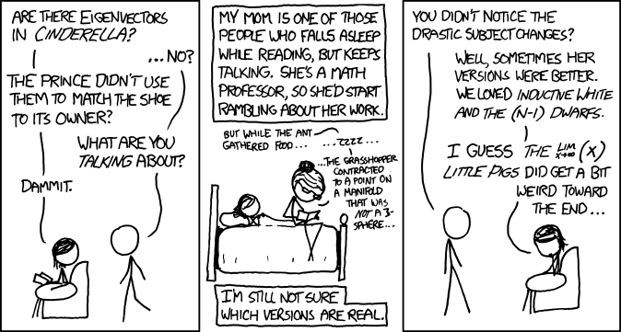

Slide 14
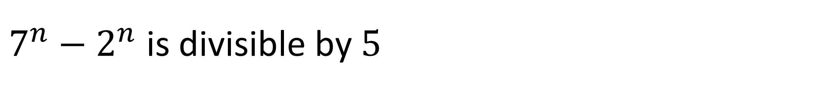
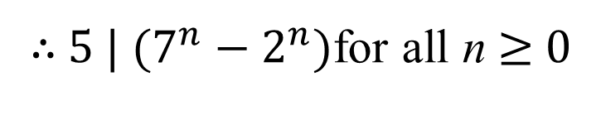
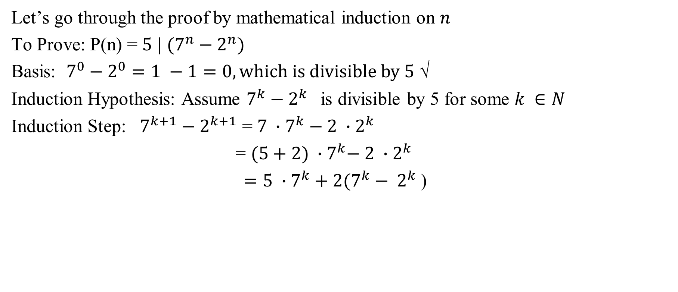
$7^{n}−2^{n}$ is divisible by $5$
Let’s go through the proof by mathematical induction on $n$
To Prove: P(n) = ${5 | (7}^{n}−2^{n})$
Basis: $7^{0}−2^{0}=1 −1=0, which is divisible by 5$ √
Induction Hypothesis: Assume $7^{k}−2^{k}$ is divisible by 5 for some $k ∈N$
Induction Step: $7^{k+1}−2^{k+1}$ = ${7 ∙7}^{k}−{2 ∙2}^{k}$
= ${(5+2) ∙7}^{k}− {2 ∙2}^{k}$
$={5 ∙7}^{k}+{2(7^{k}− 2}^{k}$)
Divisible by 5, by I.H.
∴ ${5 | (7}^{n}−2^{n})$for all n ≥ 0
Divisible by 5, by corollary 1, p. 253: if a | b and a | c then a | (b+c)
Notes:
Crucial step: 7x7^k – 2x2^k = (5+2)7^k - 2x2^k = 5x7^k + 2(7^k – 2^k) = 5x7^k + [multiple of 5 by IH]

Slide 15
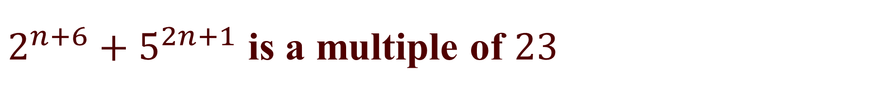
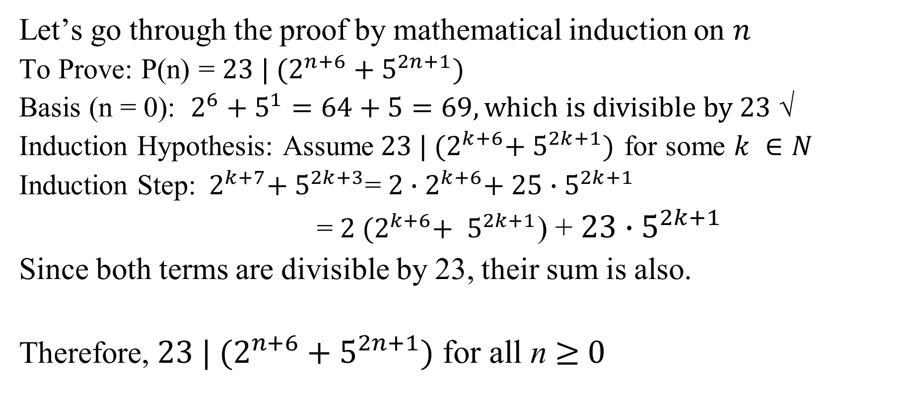
$2^{n+6}+5^{2n+1}$ is a multiple of $23$
Let’s go through the proof by mathematical induction on $n$
To Prove: P(n) = ${23 | (2}^{n+6}+5^{2n+1})$
Basis (n = 0): $2^{6}+5^{1}=64+5=69, which is divisible by 23$ √
Induction Hypothesis: Assume${ 23 | (2}^{k+6}+{ 5}^{2k+1})$ for some $k ∈N$
Induction Step:${ 2}^{k+7}+{ 5}^{2k+3}$=${ 2∙2}^{k+6}+ 25{∙5}^{2k+1}$
=${ 2 (2}^{k+6}+ 5^{2k+1}$) + $23{∙5}^{2k+1}$
Since both terms are divisible by 23, their sum is also.
Therefore, ${23 | (2}^{n+6}+5^{2n+1})$ for all n ≥ 0
Notes:
Crucial step: 2^{n+7}+5^{2n+3} = 2*2^{n+6} + 5^2*5^{2n+1} = 2(2^{n+6}+5^{2n+1})+(5^2-2)*5^{2n+1} = 2(23m)+23*5^{2n+1}
What’s neat is that these kinds of problems can be generalized and an automated process can efficiently find variants of the form X^{an+b} +Y^{cn+d} is a multiple of Z.

Slide 16
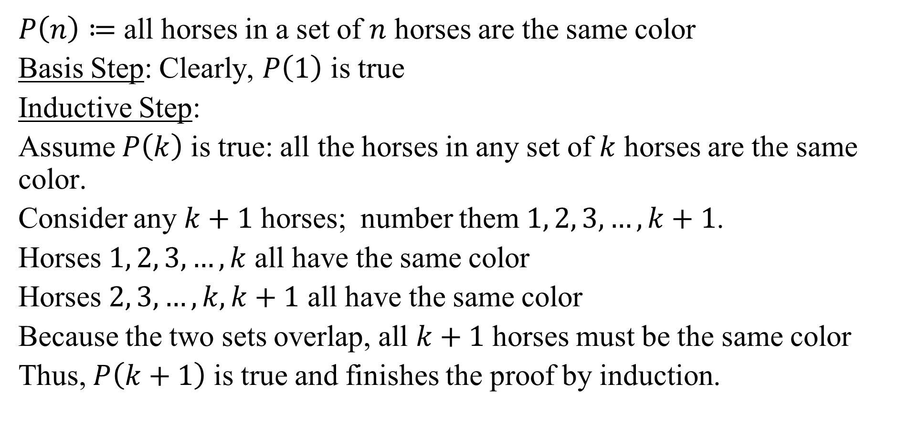
What is wrong with this proof? (§ 5.1.8)
$P\left(n\right)≔$ all horses in a set of $n$ horses are the same color
Basis Step: Clearly, $P\left(1\right)$ is true
Inductive Step:
Assume $P\left(k\right)$ is true: all the horses in any set of $k$ horses are the same color.
Consider any $k+1$ horses; number them $1, 2, 3,…,k+1$.
Horses $1, 2, 3,…,k$ all have the same color
Horses $2, 3,…,k,k+1$ all have the same color
Because the two sets overlap, all $k+1$ horses must be the same color
Thus, $P\left(k+1\right)$ is true and finishes the proof by induction.
Notes:
If n=2, the two sets do not overlap. P(1) does not imply P(2)

Slide 17
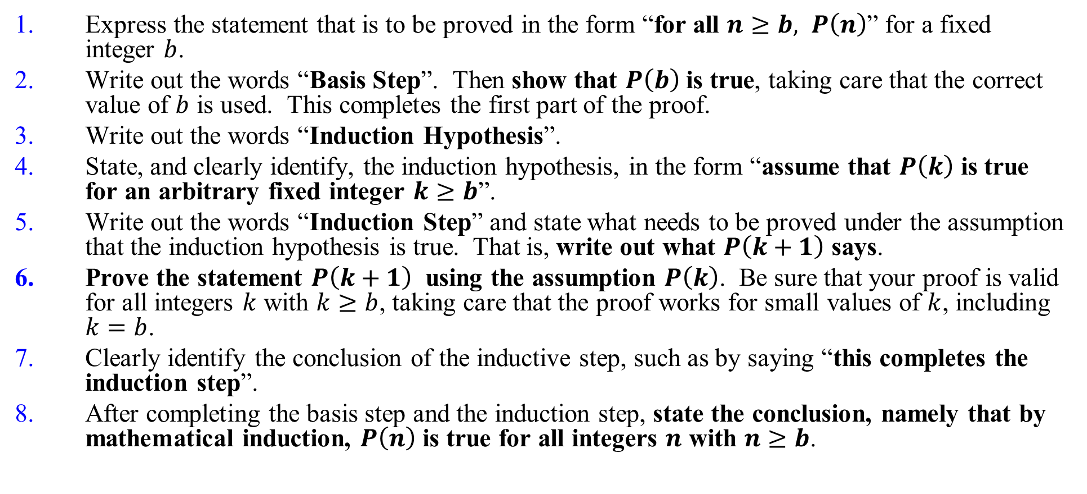
Template for Proofs by Mathematical Induction
Express the statement that is to be proved in the form “for all $n≥b, P\left(n\right)$” for a fixed integer $b$.
Write out the words “Basis Step”. Then show that $P\left(b\right)$ is true, taking care that the correct value of $b$ is used. This completes the first part of the proof.
Write out the words “Induction Hypothesis”.
State, and clearly identify, the induction hypothesis, in the form “assume that $P\left(k\right)$ is true for an arbitrary fixed integer $k≥b$”.
Write out the words “Induction Step” and state what needs to be proved under the assumption that the induction hypothesis is true. That is, write out what $P\left(k+1\right)$ says.
Prove the statement $P\left(k+1\right)$ using the assumption $P\left(k\right)$. Be sure that your proof is valid for all integers $k$ with $k≥b$, taking care that the proof works for small values of $k$, including $k=b$.
Clearly identify the conclusion of the inductive step, such as by saying “this completes the induction step”.
After completing the basis step and the induction step, state the conclusion, namely that by mathematical induction, $P\left(n\right)$ is true for all integers $n$ with $n≥b$.

Slide 18
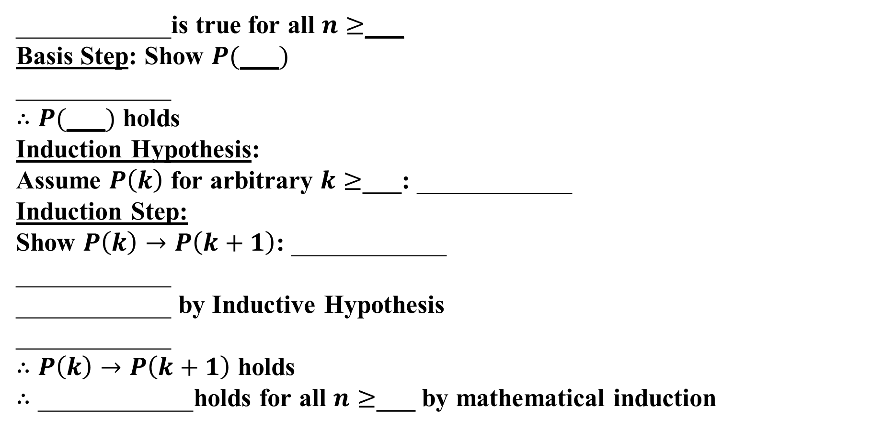
Template for Proofs by Mathematical Induction
____________is true for all $n≥$___
Basis Step: Show $P(\text{___})$
____________
$∴P(\text{___})$ holds
Induction Hypothesis:
Assume $P\left(k\right)$ for arbitrary $k≥$___: ____________
Induction Step: Show $P\left(k\right)→P\left(k+1\right)$: ____________
____________
____________ by Inductive Hypothesis ____________
$∴P\left(k\right)→P\left(k+1\right)$ holds $∴\text{____________}$holds for all $n≥$___ by mathematical induction
All you must do is
Fill in the [blanks]

Slide 19
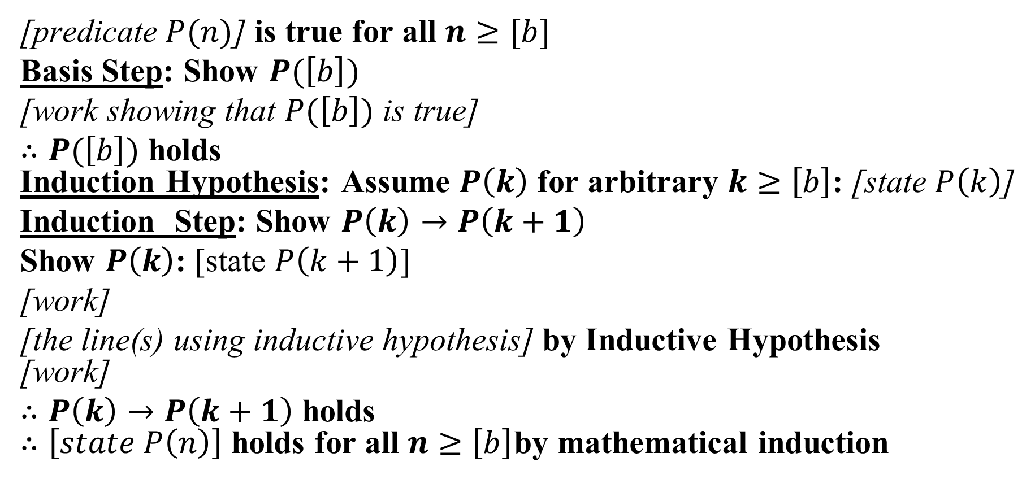
Template for Proofs by Mathematical Induction (§ 5.1.5)
[predicate $P(n)$] is true for all $n≥[b]$
Basis Step: Show $P(\left[b\right])$
[work showing that $P(\left[b\right])$ is true]
$∴P(\left[b\right])$ holds Induction Hypothesis: Assume $P\left(k\right)$ for arbitrary $k≥\left[b\right]$: [state $P\left(k\right)$]
Induction Step: Show $P\left(k\right)→P\left(k+1\right)$
Show $P\left(k\right)$: [state $P\left(k+1\right)$]
[work]
[the line(s) using inductive hypothesis] by Inductive Hypothesis [work]
$∴P\left(k\right)→P\left(k+1\right)$ holds $∴\left[state P\left(n\right)\right]$ holds for all $n≥\left[b\right]$by mathematical induction

Slide 20
Strong Induction (§ 5.2.2)
There is another proof technique that is very similar to the principle of mathematical induction.
It is called the second principle of mathematical induction (AKA strong induction).
It can be used to prove that a propositional function P(n) is true for any natural number n.

Slide 21
Strong Induction
The second principle of mathematical induction:
Show that P(0) is true. (basis step)
Show that if P(0) and P(1) and … and P(n), then P(n + 1) for any n∈N. (inductive step)
Then P(n) must be true for any n∈N. (conclusion)

Slide 22
Strong Induction (§ 5.2.3)
Example: Show that every integer greater than 1 can be written as the product of primes.
Show that P(2) is true. (basis step)
2 is the product of one prime: itself.

Slide 23
Strong Induction
Show that if P(2) and P(3) and … and P(n), then P(n + 1) for any n∈N. (inductive step)
Two possible cases:
If (n + 1) is prime, then obviously P(n + 1) is true.
If (n + 1) is composite, it can be written as the product of two integers a and b such that 2 ≤ a ≤ b < n + 1.
By the induction hypothesis, both a and b can be written as the product of primes.
Therefore, n + 1 = a⋅b can be written as the product of primes.

Slide 24
Strong Induction
Then P(n) must be true for any n∈N. (conclusion)
End of proof.
We have shown that every integer greater than 1 can be written as the product of primes.

Slide 25
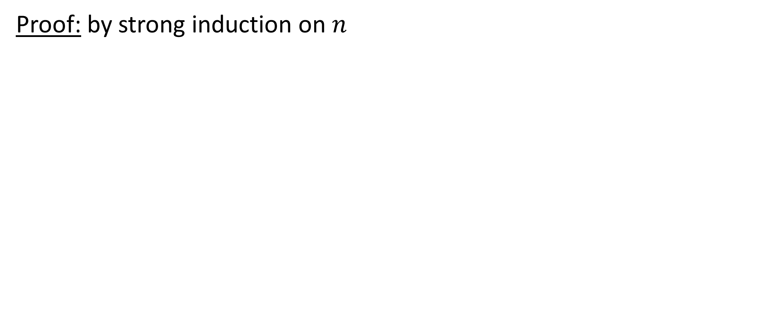
Every amount of postage of 12 cents or more can be formed using 4-cent and 5-cent stamps
Proof: by strong induction on $n$
Notes:
Basis:
12 = 3 x 4
13 = 2 x 4 + 1 x 5
14 = 1 x 4 + 2 x 5
15 = 3 x 5
Inductive:
Assume P(i) for 12 <= i <= k, k >= 15 : i cents of postage is formed with 4- and 5-cents stamps
Show P(k+1): k+1 cents of postage is formed with 4- and 5-cents stamps
P(k-3) is true since k >= 15.
To form k+1 cents of postage, form k-3 cents and then add a 4-cent stamp.
QED

Slide 26
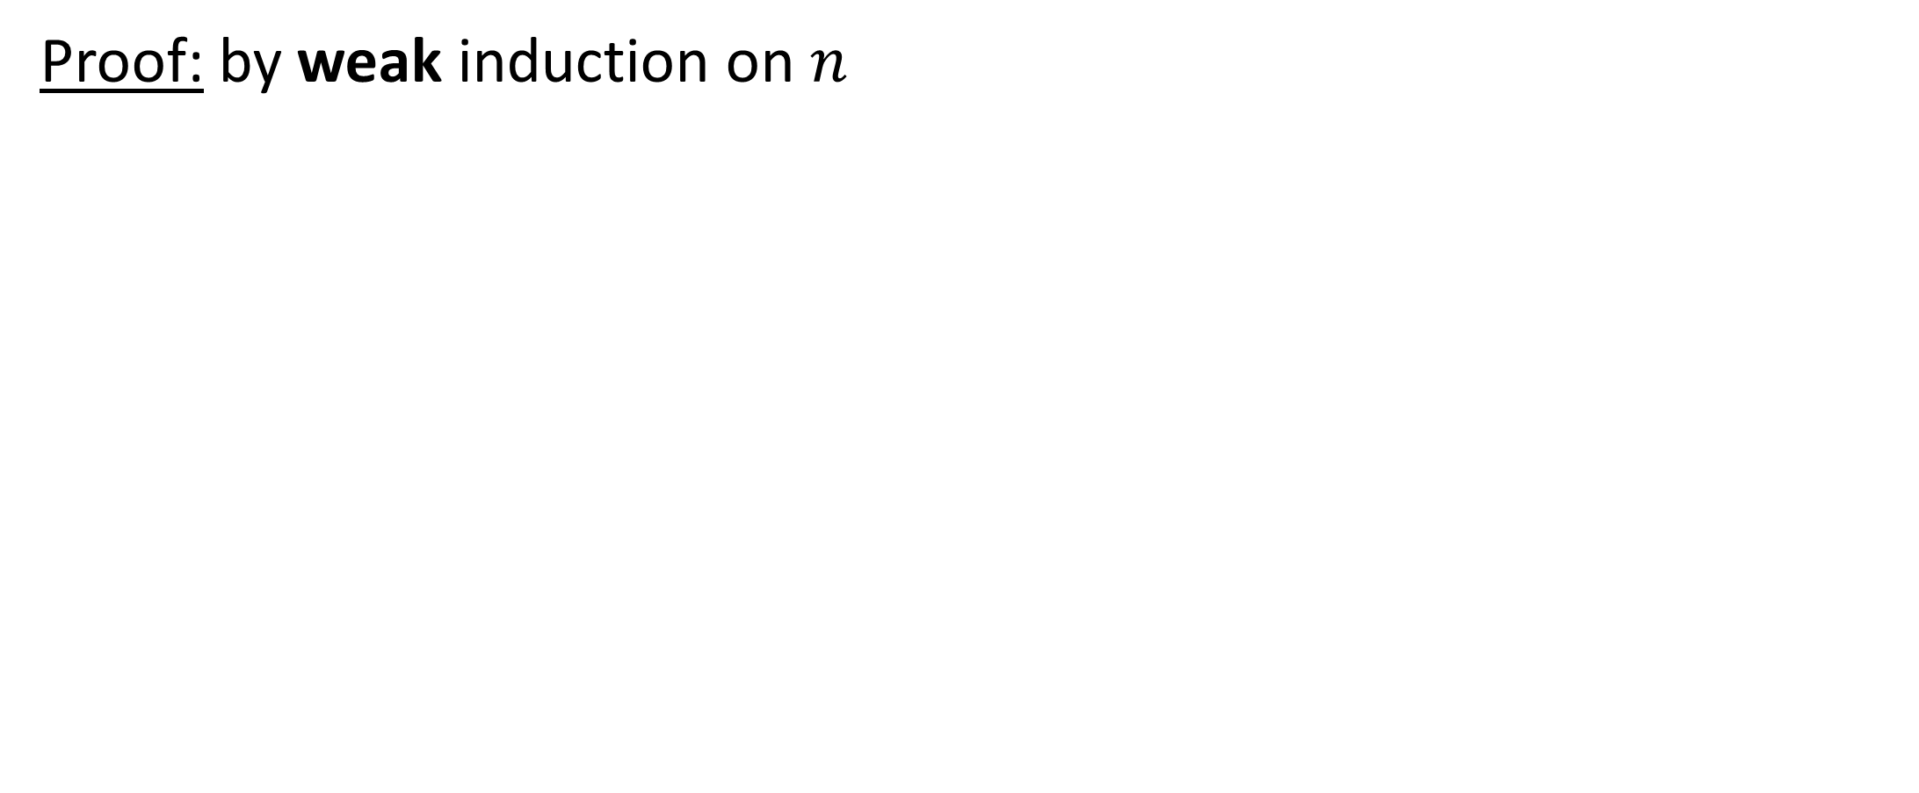
Every amount of postage of 12 cents or more can be formed using 4-cent and 5-cent stamps
Proof: by weak induction on $n$
Notes:
Basis:
12 = 3 x 4
Inductive:
Assume P(k): k cents of postage is formed with 4- and 5-cents stamps for some k >= 12
Show P(k+1): k+1 cents of postage is formed with 4- and 5-cents stamps
Case 0 4-cent stamps:
since k>=12, then k must be >=15, replace 3 5-cent stamps with 4 4-cent stamps
Case >=1 4-cent stamp:
Replace 1 4-cent stamp with 1 5-cent stamp
QED

Slide 27
Strong Induction vs. Weak Induction
Sometimes strong induction is easier to use.
It can be shown that strong induction and weak induction are equivalent:
any proof by induction is also a proof by strong induction (why?)
any proof by strong induction can be converted into a proof by induction

Slide 28
Strong Mathematical Induction (§ 5.2.4)
An example from computational geometry.
Given n blue points and n orange points in a plane with no 3 collinear, prove there is a way to match them, blue to orange, so that none of the segments between the pairs intersect.

Slide 29
Strong Mathematical Induction
Base case (n=1):
Assume any matching problem of size less than (k+1) can be solved.
Show that we can match (k+1) pairs.

Slide 30
Strong Mathematical Induction
Show that we can match (k+1) pairs.
Suppose there is a line partitioning the group into a smaller one of j blues and j oranges, and another smaller one of (k+1)-j blues and (k+1)-j oranges.
OK!! (by IH)
OK!! (by IH)

Slide 31
Strong Mathematical Induction
But, how do we know such a line always exists?
Consider the convex hull of the points:
OK!! (by IH)
If there is an alternating pair of colors on the hull, we’re done!
OK!! (by IH)

Slide 32
Strong Mathematical Induction
If there is no alternating pair, all points on hull are the same color. ☹
Notice that any sweep of the hull hits an orange point first and also last. We sweep on some slope not given by a pair of points.
Keep score of # of each color seen. Orange gets the early lead, and then comes from behind to tie at the end.
OK!! (by IH)
OK!! (by IH)
There must be a tie along the way

Slide 33
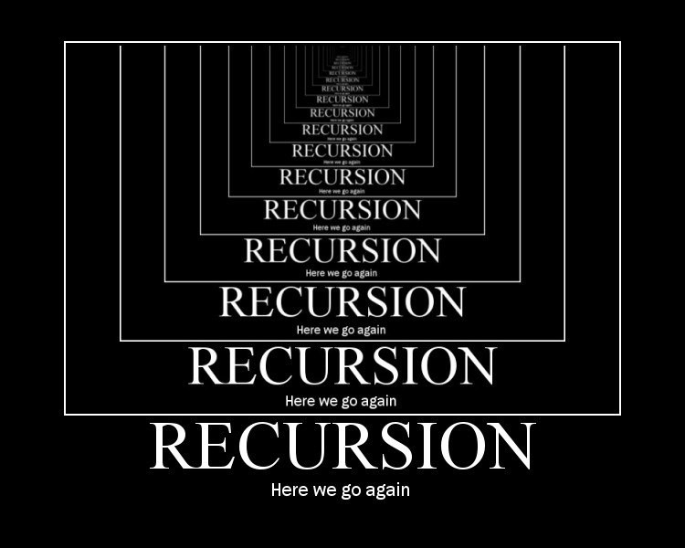
Recursive Definitions and Structural Induction

Slide 34
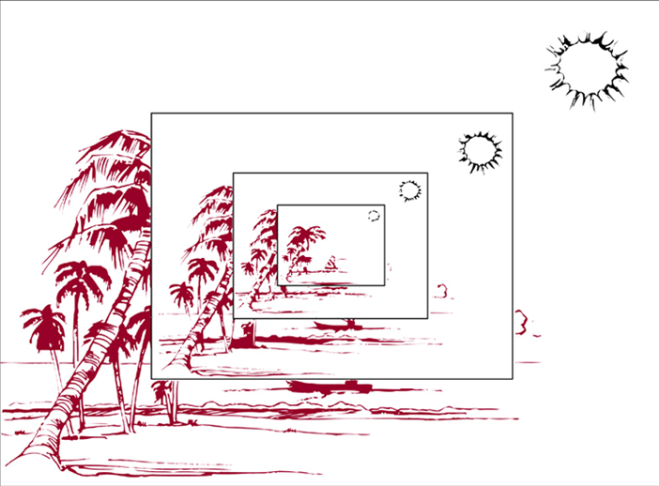
Recursive or Inductive Definitions (§ 5.3.1)
Sometimes it is difficult to define an object explicitly. However, it may be easy to define the object in terms of itself. This process is called recursion.
Recursion is useful to define sequences, functions, sets, and algorithms.
When a sequence is defined recursively,
by specifying how terms are formed from
previous terms, we can use induction
to prove results about the sequence.

Slide 35
Recursive Definitions
Recursion is a principle closely related to mathematical induction.
In a recursive definition, an object is defined in terms of itself.
We can recursively define sequences, functions and sets.

Slide 36
Recursively Defined Sequences
Example:
The sequence {a_{n}} of powers of 2 is given by a_{n} = 2^{n} for n = 0, 1, 2, … .
The same sequence can also be defined recursively:
a₀ = 1
a_{n+1} = 2a_{n} for n = 0, 1, 2, …
Obviously, induction and recursion are similar principles.

Slide 37
Recursively Defined Functions
We can use the following method to define a function with the natural numbers as its domain:
Base case: Specify the value of the function at zero.
Recursion: Give a rule for finding its value at any integer from its values at smaller integers.
Such a definition is called a recursive definition.

Slide 38
Recursively Defined Functions
Example:
f(0) = 3
f(n) = 2f(n-1) + 3
f(0) = 3
f(1) = 2f(0) + 3 = 2⋅3 + 3 = 9
f(2) = 2f(1) + 3 = 2⋅9 + 3 = 21
f(3) = 2f(2) + 3 = 2⋅21 + 3 = 45
f(4) = 2f(3) + 3 = 2⋅45 + 3 = 93

Slide 39
Recursively Defined Functions
How can we recursively define the factorial function f(n) = n! ?
f(0) = 1
f(n) = (n)⋅f(n-1)
f(0) = 1
f(1) = 1f(0) = 1⋅1 = 1
f(2) = 2f(1) = 2⋅1 = 2
f(3) = 3f(2) = 3⋅2 = 6
f(4) = 4f(3) = 4⋅6 = 24

Slide 40
Recursively Defined Functions
A famous example: The Fibonacci numbers
f(0) = 0, f(1) = 1
f(n) = f(n – 1) + f(n - 2)
f(0) = 0
f(1) = 1
f(2) = f(1) + f(0) = 1 + 0 = 1
f(3) = f(2) + f(1) = 1 + 1 = 2
f(4) = f(3) + f(2) = 2 + 1 = 3
f(5) = f(4) + f(3) = 3 + 2 = 5
f(6) = f(5) + f(4) = 5 + 3 = 8

Slide 41
Recursively Defined Sets
If we want to recursively define a set, we need to provide two things:
an initial set of elements,
rules for the construction of additional elements from elements in the set.
Example: Let S be recursively defined by:
3 ∈ S
(x + y) ∈ S if (x ∈ S) and (y ∈ S)
S is the set of positive integers divisible by 3.
Exclusion rule:
The set contains nothing other than those elements specified in the basic step or generated by the recursive step.

Slide 42
Recursively Defined Sets
Proof:
Let A be the set of all positive integers divisible by 3.
To show that A = S, we must show that A ⊆ S and S ⊆ A.
Part I: To prove that A ⊆ S, we must show that every positive integer divisible by 3 is in S.
We will use mathematical induction to show this.

Slide 43
Recursively Defined Sets
Let P(n) be the statement “3n belongs to S”.
Basis step: P(1) is true, because 3 is in S.
Inductive step: To show: If P(n) is true, then P(n + 1) is true.
Assume 3n is in S. Since 3n is in S and 3 is in S, it follows from the recursive definition of S that 3n + 3 = 3(n + 1) is also in S.
Conclusion of Part I: A ⊆ S.

Slide 44
Recursively Defined Sets
Part II: To show: S ⊆ A.
Basis step: To show: All initial elements of S are in A. 3 is in A. True.
Inductive step: To show: If x and y in S are in A, then (x + y) is in A .
Since x and y are both in A, it follows that 3 | x and 3 | y. From Theorem I, Section 4.1.2, it follows that 3 | (x + y).
Conclusion of Part II: S ⊆ A.
Overall conclusion: A = S.

Slide 45
Recursively Defined Sets
Another example:
The well-formed formulæ of variables, numerals and operators from {+, -, *, /, ^} are defined by:
x is a well-formed formula if x is a numeral or variable.
(f + g), (f – g), (f * g), (f / g), (f ^ g) are well-formed formulæ if f and g are.

Slide 46
Recursively Defined Sets
With this definition, we can construct formulæ such as:
(x – y)
((z / 3) – y)
((z / 3) – (6 + 5))
((z / (2 * 4)) – (6 + 5))
Note that the definition on the previous slide requires fully parenthesized subformulæ

Slide 47
Recursive Algorithms
An algorithm is called recursive if it solves a problem by reducing it to an instance of the same problem with smaller input.
Example I: Recursive Euclidean Algorithm
procedure gcd(a, b: nonnegative integers with a < b)
if a = 0 then gcd(a, b) := b else gcd(a, b) := gcd(b mod a, a) endif
end gcd
Compare this with the iterative algorithm in the previous module
Notes:
Show what happens with gcd(27,6) vs gcd(6,27)

Slide 48
Recursive Algorithms
Example II: Recursive Fibonacci Algorithm
procedure fib(n: nonnegative integer) if n = 0 then fib(0) := 0 elseif n = 1 then fib(1) := 1 else fib(n) := fib(n – 1) + fib(n – 2) endif end fib

Slide 49
Recursive Algorithms
Recursive Fibonacci Evaluation:
f(4)
Note the redundant computations involved here, which leads to the conclusion that recursion in this case is not the most efficient way to compute the solution
f(3)
f(2)
f(2)
f(1)
f(1)
f(0)
f(1)
f(0)

Slide 50
Recursive Algorithms
procedure iterative_fib(n: nonnegative integer)
if n = 0 then y := 0
else x := 0
y := 1
for i := 1 to n-1 do
z := x + y
x : = y
y := z
endfor
endif end iterative_fib {y is the n-th Fibonacci number}

Slide 51
Recursive Algorithms
For every recursive algorithm, there is an equivalent iterative algorithm.
Sometimes, however, the iterative version requires an auxiliary stack data structure (covered in CSCE 221)
Recursive algorithms are often shorter, more elegant, and easier to understand than their iterative counterparts.
However, iterative algorithms are sometimes more efficient in their use of space and time.

Slide 52
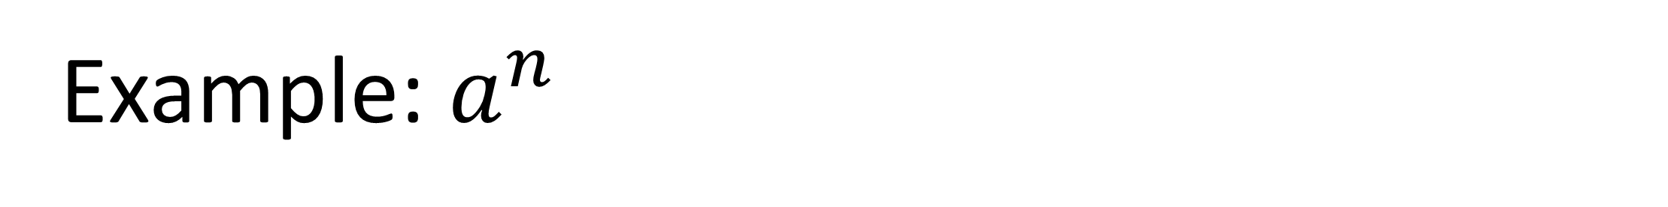
Example: $a^{n}$
Notes:
Procedure power(a: non-zero real, n: nonnegative integer)
If n = 0 then return 1
Else return a* power(a,n-1)
// output is a^n
Runtime:
T(n) = 1 + 1 + T(n-1) + 1 + 1
[same as before]
= 4n+1 = O(n)

Slide 53
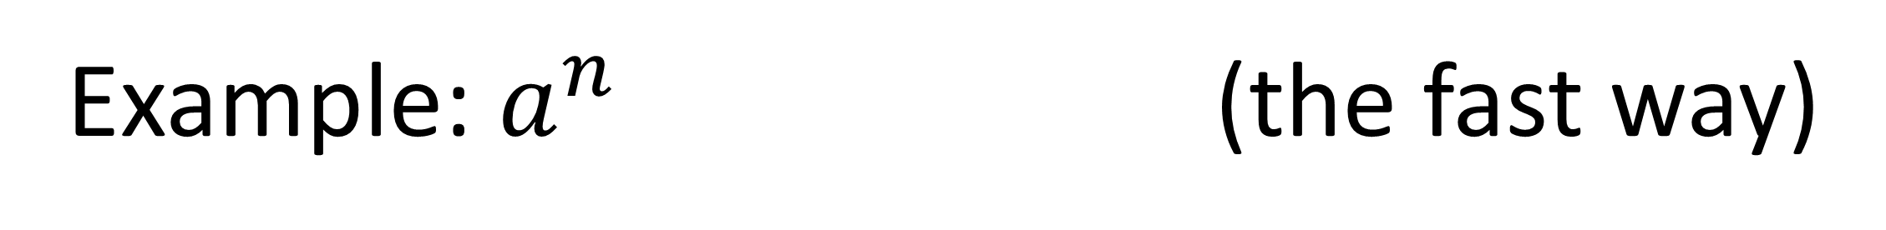
Example: $a^{n}$ (the fast way)
Notes:
Procedure power2(a: non-zero real, n: nonnegative integer)
If n = 0 then return 1
Else if n is even, return power2(a,n/2)^2
Else return a * power2(a,(n-1)/2)^2
// output is a^n
Runtime:
T(n) = 1 + 1 + 1 + 1 + 1 + T(n/2) + 1 + 1 = 7 + T(n/2)
= 7 + 7 + T(n/4)
= 7 + 7 + 7 + T(n/8)
…
= 7 log n + T(0)
= 7 log n + 1 = O(log n) for C = 8, k = 2

Slide 54
Why Use Recursion?
Notes:
If iterative algorithms require fewer operations, then why do we bother with recursive algorithms.
Are beauty and elegance not enough for you!?
Here’s why: ease of implementation.

Slide 55
Tower of Hanoi
procedure hanoi(n,src,dest,aux)
// puzzle of size n=0 is trivial: do nothing
// move n-1 disks from src to aux using dest
// move the n-th disk from src to dest
// move n-1 disks from aux to dest using src
Notes:
This will come back when we get to counting.

Slide 56
Tower of Hanoi
procedure hanoi(n,src,dest,aux) if n = 0 then return // base case else
hanoi(n-1,src,aux,dest)
print “move disk “ n “ from “ src “ to “ dest
hanoi(n-1,aux,dest,src) endif
end hanoi

Slide 57
The [Recursive] Merge Sort
To sort a list:
Divide list in half
Recursively sort the left half
Recursively sort the right half
Merge the sorted halves into a single sorted list
Notes:
So simple! So elegant!
Of course you can do mergesort iteratively, but WHY!?

Slide 58
procedure mergesort(A = a₁,…,a_{n}) if n > 1 then m = floor(n/2) L = a₁,…,a_{m} R = a_{m+1},…,a_{n} mergesort(L) mergesort(R) A = merge(L,R) endif end mergsort
Notes:
Isn’t it BEAUTFUL!?
The efficiency of mergesort depends on having an efficient algorithm for merging to sorted lists

Slide 59
procedure merge(L,R: sorted lists) A = empty list while L and R are both non-empty l,r = first element of L,R if l < r then remove l from L append l to A else remove r from R append r to A endif endwhile remove and append to A all elements of L,R return A // the merged list
Notes:
Worst case for merging two sorted lists with m and n elements is m+n-1 comparisons.
Can do better, e.g. if m=1, binary search through n elements takes log n compares.
(but still have to do m+n assigns)

Slide 60
Analysis of Merge Sort
Notes:
Count comparisons
T(n) = 1 + T(n/2) + T(n/2) + M(n) = 1 + 2T(n/2) + n - 1 = 2T(n/2) + n
= 2(2T(n/4) + n/2) + n = 2^2T(n/4) + n + n = 2^2T(n/4) + 2n
= 2^2(2T(n/8) + n/4) + 2n = 2^3T(n/8) + n + 2n = 2^3T(n/8) + 3n
…
= 2^(log n)T(1) + n log n
= n + n log n = O(n log n)

