Slide 1

CSCE 222 Discrete Structures
Recursion
Dr. Tim McGuire
Grateful acknowledgement to Professor Bart Selman, Cornell University, and Prof. Johnnie Baker, Kent State, for some of the material upon which these notes are adapted.

Slide 2
Based on Chapter 5 of Rosen Discrete Mathematics and its Applications

Slide 3
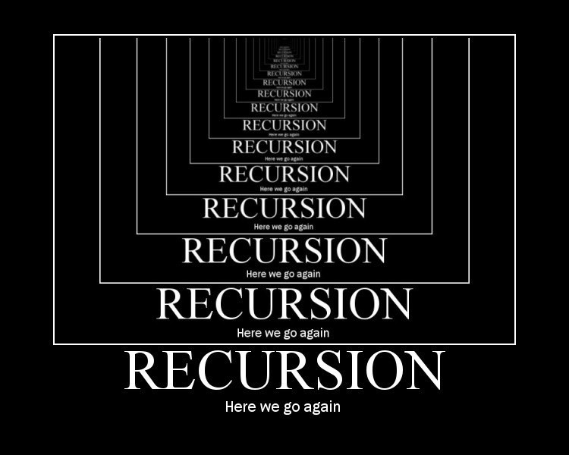
Recursive Definitions and Structural Induction

Slide 4
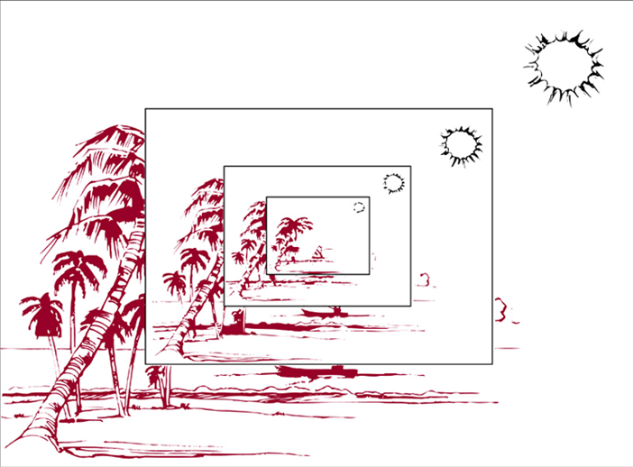
Recursive or Inductive Definitions
Sometimes it is difficult to define an object explicitly. However, it may be easy to define the object in terms of itself. This process is called recursion.
Recursion is useful to define sequences, functions, sets, and algorithms.
When a sequence is defined recursively,
by specifying how terms are formed from
previous terms, we can use induction
to prove results about the sequence.

Slide 5
Recursive Definitions
Recursion is a principle closely related to mathematical induction.
In a recursive definition, an object is defined in terms of itself.
We can recursively define sequences, functions and sets.

Slide 6
Recursively Defined Sequences
Example:
The sequence {a_{n}} of powers of 2 is given by a_{n} = 2^{n} for n = 0, 1, 2, … .
The same sequence can also be defined recursively:
a₀ = 1
a_{n+1} = 2a_{n} for n = 0, 1, 2, …
Obviously, induction and recursion are similar principles.

Slide 7
Recursively Defined Functions
We can use the following method to define a function with the natural numbers as its domain:
Base case: Specify the value of the function at zero.
Recursion: Give a rule for finding its value at any integer from its values at smaller integers.
Such a definition is called a recursive definition.

Slide 8
Recursively Defined Functions
Example:
f(0) = 3
f(n) = 2f(n-1) + 3
f(0) = 3
f(1) = 2f(0) + 3 = 2⋅3 + 3 = 9
f(2) = 2f(1) + 3 = 2⋅9 + 3 = 21
f(3) = 2f(2) + 3 = 2⋅21 + 3 = 45
f(4) = 2f(3) + 3 = 2⋅45 + 3 = 93

Slide 9
Recursively Defined Functions
How can we recursively define the factorial function f(n) = n! ?
f(0) = 1
f(n) = (n)⋅f(n-1)
f(0) = 1
f(1) = 1f(0) = 1⋅1 = 1
f(2) = 2f(1) = 2⋅1 = 2
f(3) = 3f(2) = 3⋅2 = 6
f(4) = 4f(3) = 4⋅6 = 24

Slide 10
Recursively Defined Functions
A famous example: The Fibonacci numbers
f(0) = 0, f(1) = 1
f(n) = f(n – 1) + f(n - 2)
f(0) = 0
f(1) = 1
f(2) = f(1) + f(0) = 1 + 0 = 1
f(3) = f(2) + f(1) = 1 + 1 = 2
f(4) = f(3) + f(2) = 2 + 1 = 3
f(5) = f(4) + f(3) = 3 + 2 = 5
f(6) = f(5) + f(4) = 5 + 3 = 8

Slide 11
Recursively Defined Sets
If we want to recursively define a set, we need to provide two things:
an initial set of elements,
rules for the construction of additional elements from elements in the set.
Example: Let S be recursively defined by:
3 ∈ S
(x + y) ∈ S if (x ∈ S) and (y ∈ S)
S is the set of positive integers divisible by 3.
Exclusion rule:
The set contains nothing other than those elements specified in the basic step or generated by the recursive step.

Slide 12
Recursively Defined Sets
Proof:
Let A be the set of all positive integers divisible by 3.
To show that A = S, we must show that A ⊆ S and S ⊆ A.
Part I: To prove that A ⊆ S, we must show that every positive integer divisible by 3 is in S.
We will use mathematical induction to show this.

Slide 13
Recursively Defined Sets
Let P(n) be the statement “3n belongs to S”.
Basis step: P(1) is true, because 3 is in S.
Inductive step: To show: If P(n) is true, then P(n + 1) is true.
Assume 3n is in S. Since 3n is in S and 3 is in S, it follows from the recursive definition of S that 3n + 3 = 3(n + 1) is also in S.
Conclusion of Part I: A ⊆ S.

Slide 14
Recursively Defined Sets
Part II: To show: S ⊆ A.
Basis step: To show: All initial elements of S are in A. 3 is in A. True.
Inductive step: To show: If x and y in S are in A, then (x + y) is in A .
Since x and y are both in A, it follows that 3 | x and 3 | y. From Theorem I, Section 3.4, it follows that 3 | (x + y).
Conclusion of Part II: S ⊆ A.
Overall conclusion: A = S.

Slide 15
Recursively Defined Sets
Another example:
The well-formed formulae of variables, numerals and operators from {+, -, *, /, ^} are defined by:
x is a well-formed formula if x is a numeral or variable.
(f + g), (f – g), (f * g), (f / g), (f ^ g) are well-formed formulae if f and g are.

Slide 16
Recursively Defined Sets
With this definition, we can construct formulae such as:
(x – y)
((z / 3) – y)
((z / 3) – (6 + 5))
((z / (2 * 4)) – (6 + 5))
Note that the definition on the previous slide requires fully parenthesized subformulae

Slide 17
Recursive Algorithms

Slide 18


First, a Digression
Mathematicians and Telephones

Slide 19

Mathematicians & Telephones

Slide 20
Recursive Algorithms
An algorithm is called recursive if it solves a problem by reducing it to an instance of the same problem with smaller input.
Example 0: Recursive Factorial Algorithm
procedure factorial(n: nonnegative integer) returns integer;
if n = 0 then return 1 else return n * factorial(n-1) endif
end factorial
Compare this with the iterative algorithm you’ve seen before

Slide 21
Recursive Algorithms
An algorithm is called recursive if it solves a problem by reducing it to an instance of the same problem with smaller input.
Example I: Recursive Euclidean Algorithm
procedure gcd(a, b: nonnegative integers with a < b) returns integer
if a = 0 then return b else return gcd(b mod a, a) endif
end gcd
Compare this with the iterative algorithm in the previous module

Slide 22
Recursive Algorithms
Example II: Recursive Fibonacci Algorithm
procedure fib(n: nonnegative integer) returns integer if n = 0 then return 0 elseif n = 1 then return 1 else return fib(n – 1) + fib(n – 2) endif end fib

Slide 23
Recursive Algorithms
Recursive Fibonacci Evaluation:
f(4)
Note the redundant computations involved here, which leads to the conclusion that recursion in this case is not the most efficient way to compute the solution
f(3)
f(2)
f(2)
f(1)
f(1)
f(0)
f(1)
f(0)

Slide 24
Recursive Algorithms
procedure iterative_fib(n: nonnegative integer) returns integer
if n = 0 then y := 0
else x := 0
y := 1
for i := 1 to n-1 do
z := x + y
x : = y
y := z
endfor
endif
return y end iterative_fib {y is the n-th Fibonacci number}

Slide 25
Recursive Algorithms
For every recursive algorithm, there is an equivalent iterative algorithm.
Sometimes, however, the iterative version requires and auxiliary stack data structure
Recursive algorithms are often shorter, more elegant, and easier to understand than their iterative counterparts.
However, iterative algorithms are sometimes more efficient in their use of space and time.

Slide 26
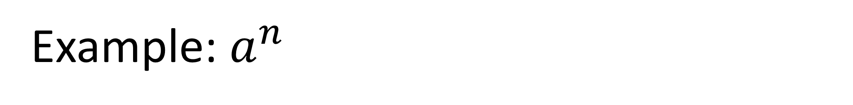
Example: $a^{n}$
procedure power(a: non-zero real, n: nonnegative integer)
if n = 0 then return 1
else return a* power(a,n-1)
// output is a^{n}
Runtime: (count # of multiplications)
T(0) = 0 T(n) = 1 + T(n-1)
= 1 + 1 + 1 + … + 1 (n terms) = n
Notes:
Procedure power(a: non-zero real, n: nonnegative integer)
If n = 0 then return 1
Else return a* power(a,n-1)
// output is a^n
Runtime:
T(n) = 1 + 1 + T(n-1) + 1 + 1
[same as before]
= 4n+1 = O(n)

Slide 27
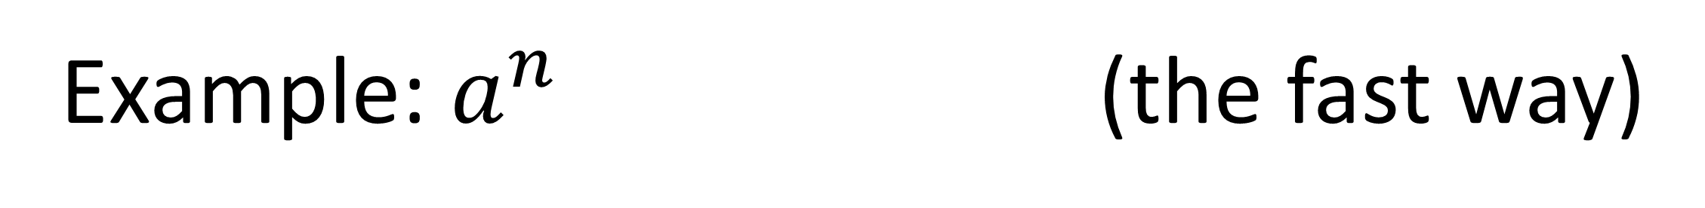
Example: $a^{n}$ (the fast way)
procedure power(a: non-zero real, n: nonnegative integer)
if n = 0 then return 1
elseif n is even then temp = power(a, n/2) return temp * temp else temp = power(a, floor(n/2)) return temp * temp * a
// output is a^{n}
Runtime (# of f.p. multiplications): worst case (n = 2^{k}-1 , thus odd always results from division
T(0) = 0
T(n) = T(n/2) + 2 = 2 + 2 + T(n/4) =
= 2 + 2 + 2 + T(n/8) = 2k + T(n/2^{k})
= 2 lg n + 2 = O(lg n)
Notes:
Procedure power2(a: non-zero real, n: nonnegative integer)
If n = 0 then return 1
Else if n is even, return power2(a,n/2)^2
Else return a * power2(a,(n-1)/2)^2
// output is a^n
Runtime:
T(n) = 1 + 1 + 1 + 1 + 1 + T(n/2) + 1 + 1 = 7 + T(n/2)
= 7 + 7 + T(n/4)
= 7 + 7 + 7 + T(n/8)
…
= 7 log n + T(0)
= 7 log n + 1 = O(log n) for C = 8, k = 2

Slide 28
Why Use Recursion?
Notes:
If iterative algorithms require fewer operations, then why do we bother with recursive algorithms.
Are beauty and elegance not enough for you!?
Here’s why: ease of implementation.

Slide 29
Tower of Hanoi
procedure hanoi(n,src,dest,aux)
// puzzle of size n=0 is trivial: do nothing
// move n-1 disks from src to aux using dest
// move the n-th disk from src to dest
// move n-1 disks from aux to dest using src
Notes:
This will come back when we get to counting.

Slide 30
Tower of Hanoi
procedure hanoi(n,src,dest,aux) if n = 0 then return // base case else
hanoi(n-1,src,aux,dest)
print “move disk “ n “ from “ src “ to “ dest
hanoi(n-1,aux,dest,src) endif
end hanoi

Slide 31
Binary search algorithm
procedure binary_search(i, j, x: integers, 1≤i≤n, 1 ≤j≤n)
m= ⌊(i+j)/2⌋ if x=a_{m} then
location:=m
else if (x < a_{m} and i < m) then
binary_search(x, i, m-1)
else if (x > a_{m} and j > m) then
binary_search(x, m+1, j)
else
location:=0
endif
end binary_search

Slide 32
The [Recursive] Merge Sort
To sort a list:
Divide list in half
Recursively sort the left half
Recursively sort the right half
Merge the sorted halves into a single sorted list
Notes:
So simple! So elegant!
Of course you can do mergesort iteratively, but WHY!?

Slide 33
procedure mergesort(A = a₁,…,a_{n}) if n > 1 then m = floor(n/2) L = a₁,…,a_{m} R = a_{m+1},…,a_{n} mergesort(L) mergesort(R) A = merge(L,R) endif end mergsort
Notes:
Isn’t it BEAUTFUL!?
The efficiency of mergesort depends on having an efficient algorithm for merging to sorted lists

Slide 34
procedure merge(L,R: sorted lists) A = empty list while L and R are both non-empty l,r = first element of L,R if l < r then remove l from L append l to A else remove r from R append r to A endif endwhile remove and append to A all elements of L,R return A // the merged list
Notes:
Worst case for merging two sorted lists with m and n elements is m+n-1 comparisons.
Can do better, e.g. if m=1, binary search through n elements takes log n compares.
(but still have to do m+n assigns)

Slide 35
Analysis of Merge Sort
Count list comparisons (Assume n = 2^{k})
T(1) = 0 (no work needed to sort one element) T(n) = 2T(n/2) + M(n) (Time to sort both halves + time to merge)
= 2T(n/2) + n - 1 (M(n) takes at most n-1 comparisons)
< 2T(n/2) + n (ignoring the constant makes the big-Oh analysis easier)
= 2(2T(n/4) + n/2) + n = 4T(n/4) + n + n = 4T(n/4) + 2n
= 4(2T(n/8) + n/4) + 2n = 2³T(n/2³) + n + 2n = 2³T(n/2³) + 3n …
= 2^{k}T(n/2^{k}) + k n (but since n = 2^{k} , k = lg(n))
= 0 + n log n = O(n log n)
Notes:
Count comparisons
T(n) = 1 + T(n/2) + T(n/2) + M(n) = 1 + 2T(n/2) + n - 1 = 2T(n/2) + n
= 2(2T(n/4) + n/2) + n = 2^2T(n/4) + n + n = 2^2T(n/4) + 2n
= 2^2(2T(n/8) + n/4) + 2n = 2^3T(n/8) + n + 2n = 2^3T(n/8) + 3n
…
= 2^(log n)T(1) + n log n
= n + n log n = O(n log n)

