Slide 1

CSCE 222 Discrete Structures
Counting
Dr. Tim McGuire
Grateful acknowledgement to Professor Bart Selman, Cornell University, and Prof. Johnnie Baker, Kent State, for some of the material upon which these notes are adapted.
Notes:
Roger Creager - Sweet Home College Station, https://www.youtube.com/watch?v=K5Y1GmvAed0
Start 5 minutes before class

Slide 2
Based on Chapter 6 of Rosen Discrete Mathematics and its Applications

Slide 3
Combinatorics: the study of arrangements of objects Enumeration: the counting of objects with certain properties
Notes:
Combinatorics is an important part of discrete math.
Enumeration is an important part of combinatorics.
Counting is used extensively in computer science and engineering: analysis of algorithms, security, graph theory, simulation, software testing

Slide 4
Basic Counting Principles
Counting problems are of the following kind:
“How many different 8-letter passwords are there?”
“How many possible ways are there to pick 11 soccer players out of a 20-player team?”
Most importantly, counting is the basis for computing probabilities of discrete events.
(“What is the probability of winning the lottery?”)

Slide 5
Basic Counting Principles
The sum rule: If a task can be done either in one of n₁ ways or in one of n₂ ways, where none of the set of n₁ ways is the same as any of the set of n₂ ways, then there are n₁+n₂ ways to do the task
Example:
The department will award a free computer to either a CSE student or a CSE professor.
How many different choices are there, if there are 1229 students and 50 professors?
There are 1229 + 50 = 1279 choices.

Slide 6
Basic Counting Principles
Generalized sum rule:
If a task can be done in n₁, n₂, …, n_{m} ways, where none of the set of n_{i} ways is the same as any of the set of n_{j} ways (i ≠ j), then there are n₁ + n₂ + … + n_{m} ways to do the task.

Slide 7
Basic Counting Principles
The product rule:
Suppose that a procedure can be broken down into two successive tasks. If there are n₁ ways to do the first task and n₂ ways to do the second task after the first task has been done, then there are n₁n₂ ways to do the procedure.

Slide 8
Basic Counting Principles
Example:
How many different license plates are there that containing exactly three English letters ?
Solution:
There are 26 possibilities to pick the first letter, then 26 possibilities for the second one, and 26 for the last one.
So there are 26⋅26⋅26 = 17576 different license plates.

Slide 9
Basic Counting Principles
Generalized product rule:
If we have a procedure consisting of sequential tasks T₁, T₂, …, T_{m} that can be done in n₁, n₂, …, n_{m} ways, respectively, then there are n₁ ⋅ n₂ ⋅ … ⋅ n_{m} ways to carry out the procedure.

Slide 10
Basic Counting Principles
The sum and product rules can also be phrased in terms of set theory.
Sum rule: Let A₁, A₂, …, A_{m} be disjoint sets. Then the number of ways to choose any element from one of these sets is |A₁ ∪ A₂ ∪ … ∪ A_{m} | = |A₁| + |A₂| + … + |A_{m}|.
Product rule: Let A₁, A₂, …, A_{m} be finite sets. Then the number of ways to choose one element from each set in the order A₁, A₂, …, A_{m} is |A₁ × A₂ × … × A_{m} | = |A₁| ⋅ |A₂| ⋅ … ⋅ |A_{m}|.

Slide 11
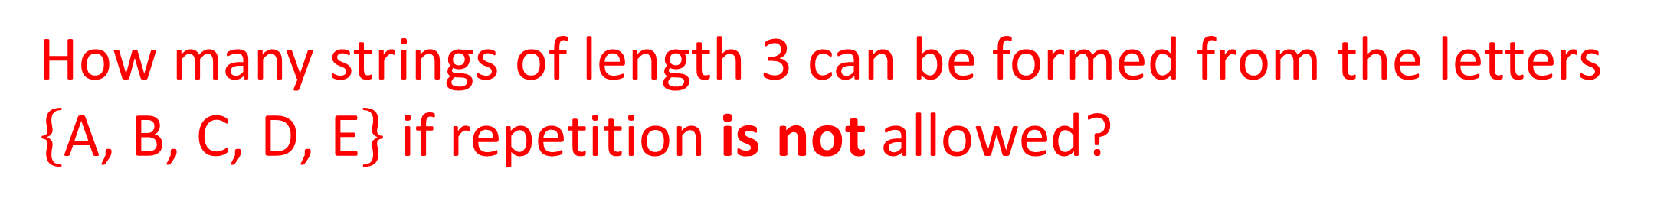
How many strings of length 3 can be formed from the letters $\left\{\text{A}\text{, }\text{B}\text{, }\text{C}\text{, }\text{D}\text{, }\text{E}\right\}$ if repetition is not allowed?
Task 1: choosing the first letter: 5 ways
Task 2: choosing the remaining letters: ? Ways
Task 2.1: choosing the second letter: 4 ways
Task 2.2 choosing the third letter: 3 ways
Task 2: 4*3=12 ways
5*12 = 60 strings of length 3
Notes:
Task 1: choosing the first letter: 5 ways
Task 2: choosing the remaining letters: ? Ways
Task 2.1: choosing the second letter: 4 ways
Task 2.2 choosing the third letter: 3 ways
Task 2: 4*3=12 ways
5*12 = 60 strings of length 3

Slide 12
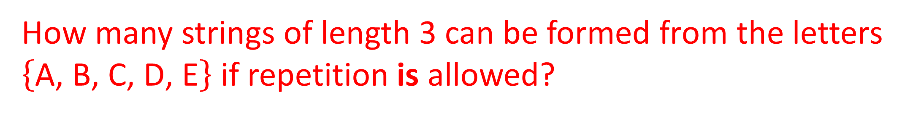
How many strings of length 3 can be formed from the letters $\left\{\text{A}\text{, }\text{B}\text{, }\text{C}\text{, }\text{D}\text{, }\text{E}\right\}$ if repetition is allowed?
Task 1: choosing the first letter: 5 ways
Task 2: choosing the remaining letters: ? Ways
Task 2.1: choosing the second letter: 5 ways
Task 2.2 choosing the third letter: 5 ways
Task 2: 5*5=25 ways
5*25 = 125 strings of length 3
Notes:
Task 1: choosing the first letter: 5 ways
Task 2: choosing the remaining letters: ? Ways
Task 2.1: choosing the second letter: 5 ways
Task 2.2 choosing the third letter: 5 ways
Task 2: 5*5=25 ways
5*25 = 125 strings of length 3

Slide 13
How many bitstrings of length 7 are there?
_ _ _ _ _ _ _
2 2 2 2 2 2 2 = 2^7 = 128
Notes:
_ _ _ _ _ _ _
2 2 2 2 2 2 2 = 2^7 = 128
?? QUESTIONS

Slide 14
More complex counting problems
In a version of the BASIC programming language, the name of a variable is a string of 1 or 2 alphanumeric characters, where uppercase and lowercase letters are not distinguished.
Moreover, a variable name must begin with a letter and must be different from the five strings of two characters that are reserved for programming use
How many different variables names are there?
Let V₁ be the number of these variables of 1 character, and likewise V₂ for variables of 2 characters
So, V₁=26, and V₂=26∙36-5=931
In total, there are 26+931=957 different variables

Slide 15
Example
Each user on a computer system has a password, which is 6 to 8 characters long, where each character is an uppercase letter or a digit. Each password must contain at least one digit. How many possible passwords are there?
Let P be the number of all possible passwords and P=P₆+P₇+P₈ where P_{i} is a password of i characters
P₆=36⁶-26⁶=1,867,866,560
P₇=36⁷-26⁷=70,332,353,920
P₈=36⁸-26⁸=2,612,282,842,880
P=P₆+P₇+P₈=2,684,483,063,360

Slide 16
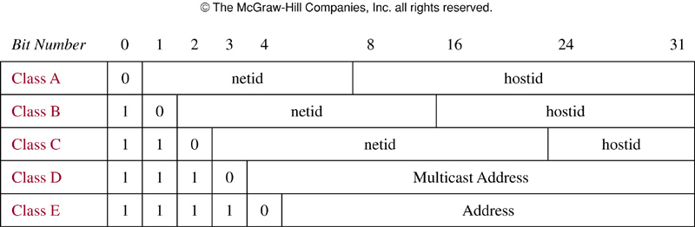
Example: Internet address
Internet protocol (IPv4)
Class A: largest network
Class B: medium-sized networks
Class C : smallest networks
Class D: multicast (not assigned for IP address)
Class E: future use
Some are reserved: netid 1111111, hostid all 1’s and 0’s
Neither class D or E addresses are assigned as the IPv4 addresses
How may different IPv4 addresses are available?

Slide 17
Example: Internet address
Let the total number of address be x, and x=x_{A}+x_{B}+x_{C}
Class A: there are 2⁷-1=127 netids (1111111 is reserved). For each netid, there are 2²⁴-2=16,777,214 hostids (as hostids of all 0s and 1s are reserved), so there are x_{A}=127∙16,777,214=2,130,706,178 addresses
Class B, C: 2¹⁴=16,384 Class B netids and 2²¹=2,097,152 Class C netids. 2¹⁶-2=65,534 Class B hostids, and 2⁸-2=254 Class C hostids. So, x_{B}=1,073,709,056, and x_{C}=532,676,608
So, x=x_{A}+x_{B}+x_{C}=3,737,091,842

Slide 18
Inclusion-exclusion principle
Suppose that a task can be done in n₁ or in n₂ ways, but some of the set of n₁ ways to do the task are the same as some of the n₂ ways to do the task
Cannot simply add n₁ and n₂, but need to subtract the number of ways to the task that is common in both sets
This technique is called principle of inclusion-exclusion or subtraction principle

Slide 19
Inclusion-Exclusion
How many bit strings of length 8 either start with a 1 or end with 00?
Task 1: Construct a string of length 8 that starts with a 1.
There is one way to pick the first bit (1),
two ways to pick the second bit (0 or 1),
two ways to pick the third bit (0 or 1),
.
.
.
two ways to pick the eighth bit (0 or 1).
Product rule: Task 1 can be done in 1⋅2⁷ = 128 ways.

Slide 20
Inclusion-Exclusion
Task 2: Construct a string of length 8 that ends with 00.
There are two ways to pick the first bit (0 or 1),
two ways to pick the second bit (0 or 1),
.
.
.
two ways to pick the sixth bit (0 or 1),
one way to pick the seventh bit (0), and
one way to pick the eighth bit (0).
Product rule: Task 2 can be done in 2⁶ = 64 ways.

Slide 21
Inclusion-Exclusion
Since there are 128 ways to do Task 1 and 64 ways to do Task 2, does this mean that there are 192 bit strings either starting with 1 or ending with 00 ?
No, because here Task 1 and Task 2 can be done at the same time.
When we carry out Task 1 and create strings starting with 1, some of these strings end with 00.
Therefore, we sometimes do Tasks 1 and 2 at the same time, so the sum rule does not apply.

Slide 22
Inclusion-Exclusion
If we want to use the sum rule in such a case, we have to subtract the cases when Tasks 1 and 2 are done at the same time.
How many cases are there, that is, how many strings start with 1 and end with 00?
There is one way to pick the first bit (1),
two ways for the second, …, sixth bit (0 or 1),
one way for the seventh, eighth bit (0).
Product rule: In 2⁵ = 32 cases, Tasks 1 and 2 are carried out at the same time.

Slide 23
Inclusion-Exclusion
Since there are 128 ways to complete Task 1 and 64 ways to complete Task 2, and in 32 of these cases Tasks 1 and 2 are completed at the same time, there are
128 + 64 – 32 = 160 ways to do either task.
In set theory, this corresponds to sets A₁ and A₂ that are not disjoint. Then we have:
|A₁ ∪ A₂| = |A₁| + |A₂| - |A₁ ∩ A₂|
This is called the principle of inclusion-exclusion.

Slide 24
Tree Diagrams
How many bit strings of length four do not have two consecutive 1s?
Task 1 Task 2 Task 3 Task 4 (1st bit) (2nd bit) (3rd bit) (4th bit)
0
0
0
1
0
1
0
1
0
0
1
0
0
1
0
1
1
0
There are 8 strings.

Slide 25
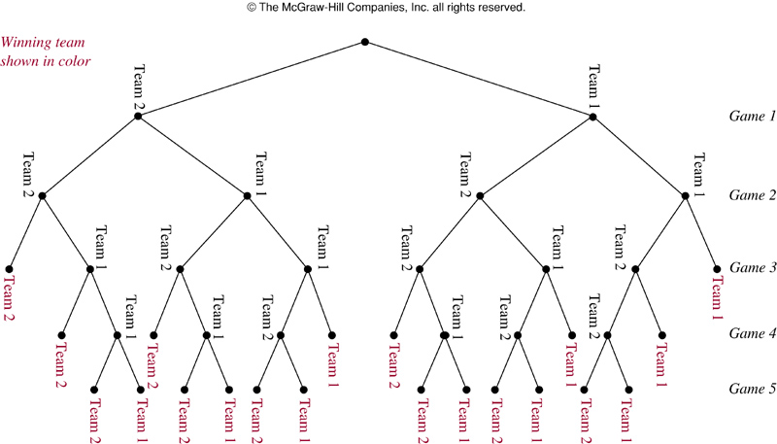
Example
A playoff between 2 teams consists of at most 5 games. The 1st team that wins 3 games wins the playoff. How many different ways are there?

Slide 26
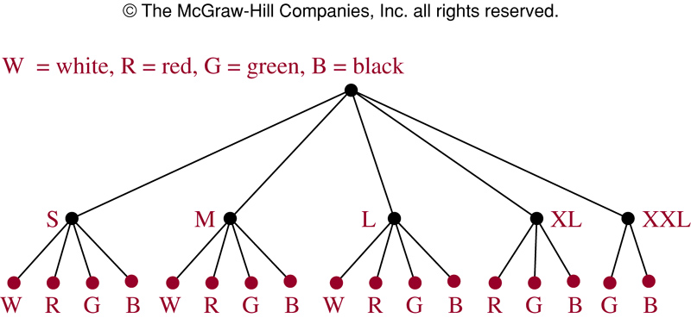
Example
Suppose a T-shirt comes in 5 different sizes: S, M, L, XL, and XXL. Further suppose that each size comes in 4 colors, white, green, red, and black except for XL which comes only in red, green and black, and XXL which comes only in green and black. How many possible size and color of the T-shirt?

Slide 27
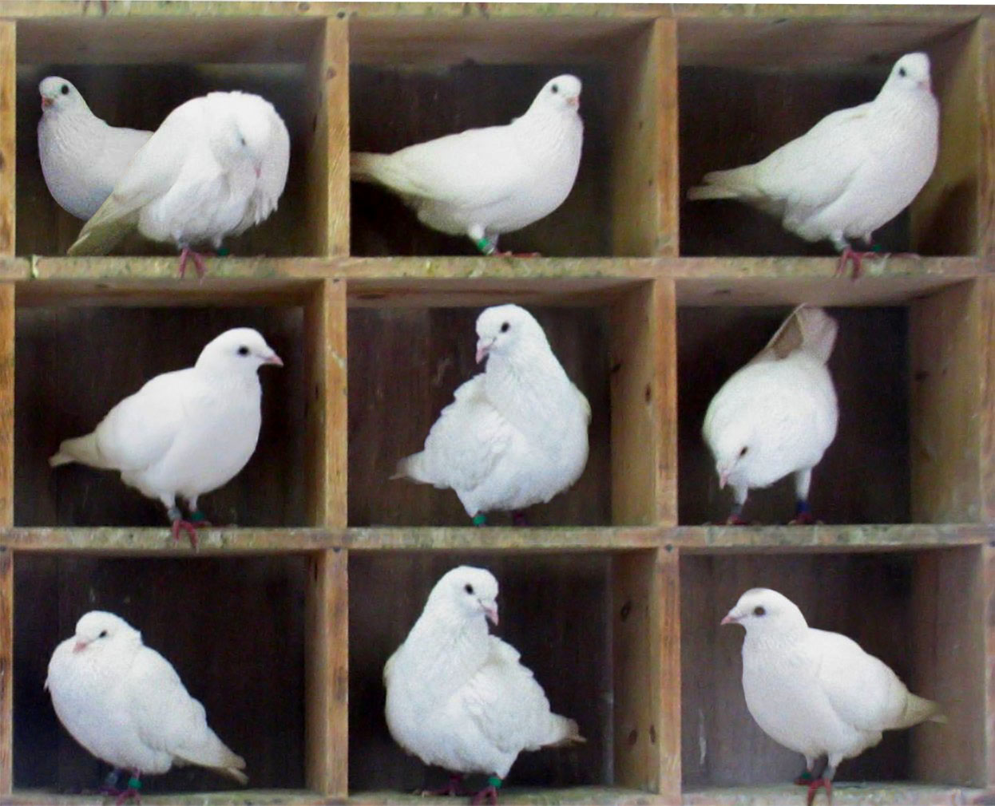
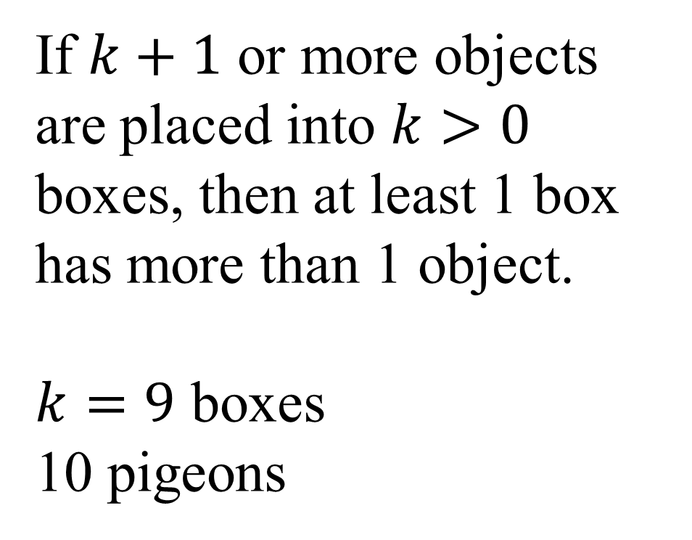
Pigeonhole Principle
If $k+1$ or more objects are placed into $k>0$ boxes, then at least 1 box has more than 1 object.
$k=9$ boxes
10 pigeons
Notes:
Corollary: if f:X→y and |X| > |Y|, then f is not one-to-one.

Slide 28
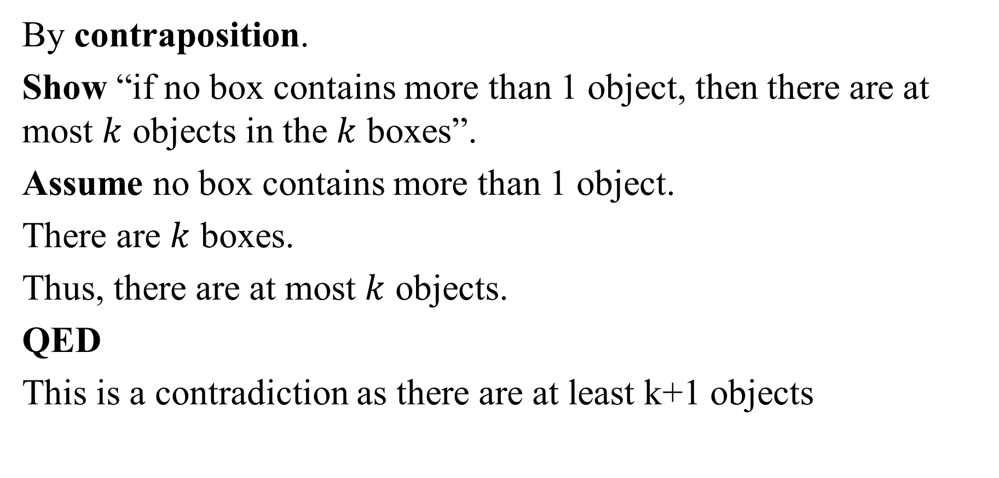
Proof
By contraposition.
Show “if no box contains more than 1 object, then there are at most $k$ objects in the $k$ boxes”.
Assume no box contains more than 1 object.
There are $k$ boxes.
Thus, there are at most $k$ objects.
QED
This is a contradiction as there are at least k+1 objects
Notes:
Skip for time.

Slide 29
The Pigeonhole Principle
The pigeonhole principle: If (k + 1) or more objects are placed into k boxes, then there is at least one box containing two or more of the objects.
Example 1: If there are 11 players in a soccer team that wins 12-0, there must be at least one player in the team who scored at least twice.
Example 2: If you have 6 classes from Monday to Friday, there must be at least one day on which you have at least two classes.

Slide 30
More Examples
Among any group of 367 people, there must be at least 2 with the same birthday
How many students must be in a class to guarantee that at least 2 students receive the same score on the final exam, if the exam is graded on a scale from 0 to 100 points?

Slide 31
The Pigeonhole Principle
The generalized pigeonhole principle: If N objects are placed into k boxes, then there is at least one box containing at least ⎡N/k⎤ of the objects.
Example 1: In our 50-student class, at least 10 students will get the same letter grade (A, B, C, D, or F).

Slide 32
The Pigeonhole Principle
Example 2: Assume you have a drawer containing a random distribution of a dozen brown socks and a dozen black socks. It is dark, so how many socks do you have to pick to be sure that among them there is a matching pair?
There are two types of socks, so if you pick at least 3 socks, there must be either at least two brown socks or at least two black socks.
Generalized pigeonhole principle: ⎡3/2⎤ = 2.

Slide 33
How many cards must be drawn from a standard deck to guarantee that at least 5 of the same suit are drawn?
Ceil(N/4) = 5
N = 21
21 cards will suffice
Deal 21 and show that at least 5 of some suit were drawn.
Notes:
Ceil(N/4) = 5
N = 21
21 cards will suffice
Deal 21 and show that at least 5 of some suit were drawn.

Slide 34
Permutations and Combinations
How many ways are there to pick a set of 3 people from a group of 6?
There are 6 choices for the first person, 5 for the second one, and 4 for the third one, so there are 6⋅5⋅4 = 120 ways to do this.
This is not the correct result!
For example, picking person C, then person A, and then person E leads to the same group as first picking E, then C, and then A.
However, these cases are counted separately in the above equation.

Slide 35
Permutations and Combinations
So how can we compute how many different subsets of people can be picked (that is, we want to disregard the order of picking) ?
To find out about this, we need to look at permutations.
A permutation of a set of distinct objects is an ordered arrangement of these objects.
An ordered arrangement of r elements of a set is called an r-permutation.

Slide 36
A permutation is an ordered arrangement of distinct objects. How many ways can a deck of cards be ordered?
Use product rule.
52 ways for card 1
51 ways for card 2
…
1 way for card 52
= 52!
Notes:
Example: how many ways can a deck of cards be ordered?
Use product rule.
52 ways for card 1
51 ways for card 2
…
1 way for card 52
= 52!

Slide 37
80,658,175,170,943,878,571,660, 636,856,403,766,975,289,505,440,883,277,824,000,000,000,000
A number so big that 1 trillion planets, each with 1 trillion humanoids, each shuffling a deck 1 trillion times per second (and always uniquely), non-stop since the beginning of time in the universe (approx. 14 billion years ago), would need 200 trillion more lifetimes of the universe to get through all possible orderings.
Notes:
A number so big that 1 trillion planets
Each with 1 trillion lifeforms,
each shuffling a deck 1 trillion times per second (and always uniquely),
Non-stop since the beginning of time in the universe (approx. 14 billion years ago),
Would need 200 trillion more lifetimes of the universe
To get through all possible orderings.

Slide 38
Permutations and Combinations
Example: Let S = {1, 2, 3}.
The arrangement 3, 1, 2 is a permutation of S.
The arrangement 3, 2 is a 2-permutation of S.
The number of r-permutations of a set with n distinct elements is denoted by P(n, r). (Read “n Pick r”)
We can calculate P(n, r) with the product rule:
P(n, r) = n⋅(n – 1)⋅(n – 2) ⋅…⋅(n – r + 1).
(n choices for the first element, (n – 1) for the second one, (n – 2) for the third one…)

Slide 39
Permutations and Combinations
Example:
P(8, 3) = 8⋅7⋅6 = 336
= (8⋅7⋅6⋅5⋅4⋅3⋅2⋅1)/(5⋅4⋅3⋅2⋅1)
General formula:
P(n, r) = n!/(n – r)!
Knowing this, we can return to our initial question:
How many ways are there to pick a set of 3 people from a group of 6 (disregarding the order of picking)?

Slide 40
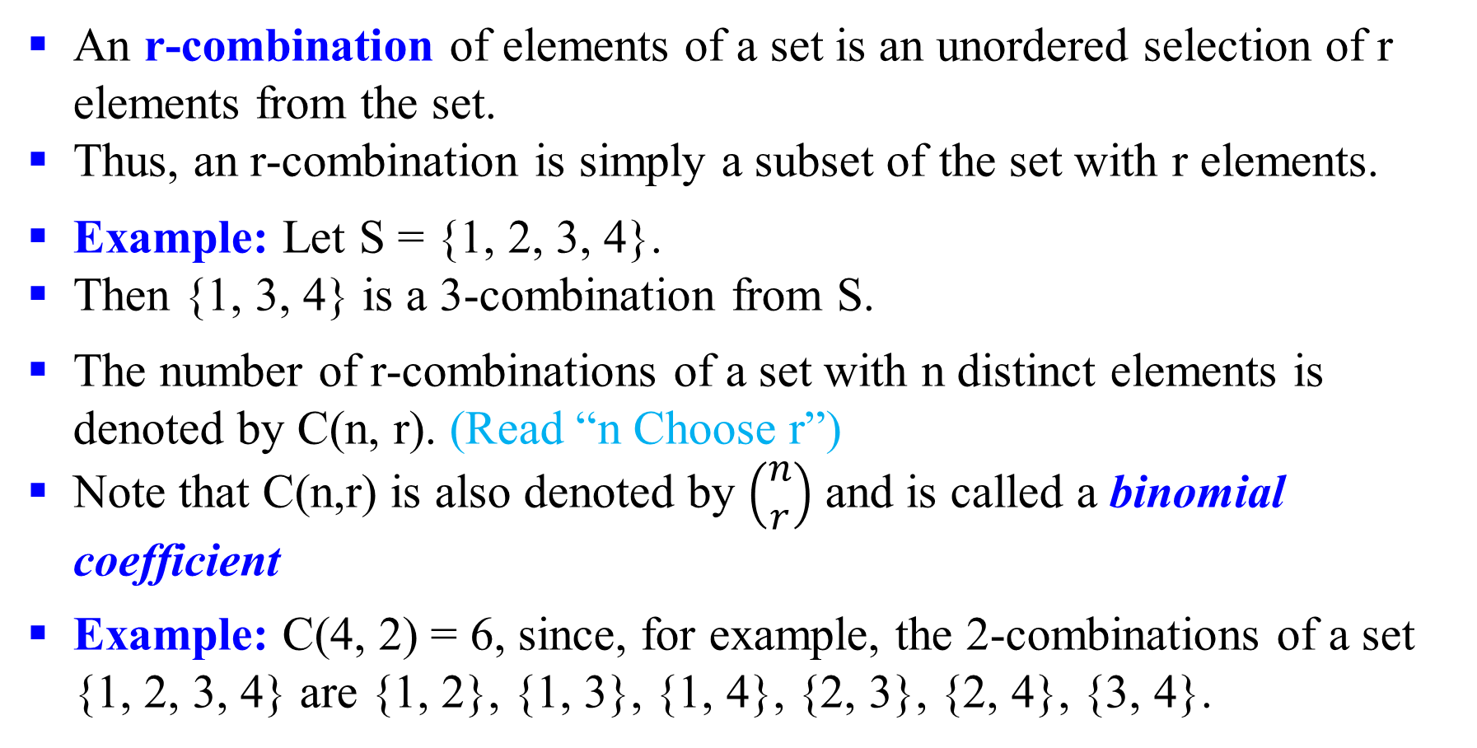
Permutations and Combinations
An r-combination of elements of a set is an unordered selection of r elements from the set.
Thus, an r-combination is simply a subset of the set with r elements.
Example: Let S = {1, 2, 3, 4}.
Then {1, 3, 4} is a 3-combination from S.
The number of r-combinations of a set with n distinct elements is denoted by C(n, r). (Read “n Choose r”)
Note that C(n,r) is also denoted by $\left(\begin{matrix}n \\ r\end{matrix}\right)$ and is called a binomial coefficient
Example: C(4, 2) = 6, since, for example, the 2-combinations of a set {1, 2, 3, 4} are {1, 2}, {1, 3}, {1, 4}, {2, 3}, {2, 4}, {3, 4}.

Slide 41
Permutations and Combinations
How can we calculate C(n, r)?
Consider that we can obtain the r-permutation of a set in the following way:
First, we form all the r-combinations of the set (there are C(n, r) such r-combinations).
Then, we generate all possible orderings in each of these r-combinations (there are P(r, r) such orderings in each case).
Therefore, we have:
P(n, r) = C(n, r)⋅P(r, r)

Slide 42
Permutations and Combinations
C(n, r) = P(n, r)/P(r, r)
= n!/(n – r)!/(r!/(r – r)!)
= n!/(r!(n – r)!)
Now we can answer our initial question:
How many ways are there to pick a set of 3 people from a group of 6 (disregarding the order of picking)?
C(6, 3) = 6!/(3!⋅3!) = 720/(6⋅6) = 720/36 = 20
There are 20 different ways, that is, 20 different groups to be picked.

Slide 43
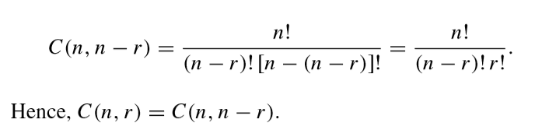
Combinations
We also have the following:
This symmetry is intuitively plausible. For example, let us consider a set containing six elements (n = 6).
Picking two elements and leaving four is essentially the same as picking four elements and leaving two.
In either case, our number of choices is the number of possibilities to divide the set into one set containing two elements and another set containing four elements.

Slide 44
Permutations and Combinations
Example:
A youth soccer club 8 female and 7 male members. For today’s match, the coach wants to have 6 female and 5 male players on the grass. How many possible configurations are there?
C(8, 6) ⋅ C(7, 5) = 8!/(6!⋅2!) ⋅ 7!/(5!⋅2!)
= 28⋅21
= 588
Note that here we are using both combinations and the product rule

Slide 45
Combinations
Pascal’s Identity:
Let n and k be positive integers with n ≥ k. Then C(n + 1, k) = C(n, k – 1) + C(n, k).
How can this be explained?
What is it good for?

Slide 46
Combinations
Imagine a set S containing n elements and a set T containing (n + 1) elements, namely all elements in S plus a new element a.
Calculating C(n + 1, k) is equivalent to answering the question: How many subsets of T containing k items are there?
Case I: The subset contains (k – 1) elements of S plus the element a: C(n, k – 1) choices.
Case II: The subset contains k elements of S and does not contain a: C(n, k) choices.
Sum Rule: C(n + 1, k) = C(n, k – 1) + C(n, k).

Slide 47
Pascal’s Triangle
In Pascal’s triangle, each number is the sum of the numbers to its upper left and upper right:
1
1
1
1
2
1
1
3
3
1
1
4
6
4
1
…
…
…
…
…
…

Slide 48
Pascal’s Triangle
Since we have C(n + 1, k) = C(n, k – 1) + C(n, k) and C(0, 0) = 1, we can use Pascal’s triangle to simplify the computation of C(n, k):
k
C(0, 0) = 1
C(1, 0) = 1
C(1, 1) = 1
n
C(2, 0) = 1
C(2, 1) = 2
C(2, 2) = 1
C(3, 0) = 1
C(3, 1) = 3
C(3, 2) = 3
C(3, 3) = 1
C(4, 0) = 1
C(4, 1) = 4
C(4, 2) = 6
C(4, 3) = 4
C(4, 4) = 1

Slide 49
Binomial Coefficients
Expressions of the form C(n, k) are also called binomial coefficients.
Why?
A binomial expression is the sum of two terms, such as (a + b).
Now consider (a + b)² = (a + b)(a + b).
When expanding such expressions, we have to form all possible products of a term in the first factor and a term in the second factor:
(a + b)² = a·a + a·b + b·a + b·b
Then we can sum identical terms:
(a + b)² = a² + 2ab + b²

Slide 50
Binomial Coefficients
For (a + b)³ = (a + b)(a + b)(a + b) we have
(a + b)³ = aaa + aab + aba + abb + baa + bab + bba + bbb
(a + b)³ = a³ + 3a²b + 3ab² + b³
There is only one term a³, because there is only one possibility to form it: Choose a from all three factors: C(3, 3) = 1.
There is three times the term a²b, because there are three possibilities to choose a from two out of the three factors: C(3, 2) = 3.
Similarly, there is three times the term ab² (C(3, 1) = 3) and once the term b³ (C(3, 0) = 1).

Slide 51
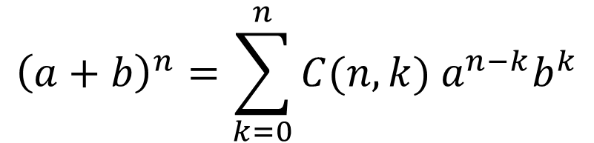
Binomial Coefficients
This leads us to the following formula:
$${\left(a+b\right)}^{n}=\sum_{k=0}^{n}{C(n,k) a^{n−k}b^{k}}$$
(Binomial Theorem)
With the help of Pascal’s triangle, this formula can considerably simplify the process of expanding powers of binomial expressions.
For example, the fifth row of Pascal’s triangle (1 – 4 – 6 – 4 – 1) helps us to compute (a + b)⁴:
(a + b)⁴ = a⁴ + 4a³b + 6a²b² + 4ab³ + b⁴

Slide 52

Many Useful Identities!
$$\sum_{i=0}^{n}{\left(\begin{matrix}n \\ i\end{matrix}\right)}=2^{n}$$
$$\sum_{i=0}^{n}{{\left(−1\right)}^{i}\left(\begin{matrix}n \\ i\end{matrix}\right)}=0$$
$$\sum_{i=0}^{n}{2^{i}\left(\begin{matrix}n \\ i\end{matrix}\right)}=3^{n}$$
Notes:
$\sum_{i=0}^{n}{\left(\begin{matrix}n \\ i\end{matrix}\right)}=2^{n}$ because 2^n = (1 + 1)^n = $\sum_{i=0}^{n}{\left(\begin{matrix}n \\ i\end{matrix}\right)1^{n−i}1^{i}}$
$\sum_{i=0}^{n}{{\left(−1\right)}^{i}\left(\begin{matrix}n \\ i\end{matrix}\right)}=0$ because 0^n = (1 + -1)^n = $\sum_{i=0}^{n}{\left(\begin{matrix}n \\ i\end{matrix}\right)1^{n−i}{\left(−1\right)}^{i}}$
$\sum_{i=0}^{n}{2^{i}\left(\begin{matrix}n \\ i\end{matrix}\right)}=3^{n}$ because 3^n = (1 + 2)^n = $\sum_{i=0}^{n}{\left(\begin{matrix}n \\ i\end{matrix}\right)1^{n−i}2^{i}}$

Slide 53
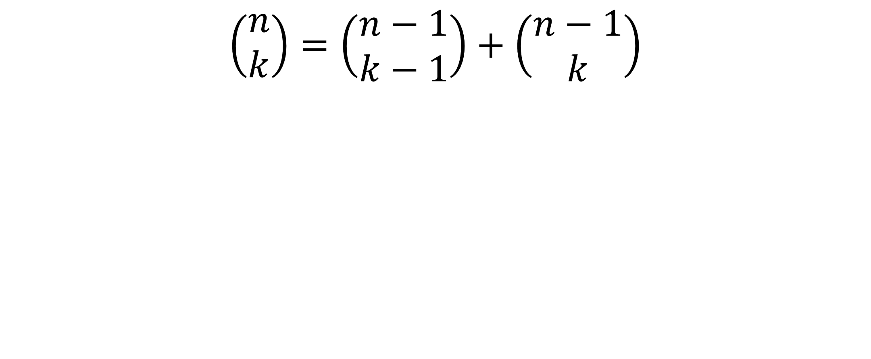
Pascal’s Identity
$$\left(\begin{matrix}n \\ k\end{matrix}\right)=\left(\begin{matrix}n−1 \\ k−1\end{matrix}\right)+\left(\begin{matrix}n−1 \\ k\end{matrix}\right)$$
Notes:
Together with (n choose 0) = 1 and (0 choose k) = 0 , this is a recursive definition of the binomial coefficient.
Draw pascal’s triangle on the slide.
Observations:
symmetric across middle
Each element is the sum of the two above it (useful in computation since only involves addition)
Sum across row n is 2^n (index from 0)

Slide 54
Review Exercises

Slide 55
There must be at least two people in New York city with exactly the same number of hairs on their heads. Why?
Typical head of hair has around 100,000 hairs. So, it is reasonable to assume that no one has more than 1,000,000 hairs on their head (m = 1 million holes).
There are more than 1,000,000 people in NYC (n is bigger than 1 million objects).
If we assign a pigeonhole for each number of hairs on a head, and assign people to the pigeonhole with their number of hairs on it, there must be at least two people with the same number of hairs on their heads.
Useful stuff to know… ☺

Slide 56
A bowl contains 10 red and 10 yellow balls
How many balls must be selected to ensure 3 balls of the same color?
One solution: consider the “worst” case
Consider 2 balls of each color
You can’t take another ball without hitting 3
Thus, the answer is 5
Via generalized pigeonhole principle
How many balls are required if there are 2 colors, and one color must have 3 balls?
How many pigeons are required if there are 2 pigeon holes, and one must have 3 pigeons?
number of boxes: k = 2
We want ⎡N/k⎤ = 3
What is the minimum N?
N = 5

Slide 57
A bowl contains 10 red and 10 yellow balls
How many balls must be selected to ensure 3 yellow balls?
Consider the “worst” case
Consider 10 red balls and 2 yellow balls
You can’t take another ball without hitting 3 yellow balls
Thus, the answer is 13

Slide 58


“The party problem”
Dinner party of six: Either there is a group of 3 who all know each other, or there is a group of 3 who are all strangers.
By contradiction. Assume we have a party of six where no three people all know each other and no three people are all strangers.
Let’s say she knows 3 others.
If any of those 3 know each other, we have a blue ⬇, which means 3 people know each other. Contradicts assumption.
So they all must be strangers. But then we
have three strangers. Contradicts assumption.
Consider one person.
She either knows or doesn’t know each other person.
The case where she doesn’t know 3 others is similar. Also, leads to constradiction.
So, such a party does not exist! QED
But there are 5 other people! So, she knows, or doesn’t know, at least 3 others.
(GPH)

Slide 59
Permutations
In how many ways can 5 distinct Martians and 3 distinct Jovians stand in line, if no two Jovians stand together? Hmm…
M1
M2
M3
M4
M5
5! X P(6,3)

Slide 60
Horse races
How many ways are there for 4 horses to finish if ties are allowed?
Note that order does matter!
Solution by cases
No ties
The number of permutations is P(4,4) = 4! = 24
Two horses tie
There are C(4,2) = 6 ways to choose the two horses that tie
There are P(3,3) = 6 ways for the “groups” to finish
A “group” is either a single horse or the two tying horses
By the product rule, there are 6*6 = 36 possibilities for this case

Slide 61
Horse races
Two groups of two horses tie
There are C(4,2) = 6 ways to choose the two winning horses
The other two horses tie for second place
Three horses tie with each other
There are C(4,3) = 4 ways to choose the three horses that tie
There are P(2,2) = 2 ways for the “groups” to finish
By the product rule, there are 4*2 = 8 possibilities for this case
All four horses tie
There is only one combination for this
By the sum rule, the total is 24+36+6+8+1 = 75

Slide 62
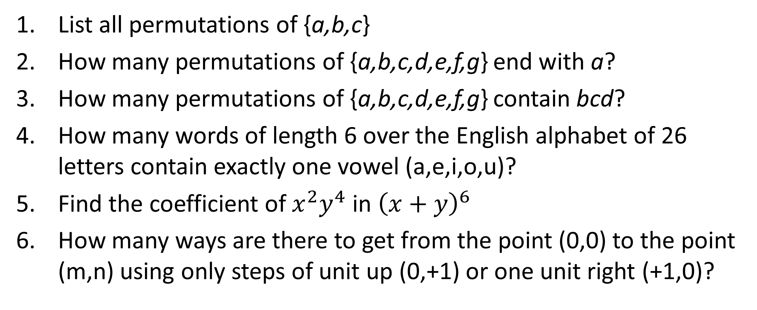
Exercises if time permits
List all permutations of {a,b,c}
How many permutations of {a,b,c,d,e,f,g} end with a?
How many permutations of {a,b,c,d,e,f,g} contain bcd?
How many words of length 6 over the English alphabet of 26 letters contain exactly one vowel (a,e,i,o,u)?
Find the coefficient of $x^{2}y^{4}$ in ${\left(x+y\right)}^{6}$
How many ways are there to get from the point (0,0) to the point (m,n) using only steps of unit up (0,+1) or one unit right (+1,0)?
Notes:
abc,acb,bac,bca,cab,cba
_ _ _ _ _ _ a → 6! = 720
a(bcd),e,f,g → 5*4! = 5! = 120
(6 choose 1)*5*21^5
(6 choose 2) = 15
m steps right + n steps, in any order → (m+n choose m)

Slide 63
Exercises if time permits
List all permutations of {a,b,c}
How many permutations of {a,b,c,d,e,f,g} end with a?
How many permutations of {a,b,c,d,e,f,g} contain bcd?
How many words of length 6 over the English alphabet of 26 letters contain exactly one vowel (a,e,i,o,u)?
Find the coefficient of $x^{2}y^{4}$ in ${\left(x+y\right)}^{6}$
How many ways are there to get from the point (0,0) to the point (m,n) using only steps of unit up (0,+1) or one unit right (+1,0)?
abc,acb,bac,bca,cab,cba
_ _ _ _ _ _ a → 6! = 720
(bcd),e,f,g → 5*4! = 5! = 120
_ _ _(6 choose 1)*5*21^5
(6 choose 2) = 15
m steps right + n steps, in any order → (m+n choose m)
Notes:
abc,acb,bac,bca,cab,cba
_ _ _ _ _ _ a → 6! = 720
a(bcd),e,f,g → 5*4! = 5! = 120
(6 choose 1)*5*21^5
(6 choose 2) = 15
m steps right + n steps, in any order → (m+n choose m)

Slide 64
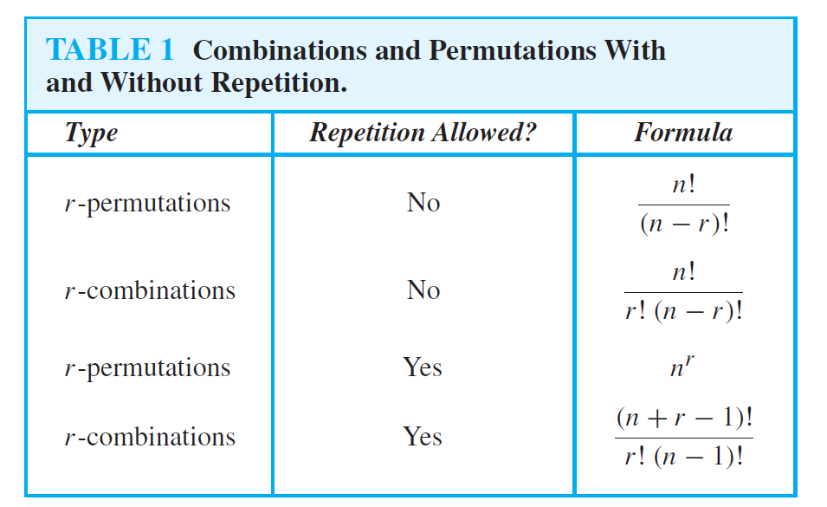

Slide 65
Combinations with Repetition (Example 5, section 6.5.3)
How many solutions does the equation
x1 + x2 + x3 = 11
have, where x1, x2, and x3 are nonnegative integers?
Solution: To count the number of solutions, we note that a solution corresponds to a way of selecting 11 items from a set with three elements so that x1 items of type one, x2 items of type two, and x3 items of type three are chosen.

Slide 66
Example, continued
Hence, the number of solutions is equal to the number
of 11-combinations with repetition allowed from a set with three elements. From Theorem 2 of Section 6.5.3 it follows that there are
C(3 + 11 − 1, 11) = C(13, 11) = C(13, 2) = (13 · 12)/(1 · 2) = 78
solutions.

Slide 67
Example, continued
What if we have constraints, such as x1 ≥ 1, x2 ≥ 2, and x3 ≥ 3?
A solution to the equation subject to these constraints corresponds to a selection of 11 items where there is at least one item of type one, two items of type two, and three items of type three. So, a solution corresponds to a choice of one item of type one, two of type two, and three of type three, together with a choice of five additional items of
any type. By Theorem 2 this can be done in C(3 + 5 − 1, 5) = C(7, 5) = C(7, 2) = (7 · 6)/(1 · 2) = 21 ways. Thus, there are 21 solutions of the equation subject to the given constraints.

