Slide 1

CSCE 222 Discrete Structures
Boolean Algebra
Dr. Tim McGuire
Grateful acknowledgement to Professor Bart Selman, Cornell University, and Prof. Johnnie Baker, Kent State, for some of the material upon which these notes are adapted.
Notes:
Roger Creager - Sweet Home College Station, https://www.youtube.com/watch?v=K5Y1GmvAed0
Start 5 minutes before classhttps://www.youtube.com/watch?v=K5Y1GmvAed0

Slide 2
Based on Chapter 12 of Rosen Discrete Mathematics and its Applications

Slide 3
Boolean Algebra
Boolean algebra provides the operations and the rules for working with the set {0, 1}.
These are the rules that underlie electronic circuits, and the methods we will discuss are fundamental to VLSI design.
We are going to focus on three operations:
Boolean complementation,
Boolean sum, and
Boolean product

Slide 4
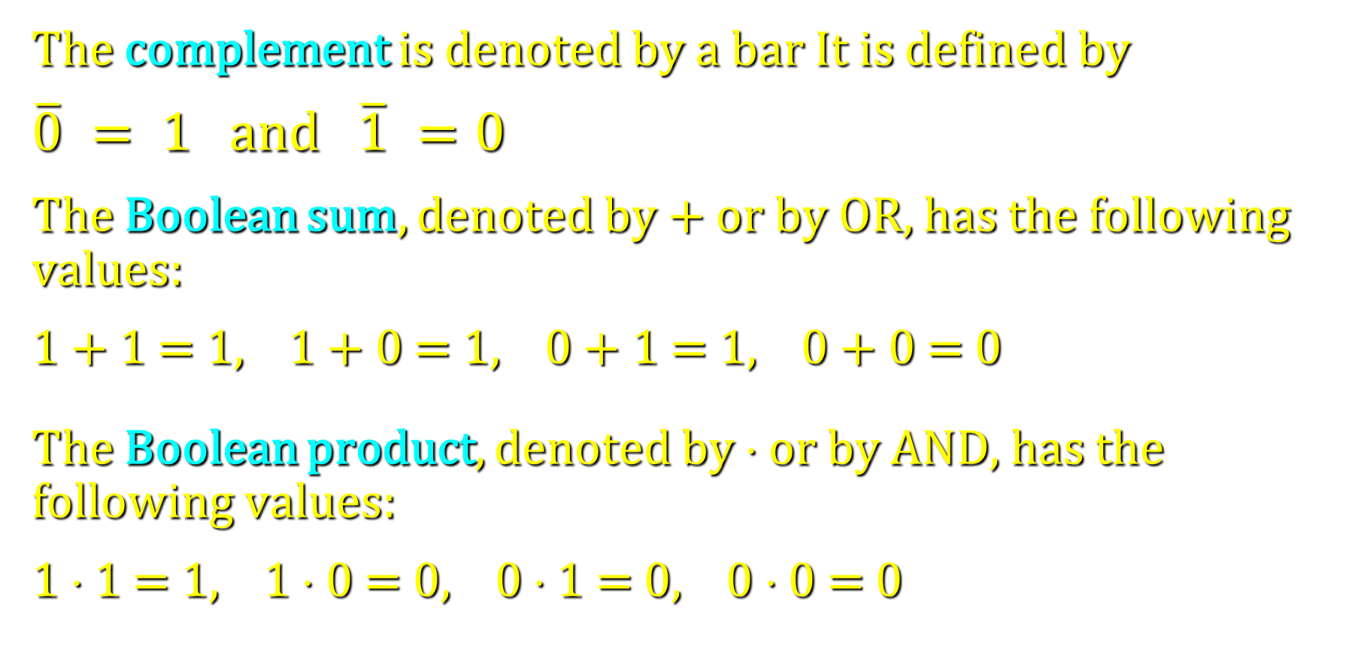
Boolean Operations
The complement is denoted by a bar It is defined by
$\overline{0} = 1$and $\overline{1} =0$
The Boolean sum, denoted by + or by OR, has the following values:
1 + 1 = 1, 1 + 0 = 1, 0 + 1 = 1, 0 + 0 = 0
The Boolean product, denoted by ⋅ or by AND, has the following values:
1 ⋅ 1 = 1, 1 ⋅ 0 = 0, 0 ⋅ 1 = 0, 0 ⋅ 0 = 0

Slide 5
Precedence of operators
Just as in algebra, operators have precedence
4+3*2 = 4+(3*2), not (4+3)*2
Precedence order (from highest to lowest):
NOT
AND
OR

Slide 6
Boolean Functions and Expressions
Definition: Let B = {0, 1}. The variable x is called a Boolean variable if it assumes values only from B.
A function from B^{n}, the set {(x₁, x₂, …, x_{n}) |x_{i}∈B, 1 ≤ i ≤ n}, to B is called a Boolean function of degree n.
Boolean functions can be represented using expressions made up from the variables and Boolean operations.

Slide 7
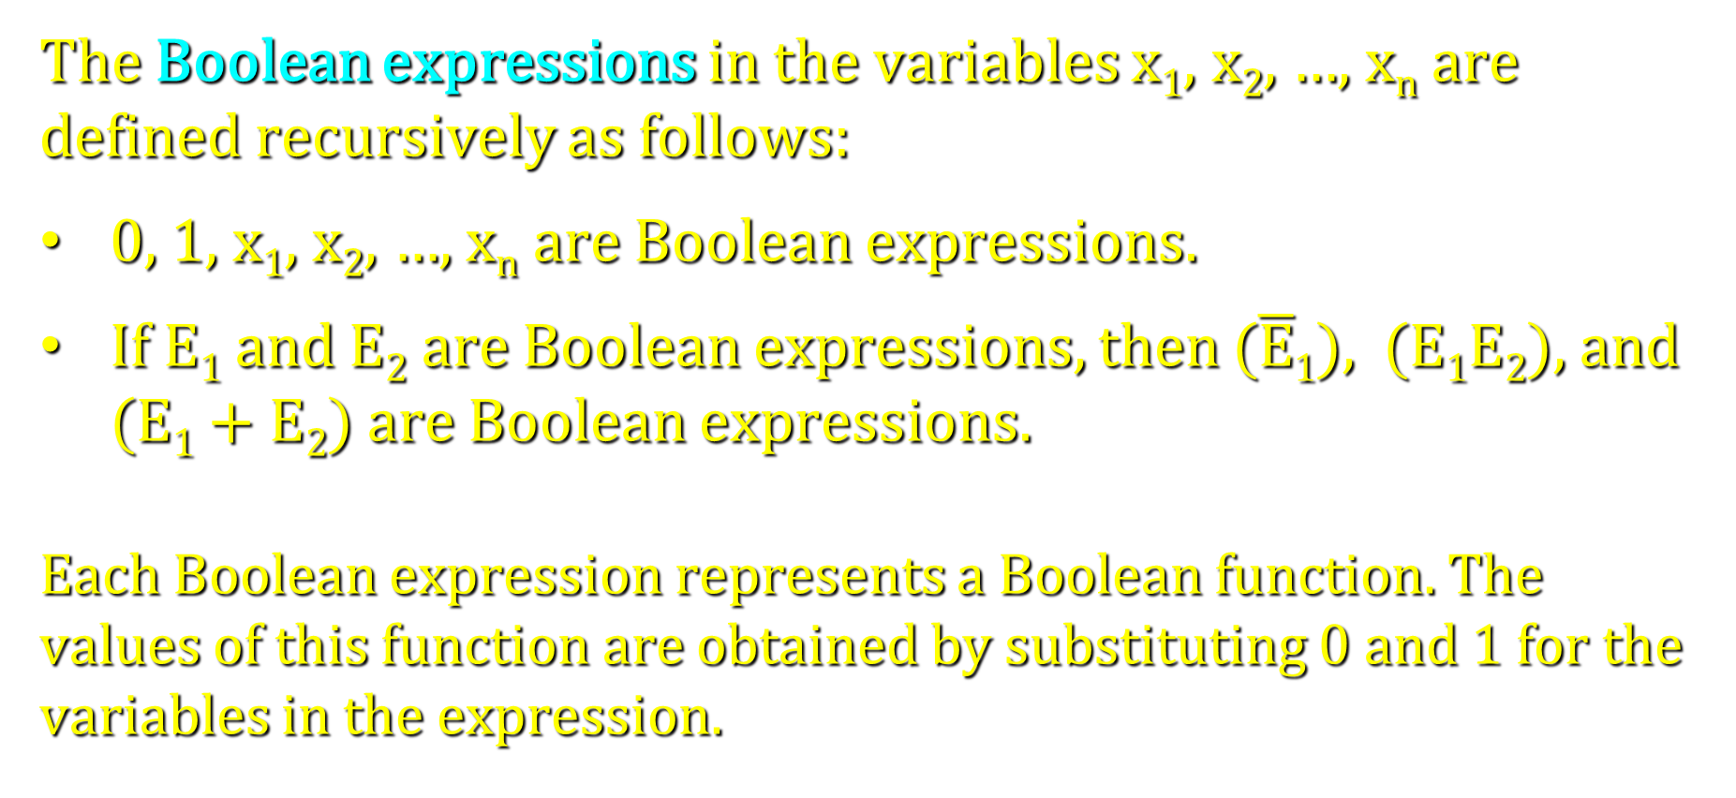
Boolean Functions and Expressions
The Boolean expressions in the variables x₁, x₂, …, x_{n} are defined recursively as follows:
0, 1, x₁, x₂, …, x_{n} are Boolean expressions.
If E₁ and E₂ are Boolean expressions, then ($\overline{E}$₁), (E₁E₂), and (E₁ + E₂) are Boolean expressions.
Each Boolean expression represents a Boolean function. The values of this function are obtained by substituting 0 and 1 for the variables in the expression.

Slide 8
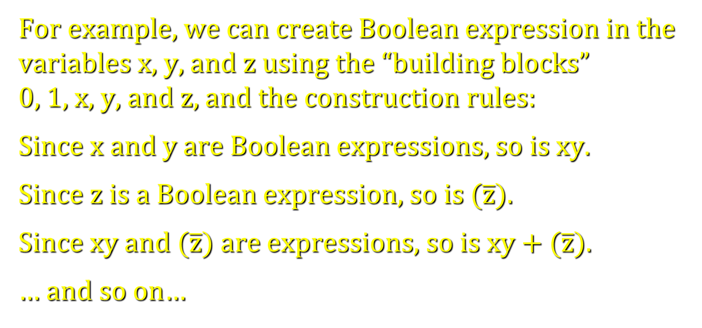
Boolean Functions and Expressions
For example, we can create Boolean expression in the variables x, y, and z using the “building blocks” 0, 1, x, y, and z, and the construction rules:
Since x and y are Boolean expressions, so is xy.
Since z is a Boolean expression, so is ($\overline{z}$).
Since xy and ($\overline{z}$) are expressions, so is xy + ($\overline{z}$).
… and so on…

Slide 9
Boolean Functions and Expressions
Example: Give a Boolean expression for the Boolean function F(x, y) as defined by the following table:
x | y | F(x, y)
0 | 0 | 0
0 | 1 | 1
1 | 0 | 0
1 | 1 | 0
Possible solution: F(x, y) = (($\overline{x}$))y

Slide 10
Boolean Functions and Expressions
Another Example:
Possible solution I:
F(x, y, z) = xz + y
x
y
z
F(x, y, z)
0
0
0
1
0
0
1
1
Possible solution II:
F(x, y, z) = (xz)(y)
0
1
0
0
0
1
1
0
1
0
0
1
1
0
1
0
1
1
0
0
1
1
1
0

Slide 11
Boolean Functions and Expressions
There is a simple method for deriving a Boolean expression for a function that is defined by a table. This method is based on minterms.
Definition: A literal is a Boolean variable or its complement. A minterm of the Boolean variables x₁, x₂, …, x_{n} is a Boolean product y₁y₂…y_{n}, where y_{i} = x_{i} or y_{i} = x_{i}.
Hence, a minterm is a product of n literals, with one literal for each variable.

Slide 12
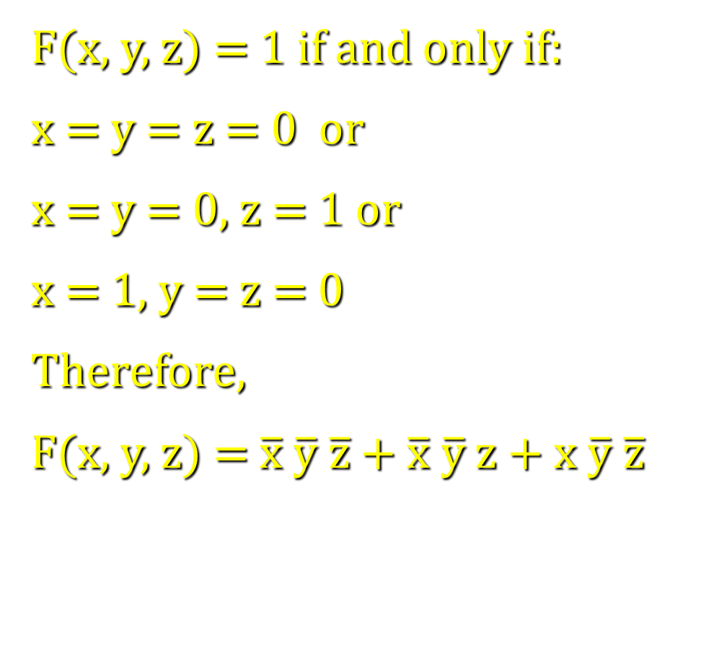
Boolean Functions and Expressions
Consider F(x,y,z) again:
F(x, y, z) = 1 if and only if:
x = y = z = 0 or
x = y = 0, z = 1 or
x = 1, y = z = 0
Therefore,
F(x, y, z) = $\overline{x} \overline{y} \overline{z}$ + $\overline{x} \overline{y}$z + x $\overline{y} \overline{z}$
x
y
z
F(x, y, z)
0
0
0
1
0
0
1
1
0
1
0
0
0
1
1
0
1
0
0
1
1
0
1
0
1
1
0
0
1
1
1
0

Slide 13
Boolean Functions and Expressions
Definition: The Boolean functions F and G of n variables are equal if and only if F(b₁, b₂, …, b_{n}) = G(b₁, b₂, …, b_{n}) whenever b₁, b₂, …, b_{n} belong to B.
Two different Boolean expressions that represent the same function are called equivalent.
For example, the Boolean expressions xy, xy + 0, and xy⋅1 are equivalent.

Slide 14
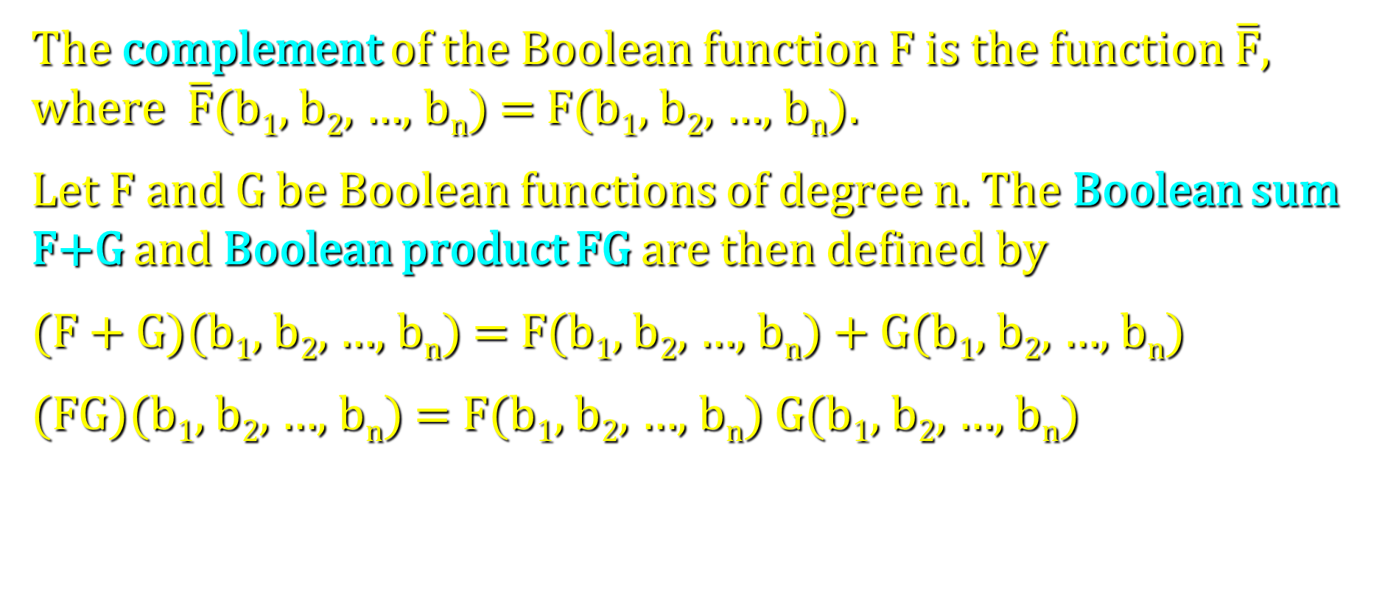
Boolean Functions and Expressions
The complement of the Boolean function F is the function $\overline{F}$, where $\overline{F}$(b₁, b₂, …, b_{n}) = F(b₁, b₂, …, b_{n}).
Let F and G be Boolean functions of degree n. The Boolean sum F+G and Boolean product FG are then defined by
(F + G)(b₁, b₂, …, b_{n}) = F(b₁, b₂, …, b_{n}) + G(b₁, b₂, …, b_{n})
(FG)(b₁, b₂, …, b_{n}) = F(b₁, b₂, …, b_{n}) G(b₁, b₂, …, b_{n})

Slide 15
Boolean Functions and Expressions
Question: How many different Boolean functions of degree 1 are there?
Solution: There are four of them, F₁, F₂, F₃, and F₄:
x | F₁ | F₂ | F₃ | F₄
0 | 0 | 0 | 1 | 1
1 | 0 | 1 | 0 | 1

Slide 16
Boolean Functions and Expressions
Question: How many different Boolean functions of degree 2 are there?
Solution: There are 16 of them, F₁, F₂, …, F₁₆:
x
y
F₁
F₂
F₃
F₄
F₅
F₆
F₇
F₈
F₉
F₁₀
F₁₁
F₁₂
F₁₃
F₁₄
F₁₅
F₁₆
0
0
0
0
0
0
0
0
0
0
1
1
1
1
1
1
1
1
0
1
0
0
0
0
1
1
1
1
0
0
0
0
1
1
1
1
1
0
0
0
1
1
0
0
1
1
0
0
1
1
0
0
1
1
1
1
0
1
0
1
0
1
0
1
0
1
0
1
0
1
0
1

Slide 17
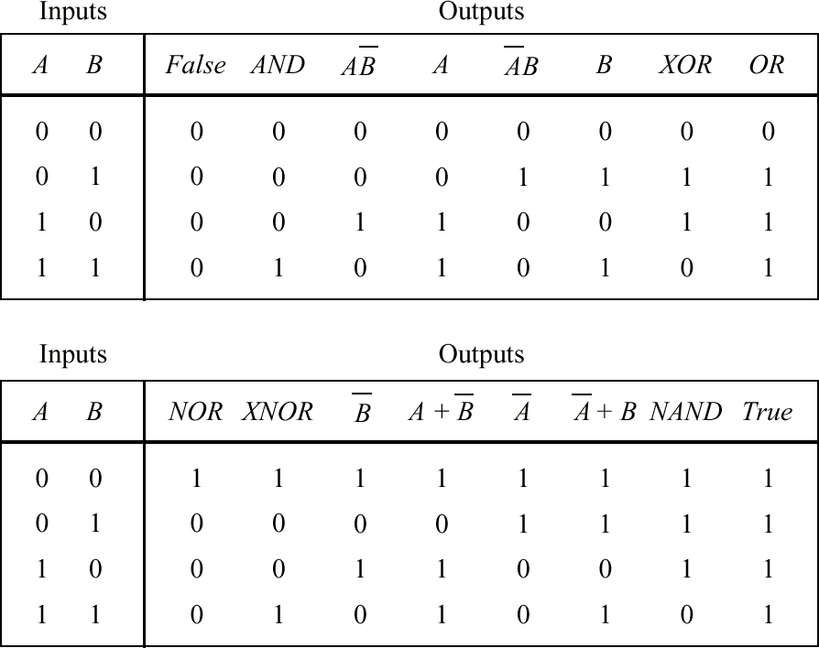
Truth Tables Showing All Possible Functions of Two Binary Variables
The more frequently used functions have names: AND, XOR, OR, NOR, XOR, and NAND. (Always use upper case spelling.)

Slide 18
Boolean Functions and Expressions
Question: How many different Boolean functions of degree n are there?
Solution:
There are 2^{n} different n-tuples of 0s and 1s.
A Boolean function is an assignment of 0 or 1 to each of these 2^{n} different n-tuples.
Therefore, there are 2^{2n} different Boolean functions.

Slide 19
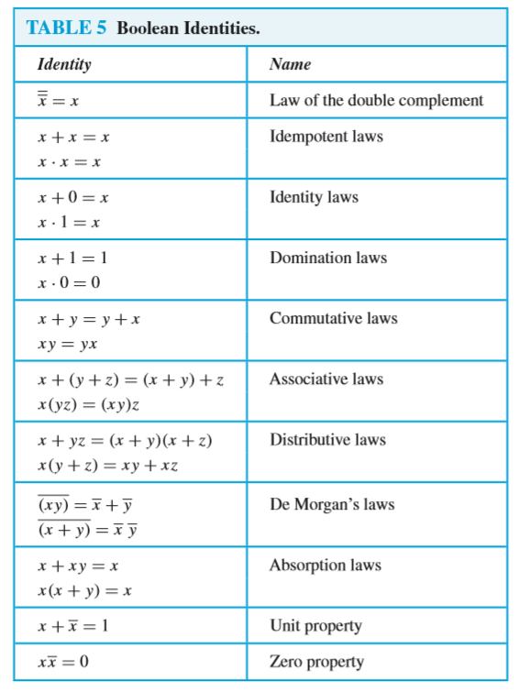
Boolean Identities
There are useful identities of Boolean expressions that can help us to transform an expression A into an equivalent expression B (see Table 5 in section 1 of the chapter, p. 851).

Slide 20
Duality
We can derive additional identities with the help of the dual of a Boolean expression.
The dual of a Boolean expression is obtained by interchanging Boolean sums and Boolean products and interchanging 0s and 1s.

Slide 21
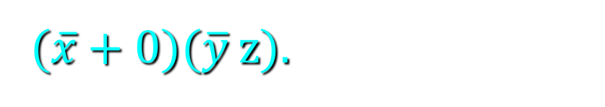

Duality
Examples:
The dual of x(y + z) is
x + y z.
The dual of $\overline{x}$1 + ($\overline{y}$ + z) is
($\overline{x}$ + 0)($\overline{y}$ z).
The dual of a Boolean function F represented by a Boolean expression is the function represented by the dual of this expression.
This dual function, denoted by F^{d}, does not depend on the particular Boolean expression used to represent F.

Slide 22
Duality
Therefore, an identity between functions represented by Boolean expressions remains valid when the duals of both sides of the identity are taken.
We can use this fact, called the duality principle, to derive new identities.
For example, consider the absorption law x(x + y) = x.
By taking the duals of both sides of this identity, we obtain the equation x + xy = x, which is also an identity (and also called an absorption law).

Slide 23
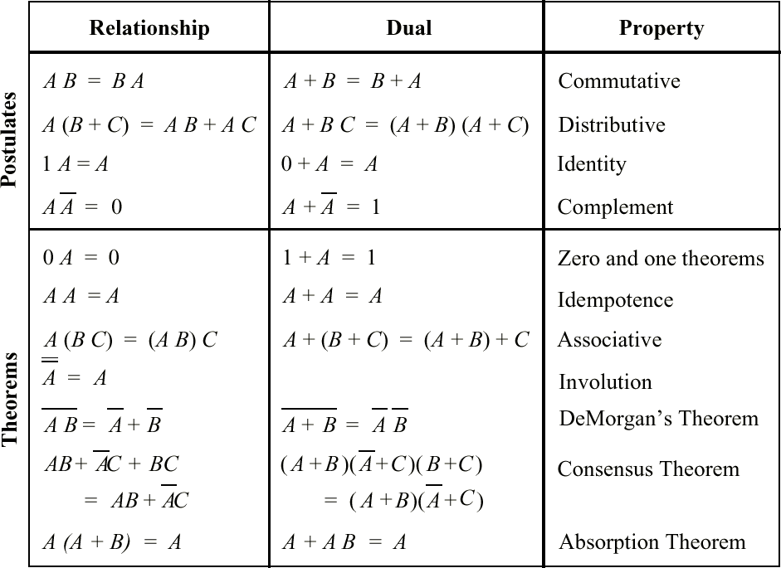
Duality
Principle of duality: The dual of a Boolean function is gotten by replacing AND with OR and OR with AND, constant 1s by 0s, and 0s by 1s

Slide 24
Definition of a Boolean Algebra
All the properties of Boolean functions and expressions that we have discovered also apply to other mathematical structures such as propositions and sets and the operations defined on them.
If we can show that a particular structure is a Boolean algebra, then we know that all results established about Boolean algebras apply to this structure.
For this purpose, we need an abstract definition of a Boolean algebra.

Slide 25
Definition of a Boolean Algebra
Definition: A Boolean algebra is a set B with two binary operations ∨ and ∧, elements 0 and 1, and a unary operation – such that the following properties hold for all x, y, and z in B:
x ∨ 0 = x and x ∧ 1 = x (identity laws)
x ∨ (-x) = 1 and x ∧ (-x) = 0 (domination laws)
(x ∨ y) ∨ z = x ∨ (y ∨ z) and (x ∧ y) ∧ z = x ∧ (y ∧ z) and (associative laws)
x ∨ y = y ∨ x and x ∧ y = y ∧ x (commutative laws)
x ∨ (y ∧ z) = (x ∨ y) ∧ (x ∨ z) and x ∧ (y ∨ z) = (x ∧ y) ∨ (x ∧ z) (distributive laws)

Slide 26
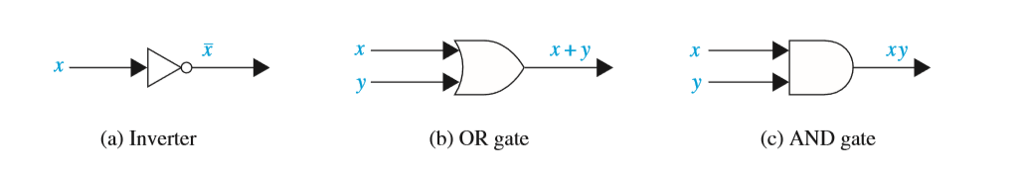
Logic Gates
Electronic circuits consist of so-called gates.
There are three basic types of gates:
Note the use of the “inversion bubble.”
(Be careful about the “nose” of the gate when drawing AND vs. OR.)

Slide 27
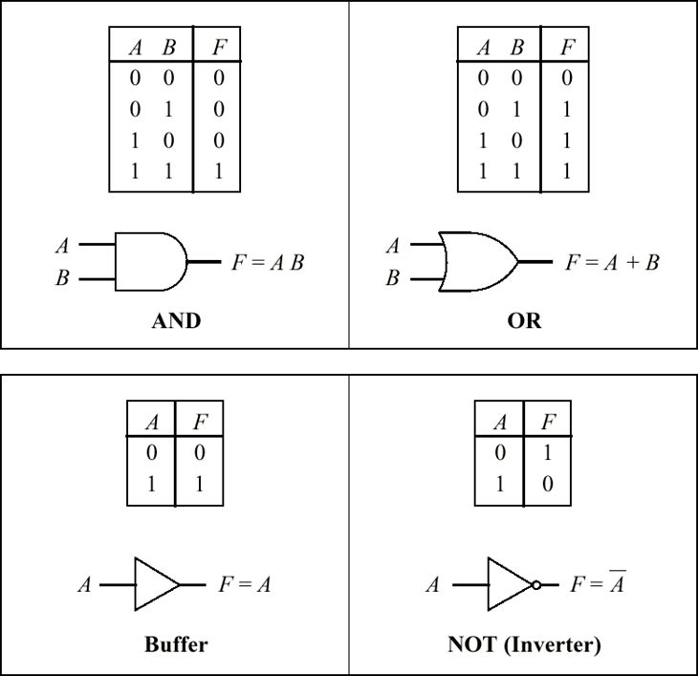
Logic Gates and Their Truth Tables

Slide 28
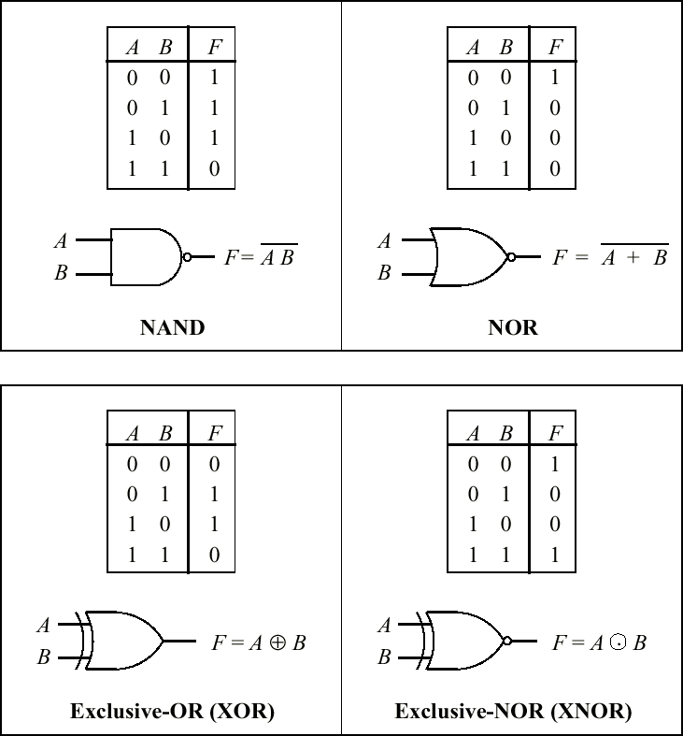
NAND, NOR, XOR, and XNOR

Slide 29
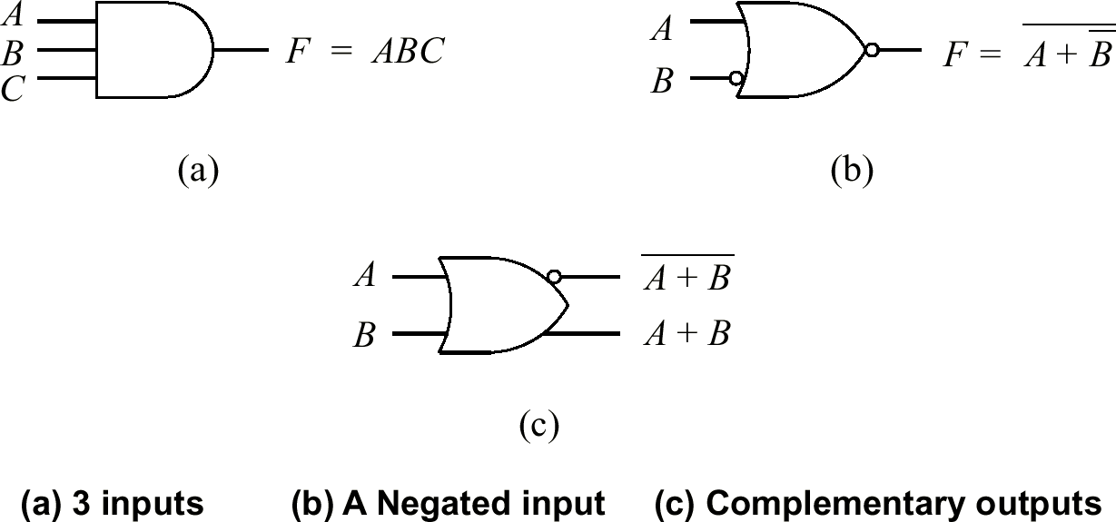
Variations of Basic Logic Gate Symbols

Slide 30
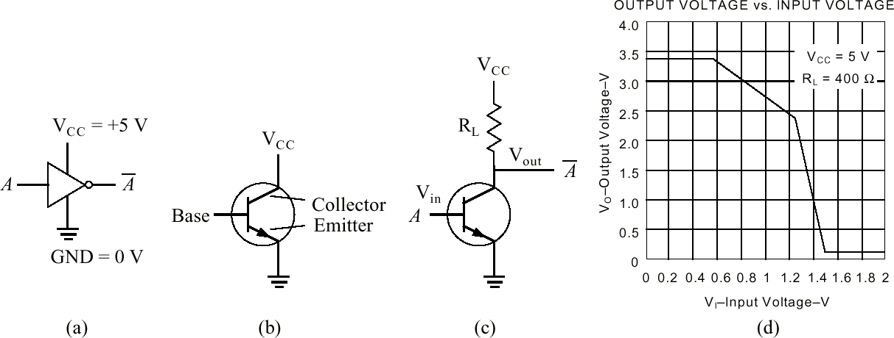
The Inverter at the Transistor Level
Power
Terminals
Transistor
Symbol
A Transistor Used
as an Inverter
Inverter Transfer
Function

Slide 31
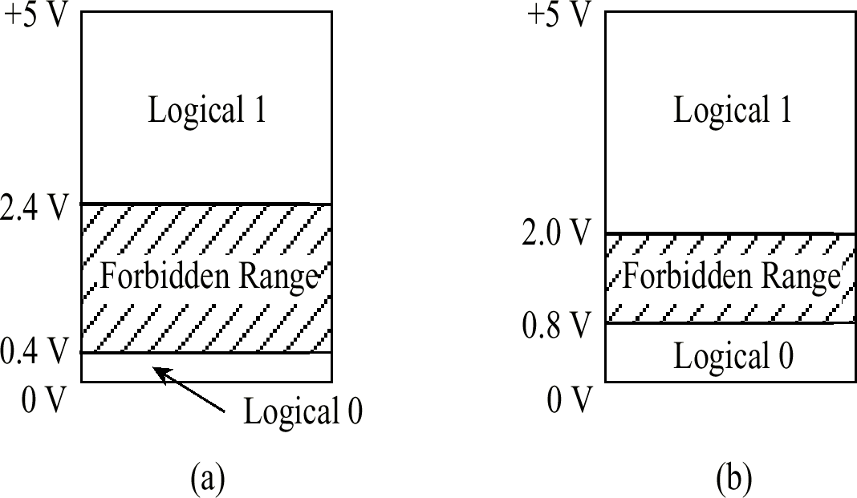
Allowable Voltages in Transistor-Transistor-Logic (TTL)
Output from a gate
Input to a gate

Slide 32
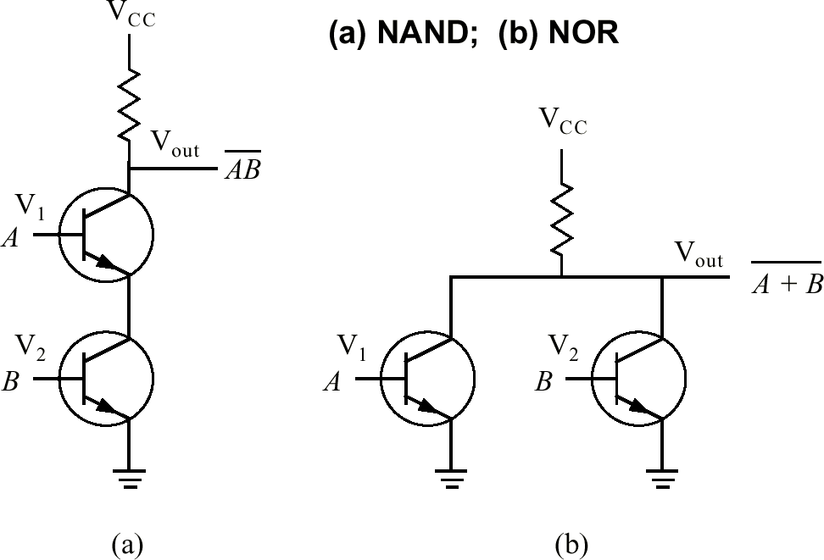
Transistor-Level Circuits For 2-Input a) NAND and b)NOR Gates

Slide 33
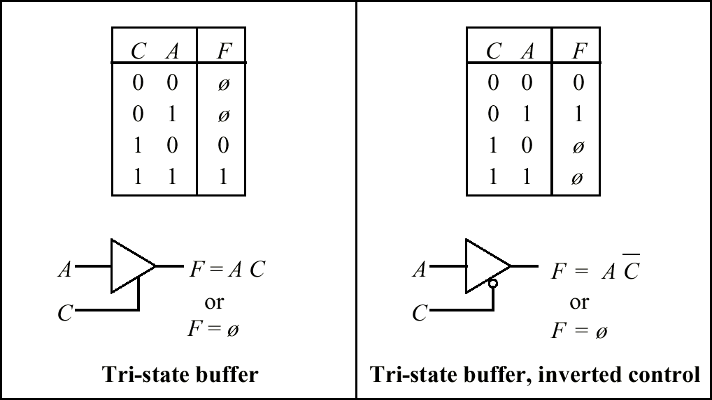
Tri-State Buffers
Outputs can be 0, 1, or “electrically disconnected.”

Slide 34
Bit Operations 1
Boolean values can be represented as 1 (true) and 0 (false)
A bit string is a series of Boolean values
10110100 is eight Boolean values in one string
We can then do operations on these Boolean strings
Each column is its own Boolean operation
01011010
 10110100
11101110
XOR (exclusive OR)

Slide 35
Bit Operations 2
Evaluate the following
11000 ∧ (01011 ∨ 11011)
= 11000 ∧ (11011)
= 11000
01011
11011
11011
11000
11011
11000

Slide 36
&& vs. & in C/C++
Consider the following:
In C/C++, any value other than 0 is true
The binary for the integer 11 is 01011
The binary for the integer 20 is 10100
int p = 11;
int q = 20;
if ( p && q ) {
}
if ( p & q ) {
}
Notice the double ampersand – this is a Boolean operation
As p and q are both true, this is true
Notice the single ampersand – this is a bitwise operation
01011
10100
00000
This evaluates to zero (false)!
Bitwise Boolean And operation:

Slide 37
&& vs. & in C/C++
Note that Java does not have this “feature”
If p and q are int:
p & q is bitwise
p && q will not compile
If p and q are boolean:
Both p & q and p && q will be a Boolean operation
The same holds true for the or operators (| and ||) in both Java and C/C++

Slide 38
The Sum-of-Products (SOP) Form
Transform the function into a two-level AND-OR equation
Implement the function with an arrangement of logic gates from the set {AND, OR, NOT}
M is true when A=0, B=1, and C=1, or when A=1, B=0, and C=1, and so on for the remaining cases.
Represent logic equations by using the sum-of-products (SOP) form
Truth Table for The Majority Function

Slide 39
The SOP Form of the Majority Function
The SOP form for the 3-input majority fucntion is:
M = ABC + ABC + ABC + ABC = m₃ + m₅ +m₆ +m₇ = Σ(3, 5, 6, 7)
Each of the 2^{n} terms are called minterms, running from 0 to 2^{n} - 1
Note the relationship between minterm number and boolean value.

Slide 40
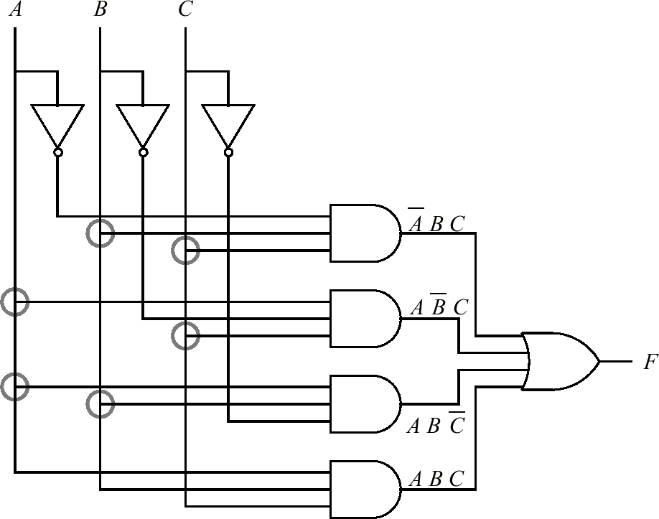
A 2-Level AND-OR Circuit that Implements the Majority Function
Discuss: What is the Gate Count?

Slide 41
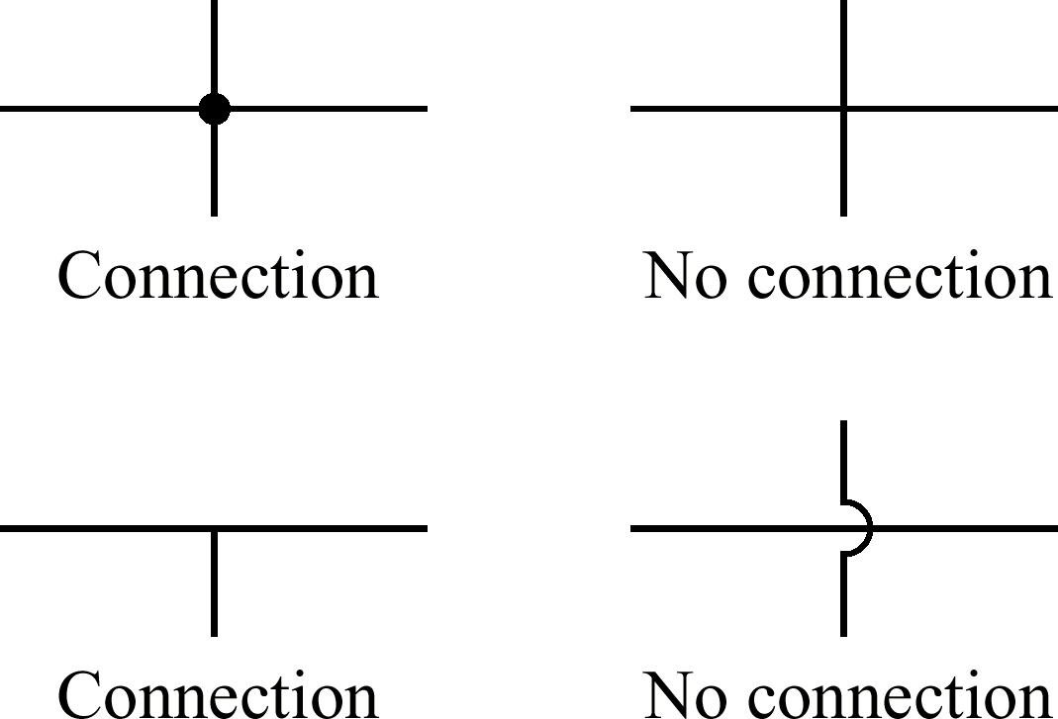
Notation Used at Circuit Intersections

Slide 42
Rosen, §12.3 question 1
Find the output of the following circuit
Answer: (x+y)y or (x∨y)∧¬y
x+y
(x+y)y
y
__

Slide 43
Rosen, §12.3 question 2
Find the output of the following circuit
Answer: xy
or ¬(¬x∧¬y) ≡ x∨y
x
x
y
x
y
y
___
_ _

Slide 44
Rosen, §12.3 question 6
Write the circuits for the following Boolean algebraic expressions
x + y
__
x
x+y

Slide 45
Rosen, §12.3 question 6
Write the circuits for the following Boolean algebraic expressions
(x+y)x
x+y
x+y
(x+y)x

Slide 46
Writing xor using and/or/not
x | y | x⊕y
1 | 1 | 0
1 | 0 | 1
0 | 1 | 1
0 | 0 | 0
p ⊕ q ≡ (p ∨ q) ∧ ¬(p ∧ q)
x ⊕ y ≡ (x + y)(xy)
____
x+y
(x+y)(xy)
xy
xy

Slide 47
Converting decimal numbers to binary
53 = 32 + 16 + 4 + 1
= 2⁵ + 2⁴ + 2² + 2⁰
= 1*2⁵ + 1*2⁴ + 0*2³ + 1*2² + 0*2¹ + 1*2⁰
= 110101 in binary
= 00110101 as a full byte in binary
211 = 128 + 64 + 16 + 2 + 1
= 2⁷ + 2⁶ + 2⁴ + 2¹ + 2⁰
= 1*2⁷ + 1*2⁶ + 0*2⁵ + 1*2⁴ + 0*2³ + 0*2² +
1*2¹ + 1*2⁰
= 11010011 in binary

Slide 48
Converting binary numbers to decimal
What is 10011010 in decimal?
10011010 = 1*2⁷ + 0*2⁶ + 0*2⁵ + 1*2⁴ + 1*2³ +
0*2² + 1*2¹ + 0*2⁰
= 2⁷ + 2⁴ + 2³ + 2¹
= 128 + 16 + 8 + 2
= 154
What is 00101001 in decimal?
00101001 = 0*2⁷ + 0*2⁶ + 1*2⁵ + 0*2⁴ + 1*2³ +
0*2² + 0*2¹ + 1*2⁰
= 2⁵ + 2³ + 2⁰
= 32 + 8 + 1
= 41

Slide 49
How to add binary numbers
Consider adding two 1-bit binary numbers x and y
0+0 = 0
0+1 = 1
1+0 = 1
1+1 = 10
Carry is x AND y
Sum is x XOR y
The circuit to compute this is called a half-adder
x | y | Carry | Sum
0 | 0 | 0 | 0
0 | 1 | 0 | 1
1 | 0 | 0 | 1
1 | 1 | 1 | 0

Slide 50
The half-adder
Sum = x XOR y
Carry = x AND y

Slide 51
Using half adders
We can then use a half-adder to compute the sum of two Boolean numbers
1
0
0
1 1 0 0
+ 1 1 1 0
?
0
1
0

Slide 52
How to fix this
We need to create an adder that can take a carry bit as an additional input
Inputs: x, y, carry in
Outputs: sum, carry out
This is called a full adder
Will add x and y with a half-adder
Will add the sum of that to the carry in
What about the carry out?
It’s 1 if either (or both):
x+y = 10
x+y = 01 and carry in = 1
x | y | c | carry | sum
1 | 1 | 1 | 1 | 1
1 | 1 | 0 | 1 | 0
1 | 0 | 1 | 1 | 0
1 | 0 | 0 | 0 | 1
0 | 1 | 1 | 1 | 0
0 | 1 | 0 | 0 | 1
0 | 0 | 1 | 0 | 1
0 | 0 | 0 | 0 | 0

Slide 53
The full adder
The “HA” boxes are half-adders

Slide 54
The full adder
The full circuitry of the full adder

Slide 55
Adding bigger binary numbers
Just chain full adders together

Slide 56
Adding bigger binary numbers
A half adder has 4 logic gates
A full adder has two half adders plus a OR gate
Total of 9 logic gates
To add n bit binary numbers, you need 1 HA and n-1 FAs
To add 32 bit binary numbers, you need 1 HA and 31 FAs
Total of 4+9*31 = 283 logic gates
To add 64 bit binary numbers, you need 1 HA and 63 FAs
Total of 4+9*63 = 571 logic gates

Slide 57
More about logic gates
To implement a logic gate in hardware, you use a transistor
Transistors are all enclosed in an “IC”, or integrated circuit
The current Intel Pentium IV processors have 55 million transistors!

Slide 58
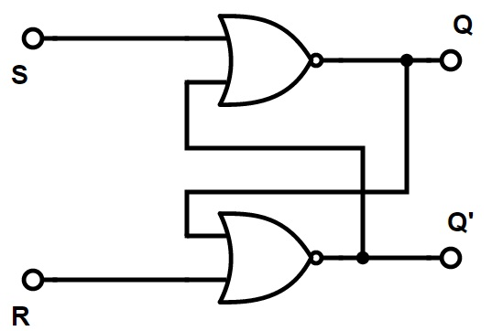
Flip-flops
Consider the following circuit:
What does it do?

Slide 59
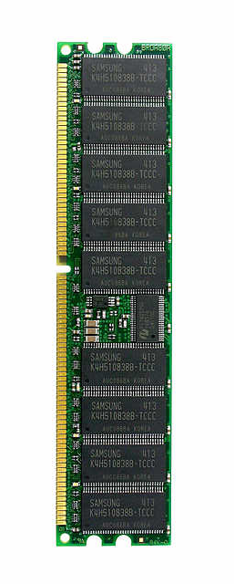
Memory
A flip-flop holds a single bit of memory
The bit “flip-flops” between the two NAND gates
In reality, flip-flops are a bit more complicated
Have 5 (or so) logic gates (transistors) per flip-flop
Consider a 1 Gb memory chip
1 Gb = 8,589,934,592 bits of memory
That’s about 43 million transistors!
In reality, those transistors are split into 9 ICs of about 5 million transistors each

Slide 60
Reduction (Simplification) of Boolean Expressions
It is often possible to simplify the canonical SOP (or POS) forms.
A smaller Boolean equation generally translates to a lower gate count in the target circuit.
We cover two methods: algebraic reduction, and Karnaugh map reduction

Slide 61
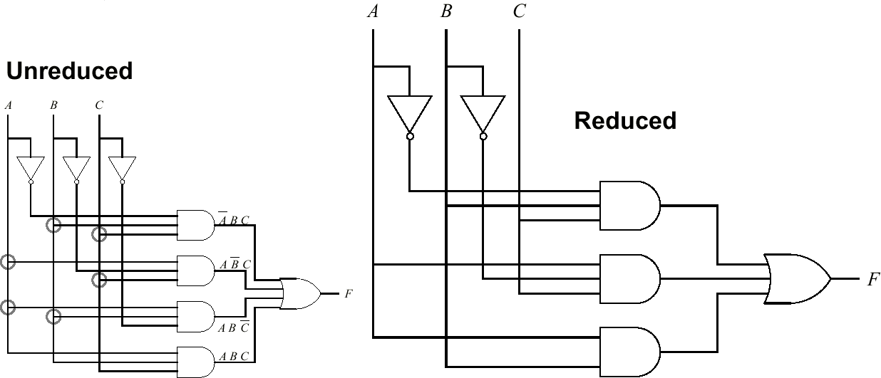
Reduced Majority Function Circuit
• Compared with the AND-OR circuit for the unreduced majority function, the inverter for C has been eliminated, one AND gate has been eliminated, and one AND gate has only two inputs instead of three inputs. Can the function by reduced further? How do we go about it?

Slide 62
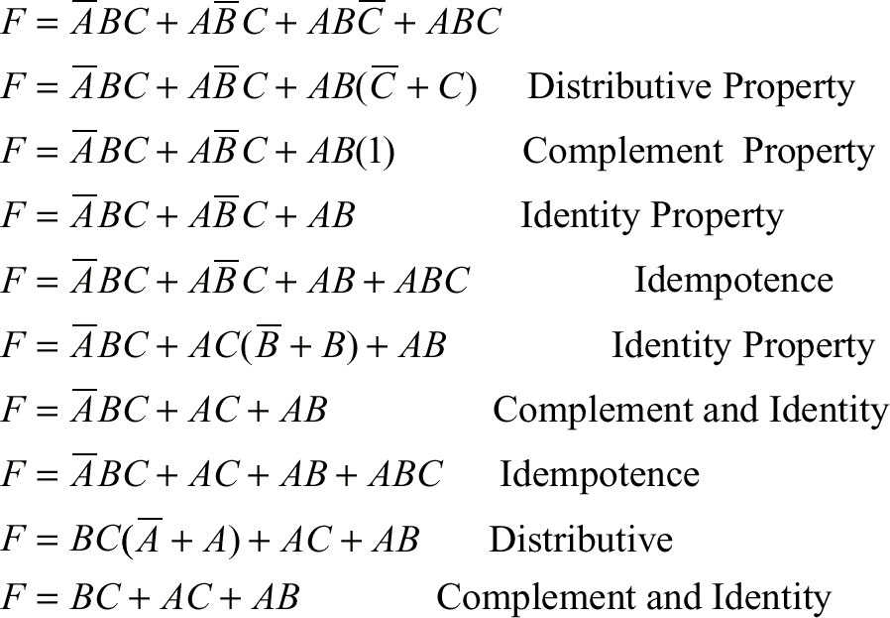
The Algebraic Method
• Consider the majority function, F. We apply the algebraic method to reduce F to its minimal two-level form:

Slide 63
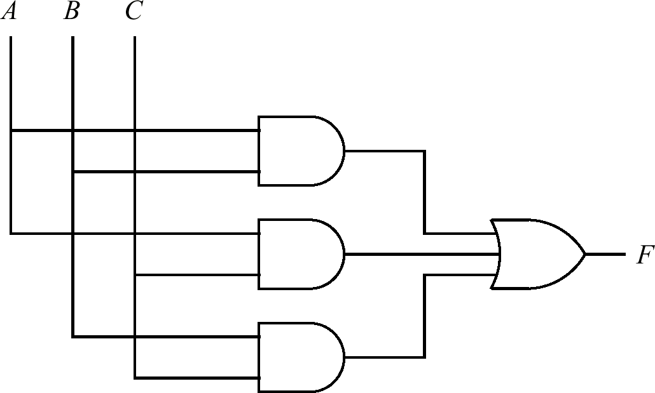
The Algebraic Method
• This majority circuit is functionally equivalent to the previous majority circuit, but this one is in its minimal two-level form:

Slide 64
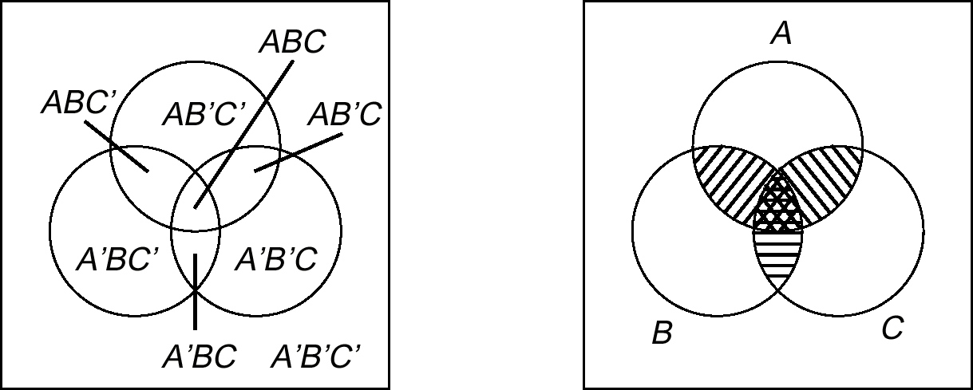
Karnaugh Maps: Venn Diagram Representation of Majority Function
• Each distinct region in the “Universe” represents a minterm.
• This diagram can be transformed into a Karnaugh Map.

Slide 65
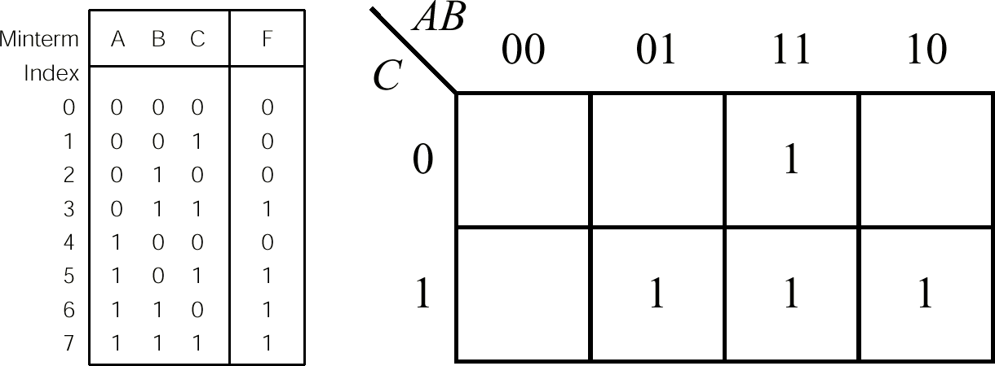
K-Map for Majority Function
• Place a “1” in each cell that corresponds to that minterm.
• Cells on the outer edge of the map “wrap around”

Slide 66
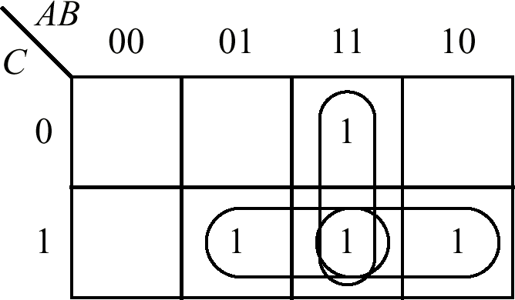
Adjacency Groupings for Majority Function
• F = BC + AC + AB

Slide 67
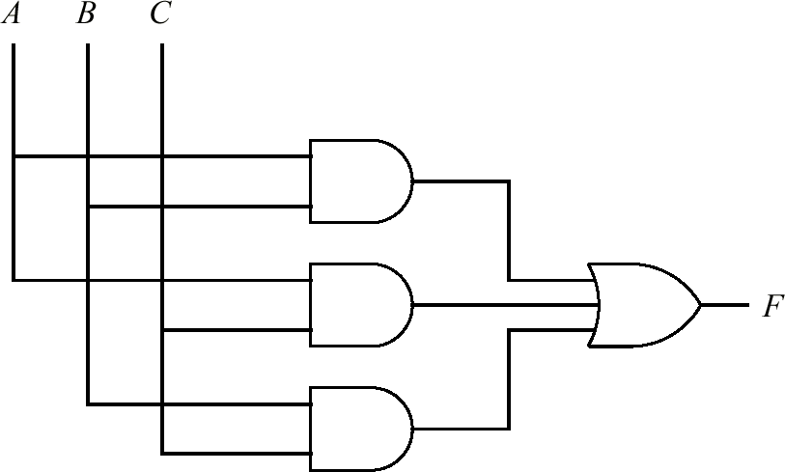
Minimized AND-OR Majority Circuit
• F = BC + AC + AB
• The K-map approach yields the same minimal two-level form as the algebraic approach.

Slide 68
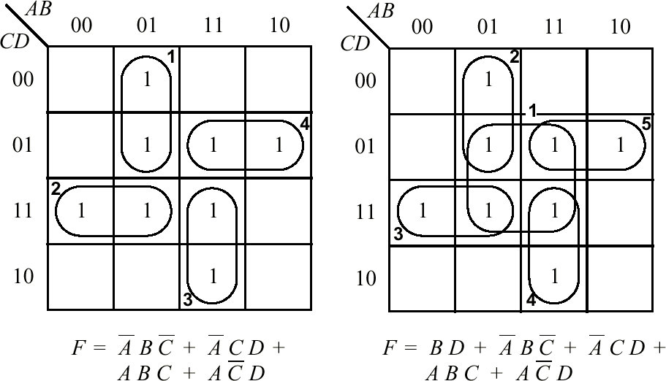
K-Map Groupings
• Minimal grouping is on the left, non-minimal (but logically equivalent) grouping is on the right.
• To obtain minimal grouping, create smallest groups first.

Slide 69
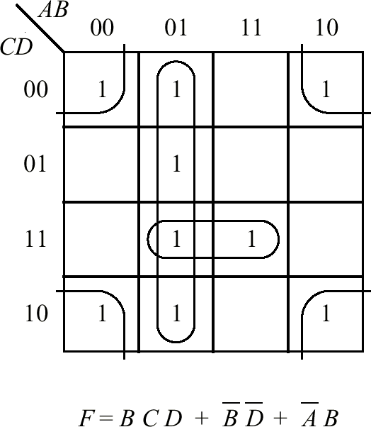
K-Map Corners are Logically Adjacent

Slide 70
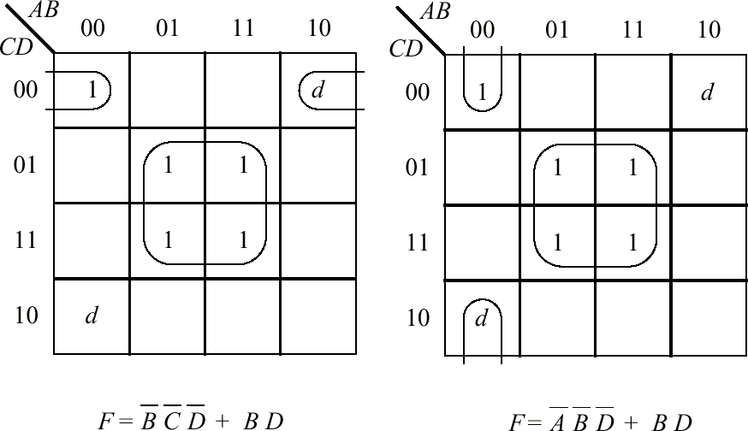
K-Maps and Don’t Cares
• There can be more than one minimal grouping, as a result of don’t cares.

Slide 71
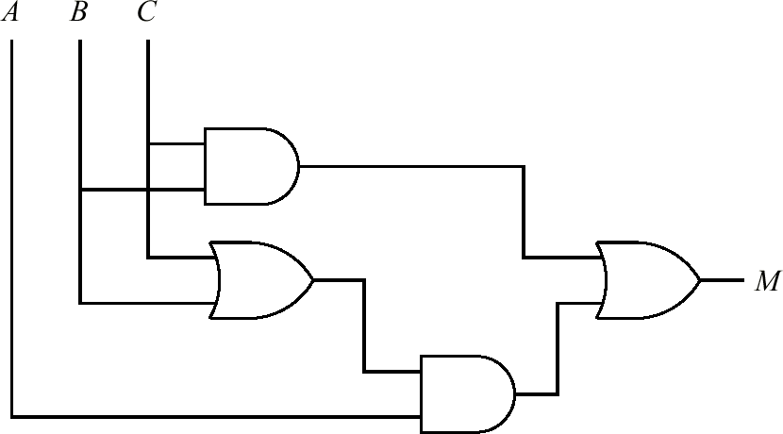
3-Level Majority Circuit
• K-Kap Reduction results in a reduced two-level circuit (that is, AND followed by OR. Inverters are not included in the two-level count). Algebraic reduction can result in multi-level circuits with even fewer logic gates and fewer inputs to the logic gates.

Slide 72
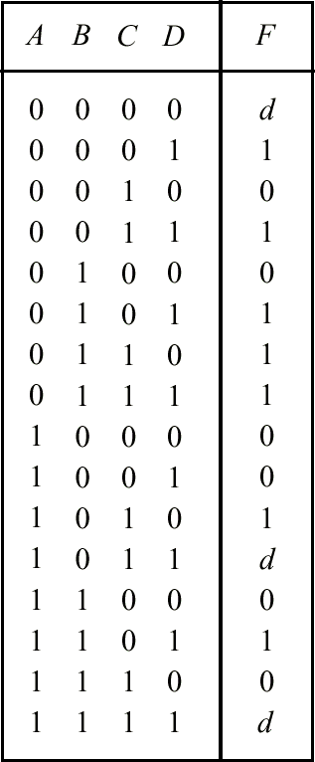
Truth Table with Don’t Cares
• A truth table representation of a single function with don’t cares.

