Slide 1

CSCE 222 Discrete Structures
Turing Machines, Computability, and NP-Completeness
Dr. Tim McGuire
Grateful acknowledgement to Dr. Richard Anderson, University of Washington, for some of the material upon which these notes are adapted.

Slide 2
Based on Chapter 13 of Rosen Discrete Mathematics and its Applications

Slide 3
Modeling Computation
We learned earlier the concept of an algorithm.
A description of a computational procedure.
Now, how can we model the computer itself, and what it is doing when it carries out an algorithm?
For this, we want to model the abstract process of computation itself.

Slide 4

Remember Cardinality??
Cardinality
A set S is countable iff we can write it as S={s₁, s₂, s₃, ...} indexed by ℕ
Set of rationals is countable
“dovetailing”
Σ* is countable
{0,1}* = {λ,0,1,00,01,10,11,000,001,010,011,100,101,...}
Set of all (C++, Java, etc.) programs is countable
1/1 | 1/2 | 1/3 | 1/4 | 1/5 | 1/6 | 1/7 | 1/8 | ...
2/1 | 2/2 | 2/3 | 2/4 | 2/5 | 2/6 | 2/7 | 2/8 | ...
3/1 | 3/2 | 3/3 | 3/4 | 3/5 | 3/6 | 3/7 | 3/8 | ...
4/1 | 4/2 | 4/3 | 4/4 | 4/5 | 4/6 | 4/7 | 4/8 | ...
5/1 | 5/2 | 5/3 | 5/4 | 5/5 | 5/6 | 5/7 | ...
6/1 | 6/2 | 6/3 | 6/4 | 6/5 | 6/6 | ...
7/1 | 7/2 | 7/3 | 7/4 | 7/5 | ....
... | ... | ... | ... | ...

Slide 5
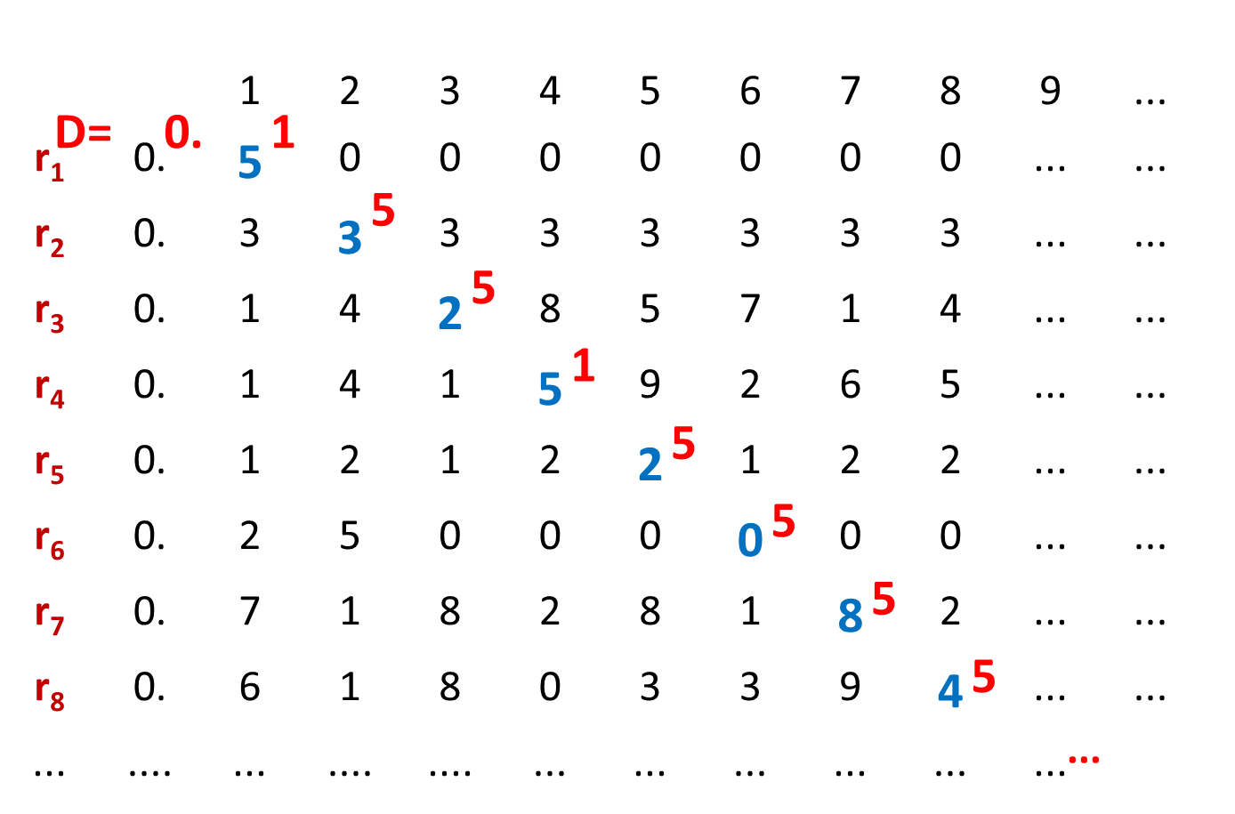
However, …
The set of real numbers is not countable
“diagonalization”

Slide 6
Therefore,
There exist functions that cannot be computed by any program
The set of all functions f : ℕ→{0,1,...,9} is not countable
The set of all (Java/C/C++) programs is countable
So there are simply more functions than programs

Slide 7
Do we care?
Are any of these functions ones that we would actually want to compute?
The argument does not even give any example of something that can’t be done, it just says that such an example exists
We haven’t used much of anything about what computers (programs or people) can do
Once we figure that out, we’ll be able to show that some of these functions are really important

Slide 8
Turing Machines
Church-Turing Thesis
Any reasonable model of computation that includes all possible algorithms is equivalent in power to a Turing machine
Evidence
Intuitive justification
Huge numbers of equivalent models to TM’s based on radically different ideas

Slide 9
Components of Turing’s Intuitive Model of Computers
Finite Control
Brain/CPU that has only a finite # of possible “states of mind”
Recording medium
An unlimited supply of blank “scratch paper” on which to write & read symbols, each chosen from a finite set of possibilities
Input also supplied on the scratch paper
Focus of attention
Finite control can only focus on a small portion of the recording medium at once
Focus of attention can only shift a small amount at a time

Slide 10

What is a Turing Machine?
Steam-powered Turing Machine Artist: Sieg Hall, 1987

Slide 11
What is a Turing Machine?
Recording Medium
An infinite read/write “tape” marked off into cells
Each cell can store one symbol or be “blank”
Tape is initially all blank except a few cells of the tape containing the input string
Read/write head can scan one cell of the tape - starts on input
In each step, a Turing Machine
Reads the currently scanned symbol
Based on state of mind and scanned symbol
Overwrites symbol in scanned cell
Moves read/write head left or right one cell
Changes to a new state
Each Turing Machine is specified by its finite set of rules

Slide 12
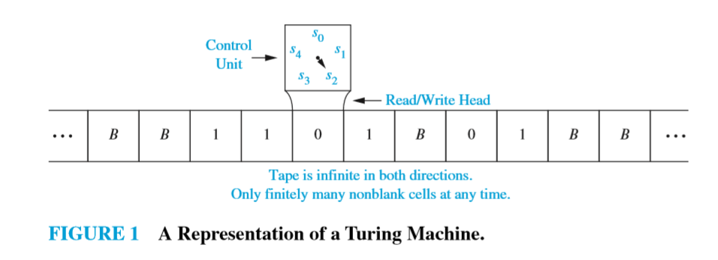
Sample Turing Machine

Slide 13
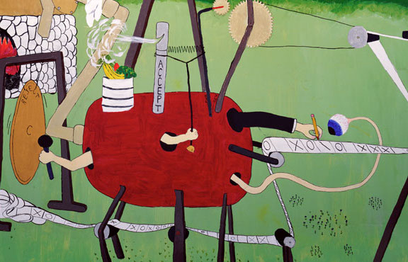
What is a Turing Machine?

Slide 14
Turing Machine ≡ Ideal Java/C Program
Ideal C/C++/Java programs
Just like the C/C++/Java you’re used to programming with, except you never run out of memory
constructor methods always succeed
malloc never fails
Equivalent to Turing machines except a lot easier to program !
Turing machine definition is useful for breaking computation down into simplest steps
We only care about high level so we use programs

Slide 15
Turing’s idea: Machines as data
Original Turing machine definition
A different “machine” M for each task
Each machine M is defined by a finite set of possible operations on finite set of symbols
M has a finite description as a sequence of symbols, its “code”
You already are used to this idea:
We’ll write <P> for the code of program P
i.e. <P> is the program text as a sequence of ASCII symbols and P is what actually executes

Slide 16
Turing’s Idea: A Universal Turing Machine
A Turing machine interpreter U
On input <P> and its input x, U outputs the same thing as P does on input x
At each step it decodes which operation P would have performed and simulates it.
One Turing machine is enough
Basis for modern stored-program computer
Von Neumann studied Turing’s UTM design
input
output
x
output
x
P
U
P(x)
P(x)
<P>

Slide 17
Halting Problem
See also Module 7, Algorithms for another look at the Halting problem.
Given: the code of a program P and an input x for P, i.e. given (<P>,x)
Output: 1 if P halts on input x 0 if P does not halt on input x
Theorem (Turing): There is no program that solves the halting problem “The halting problem is undecidable”

Slide 18
Proof by contradiction
Suppose that H is a Turing machine that solves the Halting problem
Function D(x):
if H(x,x)=1 then
while (true); /* loop forever */
else
no-op; /* do nothing and halt */
endif
What does D do on input <D>?
Does it halt?

Slide 19
Function D(x):
if H(x,x)=1 then
while (true); /* loop forever */
else
no-op; /* do nothing and halt */
endif
Does D halt on input <D>?
D halts on input <D>
⇔ H outputs 1 on input (<D>,<D>)
[since H solves the halting problem and so H(<D>,x) outputs 1 iff D halts on input x]
⇔ D runs forever on input <D>
[since D goes into an infinite loop on x iff H(x,x)=1]

Slide 20
That’s it!
This tells us that there is no compiler that can check our programs and guarantee to find any infinite loops they might have

Slide 21
SCOOPING THE LOOP SNOOPER A proof that the Halting Problem is undecidable by Geoffrey K. Pullum (U. Edinburgh)
No general procedure for bug checks succeeds. Now, I won’t just assert that, I’ll show where it leads: I will prove that although you might work till you drop, you cannot tell if computation will stop.
For imagine we have a procedure called P that for specified input permits you to see whether specified source code, with all of its faults, defines a routine that eventually halts.
You feed in your program, with suitable data, and P gets to work, and a little while later (in finite compute time) correctly infers whether infinite looping behavior occurs...

Slide 22
SCOOPING THE LOOP SNOOPER
...
Here’s the trick that I’ll use -- and it’s simple to do. I’ll define a procedure, which I will call Q, that will use P’s predictions of halting success to stir up a terrible logical mess.
...
And this program called Q wouldn’t stay on the shelf; I would ask it to forecast its run on itself. When it reads its own source code, just what will it do? What’s the looping behavior of Q run on Q?
If P warns of infinite loops, Q will quit; yet P is supposed to speak truly of it! And if Q’s going to quit, then P should say ‘Good.’ Which makes Q start to loop! (P denied that it would.)

Slide 23
SCOOPING THE LOOP SNOOPER
I’ve created a paradox, neat as can be — and simply by using your putative P. When you posited P you stepped into a snare; Your assumption has led you right into my lair...
So where can this argument possibly go? I don’t have to tell you; I’m sure you must know. A reductio: There cannot possibly be a procedure that acts like the mythical P.
...
Full poem at:
www.lel.ed.ac.uk/~gpullum/loopsnoop.html

Slide 24
The P vs. NP Question
Finally,

Slide 25
The $1M question
The Clay Mathematics Institute
Millennium Prize Problems
Is P = NP? The most important open problem in computer science

Slide 26
The P versus NP problem (informally)
Is proving a theorem much more difficult than checking the proof of a theorem?

Slide 27
Let’s start at the beginning…

Slide 28
Hamilton Cycle
Given a graph G = (V,E), a cycle that visits all the nodes exactly once

Slide 29
The Problem “HAM”
Input: Graph G = (V,E)
Output:
YES if G has a Hamilton cycle
NO if G has no Hamilton cycle

Slide 30
Satisfiability problem SAT
Input: conjunctive normal form with n variables, x₁, x₂, …, x_{n}.
Problem: find an assignment of x₁, x₂, …, x_{n} (setting each x_{i} to be 0 or 1) such that the formula is true (satisfied).
Example: conjunctive normal form is
(x1 OR NOT x2) AND (NOT x1 OR x3).
The formula is true for assignment
x1=1, x2=0, x3=1.
Note: for n Boolean variables, there are 2^{n} assignments.
Testing if formula=1 can be done in polynomial time for any given assignment.
Given an assignment that satisfies formula=1 is hard.

Slide 31
Decision Versus Search Problems
Decision Problem
Search Problem
YES/NO
Find a Hamilton cycle in G if one exists, else return NO
Does G have a Hamilton cycle?

Slide 32
Decision/Search Problems
We’ll look at decision problems because they have almost the same (asymptotically) complexity as their search counterparts

Slide 33
Polynomial Time and The Class “P” of Decision Problems

Slide 34
What is an efficient algorithm?
Is an O(n) algorithm efficient?
polynomial time
O(n^{c}) for some
constant c
How about O(n log n)?
O(n²) ?
O(n¹⁰) ?
O(n^{log n}) ?
non-polynomial
time
O(2^{n}) ?
O(n!) ?

Slide 35
We consider non-polynomial time algorithms to be inefficient.
And hence a necessary condition for an algorithm to be efficient is that it should run in polynomial-time.

Slide 36
Asking for a polynomial-time algorithm for a problem sets a (very) low bar when asking for efficient algorithms.
The question is: can we achieve even this?

Slide 37
Class P and Class NP
Class P contains those problems that are solvable in polynomial time.
They are problems that can be solved in O(n^{k}) time, where n is the input size and k is a constant.
Class NP consists of those problem that are verifiable in polynomial time.
What we mean here is that if we were somehow given a solution, then we can verify that the solution is correct in time polynomial in the input size to the problem.
Example: Hamilton Circuit: given an order of the n distinct vertices (v₁, v₂, …, v_{n}), we can test if (v_{i}, v _{i+1}) is an edge in G for i=1, 2, …, n-1 and (v_{n}, v₁) is an edge in G in time O(n) (polynomial in the input size).

Slide 38
Class P and Class NP
Based on definitions, P⊆NP.
If we can design a polynomial time algorithm for problem A, then problem A is in P.
However, if we have not been able to design a polynomial time algorithm for problem A, then there are two possibilities:
polynomial time algorithm does not exist for problem A or
we are not smart.
Open problem: P≠NP?
Clay $1 million prize.

Slide 39
Why Care?

Slide 40
NP Contains Lots of Problems We Don’t Know to be in P
Classroom Scheduling
Packing objects into bins
Scheduling jobs on machines
Finding cheap tours visiting a subset of cities
Allocating variables to registers
Finding good packet routings in networks
Decryption
…

Slide 41
OK, OK, I care.
But Where Do I Begin?

Slide 42
We know P ⊆ NP. How could we prove that NP ⊆ P?
I would have to show that every set in NP has a polynomial time algorithm…
How do I do that?
It may take forever!
Also, what if I forgot one of the sets in NP?

Slide 43
We can describe one problem L in NP, such that if this problem L is in P, then NP ⊆ P.
It is a problem that can capture all other problems in NP.

Slide 44
Polynomial-Time Reductions
Suppose we have a black box (an algorithm) that could solve instances of a problem X; If we give the input of an instance of X, then in a single step, the black box will return the correct answer.
Question:
Can arbitrary instances of problem Y be solved using polynomial number of standard computational steps, plus a polynomial number of calls to a black box that solves problem X?
If yes, then Y is polynomial-time reducible to X.

Slide 45
The “Hardest” Set in NP

Slide 46
NP-Complete
A problem X is NP-complete if it is in NP and any problem Y in NP has a polynomial time reduction to X.
it is the hardest problem in NP
If an NP-complete problem can be solved in polynomial time, then any problem in class NP can be solved in polynomial time.
The first NPC problem is Satisfiability probelm
Proved by Cook in 1971 and obtains the Turing Award for this work

Slide 47
Satisfiability problem
Input: conjunctive normal form with n variables, x₁, x₂, …, x_{n}.
Problem: find an assignment of x₁, x₂, …, x_{n} (setting each x_{i} to be 0 or 1) such that the formula is true (satisfied).
Example: conjunctive normal form is
(x1 OR NOT x2) AND (NOT x1 OR x3).
The formula is true for assignment
x1=1, x2=0, x3=1.
Note: for n Boolean variables, there are 2^{n} assignments.
Testing if formula=1 can be done in polynomial time for any given assignment.
Given an assignment that satisfies formula=1 is hard.

Slide 48
The First NP-complete Problem
Theorem: Satisfiability problem is NP-complete.
It is the first NP-complete problem.
S. A. Cook in 1971 http://en.wikipedia.org/wiki/Stephen_Cook
Won Turing prize for his work.
Significance:
If Satisfiability problem can be solved in polynomial time, then ALL problems in class NP can be solved in polynomial time.
If you want to solve P≠NP, then you should work on NP-Complete problems such as satisfiability problem.
We can use the first NPC problem, Satisfiability problem, to show that other problems are also NP-complete.

Slide 49
How to show that a problem is NP-Complete?
To show that problem A is NP-complete, we can
First find a problem B that has been proved to be NP-complete.
Show that if Problem A can be solved in polynomial time, then problem B can also be solved in polynomial time.
That is, to give a polynomial time reduction from B to A.
Remark: Since a NP-Complete problem, problem B, is the hardest in class NP, problem A is also the hardest

Slide 50
Hamilton circuit and Longest Simple Path
Hamilton circuit : a circuit uses every vertex of the graph exactly once except for the last vertex, which duplicates the first vertex.
It was shown to be NP-complete.
Longest Simple Path:
Input: V={v₁, v₂, ..., v_{n}} be a set of nodes in a graph and d(v_{i}, v_{j}) the distance between v_{i} and v_{j,}, find a longest simple path from u to v .
Theorem: The longest simple path problem is NP-complete.

Slide 51
Theorem: The longest simple path (LSP) problem is NP-complete.
Proof:
Hamilton Circuit Problem (HC): Given a graph G=(V, E), find a Hamilton Circuit.
We want to show that if we can solve the longest simple path problem in polynomial time, then we can also solve the Hamilton circuit problem in polynomial time.
Design a polynomial time algorithm to solve HC by using an algorithm for LSP.
Step 0: Set the length of each edge in G to be 1
Step 1: for each edge (u, v)∈E do
find the longest simple path P from u to v in G.
Step 2: if the length of P is n-1 then by adding edge (u, v) we obtain an Hamilton circuit in G.
Step 3: if no Hamilton circuit is found for every (u, v) then print “no Hamilton circuit exists”
Conclusion:
if LSP can be solved in polynomial time, then HC can also be solved in polynomial.
Since HC was proved to be NP-complete, LSP is also NP-complete.

Slide 52
Some basic NP-complete problems
3-Satisfiability : Each clause contains at most three variavles or their negations.
Vertex Cover: Given a graph G=(V, E), find a subset V’ of V such that for each edge (u, v) in E, at least one of u and v is in V’ and the size of V’ is minimized.
Hamilton Circuit: (definition was given before)
History: Satisfiability→3-Satisfiability→vertex cover→Hamilton circuit.
Those proofs are very hard.

Slide 53

That’s all folks!

