Slide 1
Introduction to CSCE 110
Dr. Tim McGuire Grateful acknowledgement to Dr. Tony Gaddis, Haywood Community College for some of the material contained in these slides

Slide 2
Topics
Introduction
Hardware and Software
How Computers Store Data
How a Program Works
Using Python

Slide 3
Introduction
Computers can be programmed
Designed to do any job that a program tells them to
Program: set of instructions that a computer follows to perform a task
Commonly referred to as Software
Programmer: person who can design, create, and test computer programs
Also known as software developer
Notes:
Computers can do such a wide variety of things because they can be programmed. This means that computers are not designed to do just one job, but to do any job that their programs tell them to do. A program is a set of instructions that a computer follows to perform a task.
Programs are commonly referred to as software. Software is essential to a computer because it controls everything the computer does. All of the software that we use to make our computers useful is created by individuals working as programmers or software developers. A programmer, or software developer, is a person with the training and skills necessary to design, create, and test computer programs

Slide 4
Hardware and Software
Hardware: The physical devices that make up a computer
Computer is a system composed of several components that all work together
Typical major components:
Central processing unit
Main memory
Secondary storage devices
Input and output devices
Notes:
The term hardware refers to all of the physical devices, or components, that a computer is made of. A computer is not one single device, but a system of devices that all work together.
A typical computer system consists of the following major components:
• The central processing unit (CPU)
• Main memory
• Secondary storage
• Input devices
• Output devices

Slide 5
The CPU
Central processing unit (CPU): the part of the computer that actually runs programs
Most important component
Without it, cannot run software
Used to be a huge device
Microprocessors: CPUs located on small chips

Slide 6
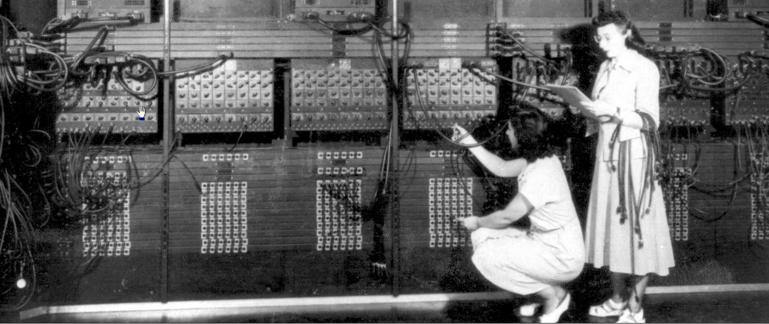
Two early programmers, Gloria Gordon and Ester Gerston at work on the ENIAC (photo courtesy US Army Research Laboratory)
Notes:
The two women in the photo are working with the historic ENIAC computer. The ENIAC, the world’s first programmable electronic computer, was built in 1945 to calculate artillery ballistic tables for the U.S. Army. This machine, which was
primarily one big CPU, was 8 feet tall, 100 feet long, and weighed 30 tons.

Slide 7
A lab technician holding a modern microprocessor (Image: Vadim Kolobanov/Shutterstock)

Slide 8
Main Memory
Main memory: where computer stores a program while program is running, and data used by the program
Known as Random Access Memory or RAM
CPU is able to quickly access data in RAM
Volatile memory used for temporary storage while program is running
Contents are erased when computer is off

Slide 9
Secondary Storage Devices
Secondary storage: can hold data for long periods of time
Programs normally stored here and loaded to main memory when needed
Types of secondary memory
Disk drive: magnetically encodes data onto a spinning circular disk
Solid state drive: faster than disk drive, no moving parts, stores data in solid state memory
Flash memory: portable, no physical disk
Notes:
Secondary storage is a type of memory that can hold data for long periods of time, even when there is no power to the computer. Programs are normally stored in secondary memory and loaded into main memory as needed. Important data, such as word processing documents, payroll data, and inventory records, is saved to secondary storage as well.
The most common type of secondary storage device is the disk drive.
Most solid state drives use flash technology, although some newer ones use 3D Xpoint (3D “crosspoint”) technology. (Current prices for Xpoint SSD are 10 to 20 times more expensive per terabyte than flash SSD)

Slide 10
Input Devices
Input: data the computer collects from people and other devices
Input device: component that collects the data
Examples: keyboard, mouse, touchscreen, scanner, camera
Disk drives can be considered input devices because they load programs into the main memory

Slide 11
Output Devices
Output: data produced by the computer for other people or devices
Can be text, image, audio, or bit stream
Output device: formats and presents output
Examples: video display, printer
Disk drives and USB drives can be considered output devices because data is sent to them to be saved

Slide 12
Software (1 of 2)
Everything the computer does is controlled by software
General categories:
Application software
System software
Application software: programs that make computer useful for every day tasks
Examples: word processing, email, games, and Web browsers

Slide 13
Software (2 of 2)
System software: programs that control and manage basic operations of a computer
Operating system: controls operations of hardware components
Utility Program: performs specific task to enhance computer operation or safeguard data
Software development tools: used to create, modify, and test software programs

Slide 14
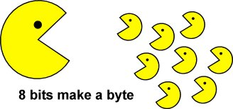

Slide 15
How Computers Store Data
All data in a computer is stored in sequences of 0s and 1s
Byte: just enough memory to store letter or small number
Divided into eight bits
Bit: electrical component that can hold positive or negative charge, like on/off switch
The on/off pattern of bits in a byte represents data stored in the byte
Notes:
In the early days before fully electronic computers, they literally were switches (relay switches)

Slide 16
Storing Numbers
Bit represents two values, 0 and 1
Computers use binary numbering system
Position of digit j is assigned the value 2^{j-1}
To determine value of binary number sum position values of the 1s
Byte size limits are 0 and 255
0 = all bits off; 255 = all bits on
To store larger number, use several bytes

Slide 17
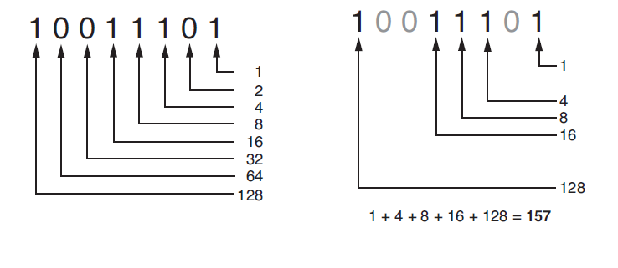
Determining the value of 10011101
7 6 5 4 3 2 1 0

Slide 18
Storing Characters
Data stored in computer must be stored as binary number
Characters are converted to numeric code, numeric code stored in memory
Most important coding scheme is ASCII
ASCII is limited: defines codes for only 128 characters
Unicode coding scheme becoming standard
Compatible with ASCII
Can represent characters for other languages

Slide 19
Advanced Number Storage
To store negative numbers and real numbers, computers use binary numbering and encoding schemes
Negative numbers encoded using two’s complement
Real numbers encoded using floating-point notation
Notes:
Computers are able to store negative numbers and real numbers in memory, but to do so they use encoding schemes along with the binary numbering system. Negative numbers are encoded using a technique known as two’s complement, and real numbers are encoded in floating-point notation. You don’t need to know how these encoding schemes work, only that they are used to convert negative numbers and real numbers to binary format.

Slide 20
Other Types of Data
Digital: describes any device that stores data as binary numbers
Digital images are composed of pixels
To store images, each pixel is converted to a binary number representing the pixel’s color
Digital music is composed of sections called samples
To store music, each sample is converted to a binary number
Notes:
The term pixel stands for picture element.
A CD quality song is divided into more than 44,000 samples per second

Slide 21
How a Program Works (1 of 3)
CPU designed to perform simple operations on pieces of data
Examples: reading data, adding, subtracting, multiplying, and dividing numbers
Understands instructions written in machine language and included in its instruction set
Each brand of CPU has its own instruction set
To carry out meaningful calculation, CPU must perform many operations

Slide 22
How a Program Works (2 of 3)
Program must be copied from secondary memory to RAM each time CPU executes it
CPU executes program in cycle:
Fetch: read the next instruction from memory into CPU
Decode: CPU decodes fetched instruction to determine which operation to perform
Execute: perform the operation

Slide 23
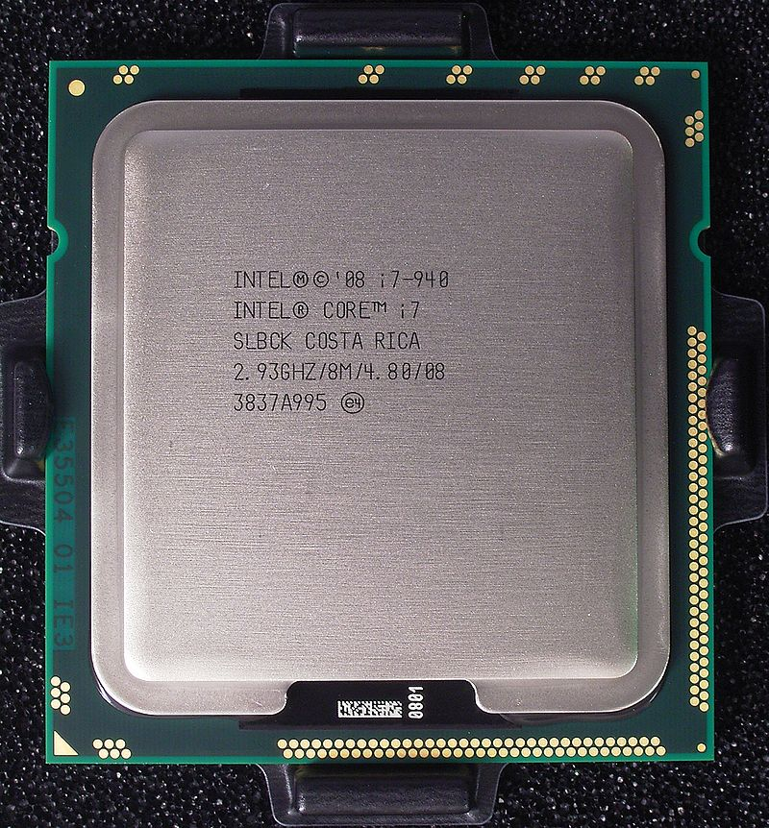
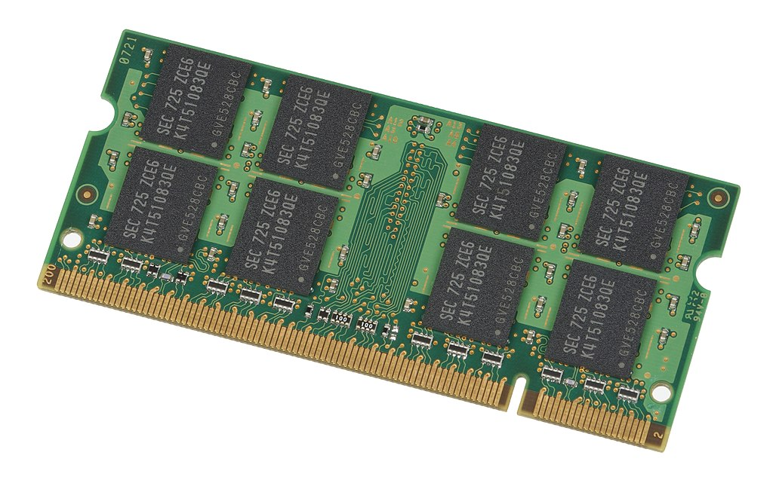
How a Program Works (3 of 3)
10100010 10111000
10011010 11101010 10110010
10011100
etc.
Fetch the next instruction in the program
Decode the instruction to determine which operation to perform
Execute the instruction (perform the operation.)
CPU
Image: Rainer Knäpper, Free Art Licence
Main memory (RAM)
Image: Evan Amos, released to public domain
The fetch-decode-execute cycle

Slide 24
From Machine Language to Assembly Language
Impractical for people to write in machine language
Assembly language: uses short words (mnemonics) for instructions instead of binary numbers
Easier for programmers to work with
Assembler: translates assembly language to machine language for execution by CPU
Notes:
A computer’s CPU can only understand instructions that are written in machine language. Because people find it very difficult to write entire programs in machine language, other programming languages have been invented.

Slide 25
High-Level Languages
Low-level language: close in nature to machine language
Example: assembly language
High-Level language: allows simple creation of powerful and complex programs
No need to know how CPU works or write large number of instructions
More intuitive to understand

Slide 26
Keywords, Operators, and Syntax: an Overview
Keywords: predefined words used to write program in high-level language
Each keyword has specific meaning
Operators: perform operations on data
Example: math operators to perform arithmetic
Syntax: set of rules to be followed when writing program
Statement: individual instruction used in high-level language

Slide 27
Compilers and Interpreters (1 of 3)
Programs written in high-level languages must be translated into machine language to be executed
Compiler: translates high-level language program into separate machine language program
Machine language program can be executed at any time

Slide 28
Compilers and Interpreters (2 of 3)
Interpreter: translates and executes instructions in high-level language program
Used by Python language
Interprets one instruction at a time
No separate machine language program
Source code: statements written by programmer
Syntax error: prevents code from being translated

Slide 29
Compilers and Interpreters (3 of 3)
High-level language program
print(“Hello, world!”)
etc.
Interpreter
Machine language instruction 10100101
The interpreter translates each high-level instruction to its set of equivalent machine language instructions and then immediately executes them.
The process is repeated for each high-level language instruction.
Executing a high-level program with an interpreter

Slide 30
Using Python
Python must be installed and configured prior to use
One of the items installed is the Python interpreter
Python interpreter can be used in two modes:
Interactive mode: enter statements on keyboard
Script mode: save statements in Python script

Slide 31
Interactive Mode
When you start Python in interactive mode, you will see a prompt
Indicates the interpreter is waiting for a Python statement to be typed
Prompt reappears after previous statement is executed
Error message displayed If you incorrectly type a statement
Good way to learn new parts of Python

Slide 32
Writing Python Programs and Running Them in Script Mode
Statements entered in interactive mode are not saved as a program
To have a program use script mode
Save a set of Python statements in a file
The filename should have the .py extension
To run the file, or script, type
python filename
at the operating system command line

Slide 33
Summary
This module covered:
Main hardware components of the computer
Types of software
How data is stored in a computer
Basic CPU operations and machine language
Fetch-decode-execute cycle
Complex languages and their translation to machine code

