Slide 1
Storing Data in a Program
Dr. Tim McGuire Grateful acknowledgement to David Kebo Houngninou for some of the material contained in these slides

Slide 2
Basic Processor-Based System
Processor
core
Registers
Cache/SRAM
memory
Main memory
?
running programs
I/O Interface
keyboard
mouse
joystick
display
printer
speaker
Storage memory
?
Address bus, data bus, and bus control signals
files

Slide 3
Storing data in memory
STR r3, [r8]
;Store r3 to the address r8
r3 content
Memory after Store
0xE011CFD0
Address
Data
0x8000 | 0xD0
0x8001 | 0xCF
0x8002 | 0x11
0x8003 | 0xE0
0x8004 | 0x00
0x8005 | 0x00
0x8006 | 0x00
r8 content
0x00008000

Slide 4
What is a variable?
A variable is a label for a storage location.
A variable stores information to be referenced and manipulated in a computer program.
A variable holds a value. The value can be a number, characters, or another type of data.
A variable can vary by changing what pieces of information it holds.
Notes:
Variable: name that represents a value stored in the computer memory
Used to access and manipulate data stored in memory
A variable references the value it represents

Slide 5
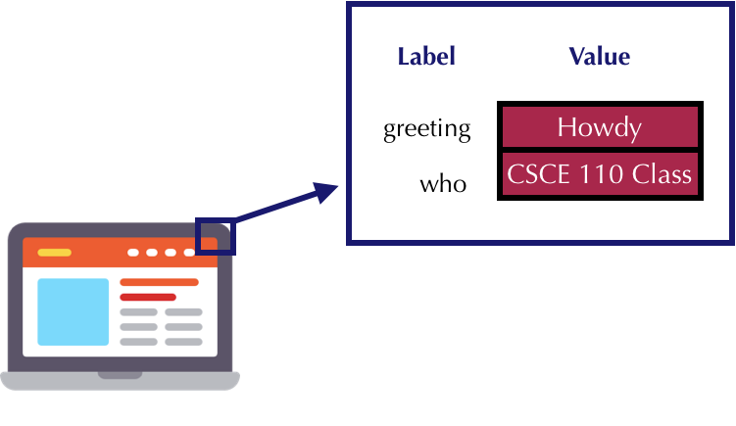
Variables: memory

Slide 6
Variables: rules
The 1st character must be a letter or an underscore. Additional characters can be alphanumeric or underscore
No variable can begin with a number
No symbols other than alphanumeric or underscores are ever allowed
No variable can be the same as keywords, which form the foundation of the language
Variables are case-sensitive
Notes:
Rules for naming variables in Python:
Variable name cannot be a Python key word
First character must be a letter or an underscore Variable name cannot contain spaces
After first character may use letters, digits, or underscores
Variable names are case sensitive
Variable name should reflect its use

Slide 7
Variables: rules
These reserved key words cannot be used to name variables.
False | class | finally | is | return
None | continue | for | lambda | try
True | def | from | nonlocal | while
and | del | global | not | with
as | elif | if | or | yield
assert | else | import | pass
break | except | in | raise

Slide 8
Variables: assignment
An assignment associates a variable on the left of the equal sign to the value of an expression from the right of the equal sign.
The right of the expression is evaluated first.
The value from the right is assigned to the variable on the left.
Once a variable is assigned a value, the variable can be used in place of that value.
Notes:
Assignment statement: used to create a variable and make it reference data
In assignment statement, variable receiving value must be on left side
A variable can be passed as an argument to a function
Variable name should not be enclosed in quote marks
You can only use a variable if a value is assigned to it

Slide 9
Variables: assignment
age = 23
Variable name
Value
Assignment operator
Notes:
General format is variable = expression
Example: age = 23
Assignment operator: the equal sign (=)

Slide 10
Variables: assignment
color = "blue"
Variable name
Value
Assignment operator

Slide 11
Variables: assignment
description = "Anaconda is a python distribution"
Variable name
Value
Assignment operator

Slide 12
Variables: assignment
age = 2+6*4
Variable name
Value
Assignment operator
Notes:
What is the value assigned to the variable ‘age’?

Slide 13
What are data types?
Data types are classifications of objects in programming.
They have attributes such as:
Size
Type of value
Methods

Slide 14
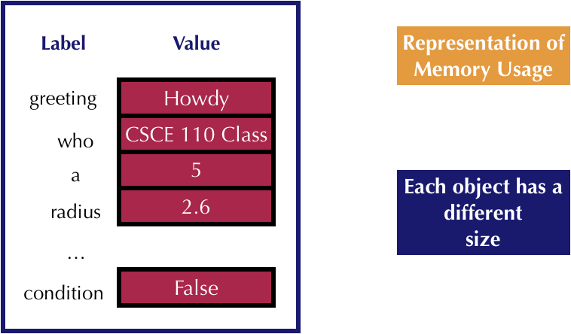
Variables: data types

Slide 15
Variable Reassignment
Variables can reference different values while program is running
Garbage collection: removal of values that are no longer referenced by variables
Carried out by Python interpreter
A variable can refer to item of any type
Variable that has been assigned to one type can be reassigned to another type

Slide 16
Numeric Data Types, Literals, and the str Data Type
Data types: categorize value in memory
e.g., int for integer, float for real number, str used for storing strings in memory
Numeric literal: number written in a program
No decimal point considered int, otherwise, considered float
Some operations behave differently depending on data type

Slide 17
Strings and String Literals
String: sequence of characters that is used as data
String literal: string that appears in actual code of a program
Must be enclosed in single (') or double (") quote marks

Slide 18
Reassigning a Variable to a Different Type
A variable in Python can refer to items of any type
x
42
Here, the variable x references an integer
x
42
Howdy, y’all!
Here, the variable x has been reassigned to a string
Notes:
The 42 will be eventually reclaimed by the garbage collector

Slide 19
Basic operators
Operator | Description
() | Parentheses (grouping)
** | Exponentiation
* / // % | Multiplication Division Integer (Floor) Division Remainder (modulus)
+ - | Addition Subtraction
Notes:
PEMDAS : Please Excuse My Dear Aunt Sally

Slide 20
The Exponentiation Operator and the Remainder Operator
Exponentiation operator (**): Raises a number to a power
x ** y = x^{y}
Remainder operator (%): Performs integer division and returns the remainder
a.k.a. modulus operator
e.g., 4%2=0, 5%2=1
Typically used to convert times and distances, and to detect odd or even numbers

Slide 21
Operators precedence
Operator | Description
() | Parentheses (grouping)
** | Exponentiation
+, - | Positive, Negative
* / % // | Multiplication Division Remainder Floor division
+ - | Addition Subtraction
Notes:
Python operator precedence:
Operations enclosed in parentheses
Forces operations to be performed before others
Exponentiation (**)
Multiplication (*), division (/ and //), and remainder (%)
Addition (+) and subtraction (-)
Higher precedence performed first
Same precedence operators execute from left to right EXCEPT exponentiation goes from right to left

Slide 22
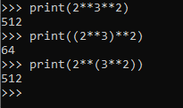
Exponentiation is Right Associative

Slide 23
Examples
Calculate the result of these Python operations:
number = 3+5*4
number = 2+3*2/6
number = 1+4/2*4*3-10
number = 4*3**2
number =(7-9/3)*2

Slide 24
Examples
3+5*4 = 3 + (5*4)
= 23

Slide 25
Examples
2+3*2/6 = 2+(3*2)/6
= 2+((3*2)/6)
= 3

Slide 26
Examples
1+4/2*4*3-10 = 1+(4/2)*4*3-10
= 1+((4/2)*4)*3-10
= 1+(((4/2)*4)*3)-10
= (1+(((4/2)*4)*3))-10
= 15

Slide 27
Examples
4*3**2 = 4*(3**2)
= 36

Slide 28
Examples
(7-9/3)*2 = (7-(9/3))*2
= 8

Slide 29
End

