Slide 1
Python Basics Input & Output
Dr. Tim McGuire Grateful acknowledgement to David Kebo Houngninou for some of the material contained in these slides

Slide 2
I/O (Input/Output) Functions
A program needs to communicate with the computer system or the outside world.
Programming languages can provide I/O functionalities, i.e. input/output.
I/O functions ensure the interaction or communication with other components e.g. a user, a file, or a database.

Slide 3
Input, Processing, and Output
Typically, computer performs three-step process
Receive input
Input: any data that the program receives while it is running
Perform some process on the input
Example: mathematical calculation
Produce output

Slide 4
Basic Processor-Based System
Processor
core
Registers
Cache/SRAM
memory
Main memory
running programs
I/O Interface
keyboard
display
Storage memory
?
Address bus, data bus, and bus control signals
files

Slide 5
Displaying Output with the print Function
Function: piece of prewritten code that performs an operation
print function: displays output on the screen
Argument: data given to a function
Example: data that is printed to screen
Statements in a program execute in the order that they appear
From top to bottom

Slide 6
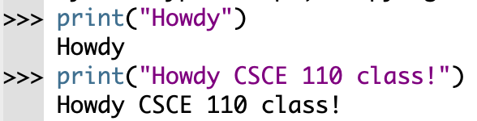
The print() function
The print() function prints the given object to the standard output device (screen) or to the text stream file.

Slide 7
Example
Write a program that prints a welcome message to students of CSCE 110.

Slide 8
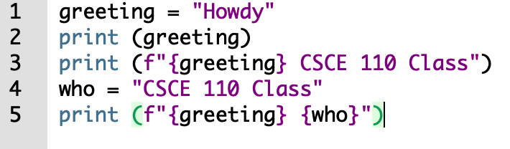
Variables: printing

Slide 9
Displaying Formatted Output with F-strings (1 of 3)
An f-string is a special type of string literal that is prefixed with the letter f
F-strings support placeholders for variables
>>> print(f'Hello world')
Hello world
>>> name = 'Johnny'
>>> print(f'Hello {name}.')
Hello Johnny.

Slide 10
Displaying Formatted Output with F-strings (2 of 3)
Placeholders can also be expressions that are evaluated
>>> print(f'The value is {10 + 2}.')
The value is 12.
>>> val = 10
>>> print(f'The value is {val + 2}.')
The value is 12.

Slide 11
Displaying Formatted Output with F-strings (3 of 3)
Format specifiers can be used with placeholders
.2f means:
round the value to 2 decimal places
display the value as a floating-point number
>>> num = 123.456789
>>> print(f'{num:.2f}')
123.46
>>>

Slide 12
By default, the print() statement puts a newline at the end of the output, so that subsequent output will begin at the start of the next line.
This behavior can be changed using end= print(‘this is’, end=‘ ‘) print(‘all on one line’)
Will print
this is all on one line

Slide 13
Reading Input from the Keyboard
Most programs need to read input from the user
Built-in input function reads input from keyboard (the standard input device)
Returns the data as a string
Format: variable = input(prompt)
prompt is typically a string instructing user to enter a value
Does not automatically display a space after the prompt

Slide 14
Example
Write a program that:
Asks for a person's name.
Greets the person using their name.

Slide 15
Algebra review: number sets
Notes:
https://www.mathsisfun.com/sets/number-types.html

Slide 16
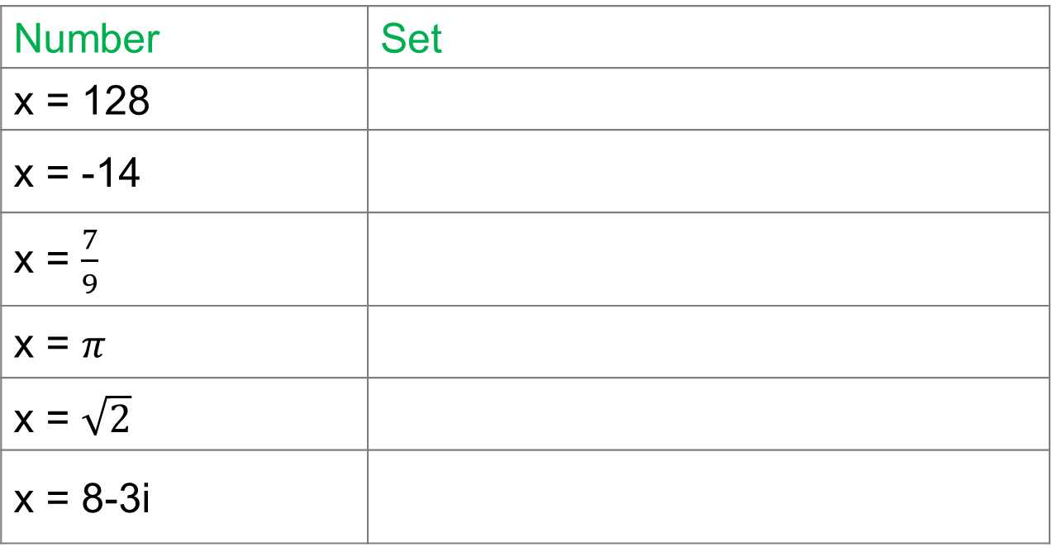
Example
Determine the set to which each of these numbers belong:
Number | Set
x = 128
x = -14
x = $\frac{7}{9}$
x = $π$
x = $\sqrt{2}$
x = 8-3i

Slide 17
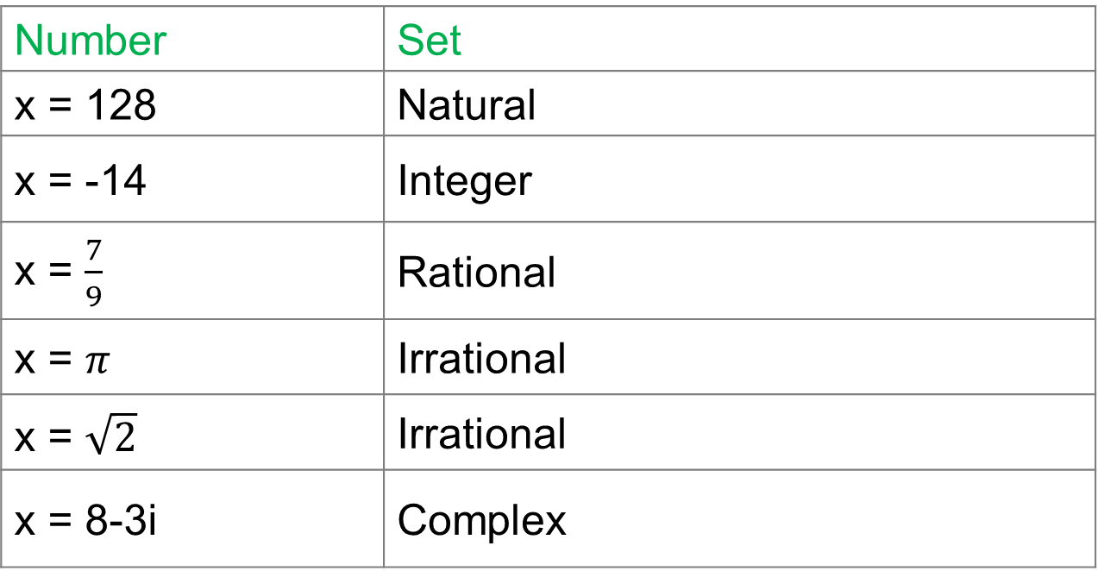
Activity solution
Determine the set to which each of these numbers belong:
Number | Set
x = 128 | Natural
x = -14 | Integer
x = $\frac{7}{9}$ | Rational
x = $π$ | Irrational
x = $\sqrt{2}$ | Irrational
x = 8-3i | Complex

Slide 18
Example
Ask the user to enter an integer number.
Print out the square of the number.
Print the result in a full sentence that ends in a period.

Slide 19
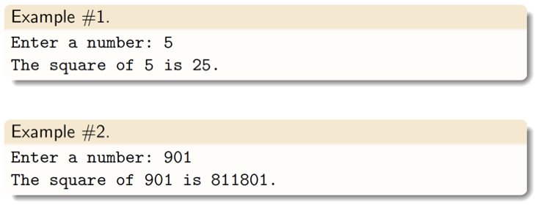
Example: expected output

Slide 20
Type conversion

Slide 21
Python numeric data types
Python supports three numeric data types:
int (signed integers): Positive or negative whole numbers with no decimal point. e.g: 110
float (floating point real numbers): Real numbers with a decimal point dividing the integer and fractional parts. e.g. 1.10
complex (complex numbers): a + bj, where a and b are floats and j the imaginary number (square root of -1). e.g: 1+10j
Notes:
int (signed integers): Positive or negative whole numbers with no decimal point. e.g: 110
long (long integers): Integers of infinite size, written like integers and followed by an uppercase or lowercase L. e.g: 110L
Integers in Python 3 are of unlimited size. Python 2 has two integer types - int and long. There is no 'long integer' in Python 3 anymore.

Slide 22
Explicit type conversion
With an explicit type conversion, the programmer converts the data type of an object to another data type.
e.g. we can convert one type of number into another.
The int() function returns an integer object from any number or string.
The float() function returns an floating point number from any number or string.

Slide 23
Implicit type conversion
With an implicit type conversion, Python automatically converts the data type of an object to another data type.

Slide 24
Implicit type conversion
With an implicit type conversion, Python automatically converts the data type of an object to another data type.
e.g:
int_num = 123
float_num = 1.23
sum = int_num + float_num
print("datatype of int_num:", type(int_num))
print("datatype of float_num:", type(float_num))
print("Value of sum:", sum)
print("datatype of the sum:", type(sum))

Slide 25
Example: 1st tentative solution
What is wrong with the following Python code?
The input() function reads a line from input, converts into a string and returns it.

Slide 26
Reading Numbers with the input Function
input function always returns a string
Built-in functions convert between data types
int(item) converts item to an int
float(item) converts item to a float
Type conversion only works if item is valid numeric value, otherwise, throws exception

Slide 27
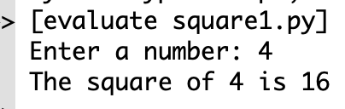
Example: 2nd tentative solution
The input() function reads a line from input, int() converts the input to an integer object and returns it.

Slide 28
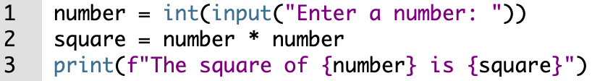
Example: 3rd tentative solution
The input() function reads a line from input, int() converts the input to an integer object and returns it.

Slide 29
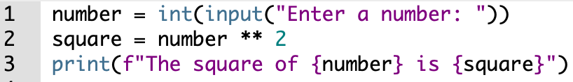
Example: 4th tentative solution
The input() function reads a line from input, int() converts the input to an integer object and returns it.

Slide 30
Example
The diagonal of a polygon is a line segment linking two non-adjacent vertices.
Write a program that asks for the number of sides of a polygon.
Compute the number of diagonals.
Print the result in a full sentence.
Notes:
Monday 28

Slide 31
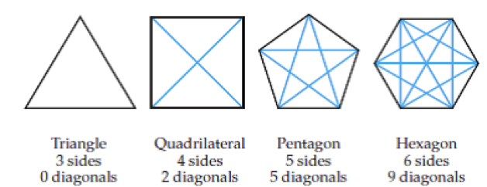

Example
$diagonals= \frac{n(n−3)}{2}$
n is the numbers of sides or vertices

Slide 32

Example
$diagonals= \frac{n(n−3)}{2}$
n is the numbers of sides or vertices

Slide 33
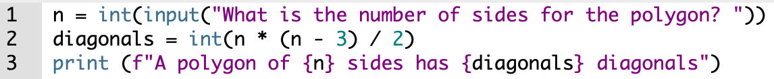
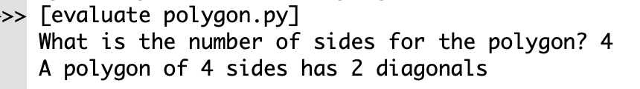
Example: solution

Slide 34


Example
Write a program that asks for the radius of a circle.
Compute the area of the circle.
Print the result in a full sentence.
$Area of a circle= π∙{radius}^{2}$

Slide 35
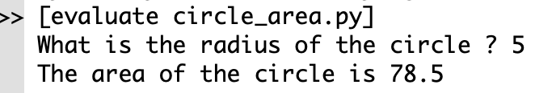
Example: 1st Solution

Slide 36
Operators precedence
Operator | Description
() | Parentheses (grouping)
** | Exponentiation
+, - | Positive, Negative (unary operators)
* / % // | Multiplication Division Remainder Floor division
+ - | Addition Subtraction

Slide 37
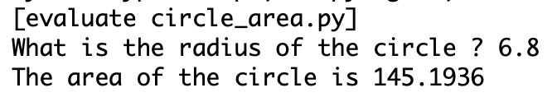
Example: 2nd Solution

Slide 38
Example: counting bills
Write a Python program to simulate an ATM.
For a given dollar amount, the program reports the number of $100, $50, $20, and $10 bills.
Compute the combination that returns the smallest number of bills.
Consider that the user will always request a valid amount.

Slide 39
Example
Amount: $1290 | Amount: $420
1290 // 100 = 12 1290 % 100 = 90 90 // 50 = 1 90 % 50 = 40 40 // 20 = 2 40 % 20 = 0 The ATM returns 12 bills of $100 01 bill of $50 02 bills of $20 | ?

