Slide 1
Python Basics Strings
Dr. Tim McGuire Grateful acknowledgement to David Kebo Houngninou for some of the material contained in these slides

Slide 2
What is a string?
A string is a sequence of characters including letters, numbers, whitespace characters, or symbols.
String literal: string that appears in actual code of a program
Must be enclosed in single (') or double (") quote marks
device = "Arduino"
memory = "32kB"
description = "Arduino is open-source"
print (device)
print (memory)
print (description)

Slide 3
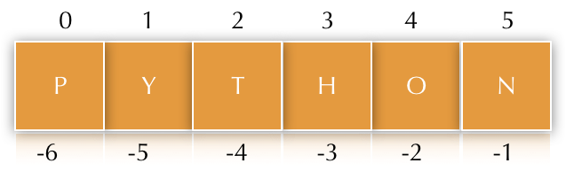
Strings: indexing
Each character in the string has an index that represents its location in the string.
The characters in a string are numbered starting at zero.
name
You can subscript with negative numbers, counting from the right end
name[-1] is the last, rightmost character
name[-2] is the next to last character

Slide 4
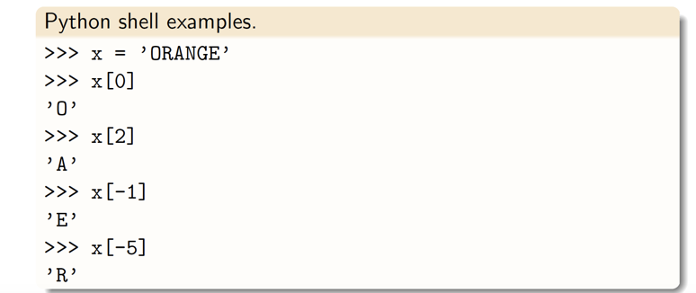
Strings: indexing
Consider the string ‘ORANGE’. The location or index of each character in the string are given below.
index | 0 | 1 | 2 | 3 | 4 | 5
characters | O | R | A | N | G | E
index | -6 | -5 | -4 | -3 | -2 | -1

Slide 5
Example: the Einstein’s puzzle
Write a Python program to implement one of Einstein’s favorite puzzles:
1. Enter a 3 digit number. The first and last digit differ by at least two.
e.g. 442 is correct but 244 is not since the first and last digit differ by -2.
2. Reverse the input.
3. Subtract the reversed number from the original number.
4. Reverse the difference.
5. Add the difference to the reversed difference.
6. The sum should be 1089.

Slide 6
Reversing a 3-digit number
number = d₁d₂d₃ where d₁, d₂, and d₃ are the three digits
To reverse the number, reverse the order of the digits
reversed_number = d₃d₂d₁
How to extract each of the three digits from the number?

Slide 7
Method 1: extracting the three digits
Using string indexing:
If number is a String object, we can use indexing.
number = d₁d₂d₃
d₁ = number[0]
d₂ = number[1]
d₃ = number[2]

Slide 8
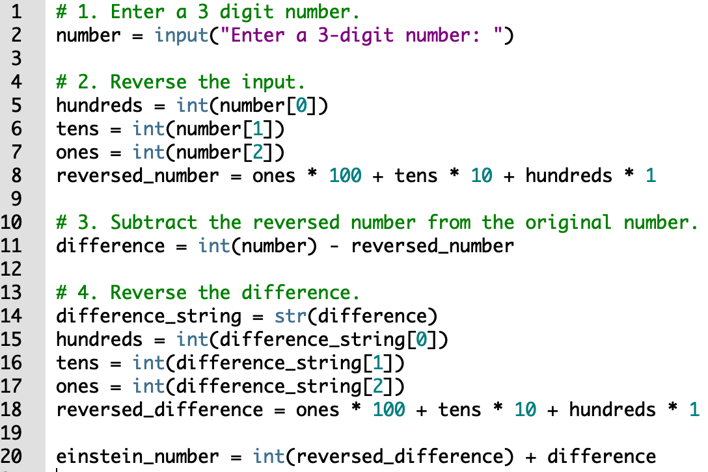
Extracting the three digits: method 1

Slide 9
Method 2: extracting the three digits
Using integer divisions:
If number is a Integer object, we can use divisions.
number = d₁d₂d₃
d₁ = hundreds = number // 100
d₂ = tens = (number % 100) // 10
d₃ = ones = number % 10

Slide 10
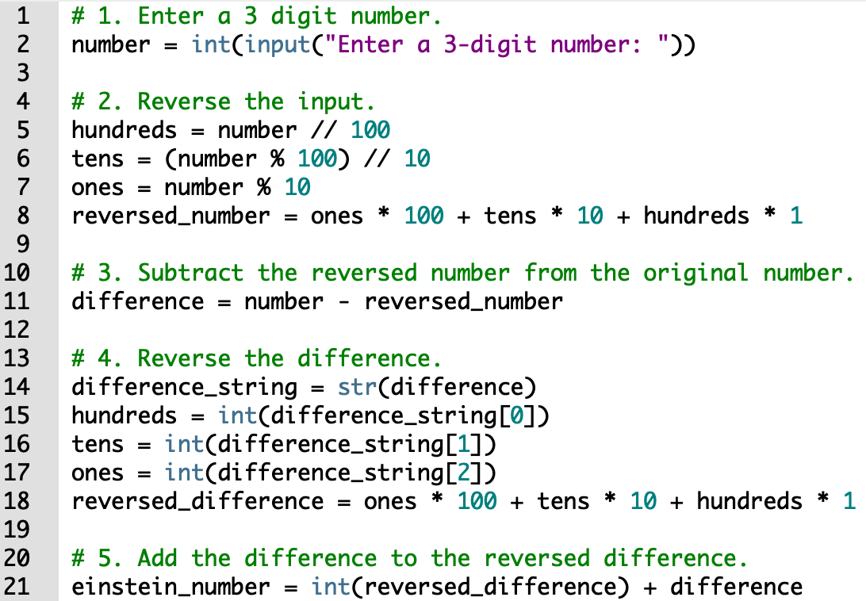
Extracting the three digits: method 2

Slide 11
String slicing
We can slice a string using a range defined by two indexes.
The slice is a substring or a subset of the string. Subscript using a slice (“slicing”)
Syntax: start position, a colon “:”, and stop position (one-past-the-end)
x[low:high]: get the characters in string x starting at location low and ending at location (high-1).
x[low: ]: get the characters in string x starting at location low and ending at the end of the string.
x[ :high]: get the characters in string x starting at location 0 and ending at location (high-1).

Slide 12
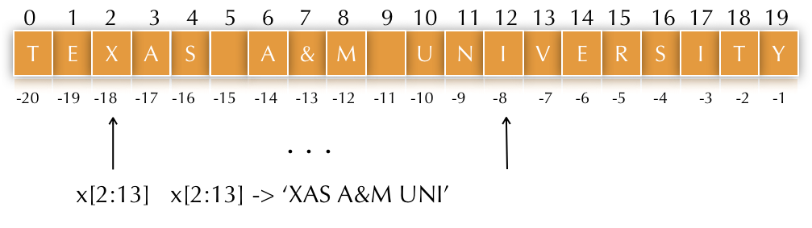
String slicing
Slicing does NOT change the original string, it makes (returns) a new one!
x = 'Texas A&M University'

Slide 13
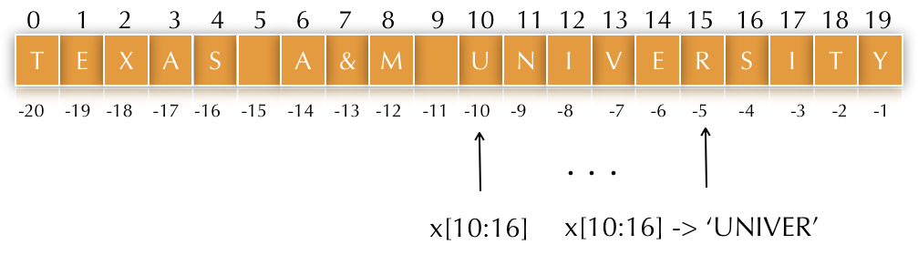
String slicing
x = 'Texas A&M University'

Slide 14
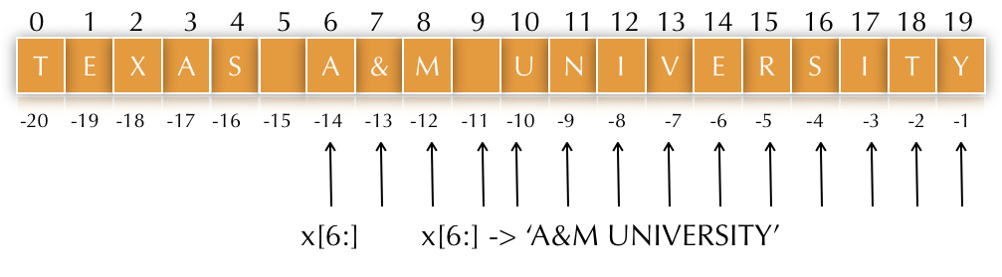
String slicing
x = 'Texas A&M University'

Slide 15
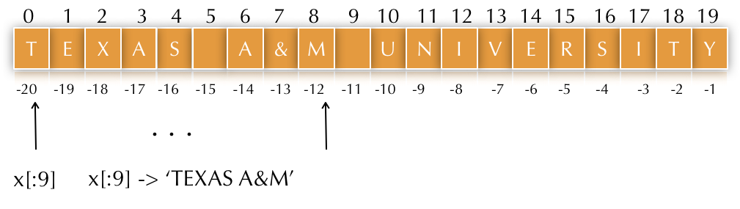
String slicing
x = 'Texas A&M University'

Slide 16
String slicing with a stride
We can slice a string using a range defined by two indexes and a stride parameter.
The stride parameter represents the steps between characters.
x[low:high:stride]: get the characters in string x starting at location low and ending at location (high-1) with an increment of stride.
x[low::stride]: get the characters in string x starting at location low and ending at the end of the string, with an increment of stride.
x[:high:stride]: get the characters in string x starting at location 0 and ending at location (high-1), with an increment of stride.
x[::stride]: get the characters in string x starting at location 0 and ending at the end of the string, with an increment of stride.

Slide 17
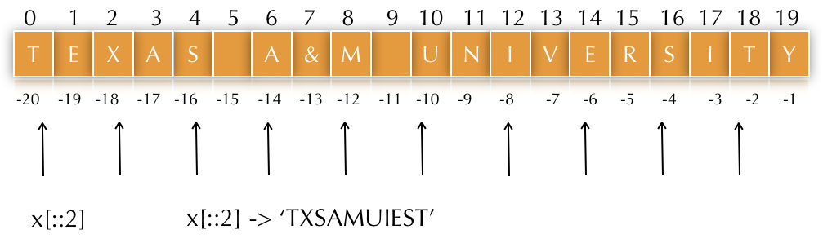
Strings
x = 'Texas A&M University'

Slide 18
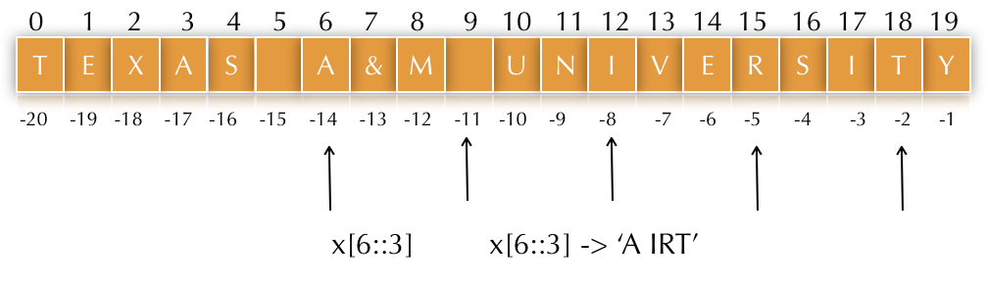
Strings
x = 'Texas A&M University'

Slide 19
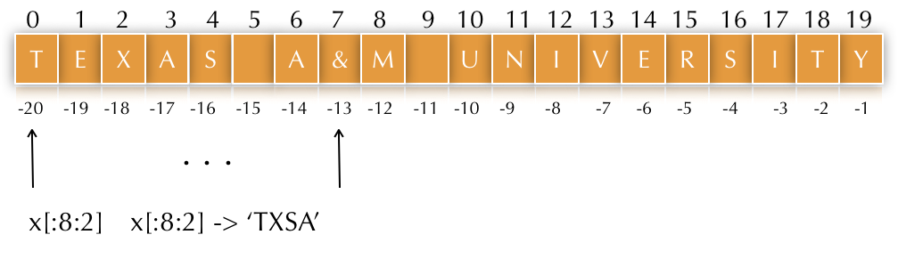
Strings
x = 'Texas A&M University'

Slide 20
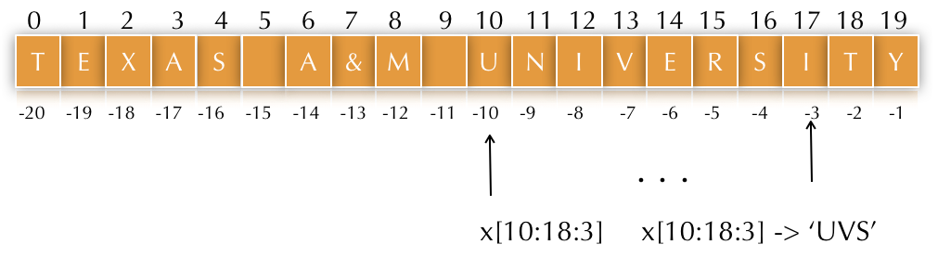
Strings
x = 'Texas A&M University'

Slide 21
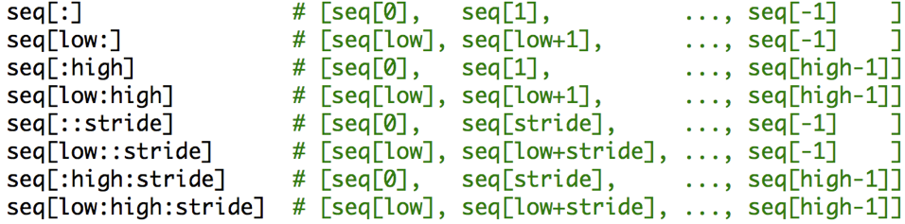
Strings: summary

Slide 22
String slicing with a negative stride
Negative stride: the ordering of parameters low and high is reversed since we are counting down.
x[high:low:-stride]: get characters in string x starting at location high and ending at location (low+1), with a decrement of stride.
x[::-stride]: get characters in string x starting at location -1 and ending at the beginning of the string, with a decrement of stride.
x[high::-stride]: get characters from the string x starting at location high and ending at the beginning of the string, with a decrement of stride.
x[:low:-stride]: get characters in string x starting in location -1 and ending at location (low+1), with a decrement of stride.

Slide 23
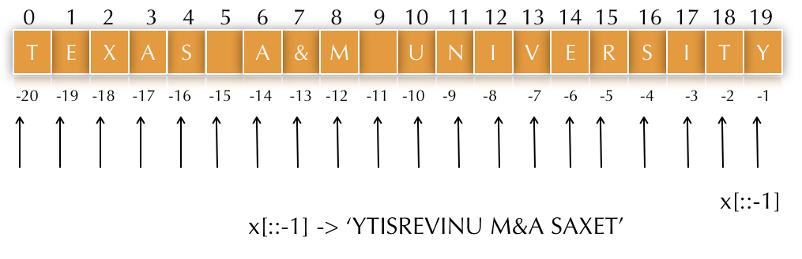
Strings
x = 'Texas A&M University'

Slide 24
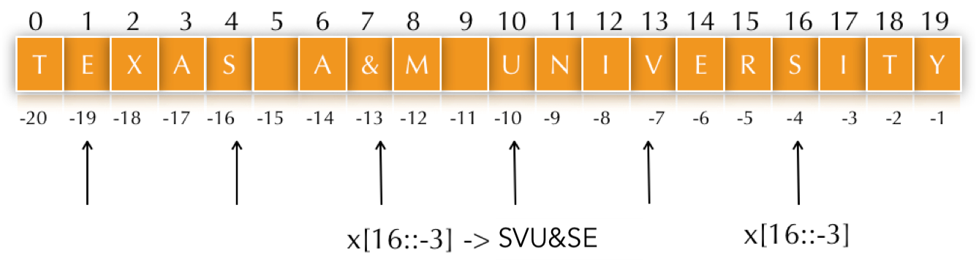
Strings
x = 'Texas A&M University'

Slide 25
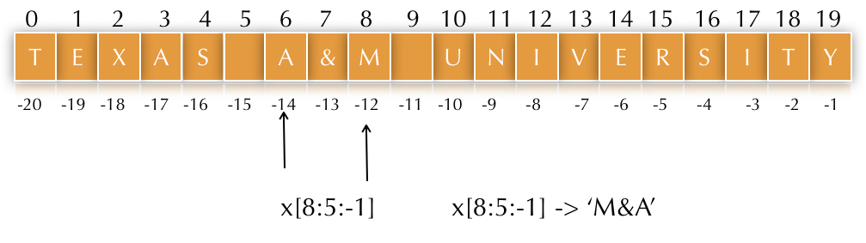
Strings
x = 'Texas A&M University'

Slide 26
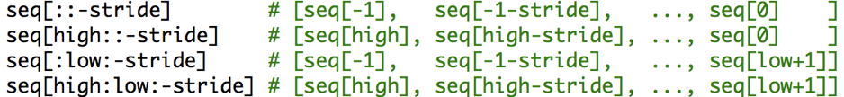
Strings
Negative stride: the ordering is changed a bit since we're counting down.

Slide 27
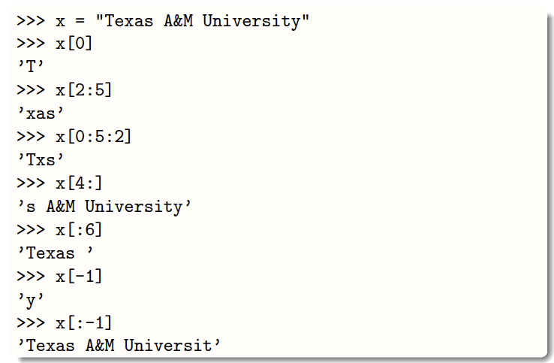
Strings

Slide 28
Example: the Einstein’s puzzle
Write a program to implement one of Einstein’s favorite puzzles:
1. Enter a 3 digit number. The first digit must be higher than the last digit by at least two.
2. Reverse the input.
3. Subtract the reversed number from the original number.
4. Reverse the difference.
5. Add the difference to the reversed difference.
6. The sum should be 1089.

Slide 29
Example: the Einstein’s puzzle
Write a program to implement one of Einstein’s favorite puzzles:
1. Enter a 3 digit number. The first digit must be higher than the last digit by at least two.
2. Reverse the input.
3. Subtract the reversed number from the original number.
4. Reverse the difference.
5. Add the difference to the reversed difference.
6. The sum should be 1089.

Slide 30
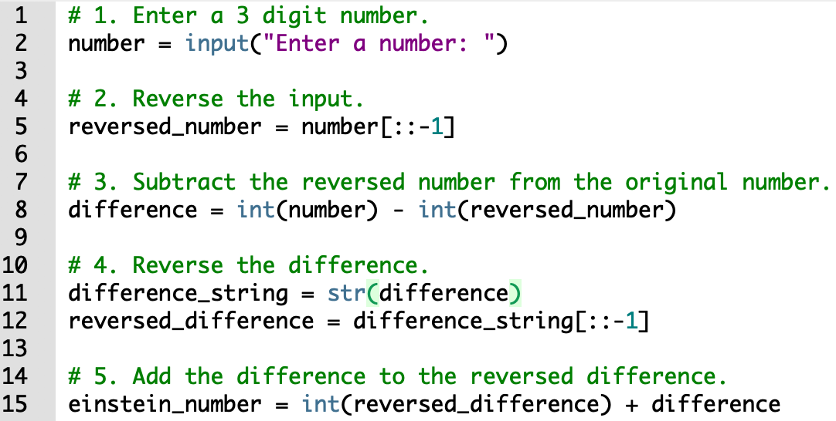
Method 3: negative stride reversal
Using the negative stride, we can reverse the 3-digit number.

Slide 31
String: concatenation
The plus (+) sign is the string concatenation operator.
a = 'Texas'
b = 'A&M'
c = a + ' ' + b
c = 'Texas A&M’
Tip: The same operator can have different purpose depending on the type of data.
We use (+) for the addition of numbers and for the concatenation of strings.

Slide 32
String Concatenation (2 of 2)
You can use string concatenation to break up a long string literal
print('Enter the amount of ' +
'sales for each day and ' +
'press Enter.')
This statement will display the following:
Enter the amount of sales for each day and press Enter.

Slide 33
Implicit String Literal Concatenation
Two or more string literals written adjacent to each other are implicitly concatenated into a single string
>>> my_str = 'one' 'two' 'three'
>>> print(my_str)
onetwothree

Slide 34
Strings: Repetition
The asterisk (*) is the string repetition operator.
a = 'Texas'
c = a * 3
c = 'TexasTexasTexas’
Tip: The same operator can have different purpose depending on the type of data.
We use (*) for the multiplication of numbers and for the repetition of strings.

Slide 35
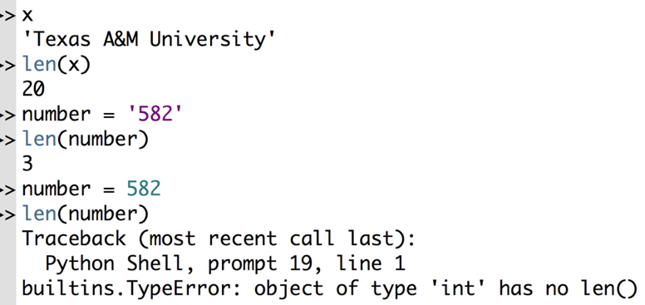
String: length
The len() function returns the number of items in an object.
The argument of len() may be a sequence (string, bytes, tuple, list, range) or a collection (dictionary, set).

Slide 36
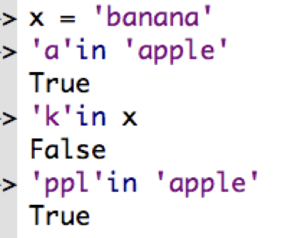
Strings: Membership
The in operator is used to determine if a string contains the element of interest.
The not in operator determines if a string doesn’t contain the element of interest

Slide 37
String methods

Slide 38
Strings: Letter case
Imagine that your program needs to identify if someone is from Texas.
You can ask the user to type the abbreviation of the state.
You can accept: TX, tx , Tx, tX.
How can you validate the use entry?

Slide 39
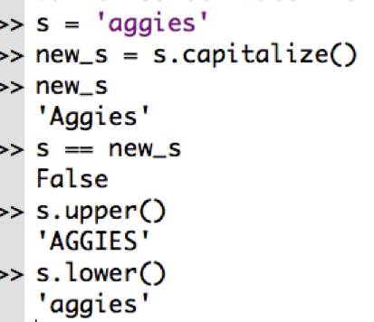

Strings: Letter case
We can use String methods (or functions) to capitalize the first letter in a string, transform all the letters to uppercase, or transform all of the letters to lowercase.

Slide 40
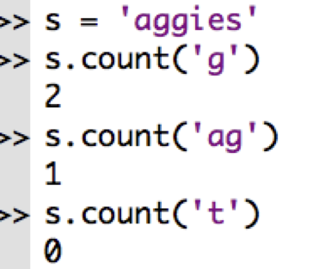
Strings: counting
The count() function returns the number of times that a substring appears in a string.
The count() function also works for lists.

Slide 41
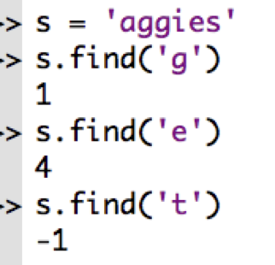
String: find
The find() function returns the index of the first occurrence of a substring.
The find() function returns -1 if the substring does not exist in a string.

Slide 42
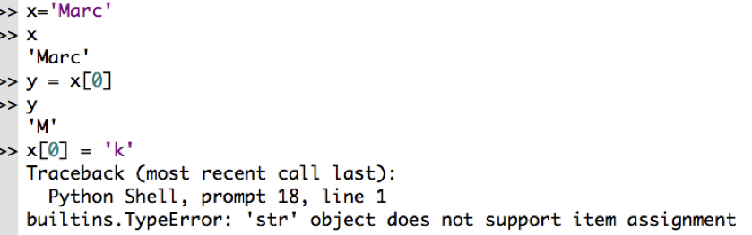
String: Immutability
Strings are immutable sequences. A program can refer to elements or subsequences of strings.
However, strings cannot be modified.

Slide 43
String: replace
The function replace() returns a copy of the string in which the occurrences of old have been replaced with new, optionally restricting the number of replacements to max.
str.replace(old, new[, max])

Slide 44
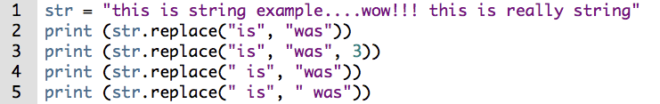
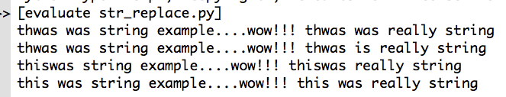
String: replace()

Slide 45
String: deletion
We cannot delete or remove characters from a string. But we can delete a string entirely using the keyword del.
del first_name

