Slide 1
Python Basics Decision Structures
Dr. Tim McGuire Grateful acknowledgement to David Kebo Houngninou for some of the material contained in these slides

Slide 2
Basics of Python
Decision-making statements

Slide 3
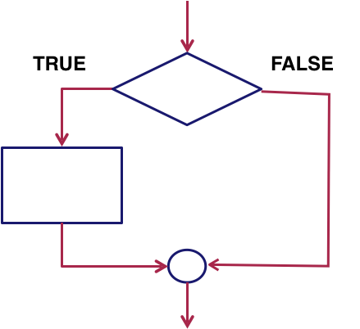
Conditional execution
Conditional / Selection

Slide 4
Conditional Execution and Flags
Instructions can be made to execute conditionally
CMP r3,#0 BEQ skip ADD r0,r1,r2 skip | CMP r3,#0 ADDNE r0,r1,r2

Slide 5
Conditional Codes Examples
C source code
unconditional
conditional
if (r0 == 0)
{
r1 = r1 + 1;
}
else
{
r2 = r2 + 1;
}
CMP r0, #0
BNE else
ADD r1, r1, #1
B end
else
ADD r2, r2, #1
end ...
CMP r0, #0
ADDEQ r1, r1, #1
ADDNE r2, r2, #1
...
5 instructions
3 instructions

Slide 6
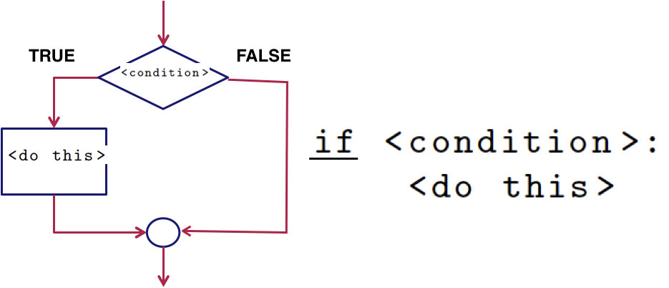
Conditional Execution
Conditional / Selection

Slide 7
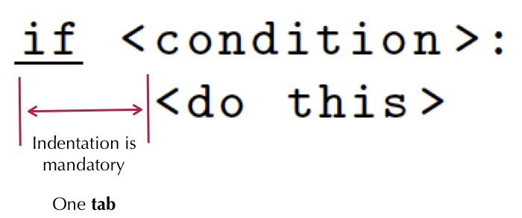
Conditional Execution
Conditional / Selection

Slide 8
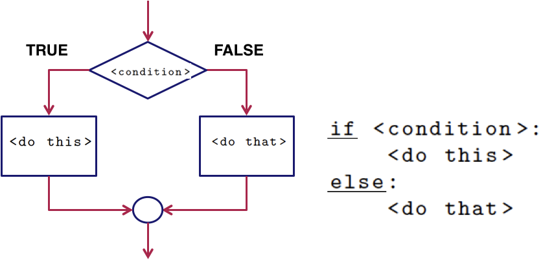
Conditional Execution
Conditional / Selection

Slide 9
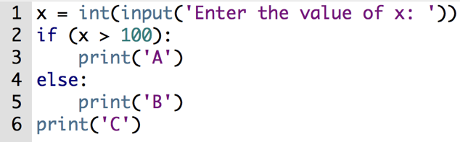
Example
What is the expected output for the following values of x?
Input | Expected output
x = 150
x = 100
x = 98
x = 0

Slide 10
Example solution
Input | Expected output
x = 150 | A C
x = 100 | B C
x = 98 | B C
x = 0 | B C

Slide 11
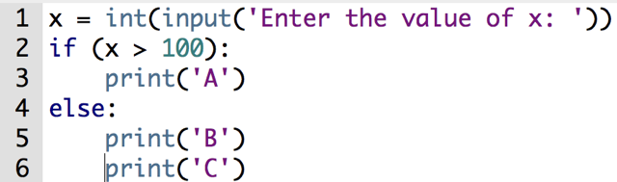
Example
What is the expected output for the following values of x?
Input | Expected output
x = 150
x = 100
x = 98
x = 0

Slide 12
Activity solution
Input | Expected output
x = 150 | A
x = 100 | B C
x = 98 | B C
x = 0 | B C

Slide 13
Truth Value Testing
False values | True values
0
None | Everything else
False
'' - an empty string
[] - an empty list
{} - an empty dictionary
() - an empty tuple
set() – an empty set
range(0) – an empty range
Notes:
These are the only possible Boolean values (named after 19th century mathematician George Boole). In Python the name Boolean is shortened to the type bool.
It is the type of the results of true-false conditions or tests.
A binary variable, having two possible values called “true” and “false.”.

Slide 14
Comparison Operators
Description | Operator
Strictly less than | <
Less than or equal to | <=
Strictly greater than | >
Greater than or equal | >=
Equal to | ==
Not equal to | !=

Slide 15
Comparison Operators
Comparison
Operator
= > < !=
Value 1
Value 2
True | or | False

Slide 16
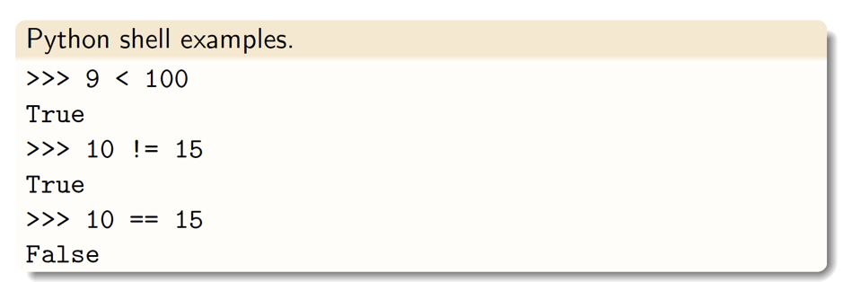
Comparison Operators

Slide 17
Example
What is the expected output?
Input | Expected output
2**2 < 3*2
9**0.5 != 3
size = 10 2*size < size
1089%10 == 89
len("eight")==8
bool("") == False

Slide 18
Activity solution
What is the expected output for the following values of x?
Input | Expected output
2**2 < 3*2 | True
9**0.5 != 3 | False
size = 10 2*size < size | False
1089%10 == 89 | False
len("eight")==8 | False
bool("") == False | True

Slide 19
Logical Operators
Description | Operator
Logical AND | and
Logical OR | or
Logical NOT | not

Slide 20
Logical Operators
Logical
Operator
and or not
Value 1
Value 2
True | or | False

Slide 21
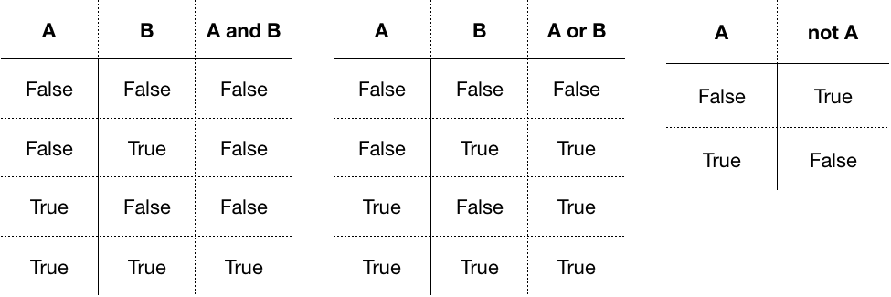
Logical operators
and, or, not

Slide 22
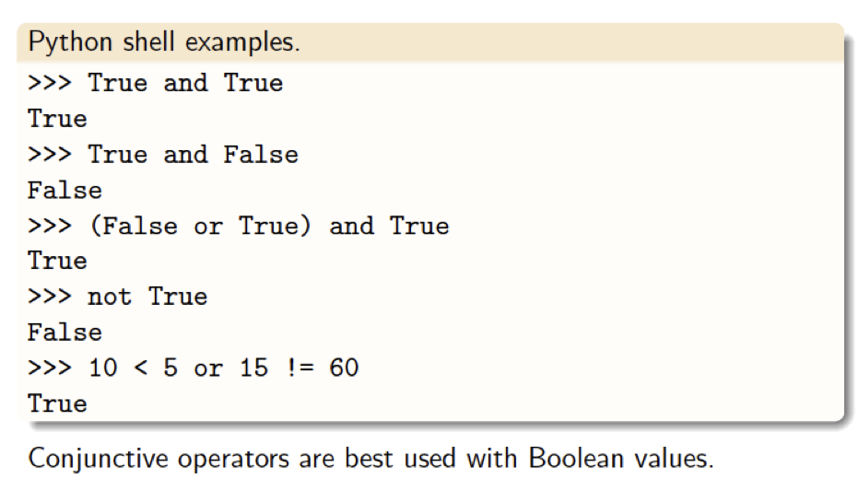
Logical operators
and, or, not

Slide 23
Membership Operators
Description | Operator
True if a variable is in the sequence; false otherwise. | in
True if a variable is not in the specified sequence; false otherwise. | not in

Slide 24
Activity 2.2
Write a program that takes an integer and:
If the integer is a multiple of 3, print "Howdy".
If the integer is a multiple of 5, print "Aggies".
If the integer is a multiple of both 3 and 5, print "Howdy Aggies".

Slide 25
Activity 2.3
Create a program that takes two strings as arguments and return either True or False depending on whether the total number of characters in the first string is equal to the total number of characters in the second string.

Slide 26
Activity 2.4
Create a program that takes a number as an argument and prints True or False depending on whether the number is symmetrical or not.
A number is symmetrical when it is the same as its reverse.

Slide 27
Activity 2.5
Create a program that takes three integer values (a, b, c) and prints the number of equal values.

Slide 28
Operators precedence

Slide 29
Example
Write a Python program to implement one of Einstein’s favorite puzzles:
1. Enter a 3 digit number. The first and last digit differ by at least two.
e.g. 442 is correct but 244 is not since the first and last digit differ by -2.
2. Reverse the input.
3. Subtract the reversed number from the original number.
4. Reverse the difference.
5. Add the difference to the reversed difference.
6. The sum should be 1089.

Slide 30
Example
Your program should test if the user entered a three digits number.
If the number doesn’t have three digits the program should display the message ‘The input is not valid’.

Slide 31
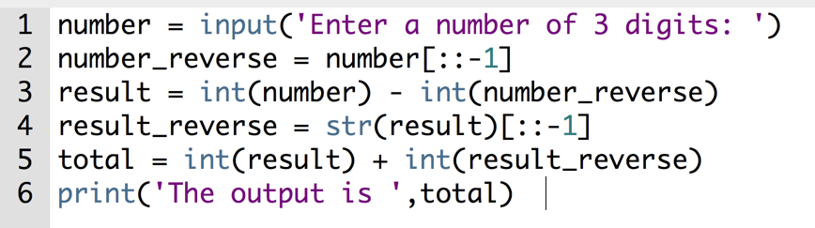
Example: solution

Slide 32
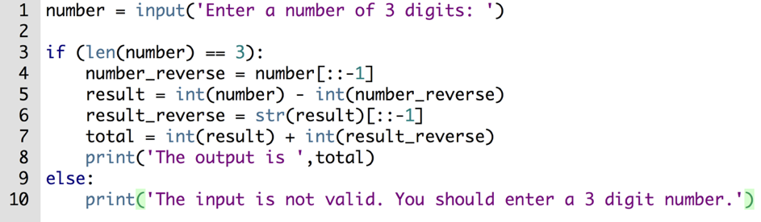
Example: solution

Slide 33
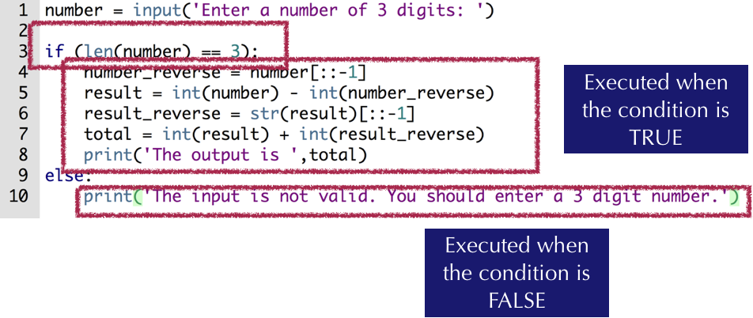
Example: solution

Slide 34
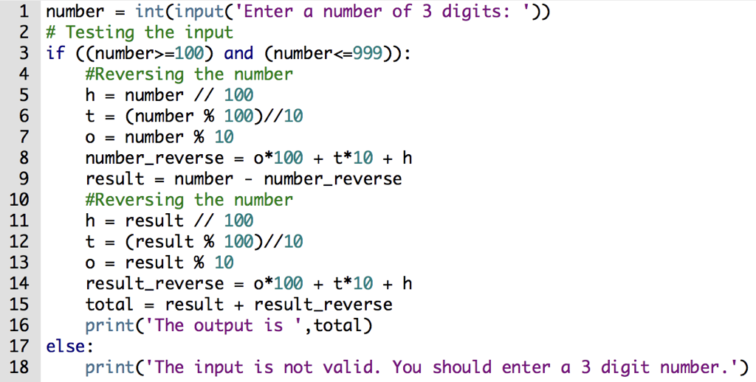
Example: solution

Slide 35


Slide 36
Example
Consider a second degree polynomial or Quadratic equation in the form:
ax² + bx + c = 0
Write a program to test if a quadratic equation has real roots.

Slide 37
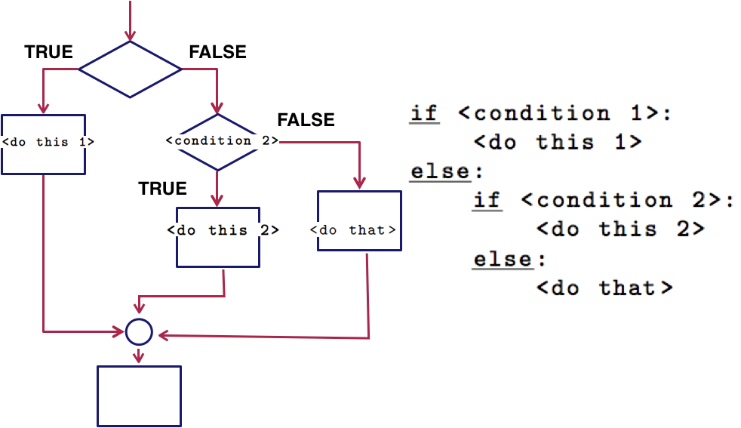
Conditional Execution

Slide 38
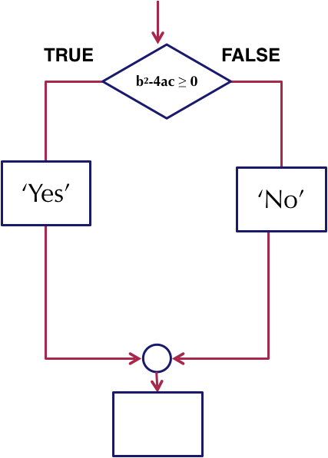
Example
How to test if a quadratic equation has real roots ?
Notes:
Discriminant: b² – 4ac

Slide 39
Example: discriminant
x² + 3x + 2 = 0
a = 1, b = 3, c = 2
Δ = b² – 4ac = 3² – (4 * 1 * 2) = 1

Slide 40
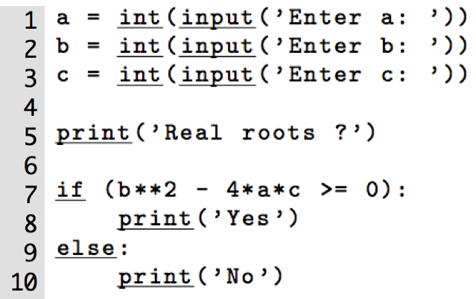
Example
Notes:
Discriminant: b² – 4ac

Slide 41
Example
Consider a second degree polynomial or Quadratic equation in the form:
ax² + bx + c = 0
Write a program to compute the number of real roots of a quadratic equation.

Slide 42
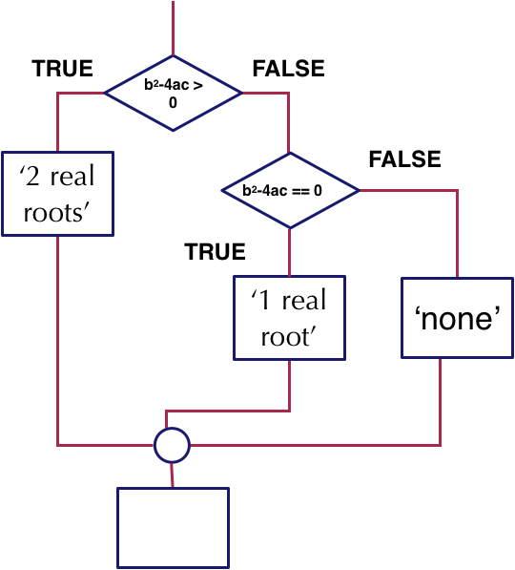
Example
How can I test the number of real roots of a quadratic equation?
ax² + bx + c = 0
is b² – 4ac ≥ 0
Notes:
Discriminant: b² – 4ac

Slide 43
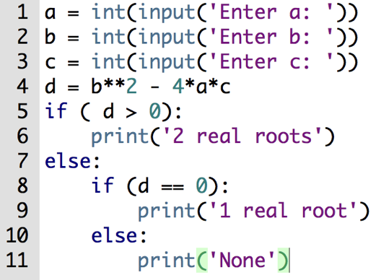
Example
Notes:
Discriminant: b² – 4ac

Slide 44
Example
For equation: x² + 3x + 2 = 0
What is the execution order of this program?
What is the output of this program?
Execution order: 1, 2, 3, 4, 5, 6
Output: 2 real roots

Slide 45
Activity 4.1
For equation: x² + 2x + 1 = 0
What is the execution order of this program?
What is the output of this program?
Execution order:
Output:
Notes:
Execution order: 1, 2, 3, 4, 5, 7, 8, 9
Output: ‘1 real root’

Slide 46
Activity 4.1 solution
For equation: x² + 2x + 1 = 0
What is the execution order of this program?
What is the output of this program?
Execution order: 1, 2, 3, 4, 5, 7, 8, 9
Output: 1 real root
Notes:
Execution order: 1, 2, 3, 4, 5, 7, 8, 9
Output: ‘1 real root’

Slide 47
Activity 4.2
For equation: x² + 2x + 2 = 0
What is the execution order of this program?
What is the output of this program?
Execution order:
Output:
Notes:
Execution order: 1, 2, 3, 4, 5, 7, 8, 10, 11
Output: ‘None’

Slide 48
Activity 4.2 solution
For equation: x² + 2x + 2 = 0
What is the execution order of this program?
What is the output of this program?
Execution order: 1, 2, 3, 4, 5, 7, 8, 10, 11
Output: None
Notes:
Execution order: 1, 2, 3, 4, 5, 7, 8, 10, 11
Output: ‘None’

Slide 49
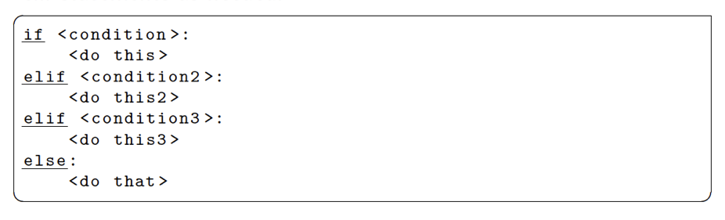
Conditional Execution
If you need more than two conditions (if-else), then use the elif statement.

Slide 50

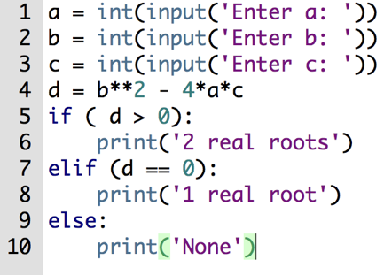
Conditional Execution
Same algorithm - different implementation
1
2

Slide 51
Example
Write a program that computes the letter grade of a student given her score grade.

Slide 52
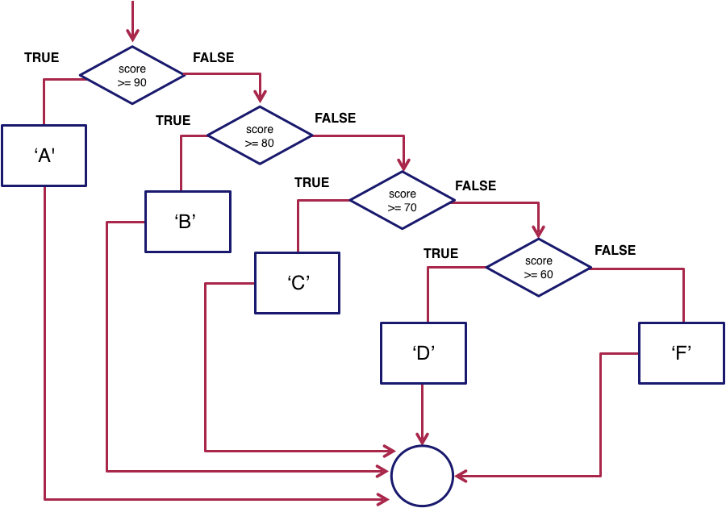
Conditional Execution

Slide 53
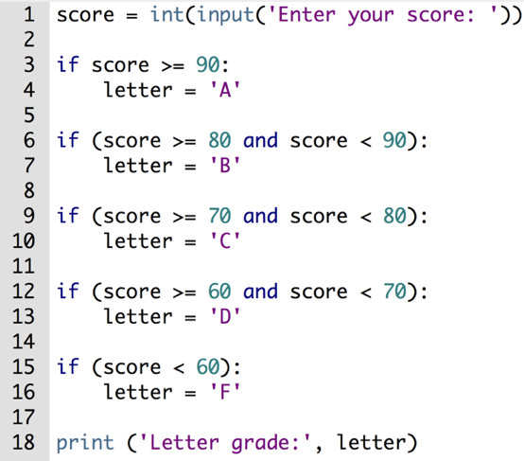
Conditional Execution
How many conditions does the program test?
5

Slide 54
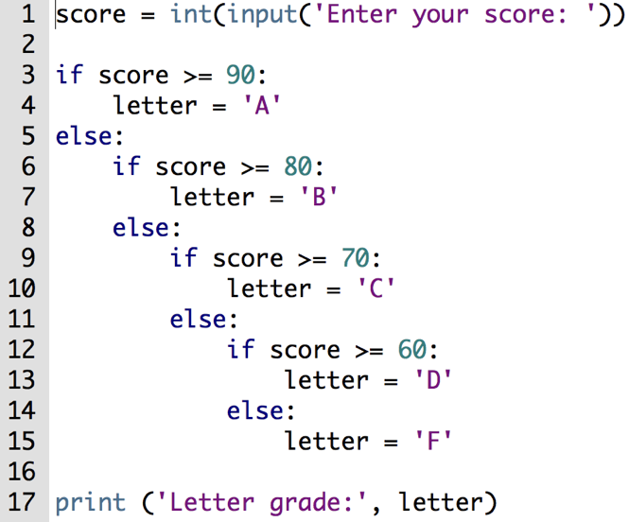
Conditional Execution
How many conditions does the program test?
It depends on the score!
What is the execution order for a score of 94?
Notes:
score = 94
Execution order: 1, 3, 4, 17
Output: 'A'

Slide 55
Conditional Execution
What is the execution order for a score of 83?
Notes:
score = 83
Execution order: 1, 3, 5, 6, 7, 17
Output: ‘B'

Slide 56
Conditional Execution
If you need more than two conditions (if-else), then use the if-elif-else statement.
With this statement, you can have as many elif statement as needed.

Slide 57
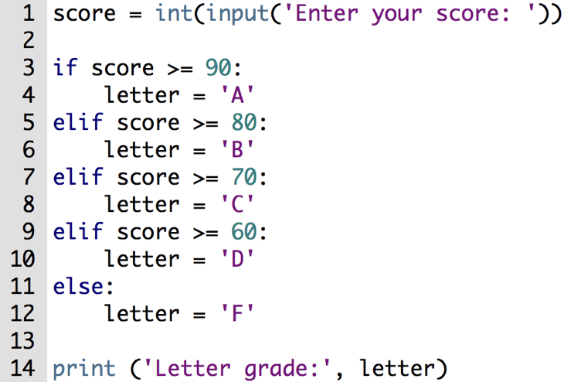
Conditional Execution
What is the execution order for a score of 64?
Notes:
score = 64
Execution order: 1,3,5,7,9,10,14
Output: ‘D’

Slide 58
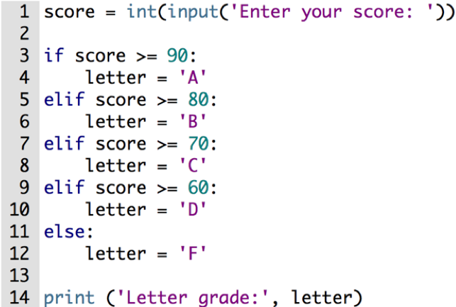
Activity 4.3
What is the execution order for a score of 94?
What is the execution order for a score of 70?
What is the execution order for a score of 0?
Notes:
score = 94
Execution order: 1, 3, 4, 14
Output: ‘A’

Slide 59
Activity 4.3 solution
What is the execution order for a score of 94?
Execution order: 1, 3, 4, 14
Output: A
Notes:
score = 94
Execution order: 1, 3, 4, 14
Output: ‘A’

Slide 60
Example
Write a program that asks for a year and classify the year as leap year or not leap year.
Leap years are divisible by 4.
However, years divisible by 100 are not leap years unless they are also divisible by 400.

Slide 61
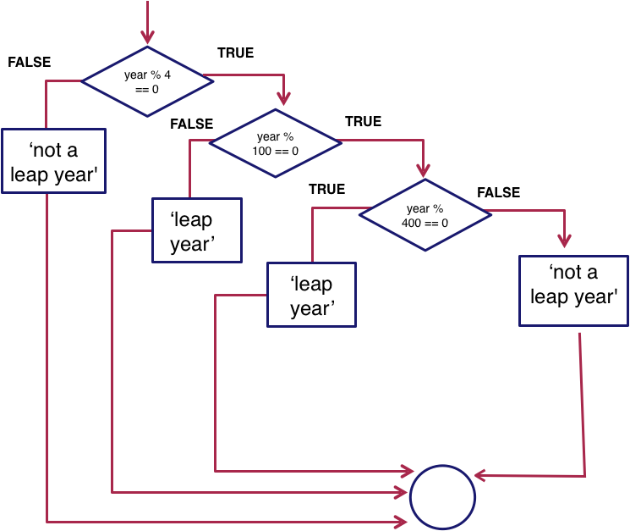
Example

Slide 62
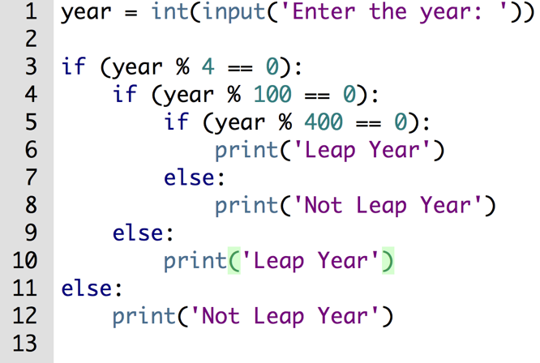
Example
Notes:
year = 2016
Execution order: 1, 3, 4, 9, 10
Output: ‘Leap Year’

Slide 63

Example

Slide 64
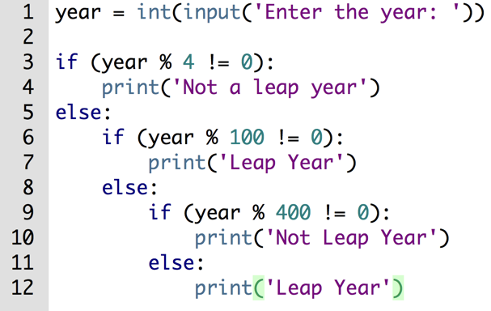
Example solution

Slide 65
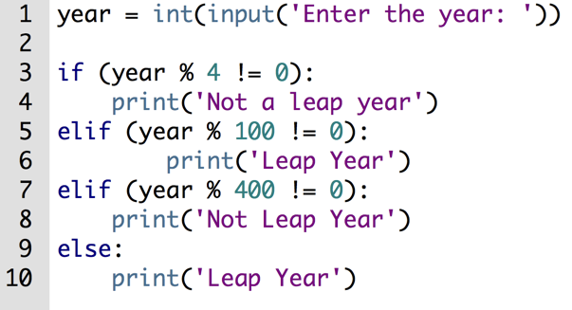
Example solution

Slide 66
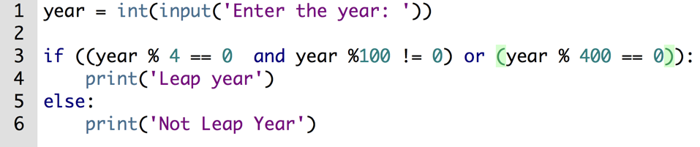
Preferred solution
Notes:
A leap year is a year that is divisible by 4 and not divisible by 100 or a year that is divisible by 400.

Slide 67
Summary
Conditional statements
Comparison operators
Logical operators
Membership operators

Slide 68
References
Flowchart In Programming: https://www.programiz.com/article/flowchart-programming.
Explanation of the Einstein's Puzzle: http://www.pleacher.com/mp/puzzles/tricks/p1089.html
Python Basic Operators: https://www.tutorialspoint.com/python/python_basic_operators.htm

Slide 69
End

