Slide 1
Python Basics Repetition Structures
Dr. Tim McGuire Grateful acknowledgement to David Kebo Houngninou for some of the material contained in these slides

Slide 2
What is a loop?
Definition:
A loop is a control flow statement that allows instructions to be executed repeatedly based on a given condition.
Purpose:
A loop is used in programming to repeat a block of instructions based on a given condition.

Slide 3
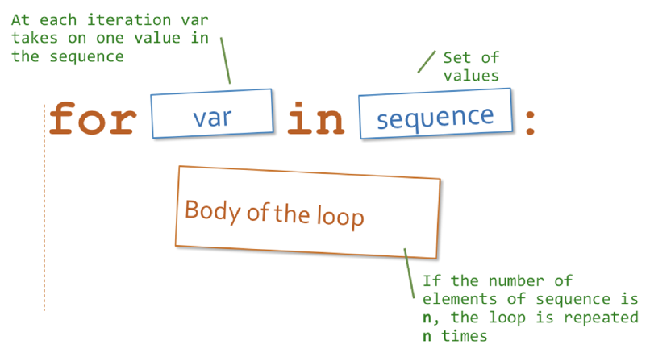
for Loop

Slide 4
for loop
The for loop iterates over a sequence or an iterable object.
for iterator in sequence:
do something
iterator is a variable representing an item in the sequence at each iteration.
The loop continues until it reaches the last value in sequence.
The datatypes for sequence are objects that support iteration:
strings
lists
range objects
tuples

Slide 5
for loop: flowchart
for each value in the sequence
Yes
last value reached ?
No
Process
Body of the loop
Exit

Slide 6
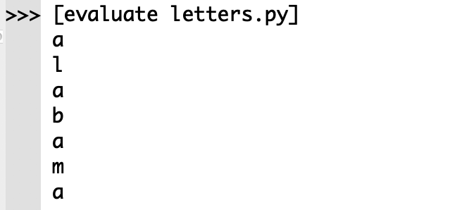
Example
state = "alabama"
# iterate over a string
for letter in state:
print (f"{letter}")

Slide 7
range() function
The range() function returns an immutable sequence of integers between the given start integer to the stop integer.
range(start, stop, step)
start: Starting point of the sequence. Defaults to 0.
stop: Endpoint of the sequence. Not included in the sequence.
step: (optional) Step size of the sequence. Defaults to 1

Slide 8
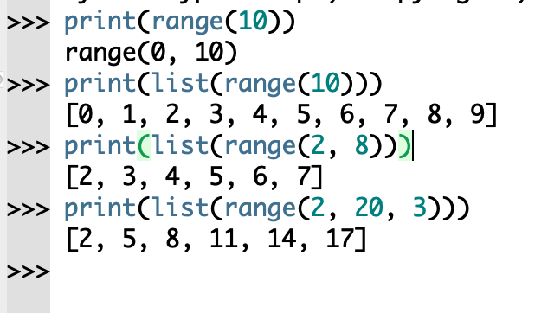
range() function
The range() function uses the start, stop and step to generates the next number.
The list() function outputs the items in the sequence.

Slide 9
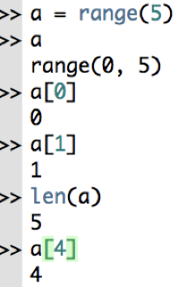
range() function
a is the sequence 0, 1, 2, 3, 4

Slide 10
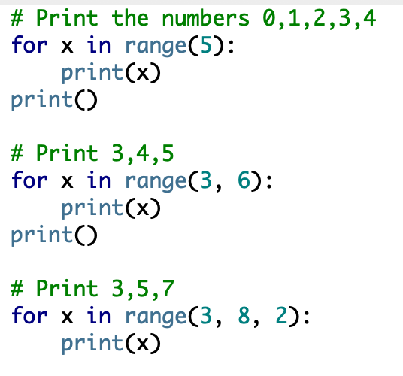
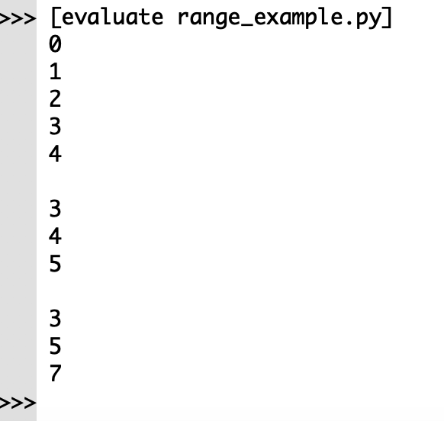
for loop: range()

Slide 11
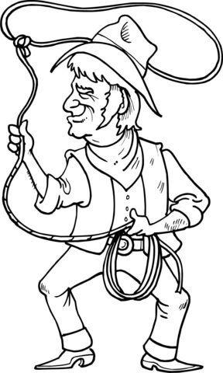
Loops
Credit: getdrawings.com licensed for noncommercial use

Slide 12
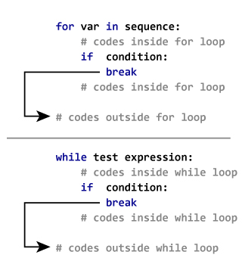
for loop: break, continue, pass
The break statement terminates the for loop containing it. Control of the program flows to the statement immediately after the body of the for loop.

Slide 13
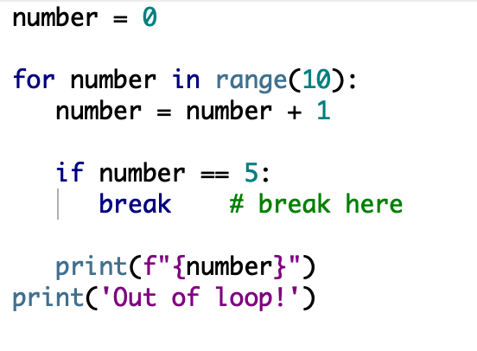
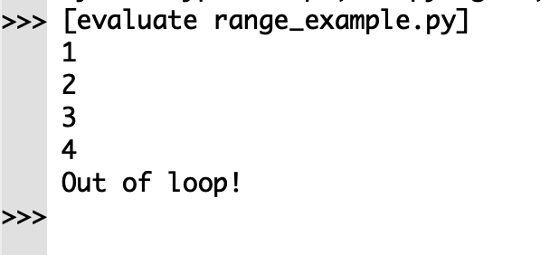
for loop: break, continue, pass
The break statement, exits out of the body of the for loop. We put a break statement within the code under the for loop usually after a conditional statement.

Slide 14
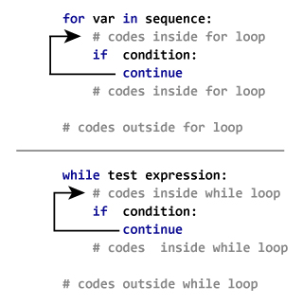
for loop: break, continue, pass
The continue statement, continues with the next iteration of the loop. It skips the part of a loop based on a given condition.
We put a continue statement within the code under the for loop usually after a conditional statement.

Slide 15
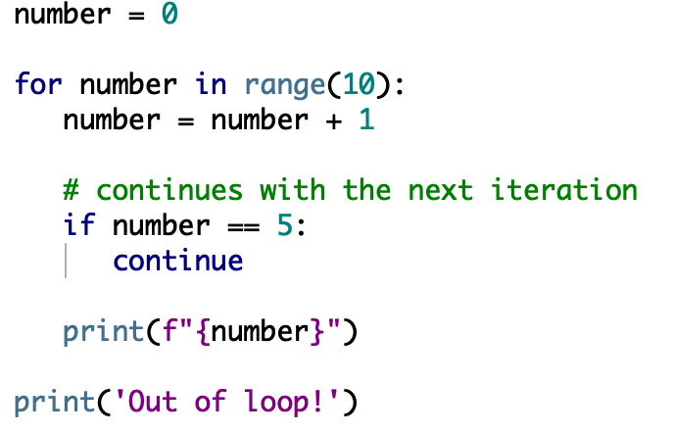
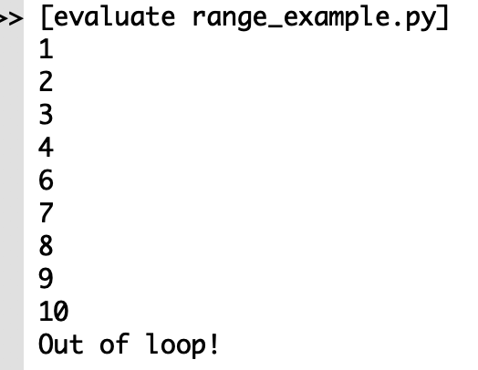
for loop: break, continue, pass
The continue statement skips the rest of the code inside the for loop for the current iteration only. The for loop does not terminate but continues on with the next iteration.

Slide 16
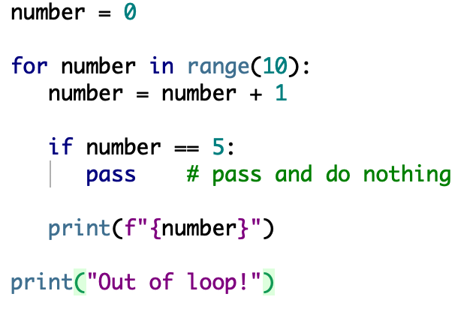
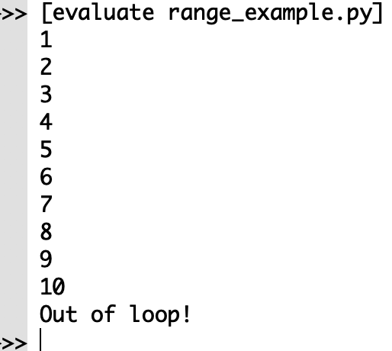
for loop: break, continue, pass
The pass statement does nothing. It can be used when a statement is required syntactically but the program requires no action.
Under a given condition, the pass statement handles the condition without the loop being impacted.

Slide 17
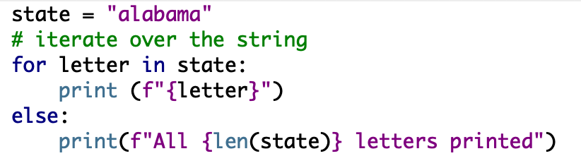
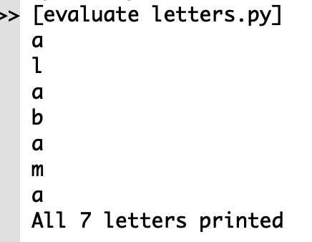
for loop: else
The for loop can have an optional else block. The else block executes if the loop reaches the last item in the sequence.
If a break statement stops the for loop the else statement part is ignored.

Slide 18
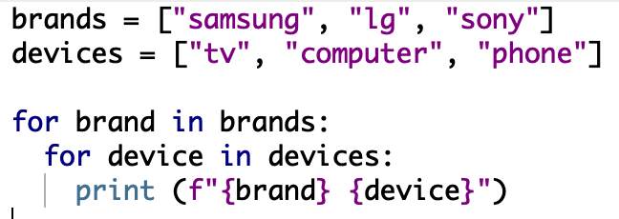
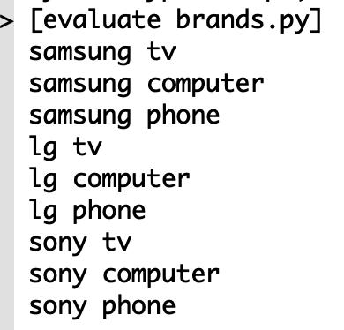
Nested loop
A nested loop is a loop inside a loop.
The inner loop executes one time for each iteration of the outer loop.

Slide 19
Exercise
Write a program to generate a sequence of numbers between 0 and 1000.
Count the even and the odd numbers in the list.
Print the result.

Slide 20
while loop
The while loop iterates over a block of code as long as the given condition is true.
We generally use this loop when we don't know, the number of times to iterate.
while condition:
do something

Slide 21
When to use a While loop?
Use a while loop to repeat instructions an unknown number of times, until a condition is met.
e.g.: ask a user for a number between 1 and 10.
We don't know how many times the user may enter a incorrect, so the program keeps asking while the number is not between 1 and 10.
If you know exactly how many times to execute instructions, then use a for loop!

Slide 22
while loop: flowchart
Enter while loop
False
condition
True
Body of while
Exit

Slide 23
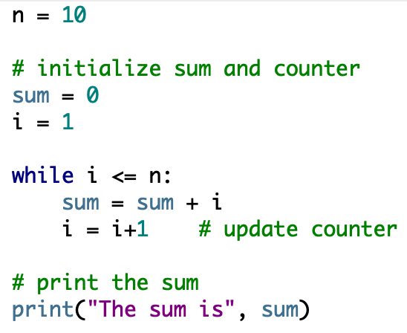
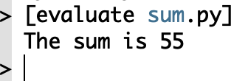
Example
Write a program to add natural numbers up to n

Slide 24
while loop: break, continue, pass
The break statement terminates the while loop containing it. Control of the program flows to the statement immediately after the body of the while loop.

Slide 25
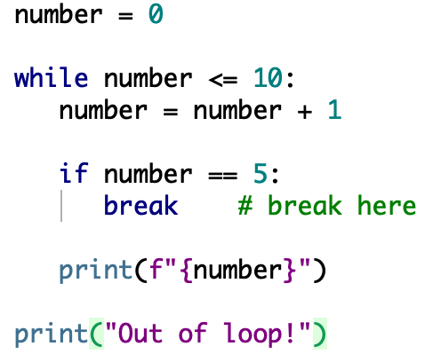
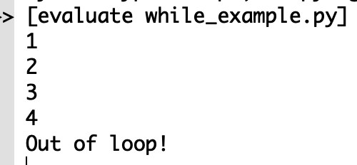
while loop: break, continue, pass
The break statement, exits out of the body of the while loop. We put a break statement within the code under the while loop usually after a conditional statement.

Slide 26
while loop: break, continue, pass
The continue statement, continues with the next iteration of the loop. It skips the part of a loop based on a given condition.
We put a continue statement within the code under the while loop usually after a conditional statement.

Slide 27
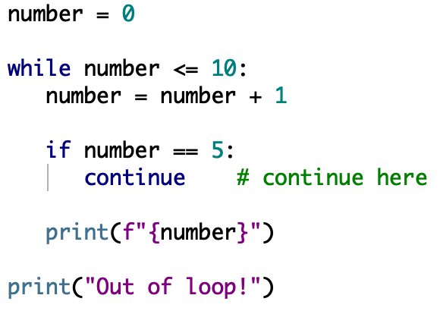
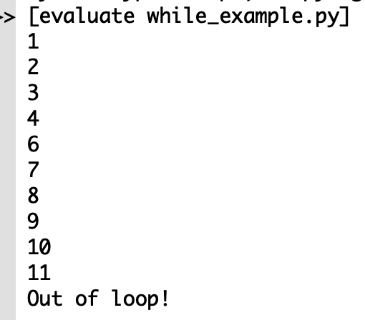
while loop: break, continue, pass
The continue statement skips the rest of the code inside the while loop while the current iteration only. The while loop does not terminate but continues on with the next iteration.

Slide 28
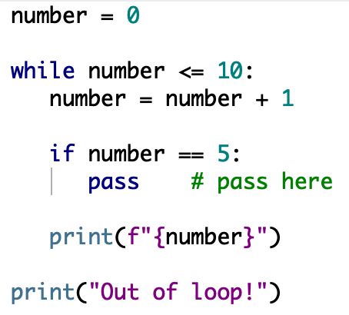
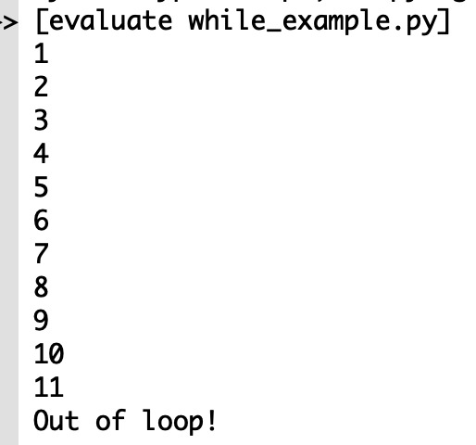
while loop: break, continue, pass
The pass statement does nothing. It can be used when a statement is required syntactically but the program requires no action.
Under a given condition, the pass statement handles the condition without the loop being impacted.

Slide 29
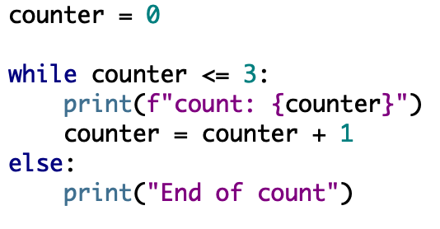
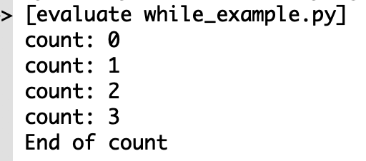
while loop: else
The while loop can have an optional else block. The else part is executed if the condition in the while loop evaluates to False.
If a break statement stops the while loop the else statement part is ignored.

Slide 30
References
1. Mutable vs Immutable Objects in Python. Available on: https://medium.com/@meghamohan/mutable-and-immutable-side-of-python-c2145cf72747.
2. Python For Loop. Available on: https://www.programiz.com/python-programming/for-loop.

Slide 31
End

