Slide 1
Python Basics Collective Data Structures lists, sets, dictionaries, tuples
Dr. Tim McGuire Grateful acknowledgement to David Kebo Houngninou for some of the material contained in these slides

Slide 2
Lists
Lists are sequences used to store collections of data.
Lists are ordered and their elements can be indexed by numbers.
Lists are mutable objects. You can change individual elements in a list.
You can create sub-lists using the slice operators.

Slide 3
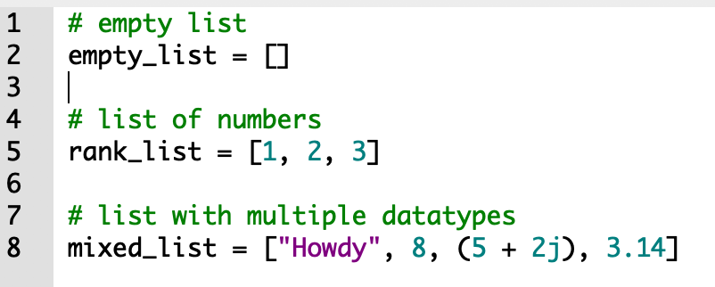
Creating lists
To create a list, place all the elements inside a square bracket [ ] and separated them by commas.
The elements can be heterogeneous: integer, float, string, list etc.

Slide 4
Introduction to Lists (1 of 2)
List: an object that contains multiple data items
Element: An item in a list
Format: list = [item1, item2, etc.]
Can hold items of different types
print function can be used to display an entire list
list() function can convert certain types of objects to lists

Slide 5
Introduction to Lists (2 of 2)
A list of integers
A list of strings
A list holding different types

Slide 6
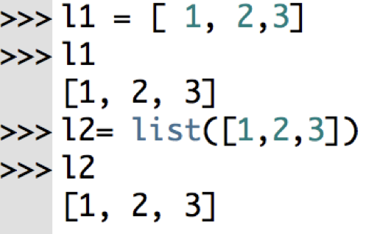
Creating lists: list() constructor
The list() constructor returns a mutable sequence list of elements.
If no parameters are passed, it creates an empty list, otherwise, it creates a list of elements.
The empty list is the list with no elements.
>>> >>>
>>> l3 = list()
>>> l3
[]
>>>

Slide 7
Indexing
Index: a number specifying the position of an element in a list
Enables access to individual element in list
Index of first element in the list is 0, second element is 1, and n’th element is n-1
Negative indexes identify positions relative to the end of the list
The index -1 identifies the last element, -2 identifies the next to last element, etc.

Slide 8
The len function
An IndexError exception is raised if an invalid index is used
len function: returns the length of a sequence such as a list
Example: size = len(my_list)
Returns the number of elements in the list, so the index of last element is len(list)-1
Can be used to prevent an IndexError exception when iterating over a list with a loop

Slide 9
Lists Are Mutable
Mutable sequence: the items in the sequence can be changed
Lists are mutable, and so their elements can be changed
An expression such as
list[1] = new_value can be used to assign a new value to a list element
Must use a valid index to prevent raising of an IndexError exception

Slide 10
Copying Lists (1 of 2)
To make a copy of a list you must copy each element of the list
Two methods to do this:
Creating a new empty list and using a for loop to add a copy of each element from the original list to the new list
Creating a new empty list and concatenating the old list to the new empty list

Slide 11

Copying Lists (2 of 2)
list1 = list2 does not actually make a copy of a list (this is sometimes called a “shallow copy” as opposed to an actual copy called a “deep copy”.)
We will see how to perform a deep copy soon.
list1 and list2 reference the same list

Slide 12
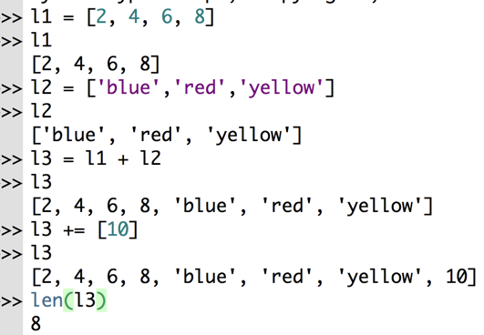
Creating lists
More examples:

Slide 13
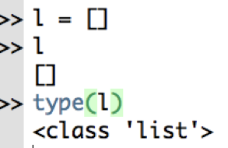
List: empty lists
The empty list is the list with no element.

Slide 14

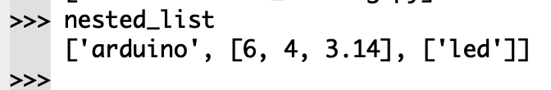
Lists: nested lists
A list can also have lists as element. That list is a nested list.

Slide 15
Two-Dimensional Lists (1 of 3)
Two-dimensional list: a list that contains other lists as its elements
Also known as nested list
Common to think of two-dimensional lists as having rows and columns
Useful for working with multiple sets of data
To process data in a two-dimensional list need to use two indexes
Typically use nested loops to process

Slide 16
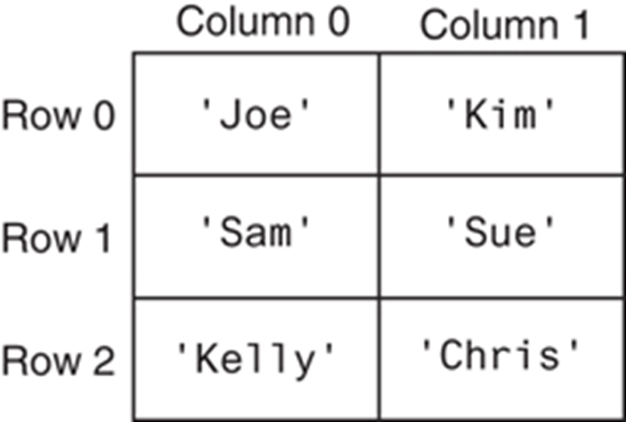
Two-Dimensional Lists (2 of 3)
A two-dimensional list
[[’Joe’,’Kim’],[’Sam’,’Sue’],[’Kelly’,’Chris’]]

Slide 17
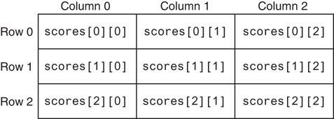
Two-Dimensional Lists (3 of 3)
Subscripts for each element of the scores list

Slide 18
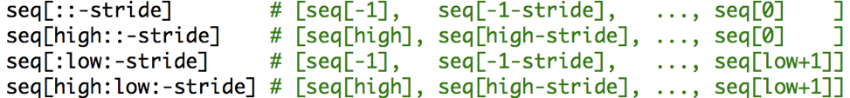
Lists: slicing operators
Just as with strings, in order to slice a range of elements in a list, or sub-list, use the slicing operators [:] or [::]
With a negative stride, the ordering changes since we are counting down.

Slide 19
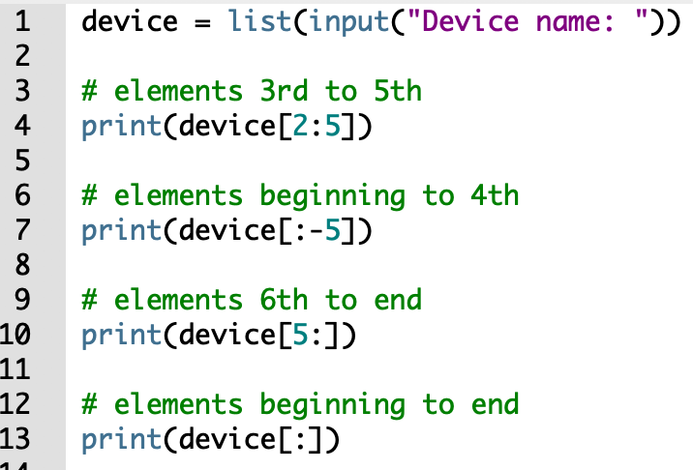
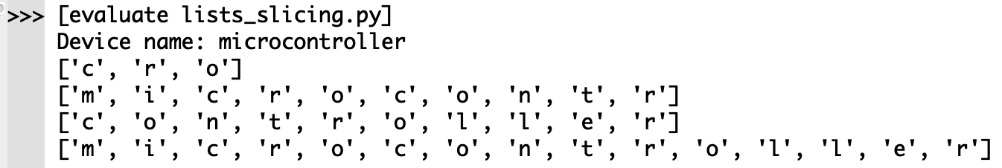
Lists: slicing operators
To slice a range of elements in a list, or sub-list, use the slicing operators [:] or [::]

Slide 20
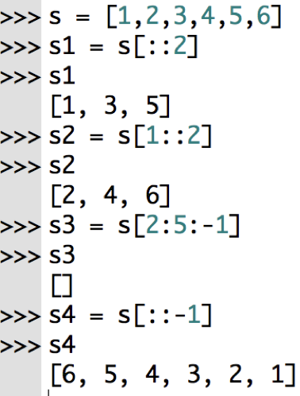
Lists: slicing operators
To slice a range of elements in a list, or sub-list, use the slicing operators [:] or [::]

Slide 21
Finding Items in Lists with the in Operator
You can use the in operator to determine whether an item is contained in a list
General format: item in list
Returns True if the item is in the list, or False if it is not in the list
Similarly you can use the not in operator to determine whether an item is not in a list

Slide 22
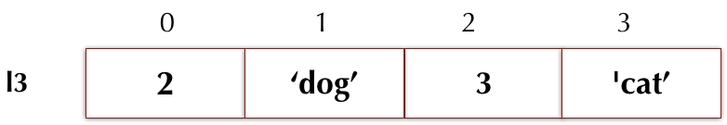
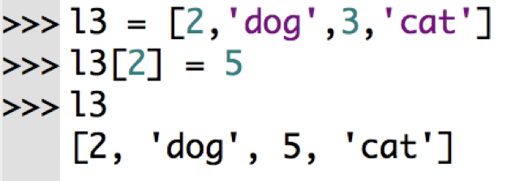
Lists: mutability
Remember that lists are mutable: their elements can be changed unlike strings.
How to change elements in a list?

Slide 23
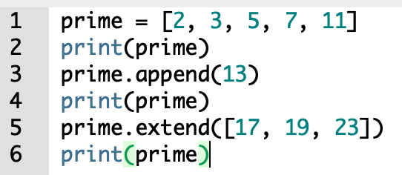
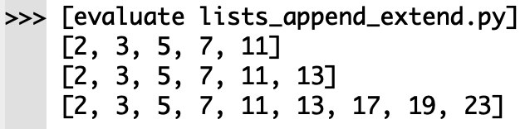
Lists: append() and extend()
How to add elements to a list?
append(item): used to add items to a list – item is appended to the end of the existing list
extend() adds multiple items to a list.
extend(list): used to add another list to a list – list is appended to the end of the existing list

Slide 24
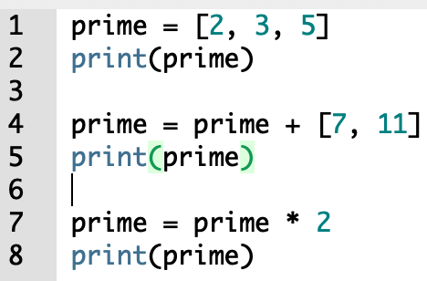
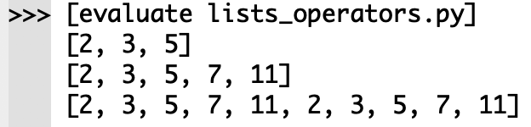
Lists: concatenation and repetition
The + operator concatenates two lists.
The * operator repeats a list n times.
So, what’s the difference between prime = prime + [7, 11] and
prime.extend([7, 11]) ? In the first you are creating a new list with the + operator, and then making prime point to that new list. In the second, you are simply tacking on the elements to the existing list. (usually)

Slide 25
He's got 'em on the list — he's got 'em on the list; And they'll none of 'em be missed — they'll none of 'em be missed Gilbert and Sullivan, The Mikado

Slide 26
Exercise
Write a program to generate a list of random numbers between 0 and 1000.
Count the even and the odd numbers in the list.
Print the result.

Slide 27
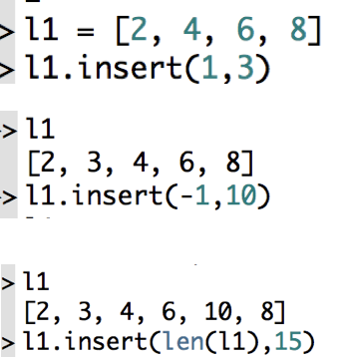
Lists: insert()
list.insert(index, x) inserts the element x at position index.
What are the outputs of the following commands?

Slide 28
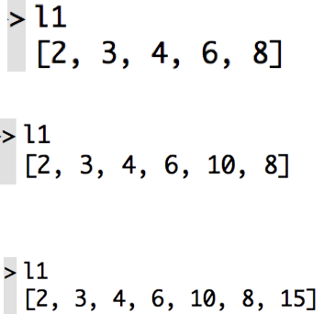
Lists: insert()
list.insert(index, x) inserts the element x at position index.
What are the outputs of the following commands?

Slide 29
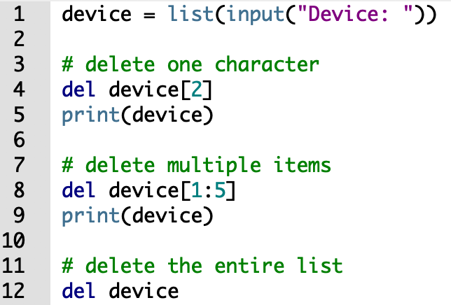
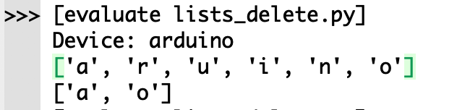
Lists: delete del
del deletes one or more elements from a list.
del can also delete the list.

Slide 30
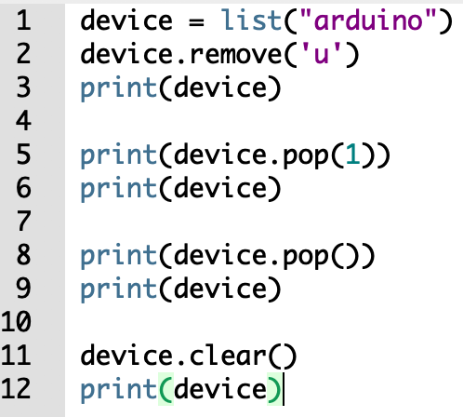
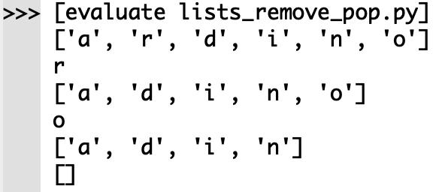
Lists: remove() and pop()
list.remove(x) removes the 1st element from the list whose value is x.
list.pop([i]) removes the element at the position i in the list, and returns it. If no index is specified, pop() removes and returns the last item in the list.

Slide 31
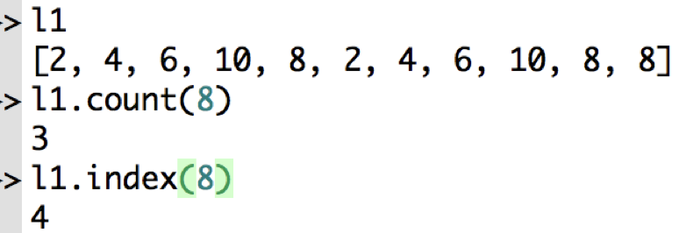
Lists: count() and index()
list.count(x) counts the number of times the element x appears.
list.index(x) returns the first index in the list where the item x is found.

Slide 32
Lists: common methods
append() | Add an element to the end of the list
extend() | Add all elements of a list to the another list
insert() | Insert an item at the defined index
remove() | Removes an item from the list
pop() | Removes and returns an element at the given index
clear() | Removes all items from the list
index() | Returns the index of the first matched item
count() | Returns the count of number of items passed as an argument
sort() | Sort items in a list in ascending order
reverse() | Reverse the order of items in the list
copy() | Returns a shallow copy of the list

Slide 33
Lists: built-in functions
all() | Return True if all elements of the list are true (or if the list is empty).
any() | Return True if any element of the list is true. If the list is empty, return False.
enumerate() | Return an enumerate object. It contains the index and value of all the items of list as a tuple.
len() | Return the length (the number of items) in the list.
list() | Convert an iterable (tuple, string, set, dictionary) to a list.
max() | Return the largest item in the list.
min() | Return the smallest item in the list
sorted() | Return a new sorted list (does not sort the list itself).
sum() | Return the sum of all elements in the list.

Slide 34
List Comprehensions (1 of 7)
List comprehension: a concise expression that creates a new list by iterating over the elements of an existing list.

Slide 35
List Comprehensions (2 of 7)
The following code uses a for loop to make a copy of a list:
The following code uses a list comprehension to make a copy of a list:
list1 = [1, 2, 3, 4]
list2 = []
for item in list1:
list2.append(item)
list1 = [1, 2, 3, 4]
list2 = [item for item in list1]

Slide 36
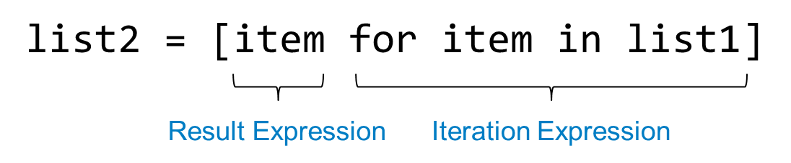
List Comprehensions (3 of 7)
The iteration expression works like a for loop
In this example, it iterates over the elements of list1
Each time it iterates, the target variable item is assigned the value of an element.
At the end of each iteration, the value of the result expression is appended to the new list.

Slide 37
List Comprehensions (4 of 7)
list1 = [1, 2, 3, 4]
list2 = [item**2 for item in list1]
After this code executes, list2 will contain the values [1, 4, 9, 16]

Slide 38
List Comprehensions (5 of 7)
str_list = ['Winken', 'Blinken', 'Nod']
len_list = [len(s) for s in str_list]
After this code executes, len_list will contain the values [6, 7, 3]

Slide 39
List Comprehensions (6 of 7)
You can use an if clause in a list comprehension to select only certain elements when processing a list
list1 = [1, 12, 2, 20, 3, 15, 4]
list2 = []
for n in list1:
if n < 10:
list2.append(n)
Works the same as…
list1 = [1, 12, 2, 20, 3, 15, 4]
list2 = [item for item in list1 if item < 10]

Slide 40
List Comprehensions (7 of 7)
list1 = [1, 12, 2, 20, 3, 15, 4]
list2 = [item for item in list1 if item < 10]
After this code executes, list2 will contain [1, 2, 3, 4]

Slide 41
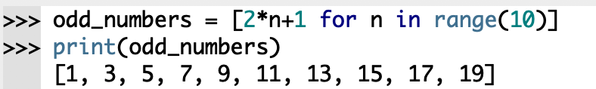
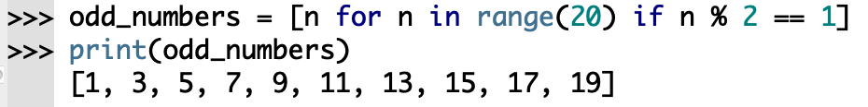
More comprehension examples
List comprehension consists of an expression followed by a for statement inside square brackets.
A list comprehension can also contain if statements to filter elements.

Slide 42
End

