Slide 1
Python Basics Collective Data Structures lists, sets, dictionaries, tuples
Dr. Tim McGuire Grateful acknowledgement to David Kebo Houngninou for some of the material contained in these slides

Slide 2
Sets
Set: object that stores a collection of data in same way as mathematical set
All items must be unique
Set is unordered
Elements can be of different data types

Slide 3
Sets
A set is a collection of distinct and unordered objects.
Sets are mutable. (We can add or remove items from them)
Elements of sets are immutable.
Elements of sets are unique.
Sets cannot be indexed.
Sets support a standard collection of operations:
union
intersection
difference
symmetric difference

Slide 4
The Language of Sets
Let S be the set of all integers between 1 and 5, inclusive:
S = {1,2,3,4,5}
We want to determine if x is an element of set S: x ∈ S?
If x = 3; is x ∈ S?
Yes, x ∈ S
If x = 10; is x ∈ S?
No, so x ∉ S

Slide 5
Common Number Sets
C = set of complex numbers
R = set of real numbers
R⁺ = set of positive real numbers
Q = set of rational numbers
Z = integers = {…,-3,-2,-1,0,1,2,3,…}
Z⁺ = positive integers = {1,2,3,…..}
N = natural numbers = {0,1,2,3….}

Slide 6
Sets and subsets
Set A is a subset of set B if every element of A is in B.
Notation: A ⊆ B
U
B
A

Slide 7
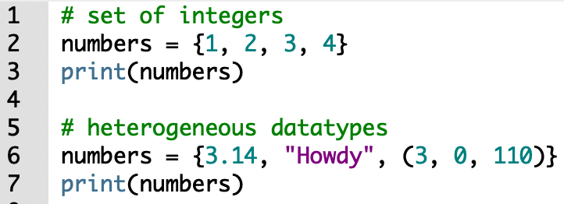
Creating sets
To create a set, place all the elements inside curly braces {}, separated by commas.
The elements can be heterogeneous: integer, float, tuple, string etc.
A set cannot contains mutable elements like lists, sets or dictionaries.

Slide 8
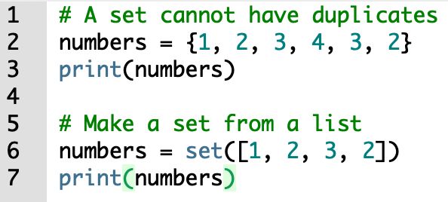
Creating sets: set() constructor
A set can be created by using the built-in function set().
We can create a set from another object such as a list.

Slide 9
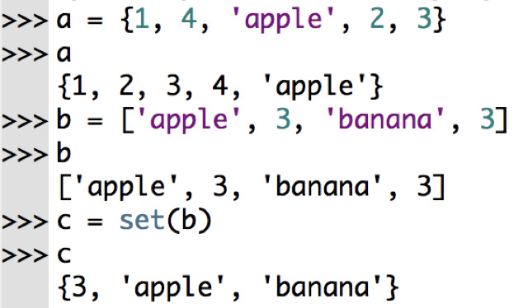
Sets
a is a set, b is a list, c = set(b) creates a set from list b

Slide 10
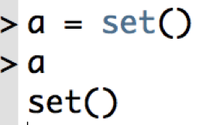
Sets: empty set
The command set() creates an empty set.

Slide 11
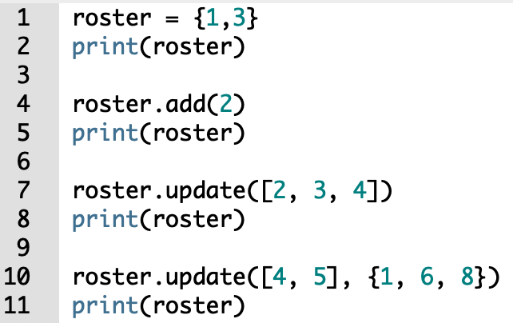
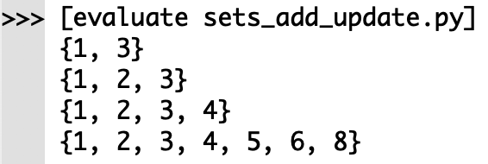
Sets: add() and update()
Sets are mutable and unordered.
The add() method adds a single element.
The update() method adds multiple elements (tuples, lists, strings, sets)

Slide 12
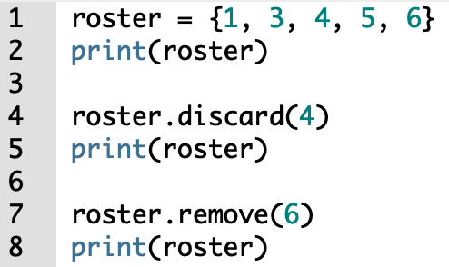
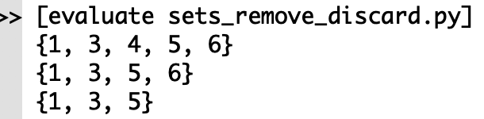
Sets: discard() and remove()
The discard() method removes an item from a set.
The remove() method removes an item from a set, it raises an error if the item does not exist.

Slide 13
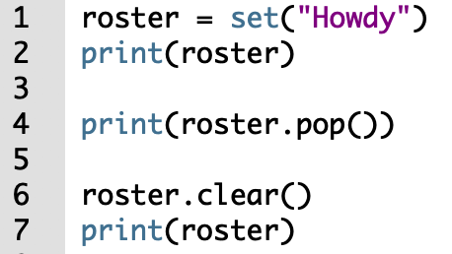
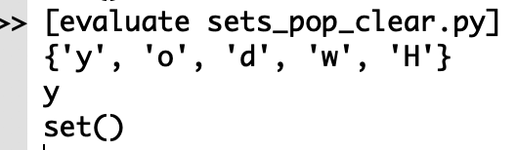
Sets: pop() and clear()
The pop() method removes and returns an element.
An element can be popped arbitrarily from a set.
The clear() methods removes all elements from the set.

Slide 14
Set Operations

Slide 15
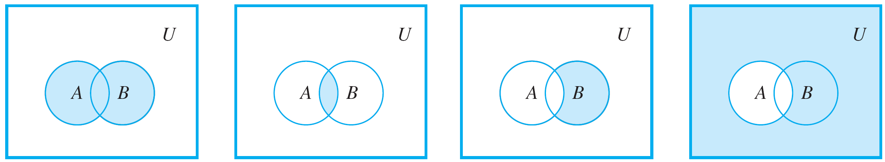
Sets Union
The union of sets A and B is the set of all elements that are in at least one of A or B. Denoted as A ∪ B

Slide 16
Sets Intersection
The intersection of sets A and B is the set of all elements that are common to both A or B. Denoted as A ∩ B

Slide 17
Sets Difference
The difference B minus A is the set of all elements that are in B and not A. Denoted as B - A.

Slide 18
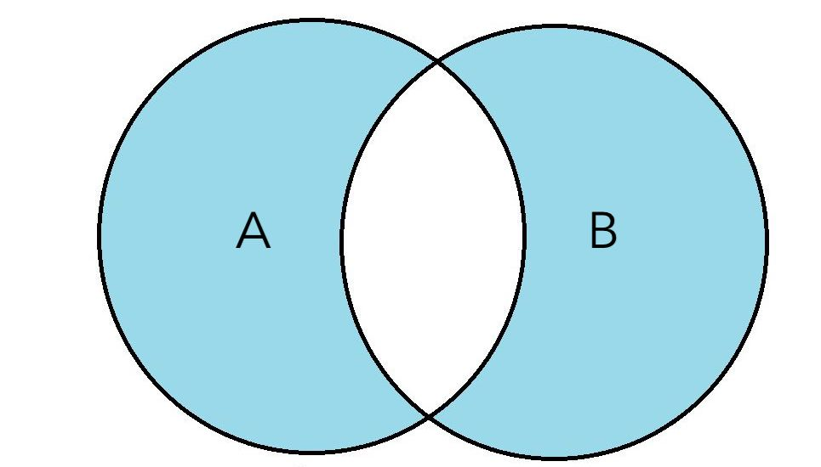
Symmetric Difference
The Symmetric Difference of A and B is a set of elements in both A and B except those that are common in both.
U

Slide 19
Set Complement
The complement of A is the set of all elements in U that are not in A. Denoted as A^{c}

Slide 20
Formal Definitions of Set Operators

Slide 21
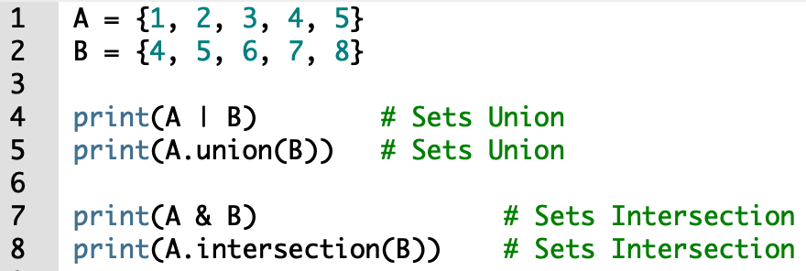
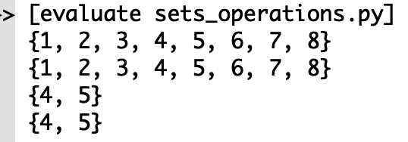
Set: Union and Intersection
Union is done using the | operator or the union() method.
Intersection is done using the & operator or the intersection() method.

Slide 22
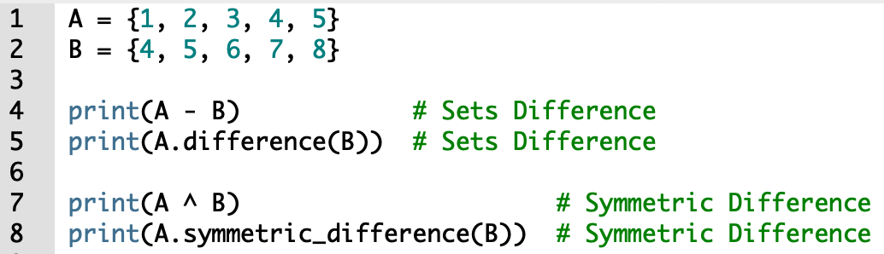
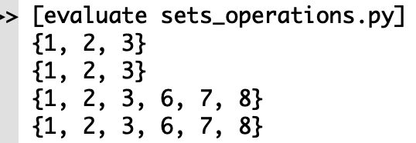
Set: Difference and Symmetric Difference
Difference is done using the - operator or the difference() method.
Symmetric difference is done using the ^ operator or the symmetric_difference() method.

Slide 23
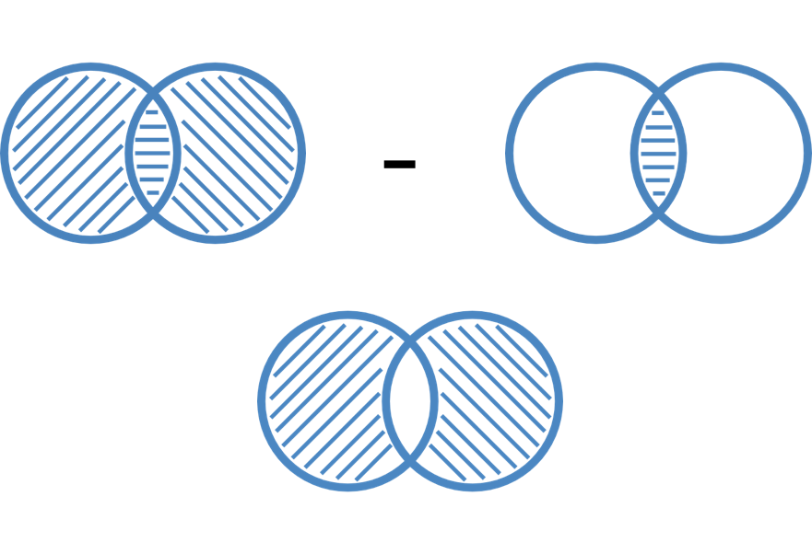
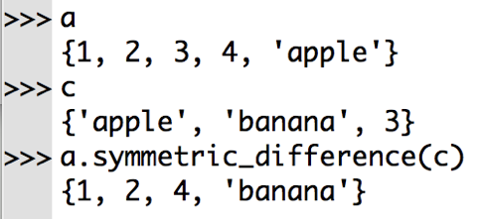
Sets: symmetric difference
A △ B = (A ∪ B) - (A ∩ B)

Slide 24
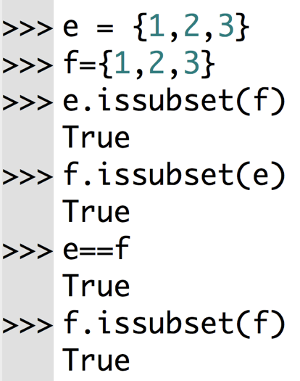
Subsets
A set A is a subset of set B if every element of A is in B. A ⊆ B. a.issubset(c)
U
B
A

Slide 25
Other set methods
difference() | Returns the difference of two or more sets as a new set
difference_update() | Removes all elements of another set from this set
discard() | Removes an element from the set if it is a member
intersection() | Returns the intersection of two sets as a new set
intersection_update() | Updates the set with the intersection of itself and another
isdisjoint() | Returns True if two sets have a null intersection
issubset() | Returns True if another set contains this set
issuperset() | Returns True if this set contains another set
symmetric_difference() | Returns the symmetric difference of two sets as a new set
symmetric_difference_update() | Updates a set with the symmetric difference of itself and another
union() | Returns the union of sets in a new set

Slide 26
Sets: built-in functions
all() | Return True if all elements of the set are true.
any() | Return True if any element of the set is true.
enumerate() | Return an enumerate object. It contains the index and value of all the items of set as a pair.
len() | Return the length of the set.
max() | Return the largest item in the set.
min() | Return the smallest item in the set.
sorted() | Return a new sorted list from elements in the set.
sum() | Return the sum of all elements in the set.

