Slide 1
Python Basics Dictionaries
Dr. Tim McGuire Grateful acknowledgement to David Kebo Houngninou for some of the material contained in these slides

Slide 2
Dictionaries
A dictionary is an unordered collection of elements.
A dictionary is a mapping between the keys and a set of values, which are mutable.
Each key maps to a value. The association of a key and a value is called a key-value pair.

Slide 3
Dictionaries
Keys
are immutable.
can be strings, numbers, and tuples.
are unique in the dictionary.
Values
can be any data type.
can appear repeatedly in the dictionary.

Slide 4
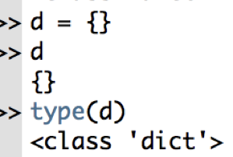
Creating dictionaries
Place elements inside curly braces {} separated by commas.
An element has a key and a value in a pair
Values can be of any data type
Keys are unique and immutable (string, number, tuple)

Slide 5
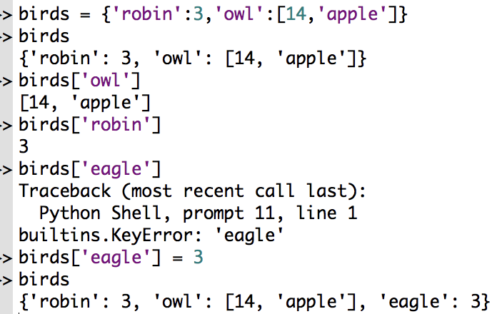
Creating dictionaries
Elements are separated by commas
Keys-values are separated by colons

Slide 6
Dictionaries: keys(), values(), items()
Dictionary methods keys(), values(), and items() return list-like values of a dictionary’s keys, values, or both keys and values.
The values returned are not true lists.
The values cannot be modified and do not have an append() method.
The values returned are iterable and can be used in for loops.

Slide 7
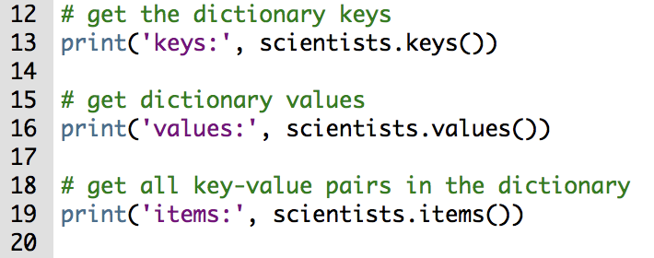
Dictionaries: keys(), values(), items()
The method keys() returns a list-like value of all the available keys in the dictionary.

Slide 8
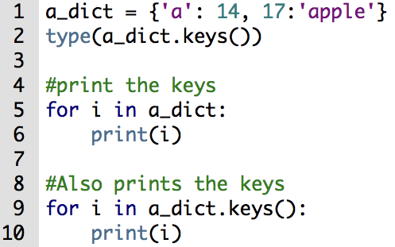
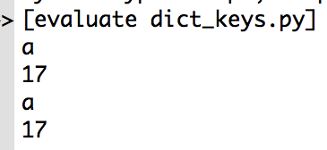
Dictionaries: keys(), values(), items()

Slide 9
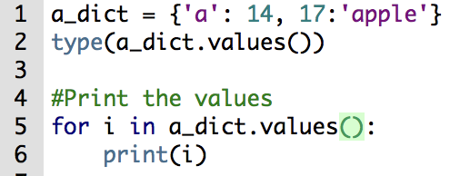
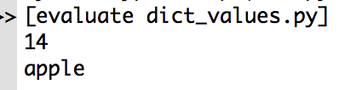
Dictionaries: keys(), values(), items()
The method values() returns a list-like value of all the available values in the dictionary.

Slide 10
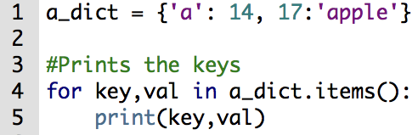
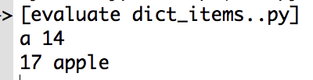
Dictionaries: keys(), values(), items()
The method items() returns a list-like of a list of dictionaries (key, value) tuple pairs.

Slide 11
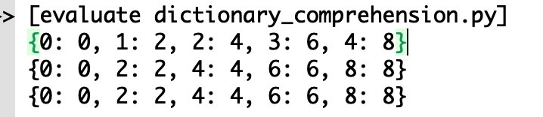
Dictionary comprehension
Comprehension creates a new dictionary from an iterable.
Comprehension uses an expression pair (key: value) followed by a for statement inside curly braces {}.

Slide 12
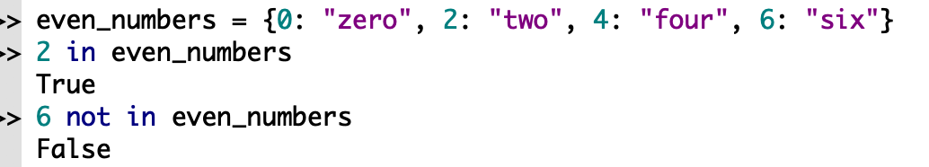
Dictionary membership
We can check if a key exists in a dictionary. Membership verification is for keys only, not values.

Slide 13
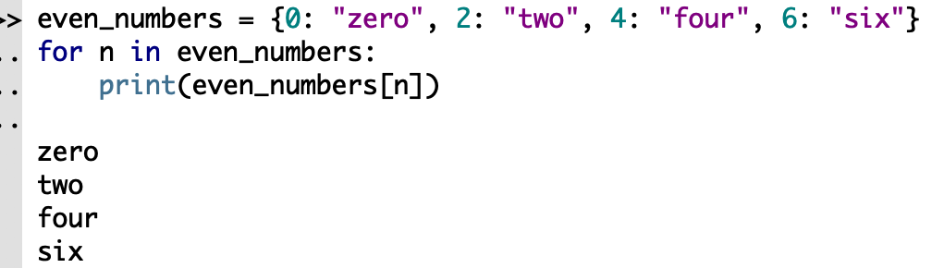
Dictionary iteration
Dictionaries support iteration using its keys.

Slide 14
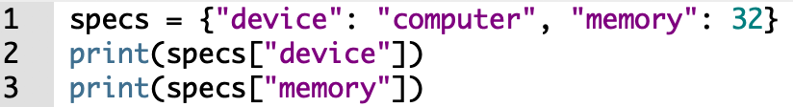
Accessing elements from a dictionary
We can access elements using keys inside square brackets [] or using the get() method.
get() returns None instead of an error if the key is not found.

Slide 15
Accessing elements from a dictionary: get()
The method get() returns the value for the given key.
If the key does not exists, then get() returns a default value.
dict.get (key, default = None)
Parameters:
key - the key to be searched in the dictionary.
default - the value to be returned in case the key does not exist.

Slide 16
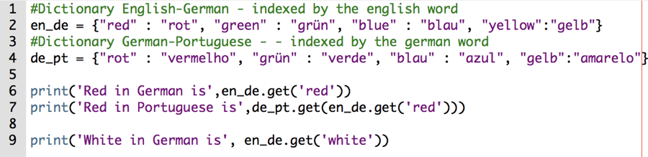
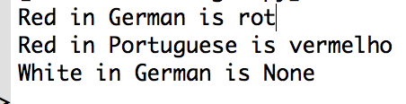
Accessing elements from a dictionary: get()

Slide 17
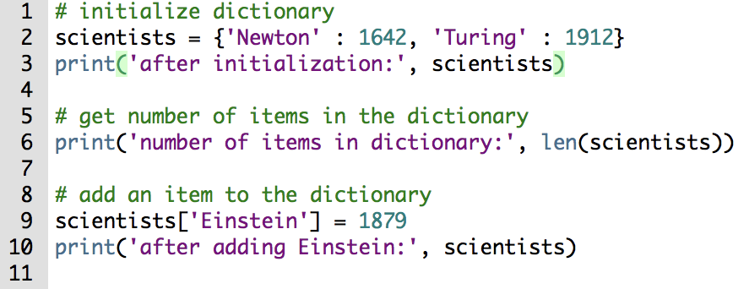
Example

Slide 18
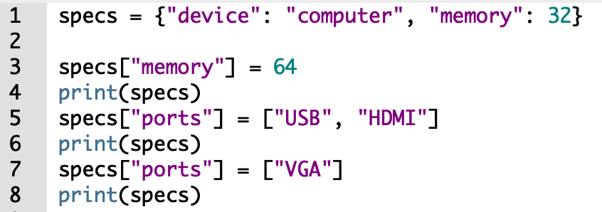
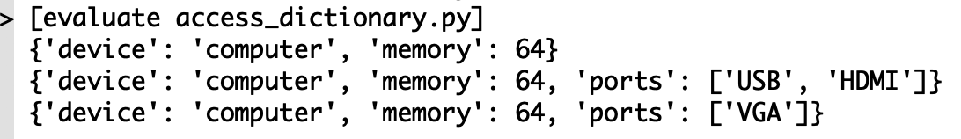
Changing dictionary elements
Dictionaries are mutable.
If a key already exist, the value is updated, else a new key:value pair is added.

Slide 19
Activity 3
Write a program that asks for 4 students names and birth years
1. e.g.
Name, birth year: anna, 1998
Name, birth year: taylor, 1996
Name, birth year: eric, 2003
Name, birth year: ashley, 2001
2. Create a dictionary with key name, and value birth year.
3. Next, your program should swap the keys and the values.
4. Sort the dictionary from youngest to oldest student.

Slide 20
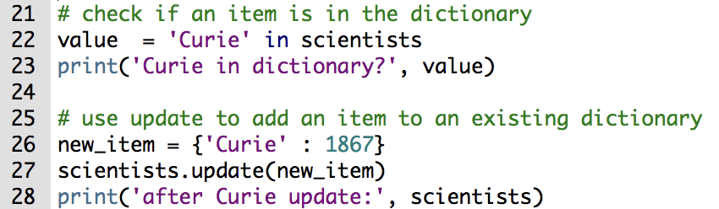
Adding dictionary elements: update()
The update() method updates the dictionary with a key:value pairs, overwriting existing keys.

Slide 21
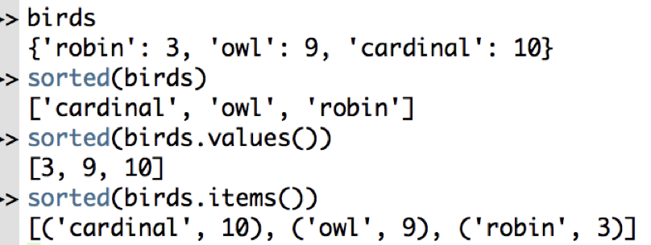
Dictionaries: Sorting elements
Dictionaries are unordered sets.
The sorted() method returns a sorted list of keys in the dictionary.

Slide 22
Deleting dictionary elements
The pop() method removes a particular element from a dictionary.
The popitem() method removes and returns an arbitrary element (key, value) form the dictionary.
The clear() method removes all the elements from the dictionary.
The del keyword removes individual elements or the entire dictionary itself.

Slide 23
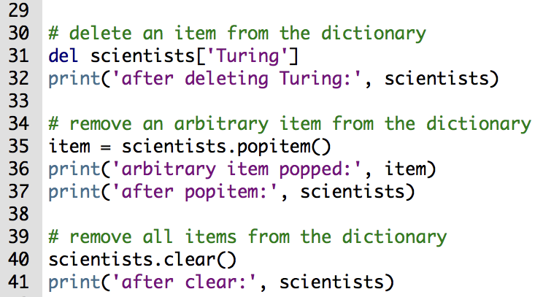
Dictionaries: delete

Slide 24
Dictionaries: Inverted dictionaries
Inverting a dictionary D allows you to use a value to look up a key.
An inverted dictionary D_{inverted} is defined as follows:
The keys of D_{inverted} are the values of D
The values of D_{inverted} are the keys of D.

Slide 25
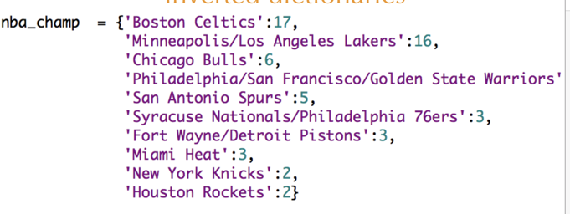
Exercise
Create an inverted dictionary where the keys are the number of NBA Championships and the values are the team names.

Slide 26
Solution
How many keys the inverted dictionary will have?
What are the data types of the keys and the values?

Slide 27
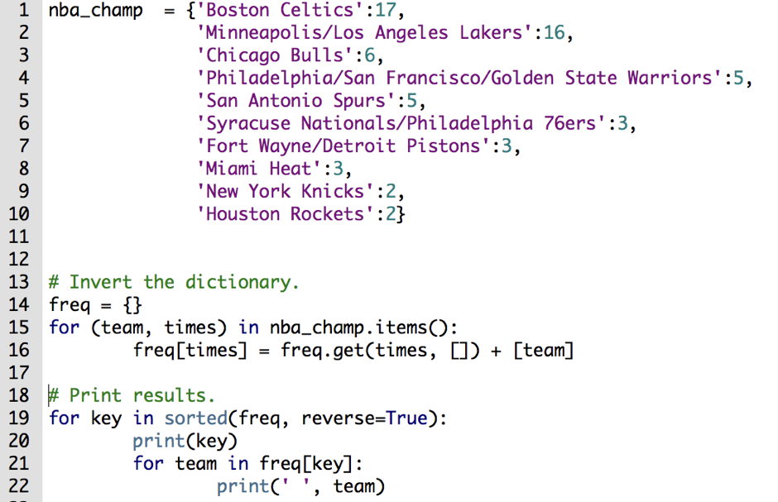
Solution

Slide 28
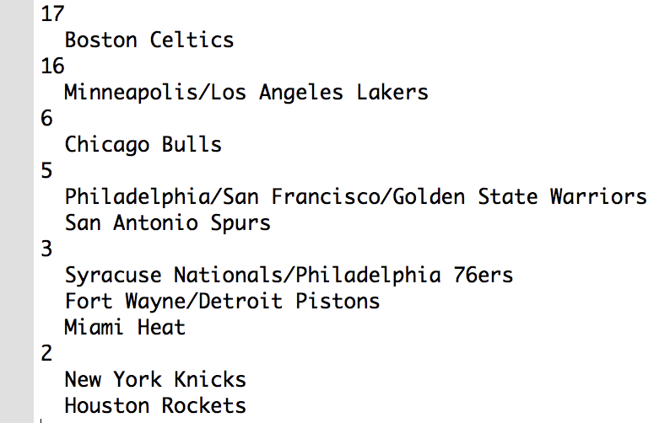
Solution

Slide 29
Other dictionary methods
clear() | Remove all items form the dictionary.
copy() | Return a shallow copy of the dictionary.
fromkeys (seq[, v]) | Return a new dictionary with keys from seq and value equal to v(defaults to None).
get(key[,d]) | Return the value of key. If key does not exit, return d (defaults to None).
items() | Return a new view of the dictionary's items (key, value).
keys() | Return a new view of the dictionary's keys.
pop(key[,d]) | Remove the item with key and return its value or d if key is not found. If d is not provided and key is not found, raises KeyError.
popitem() | Remove and return an arbitrary item (key, value). Raises KeyError if the dictionary is empty.
setdefault(key[,d]) | If key is in the dictionary, return its value. If not, insert key with a value of d and return d (defaults to None).
update([other]) | Update the dictionary with the key/value pairs from other, overwriting existing keys.
values() | Return a new view of the dictionary's values

Slide 30
Dictionaries: built-in functions
all() | Return True if all keys of the dictionary are true (or if the dictionary is empty).
any() | Return True if any key of the dictionary is true. If the dictionary is empty, return False.
len() | Return the length (the number of items) in the dictionary.
cmp() | Compares items of two dictionaries.
sorted() | Return a new sorted list of keys in the dictionary.

