Slide 1
Basics of Python
Collective Data Structures
lists, sets, dictionaries, tuples

Slide 2
Tuples
A tuple is a sequence of values. The values can be of any type, and they are indexed by integers, so in that respect tuples are similar to lists.
Unlike lists, tuples are immutable.
It is common to enclose tuples in parentheses:
t = ('a', 'b', 'c', 'd', 'e')

Slide 3
Creating tuples
Placing all the items inside a parentheses (), separated by comma. The parentheses are optional.
A tuple can have items of different datatypes (int, float, list, string, ...)
Syntactically, a tuple is a comma-separated list of values:
t = 'a', 'b', 'c', 'd', 'e'
It is common to enclose tuples in parentheses:
t = ('a', 'b', 'c', 'd', 'e')

Slide 4
Creating tuples
Note:
A value in parentheses is not a tuple:
t2 = ('a') #t2 is not a tuple, t2 is a string
To create a tuple with a single element, include a final comma:
t1 = ('a',) #t1 is a tuple

Slide 5
Creating tuples: tuple() constructor
The built-in function tuple() creates a tuple.
With no argument, it creates an empty tuple:
t = tuple()
If the argument is a sequence (string, list or tuple), the result is a tuple with the elements of the sequence:
t = tuple('python')
>>> t
('p', 'y', 't', 'h', 'o', 'n')

Slide 6
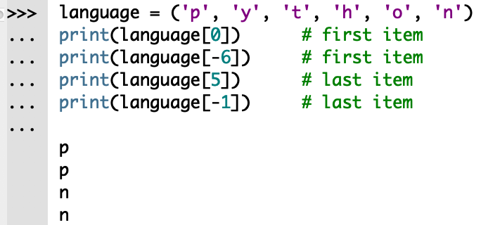
Tuples: indexing
Like strings, each element in a tuple has an index. The index operator [ ] accesses an element in the tuple.
Negative indexing works the same way. Index -1 gets the last item, -2 the second last item etc.

Slide 7
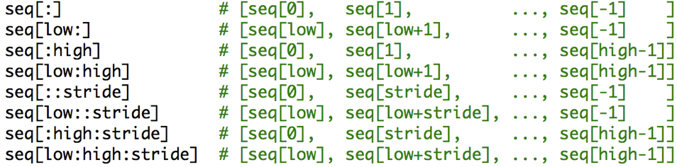
Tuples: slicing operators
To slice a range of elements in a tuple, or sub-tuple, use the slicing operators [:] or [::]

Slide 8
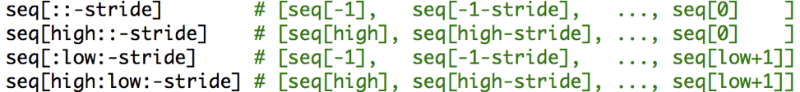
Tuples: slicing operators
To slice a range of elements in a tuple, or sub-tuple, use the slicing operators [:] or [::]
With a negative stride, the ordering changes since we are counting down.

Slide 9
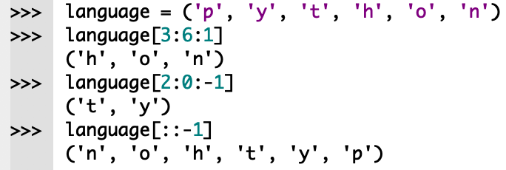
Tuples: slicing operators
To slice a range of elements in a tuple, or sub-tuple, use the slicing operators [:] or [::] with a positive or negative stride.

Slide 10
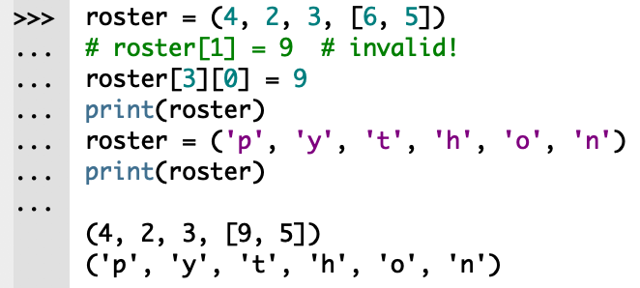
Tuples: changing a tuple
Unlike lists, tuples are immutable.
Elements of a tuple cannot be changed once we create the tuple object.
We can assign a tuple to different values (reassignment).

Slide 11
Tuples: tuple assignment
How can we swap two variables a and b?

Slide 12
Tuples: tuple assignment
How can we swap two variables a and b?
With conventional assignments, use a temporary variable.
temp = a
a = b
b = temp
Are there other methods?

Slide 13
Tuples: tuple assignment
How can we swap two variables a and b?
A tuple assignment is more elegant:
a, b = b, a
Note: # of variables on the left must be equal to # of values on the right:
e.g. a, b = b, a, c is incorrect

Slide 14
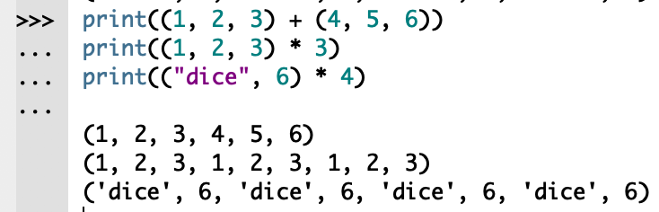
Tuples: concatenation and repetition
The + operator concatenate two tuples.
The * operator repeats a tuple n times.

Slide 15
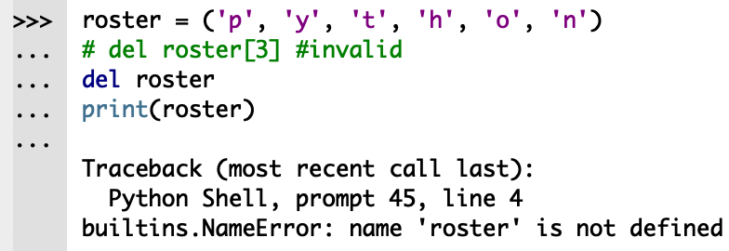
Tuple: delete del
Because a tuple is immutable, we cannot change or delete the items in a tuple.
The del keyword deletes the entire tuple.

Slide 16
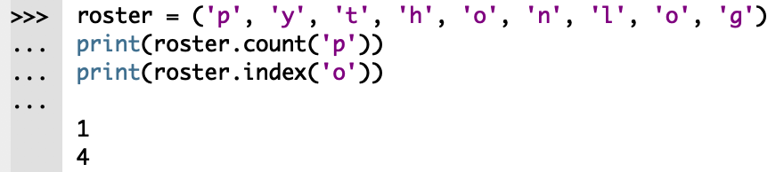
Tuples: count() and index()
tuple.count(x) counts the number of times the item x appears.
tuple.index(x) returns the 1st index where the item x is found.

Slide 17
Tuples: common methods
count(x) | Return the number of items that is equal to x
index(x) | Return index of first item that is equal to x

Slide 18
Tuples: built-in functions
all() | Return True if all elements of the tuple are true (or if the tuple is empty).
any() | Return True if any element of the tuple is true. If the tuple is empty, return False.
enumerate() | Return an enumerate object. It contains the index and value of all the items of tuple as pairs.
len() | Return the length (the number of items) in the tuple.
tuple() | Convert an iterable (list, string, set, dictionary) to a tuple.
max() | Return the largest item in the tuple.
min() | Return the smallest item in the tuple
sorted() | Return a new sorted tuple (does not sort the tuple itself).
sum() | Return the sum of all elements in the tuple.

