Slide 1
Basics of Python
Randomness

Slide 2
Randomness: Guessing game
Write a program to play the Guessing Game, where the goal is to guess a secret number between 1 and 100.
The program generates a secret number between 1 and 100.
If the users guess is wrong the program shows if the guess is too low or too high and keeps asking for a new number.
The program should count and show the number of guesses.

Slide 3
Deterministic vs. non-deterministic programs
Computer programs generate the same outputs every time (deterministic).
To make a program non-deterministic we can use algorithms that generate pseudorandom numbers.
Pseudorandom numbers are not truly random because they are generated by a deterministic computation.

Slide 4
Randomness: random module
Some programs require randomness.
Python comes with a module, called random, that allows us to use random numbers in our programs.
The sequence of numbers generated depends on a seed.
Because the random number generation is not truly random, the seed is the number that generates the random numbers.

Slide 5
What is a module in Python?
The core part of the Python language consists of:
if statements
math operators
loops
print
input
Everything else is contained in modules.
If we want to use something from a module, we import the module.
In other words, we tell Python that we want to use the module.

Slide 6
What is a module in Python?
A module is a file that contains Python code.
e.g.: puzzle.py is a module
The name of the module is puzzle.
To import a module, use the import keyword follows by the name of the module:
import puzzle
Python supports standard and user-defined modules.
Random is a Python standard module.

Slide 7
What is a module in Python?
guessing_game.py
matplotlib.py
import random
import matplotlib
import math
random.py
math.py

Slide 8
Randomness: random module
1. Import the module:
random generates pseudo-random numbers.
To import the functions from the module, use the import keyword
import random
2. Call the functions (use the module name first)
random.randint(1, 100)
random.randint(1, 3)
random.choice(['r', 'p', 's'])

Slide 9
Import operations
We can rename a module
import random as dice
print("Roll it!", dice.randint(1,6))
We can import specific definitions from a module
from random import randint
print("Roll it!", randint(1,6))
We can import all definitions from a module
from random import *
print("Roll it!", randint(1,6))
print("Guess a letter!", choice('abcdefghij'))

Slide 10
Randomness: random module definitions
The function dir() prints the definitions that are defined inside a module.
List all the definitions in the random module
import random
dir(random)

Slide 11
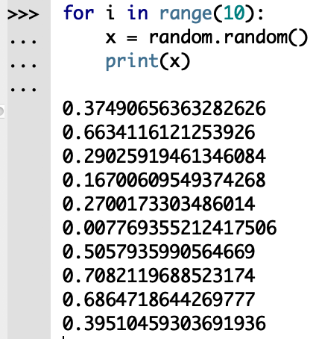
Randomness: random() function
The function random() returns a random float between 0.0 and 1.0 (including 0.0 but not 1.0).
Each time we call random, we get the next random number.

Slide 12
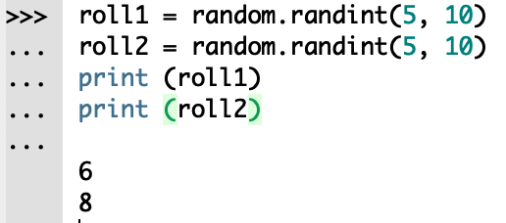
Randomness: randint() function
The function randint() takes parameters low and high and returns an integer between low and high (including both).

Slide 13
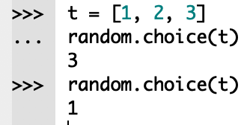
Randomness: choice() function
The function choice() chooses an element from a sequence at random.

Slide 14
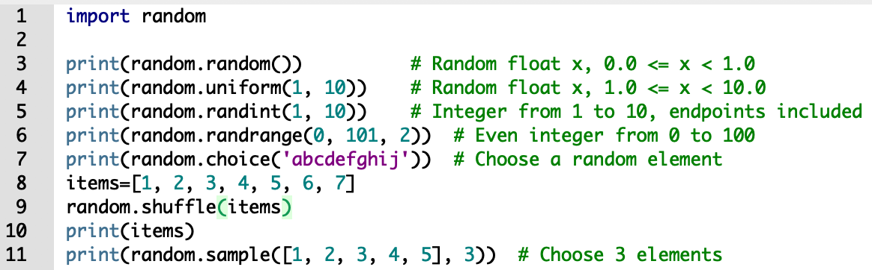
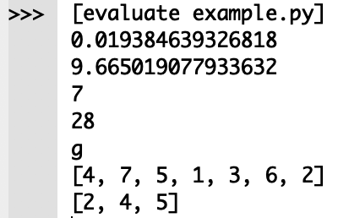
Examples

Slide 15
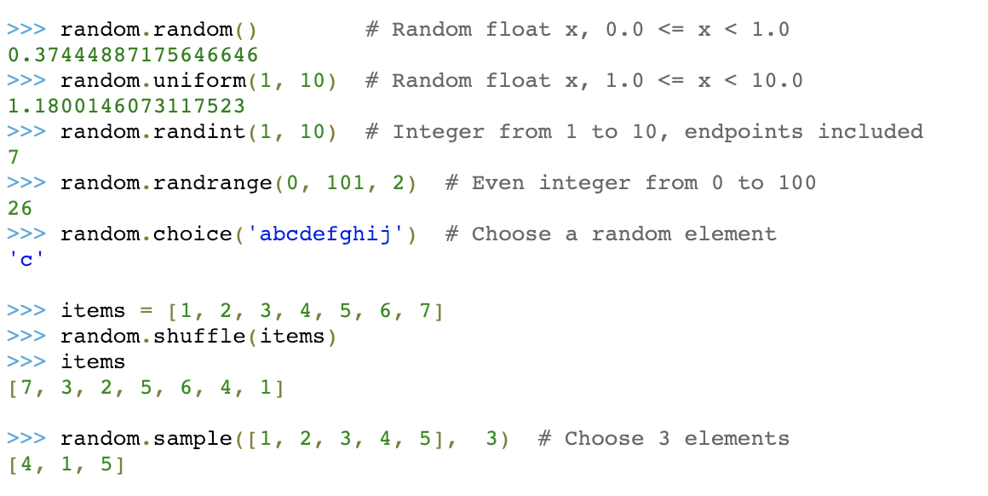
Examples

Slide 16
Problem
The goal of the Guessing Game is to guess a secret number between 1 and 100.
The program generates a secret number between 1 and 100.
If the users guess is wrong, the program prompts if the guess is too low or too high and keeps asking for a new number.
The program should count and show the number of guesses.
Draw the flowchart and write the code for this program.

Slide 17
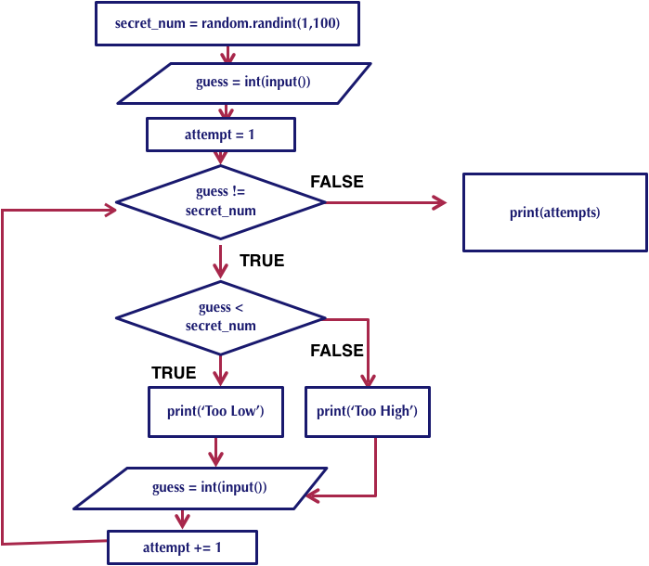
Flowchart

Slide 18
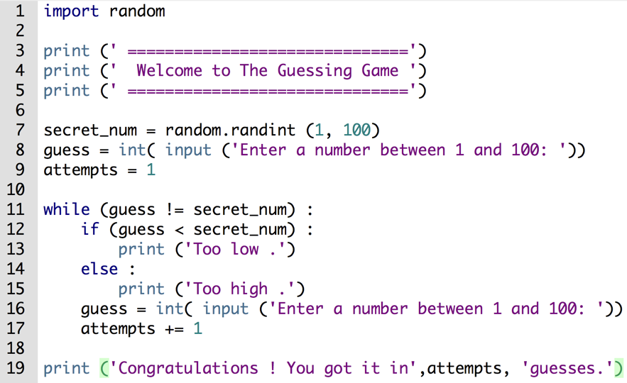
Guessing game: solution

Slide 19
Random module: common function
seed(a=None, version=2) | Initialize the random number generator
getstate() | Returns an object capturing the current internal state of the generator
setstate(state) | Restores the internal state of the generator
getrandbits(k) | Returns a Python integer with k random bits
randrange(start, stop[, step]) | Returns a random integer from the range
randint(a, b) | Returns a random integer between a and b inclusive
choice(seq) | Return a random element from the non-empty sequence
shuffle(seq) | Shuffle the sequence
sample(population, k) | Return a k length list of unique elements chosen from the population sequence
random() | Return the next random floating point number in the range [0.0, 1.0)
uniform(a, b) | Return a random floating point number between a and b inclusive

