Slide 1
Introduction to Object-Oriented Programming

Slide 2
Procedural Programming
Procedural programming: writing programs made of functions that perform specific tasks
Procedures typically operate on data items that are separate from the procedures
Data items commonly passed from one procedure to another
Focus: to create procedures that operate on the program’s data

Slide 3
Object-Oriented Programming (1 of 4)
Object-oriented programming: focused on creating objects
Object: entity that contains data and procedures
Data is known as data attributes and procedures are known as methods
Methods perform operations on the data attributes
Encapsulation: combining data and code into a single object

Slide 4
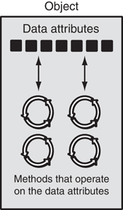
Object-Oriented Programming (2 of 4)
Graphic from Gaddis, Starting out with Java
An object contains data attributes and methods

Slide 5
Object-Oriented Programming (3 of 4)
Data hiding: object’s data attributes are hidden from code outside the object
Access restricted to the object’s methods
Protects from accidental corruption
Outside code does not need to know internal structure of the object
Object reusability: the same object can be used in different programs
Example: 3D image object can be used for architecture and game programming

Slide 6
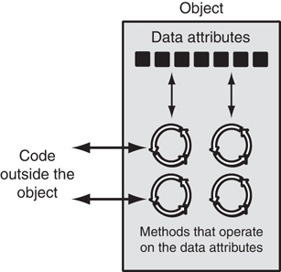
Object-Oriented Programming (4 of 4)
Graphic from Gaddis, Starting out with Java
Code outside the object interacts with the object’s methods

Slide 7
Object-Oriented Programming
An object can contain:
data in the form of fields/attributes
code in the form of procedures/methods
e.g. A race car has:
Attributes: horse power, brand, wheel size, weight, color
Methods: accelerate(), navigate(), turn()

Slide 8
Object-Oriented Programming: class
A class is a blueprint or description for an object.
e.g. If manufacturing a race car, a class would contain all the details about the brand, weight, engine size, horse-power etc.
class RaceCar:
The class keyword defines an new class called RaceCar.
Using the class RaceCar, we can build multiple race car objects.
Remember to add a docstring to describe the class!

Slide 9
Classes (1 of 2)
Class: code that specifies the data attributes and methods of a particular type of object
Similar to a blueprint of a house or a cookie cutter
Instance: an object created from a class
Similar to a specific house built according to the blueprint or a specific cookie
There can be many instances of one class

Slide 10
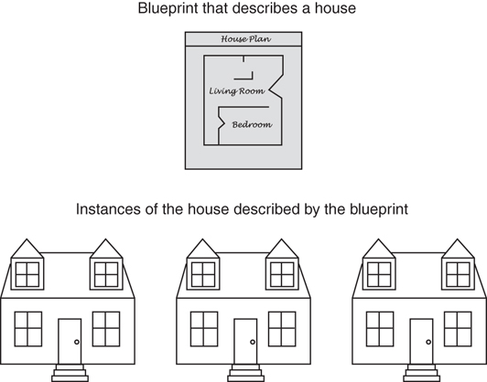
Classes (2 of 2)
Graphic from Gaddis, Starting out with Java
A blueprint and houses built from the blueprint

Slide 11
Object-Oriented Programming: constructor
The constructor is a special function that we call whenever a new object is instantiated.
The constructor initializes the attributes of the class.
Special class functions begin with double underscore ‘__’.
The name of the constructor is the __init__() function.
__init__ is a reserved method in python classes.

Slide 12
Class Definitions
Class definition: set of statements that define a class’s methods and data attributes
Format: begin with class Class_name:
Class names often start with uppercase letter
Method definition like any other python function definition
self parameter: required in every method in the class – references the specific object that the method is working on

Slide 13
Class Definitions (cont’d)
Constructor Method: automatically executed when an instance of the class is created
Initializes object’s data attributes and assigns self parameter to the object that was just created
Format: def __init__ (self):
Usually the first method in a class definition

Slide 14
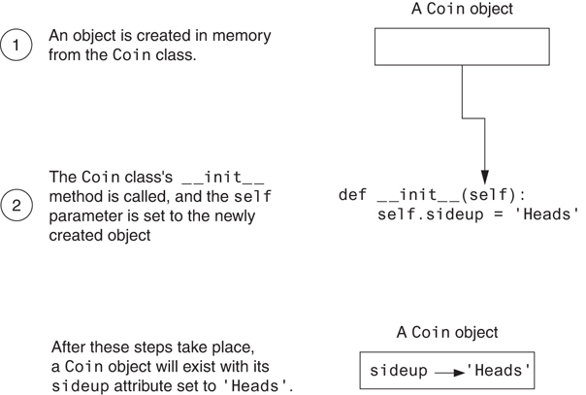
Class Definitions (cont’d)

Slide 15
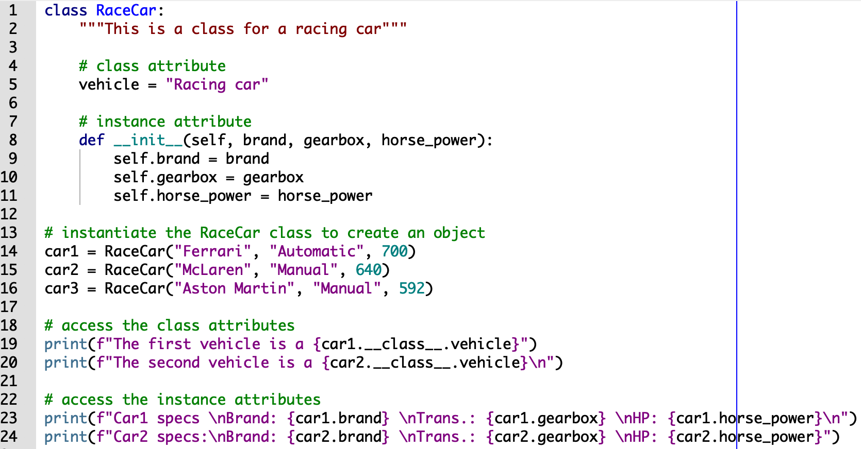
Object-Oriented Programming: constructor
In the example below, the constructor for the class RaceCar initializes the instance attributes brand, gearbox, and horse_power.

Slide 16
Class Definitions
To create a new instance of a class call the initializer method
Format: My_instance = Class_Name()
To call any of the class methods using the created instance, use dot notation
Format: My_instance.method()
Because the self parameter references the specific instance of the object, the method will affect this instance
Reference to self is passed automatically

Slide 17
Object-Oriented Programming: object
An object or instance is an instantiation of a class.
car1 = RaceCar()
car1 is an object of class RaceCar.
We can create objects with different attributes using one class.

Slide 18
Object-Oriented Programming: self parameter
The self parameter allows referring to the current object in a method.
When defining an instance method, the first parameter of the method should always be the object itself: self.
self represents the instance of the class. The self keyword can access the attributes and methods of the class.

Slide 19
Object-Oriented Programming: object

Slide 20
Object-Oriented Programming: principles
In Python, Object-oriented programming follows some principles:
Inheritance | Enables new objects to take on the properties of existing objects.
Encapsulation | Hides the private properties of a class from other objects.
Polymorphism | Enables an object to take on many forms.

Slide 21
Hiding Attributes and Storing Classes in Modules
An object’s data attributes should be private
To make sure of this, place two underscores (__) in front of attribute name
Example: __current_minute
Classes can be stored in modules
Filename for module must end in .py
Module can be imported to programs that use the class

Slide 22
Accessor and Mutator Methods
Typically, all of a class’s data attributes are private and provide methods to access and change them
Accessor methods: return a value from a class’s attribute without changing it
Safe way for code outside the class to retrieve the value of attributes
Mutator methods: store or change the value of a data attribute

Slide 23
Passing Objects as Arguments
Methods and functions often need to accept objects as arguments
When you pass an object as an argument, you are actually passing a reference to the object
The receiving method or function has access to the actual object
Methods of the object can be called within the receiving function or method, and data attributes may be changed using mutator methods

Slide 24
Finding the Classes in a Problem (1 of 4)
When developing object oriented program, first goal is to identify classes
Typically involves identifying the real-world objects that are in the problem
Technique for identifying classes:
Get written description of the problem domain
Identify all nouns in the description, each of which is a potential class
Refine the list to include only classes that are relevant to the problem

Slide 25
Finding the Classes in a Problem (2 of 4)
Get written description of the problem domain
May be written by you or by an expert
Should include any or all of the following:
Physical objects simulated by the program
The role played by a person
The result of a business event
Recordkeeping items

Slide 26
Finding the Classes in a Problem (3 of 4)
Identify all nouns in the description, each of which is a potential class
Should include noun phrases and pronouns
Some nouns may appear twice

Slide 27
Finding the Classes in a Problem (4 of 4)
Refine the list to include only classes that are relevant to the problem
Remove nouns that mean the same thing
Remove nouns that represent items that the program does not need to be concerned with
Remove nouns that represent objects, not classes
Remove nouns that represent simple values that can be assigned to a variable

Slide 28
Identifying a Class’s Responsibilities
A classes responsibilities are:
The things the class is responsible for knowing
Identifying these helps identify the class’s data attributes
The actions the class is responsible for doing
Identifying these helps identify the class’s methods
To find out a class’s responsibilities look at the problem domain
Deduce required information and actions

Slide 29
Introduction to Inheritance (1 of 2)
In the real world, many objects are a specialized version of more general objects
Example: grasshoppers and bees are specialized types of insect
In addition to the general insect characteristics, they have unique characteristics:
Grasshoppers can jump
Bees can sting, make honey, and build hives

Slide 30
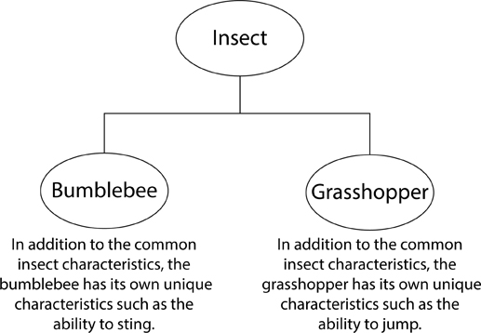
Introduction to Inheritance (2 of 2)
Graphic from Gaddis, Starting out with Java
Bumblebees and grasshoppers are specialized versions of an insect

Slide 31
Inheritance and the “Is a” Relationship (1 of 4)
“Is a” relationship: exists when one object is a specialized version of another object
Specialized object has all the characteristics of the general object plus unique characteristics
Examples:
Rectangle is a shape
Daisy is a flower

Slide 32
Inheritance and the “Is a” Relationship (2 of 4)
Inheritance: used to create an “is a” relationship between classes
Parent class (base class): a general class
Child class (derived class): a specialized class
An extended version of the parent class
Inherits attributes and methods of the parent class
New attributes and methods can be added

Slide 33
Inheritance and the “Is a” Relationship (3 of 4)
For example, need to create classes for cars, pickup trucks, and SUVs
All are automobiles
Have a make, year model, mileage, and price
This can be the attributes for the base class
In addition:
Car has a number of doors
Pickup truck has a drive type
SUV has a passenger capacity

Slide 34
Inheritance and the “Is a” Relationship (4 of 4)
In a class definition for a child class:
To indicate inheritance, the parent class name is placed in parentheses after child class name
Example: class Car(Automobile):
The initializer method of a child class calls the initializer method of the parent class and then initializes the unique data attributes
Add method definitions for unique methods

Slide 35
Object-Oriented Programming: inheritance
As we’ve seen, inheritance enables a new class to use using details of an existing class without modifying it.
The new class is a child class.
The existing class is a parent class.
The child class inherits features from the parent class, adding new features to it.
Note: Python provides a function issubclass() that directly tells us if a class is subclass (child class) of another class.

Slide 36
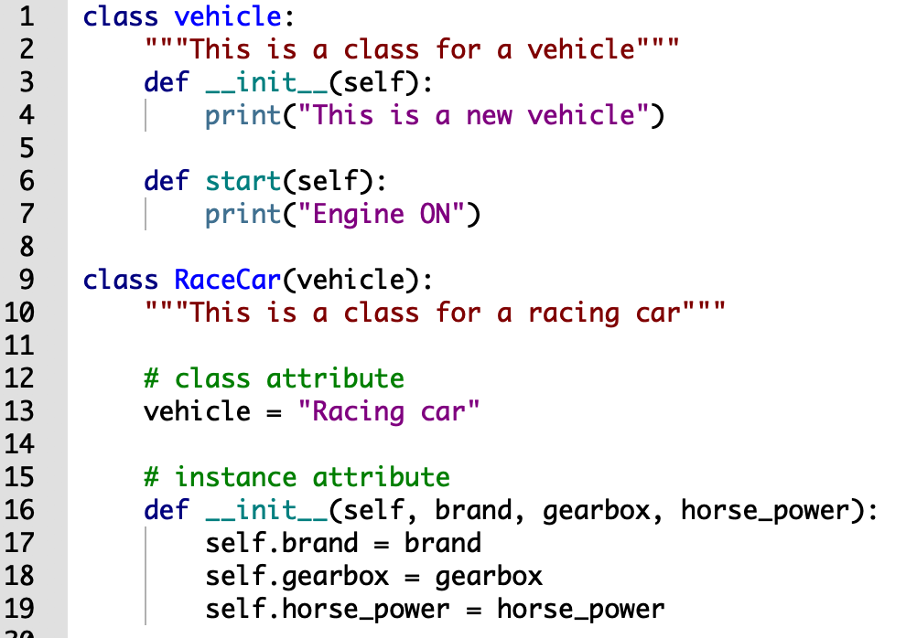
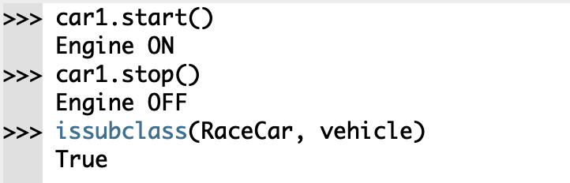
Object-Oriented Programming: inheritance
The child class RaceCar() inherits the functions of the parent class vehicle().

Slide 37
Object-Oriented Programming: encapsulation
We can restrict access to methods and variables.
Encapsulation hides the private properties of a class from other objects.
In Python, we denote private attribute using underscore as prefix ‘_’ or double ‘__’.

Slide 38
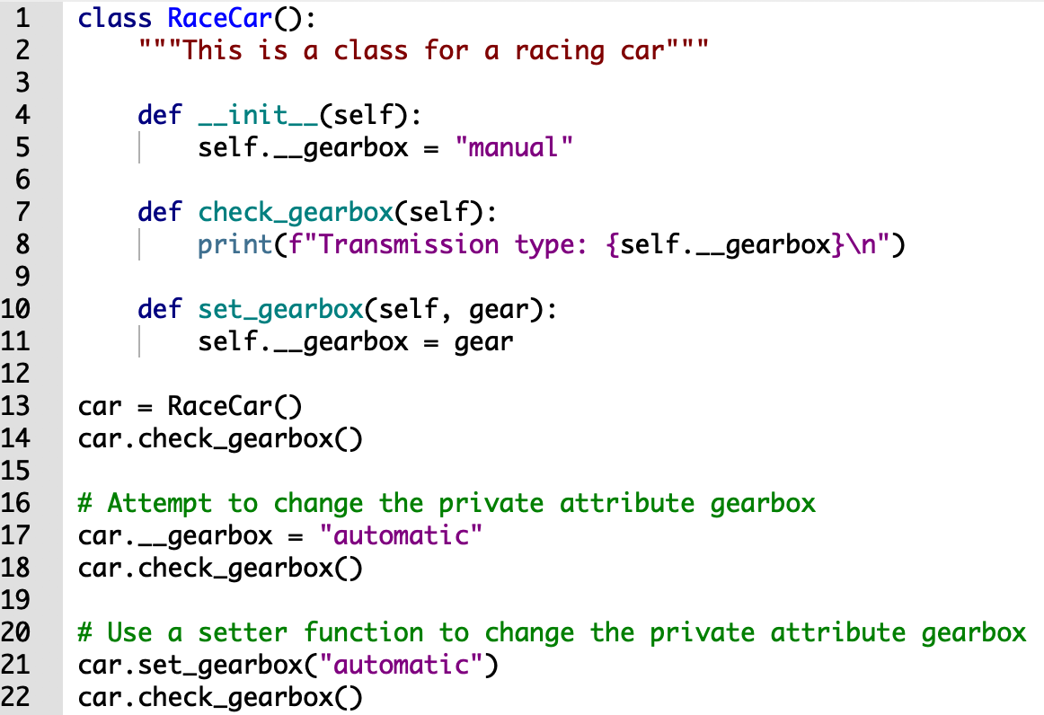
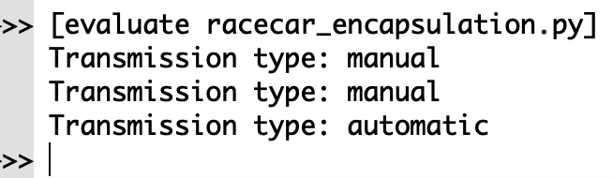
Object-Oriented Programming: encapsulation
It is not possible to change to private attribute using the assignment on line 17.
We can use a setter (or mutator) function instead.

Slide 39
Object-Oriented Programming: polymorphism
Polymorphism is the ability of an object to take on many forms.
Polymorphism allows to define methods in the child class that have the same name as the methods in the parent class.
When several classes have the same method names, but different implementations for these methods, the classes are polymorphic.
A function can evaluate these polymorphic methods without knowing which classes are invoked.

Slide 40
Polymorphism (cont’d)
Essential ingredients of polymorphic behavior:
Ability to define a method in a parent class and override it in a child class
Child class defines method with the same name
Ability to call the correct version of overridden method depending on the type of object that called for it
In previous inheritance examples showed how to override the _ _init_ _ method
Called parent class _ _init_ _ method and then added onto that
The same can be done for any other method
The method can call the parent class equivalent and add to it, or do something completely different

Slide 41
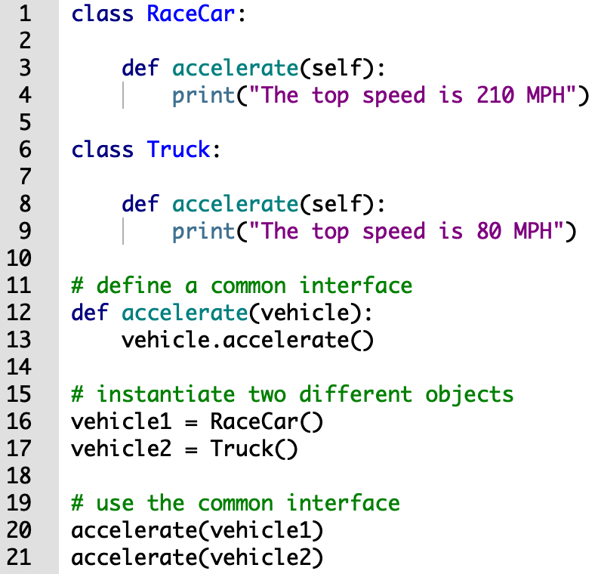
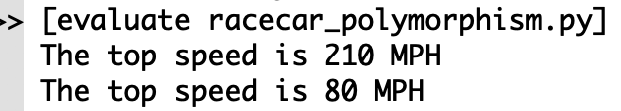
Object-Oriented Programming: polymorphism
We defined two classes Racecar and Truck.
Both classes have a common method accelerate()
The function of each method is different.
The name of the common interface is accelerate()

Slide 42
The isinstance Function
Polymorphism provides great flexibility when designing programs
AttributeError exception: raised when a method is receives an object which is not an instance of the right class
isinstance function: determines whether object is an instance of a class
Format: isinstance(object, class)

