Slide 1
Python Graphics Turtle Graphics
Dr. Tim McGuire

Slide 2
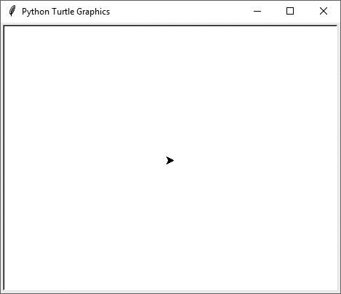
Introduction to Turtle Graphics (1 of 2)
Python's turtle graphics system displays a small cursor known as a turtle.
You can use Python statements to move the turtle around the screen, drawing lines and shapes.

Slide 3
Introduction to Turtle Graphics (2 of 2)
To use the turtle graphics system, you must import the turtle module with this statement: import turtle This loads the turtle module into memory

Slide 4
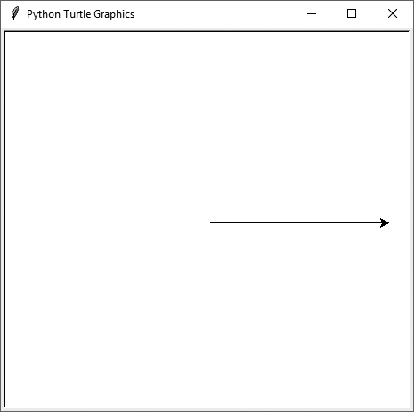
Moving the Turtle Forward
Use the turtle.forward(n) statement to move the turtle forward n pixels.
>>> import turtle
>>> turtle.forward(100)
>>>

Slide 5
Turning the Turtle (1 of 3)
The turtle's initial heading is 0 degrees (east)
Use the turtle.right(angle) statement to turn the turtle right by angle degrees.
Use the turtle.left(angle) statement to turn the turtle left by angle degrees.

Slide 6
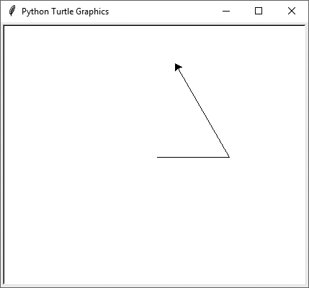
Turning the Turtle (2 of 3)
>>> import turtle
>>> turtle.forward(100)
>>> turtle.left(120)
>>> turtle.forward(100)
>>>

Slide 7
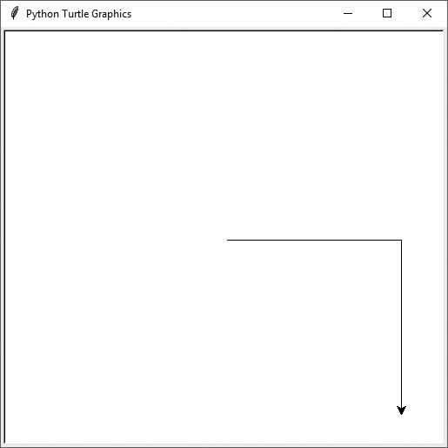
Turning the Turtle (3 of 3)
>>> import turtle
>>> turtle.forward(100)
>>> turtle.right(90)
>>> turtle.forward(100)
>>>

Slide 8
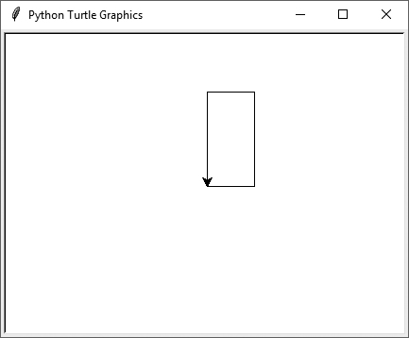
Setting the Turtle's Heading
Use the turtle.setheading(angle) statement to set the turtle's heading to a specific angle.
>>> import turtle
>>> turtle.forward(50)
>>> turtle.setheading(90)
>>> turtle.forward(100)
>>> turtle.setheading(180)
>>> turtle.forward(50)
>>> turtle.setheading(270)
>>> turtle.forward(100)
>>>

Slide 9
Setting the Pen Up or Down (1 of 2)
When the turtle's pen is down, the turtle draws a line as it moves. By default, the pen is down.
When the turtle's pen is up, the turtle does not draw as it moves.
Use the turtle.penup() statement to raise the pen.
Use the turtle.pendown() statement to lower the pen.

Slide 10
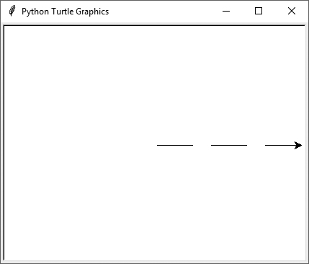
Setting the Pen Up or Down (2 of 2)
>>> import turtle
>>> turtle.forward(50)
>>> turtle.penup()
>>> turtle.forward(25)
>>> turtle.pendown()
>>> turtle.forward(50)
>>> turtle.penup()
>>> turtle.forward(25)
>>> turtle.pendown()
>>> turtle.forward(50)
>>>

Slide 11
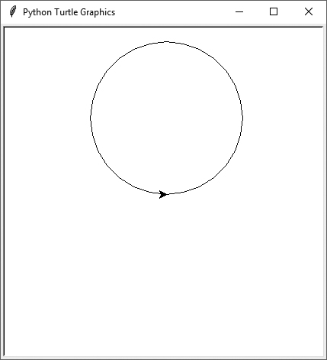
Drawing Circles
Use the turtle.circle(radius) statement to draw a circle with a specified radius.
>>> import turtle
>>> turtle.circle(100)
>>>

Slide 12
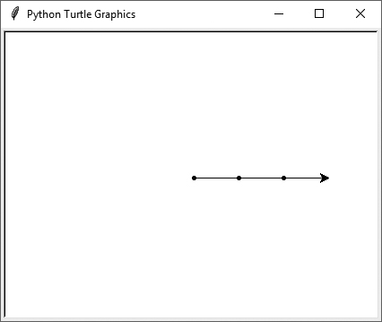
Drawing Dots
Use the turtle.dot() statement to draw a simple dot at the turtle's current location.
>>> import turtle
>>> turtle.dot()
>>> turtle.forward(50)
>>> turtle.dot()
>>> turtle.forward(50)
>>> turtle.dot()
>>> turtle.forward(50)
>>>

Slide 13
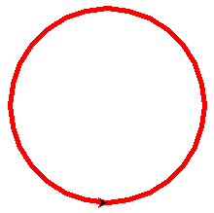
Changing the Pen Size and Drawing Color
Use the turtle.pensize(width) statement to change the width of the turtle's pen, in pixels.
Use the turtle.pencolor(color) statement to change the turtle's drawing color.
Colors include: "blue","black","brown","red","yellow","green","orange","beige","turquoise","pink"
>>> import turtle
>>> turtle.pensize(5)
>>> turtle.pencolor('red')
>>> turtle.circle(100)
>>>

Slide 14
Working with the Turtle's Window
Use the turtle.bgcolor(color) statement to set the window's background color.
Use the turtle.setup(width,height)statement to set the size of the turtle's window, in pixels.
The width and height arguments are the width and height, in pixels.
For example, the following interactive session creates a graphics window that is 640 pixels wide and 480 pixels high:
>>> import turtle
>>> turtle.setup(640, 480)
>>>

Slide 15
Resetting the Turtle’s Window (1 of 3)
The turtle.reset() statement:
Erases all drawings that currently appear in the graphics window.
Resets the drawing color to black.
Resets the turtle to its original position in the center of the screen.
Does not reset the graphics window’s background color.

Slide 16
Resetting the Turtle’s Window (2 of 3)
The turtle.clear() statement:
Erases all drawings that currently appear in the graphics window.
Does not change the turtle's position.
Does not change the drawing color.
Does not change the graphics window’s background color.

Slide 17
Resetting the Turtle’s Window (3 of 3)
The turtle.clearscreen() statement:
Erases all drawings that currently appear in the graphics window.
Resets the drawing color to black.
Resets the turtle to its original position in the center of the screen.
Resets the graphics window’s background color to white.

Slide 18
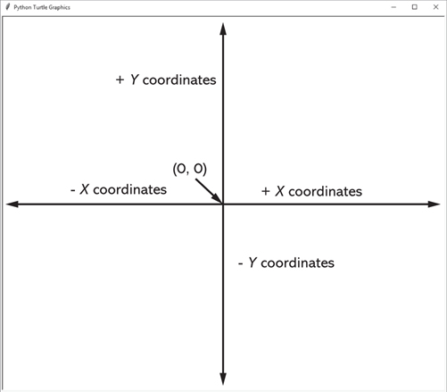
Working with Coordinates
The turtle uses Cartesian Coordinates

Slide 19
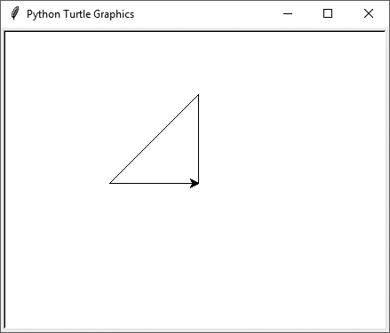
Moving the Turtle to a Specific Location
Use the turtle.goto(x, y) statement to move the turtle to a specific location.
>>> import turtle
>>> turtle.goto(0, 100)
>>> turtle.goto(−100, 0)
>>> turtle.goto(0, 0)
>>>
The turtle.pos() statement displays the turtle's current X,Y coordinates.
The turtle.xcor() statement displays the turtle's current X coordinate and the turtle.ycor() statement displays the turtle's current Y coordinate.

Slide 20
Animation Speed
Use the turtle.speed(speed) command to change the speed at which the turtle moves.
The speed argument is a number in the range of 0 through 10.
If you specify 0, then the turtle will make all of its moves instantly (animation is disabled).

Slide 21
Hiding and Displaying the Turtle
Use the turtle.hideturtle() command to hide the turtle.
This command does not change the way graphics are drawn, it simply hides the turtle icon.
Use the turtle.showturtle() command to display the turtle.

Slide 22
Displaying Text (1 of 2)
Use the turtle.write(text) statement to display text in the turtle's graphics window.
The text argument is a string that you want to display.
The lower-left corner of the first character will be positioned at the turtle’s X and Y coordinates.

Slide 23
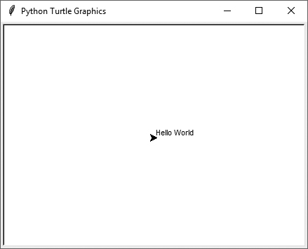
Displaying Text (2 of 2)
>>> import turtle
>>> turtle.write('Hello World')
>>>

Slide 24
Filling Shapes (1 of 2)
To fill a shape with a color:
Use the turtle.begin_fill() command before drawing the shape
Then use the turtle.end_fill() command after the shape is drawn.
When the turtle.end_fill() command executes, the shape will be filled with the current fill color

Slide 25
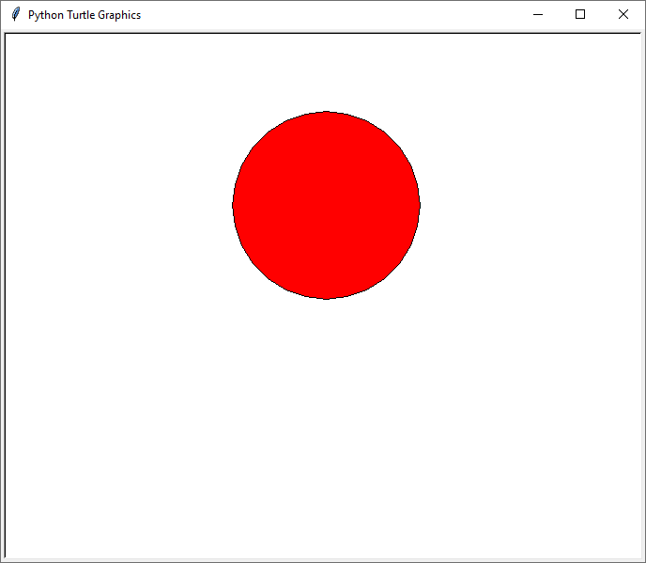
Filling Shapes (2 of 2)
>>> import turtle
>>> turtle.hideturtle()
>>> turtle.fillcolor('red')
>>> turtle.begin_fill()
>>> turtle.circle(100)
>>> turtle.end_fill()
>>>

Slide 26
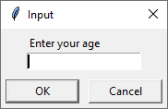
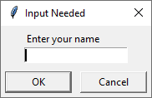
Getting Input With a Dialog Box (1 of 2)
>>> import turtle
>>> age = turtle.numinput('Input', 'Enter your age')
>>> import turtle
>>> name = turtle.textinput('Input Needed', 'Enter your name')

Slide 27
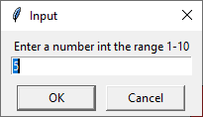
Getting Input With a Dialog Box (2 of 2)
Specifying a default value, minimum value, and maximum value with turtle.numinput:
An error message will be displayed if the input is less than minval or greater than maxval
>>> import turtle
>>> num = turtle.numinput('Input', 'Enter a number',5, minval=10, maxval=10)

Slide 28
Keeping the Graphics Window Open
When running a turtle graphics program outside an IDE, the graphics window closes immediately when the program is done.
To prevent this, add the turtle.done() statement to the very end of your turtle graphics programs.
This will cause the graphics window to remain open, so you can see its contents after the program finishes executing.

Slide 29
Turtle Graphics: Determining the State of the Turtle (1 of 9)
The turtle.xcor() and turtle.ycor() functions return the turtle's X and Y coordinates
Examples of calling these functions in an if statement:
if turtle.ycor() < 0:
turtle.goto(0, 0)
if turtle.xcor() > 100 and turtle.xcor() < 200:
turtle.goto(0, 0)

Slide 30
Turtle Graphics: Determining the State of the Turtle (2 of 9)
The turtle.heading() function returns the turtle's heading. (By default, the heading is returned in degrees.)
Example of calling the function in an if statement:
if turtle.heading() >= 90 and turtle.heading() <= 270:
turtle.setheading(180)

Slide 31
Turtle Graphics: Determining the State of the Turtle (3 of 9)
The turtle.isdown() function returns True if the pen is down, or False otherwise.
Example of calling the function in an if statement:
if turtle.isdown():
turtle.penup()
if not(turtle.isdown()):
turtle.pendown()

Slide 32
Turtle Graphics: Determining the State of the Turtle (4 of 9)
The turtle.isvisible() function returns True if the turtle is visible, or False otherwise.
Example of calling the function in an if statement:
if turtle.isvisible():
turtle.hideturtle()

Slide 33
Turtle Graphics: Determining the State of the Turtle (5 of 9)
When you call turtle.pencolor() without passing an argument, the function returns the pen's current color as a string. Example of calling the function in an if statement:
When you call turtle.fillcolor() without passing an argument, the function returns the current fill color as a string. Example of calling the function in an if statement:
if turtle.pencolor() == 'red':
turtle.pencolor('blue')
if turtle.fillcolor() == 'blue':
turtle.fillcolor('white')

Slide 34
Turtle Graphics: Determining the State of the Turtle (6 of 9)
When you call turtle.bgcolor() without passing an argument, the function returns the current background color as a string. Example of calling the function in an if statement:
if turtle.bgcolor() == 'white':
turtle.bgcolor('gray')

Slide 35
Turtle Graphics: Determining the State of the Turtle (7 of 9)
When you call turtle.pensize() without passing an argument, the function returns the pen's current size as a string. Example of calling the function in an if statement:
if turtle.pensize() < 3:
turtle.pensize(3)

Slide 36
Turtle Graphics: Determining the State of the Turtle (8 of 9)
When you call turtle.speed()without passing an argument, the function returns the current animation speed. Example of calling the function in an if statement:
if turtle.speed() > 0:
turtle.speed(0)

Slide 37
Turtle Graphics: Using Loops to Draw Designs (1 of 4)
You can use loops with the turtle to draw both simple shapes and elaborate designs. For example, the following for loop iterates four times to draw a square that is 100 pixels wide:
for x in range(4):
turtle.forward(100)
turtle.right(90)

Slide 38
Turtle Graphics: Using Loops to Draw Designs (2 of 4)
This for loop iterates eight times to draw the octagon:
for x in range(8):
turtle.forward(100)
turtle.right(45)

Slide 39
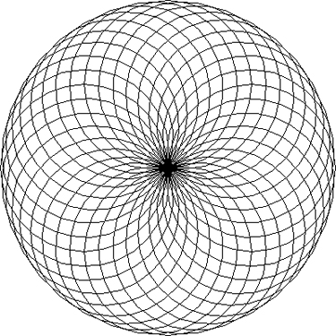
Turtle Graphics: Using Loops to Draw Designs (3 of 4)
You can create interesting designs by repeatedly drawing a simple shape, with the turtle tilted at a slightly different angle each time it draws the shape.
NUM_CIRCLES = 36 # Number of circles to draw
RADIUS = 100 # Radius of each circle
ANGLE = 10 # Angle to turn
for x in range(NUM_CIRCLES):
turtle.circle(RADIUS)
turtle.left(ANGLE)

Slide 40
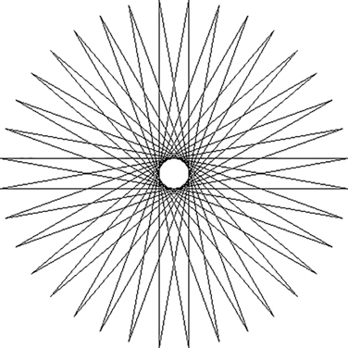
Turtle Graphics: Using Loops to Draw Designs (4 of 4)
This code draws a sequence of 36 straight lines to make a "starburst" design.
START_X = -200 # Starting X coordinate
START_Y = 0 # Starting Y coordinate
NUM_LINES = 36 # Number of lines to draw
LINE_LENGTH = 400 # Length of each line
ANGLE = 170 # Angle to turn
turtle.hideturtle()
turtle.penup()
turtle.goto(START_X, START_Y)
turtle.pendown()
for x in range(NUM_LINES):
turtle.forward(LINE_LENGTH)
turtle.left(ANGLE)

Slide 41
Turtle Graphics: Modularizing Code with Functions (1 of 6)
Commonly needed turtle graphics operations can be stored in functions and then called whenever needed.
For example, the following function draws a square. The parameters specify the location, width, and color.
def square(x, y, width, color):
turtle.penup() # Raise the pen
turtle.goto(x, y) # Move to (X,Y)
turtle.fillcolor(color) # Set the fill color
turtle.pendown() # Lower the pen
turtle.begin_fill() # Start filling
for count in range(4): # Draw a square
turtle.forward(width)
turtle.left(90)
turtle.end_fill() # End filling

Slide 42
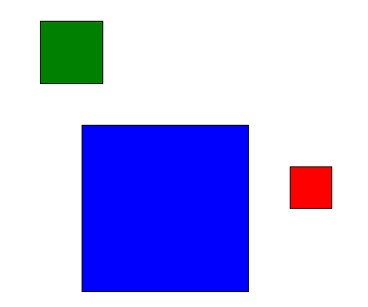
Turtle Graphics: Modularizing Code with Functions (2 of 6)
The following code calls the previously shown square function to draw three squares:
square(100, 0, 50, 'red')
square(-150, -100, 200, 'blue')
square(-200, 150, 75, 'green')

Slide 43
Turtle Graphics: Modularizing Code with Functions (3 of 6)
The following function draws a circle. The parameters specify the location, radius, and color.
def circle(x, y, radius, color):
turtle.penup() # Raise the pen
turtle.goto(x, y - radius) # Position the turtle
turtle.fillcolor(color) # Set the fill color
turtle.pendown() # Lower the pen
turtle.begin_fill() # Start filling
turtle.circle(radius) # Draw a circle
turtle.end_fill() # End filling

Slide 44
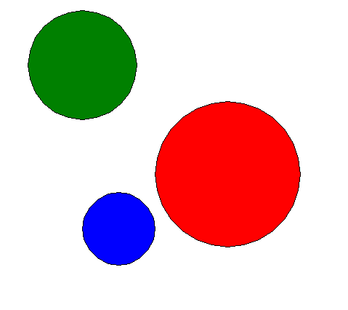
Turtle Graphics: Modularizing Code with Functions (4 of 6)
The following code calls the previously shown circle function to draw three circles:
circle(0, 0, 100, 'red')
circle(-150, -75, 50, 'blue')
circle(-200, 150, 75, 'green')

Slide 45
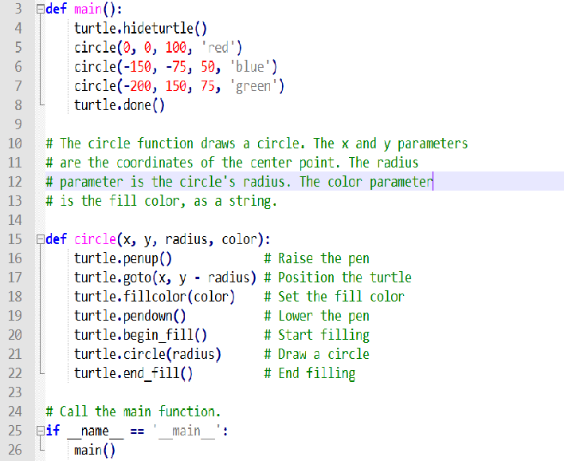


Slide 46
Turtle Graphics: Modularizing Code with Functions (5 of 6)
The following function draws a line. The parameters specify the starting and ending locations, and color.
def line(startX, startY, endX, endY, color):
turtle.penup() # Raise the pen
turtle.goto(startX, startY) # Move to the starting point
turtle.pendown() # Lower the pen
turtle.pencolor(color) # Set the pen color
turtle.goto(endX, endY) # Draw a square

Slide 47
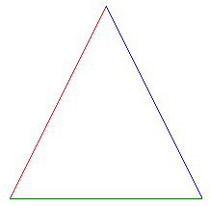
Turtle Graphics: Modularizing Code with Functions (6 of 6)
The following code calls the previously shown line function to draw a triangle:
TOP_X = 0
TOP_Y = 100
BASE_LEFT_X = -100
BASE_LEFT_Y = -100
BASE_RIGHT_X = 100
BASE_RIGHT_Y = -100
line(TOP_X, TOP_Y, BASE_LEFT_X, BASE_LEFT_Y, 'red')
line(TOP_X, TOP_Y, BASE_RIGHT_X, BASE_RIGHT_Y, 'blue')
line(BASE_LEFT_X, BASE_LEFT_Y, BASE_RIGHT_X, BASE_RIGHT_Y, 'green')

