Slide 1
Python Graphics matplotlib
Dr. Tim McGuire

Slide 2
Plotting Data with matplotlib (1 of 4)
The matplotlib package is a library for creating two-dimensional charts and graphs.
It is not part of the standard Python library, so you will have to install it separately, after you have installed Python on your system.
matplotlib replicates the plotting capability of MATLAB, an engineering-oriented programming language. matplotlib is short for "MATLAB plotting library."
matplotlib is not included with Python, but can be downloaded and installed from http://matplotlib.org/downloads.html. matplotlib also requires the NumPy package.

Slide 3
Plotting Data with matplotlib (2 of 4)
To install matplotlib on a Windows system, open a Command Prompt window and enter this command:
To install matplotlib on a Mac or Linux system, open a Terminal window and enter this command:
pip install matplotlib
sudo pip3 install matplotlib

Slide 4
Plotting Data with matplotlib (3 of 4)
To verify the package was installed, start IDLE and enter this command:
If you don't see any error messages, you can assume the package was properly installed.
>>> import matplotlib

Slide 5
Plotting Data with matplotlib (4 of 4)
The matplotlib package contains a module named pyplot that you will need to import.
pyplot is a collection of command style functions to generate plots quickly.
pyplot functions makes some change to a figure: e.g.
creates a figure
creates a plotting area in a figure
plots some lines in a plotting area
decorates the plot with labels, etc.
Use the following import statement to import the module and create an alias named plt:
import matplotlib.pyplot as plt

Slide 6
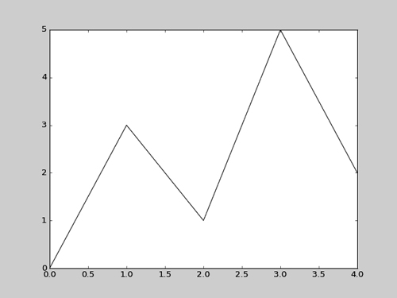
Plotting a Line Graph with the plot Function (1 of 4)
Use the plot function to create a line graph that connects a series of points with straight lines.
The line graph has a horizontal X axis, and a vertical Y axis.
Each point in the graph is located at a (X,Y) coordinate.

Slide 7
Plotting a Line Graph with the plot Function (2 of 4)
line_graph1.py
1 # This program displays a simple line graph.
2 import matplotlib.pyplot as plt
3
4 def main():
5 # Create lists with the X and Y coordinates of each data point.
6 x_coords = [0, 1, 2, 3, 4]
7 y_coords = [0, 3, 1, 5, 2]
8
9 # Build the line graph.
10 plt.plot(x_coords, y_coords)
11
12 # Display the line graph.
13 plt.show()
14
15 # Call the main function.
16 if __name__ == '__main__':
17 main()

Slide 8
Plotting a Line Graph with the plot Function (3 of 4)
You can change the lower and upper limits of the X and Y axes by calling the xlim and ylim functions. Example:
This code does the following:
Causes the X axis to begin at 1 and end at 100
Causes the Y axis to begin at 10 and end at 50
plt.xlim(xmin=1, xmax=100)
plt.ylim(ymin=10, ymax=50)

Slide 9
Plotting a Line Graph with the plot Function (4 of 4)
You can customize each tick mark’s label with the xticks and yticks functions.
These functions each take two lists as arguments.
The first argument is a list of tick mark locations
The second argument is a list of labels to display at the specified locations.
plt.xticks([0, 1, 2, 3, 4], ['2016', '2017', '2018', '2019', '2020'])
plt.yticks([0, 1, 2, 3, 4, 5], ['$0m', '$1m', '$2m', '$3m', '$4m', '$5m'])

Slide 10
line_graph2.py
1 # This program displays a simple line graph. 2 import matplotlib.pyplot as plt 3 4 def main(): 5 # Create lists with the X,Y coordinates of each data point. 6 x_coords = [0, 1, 2, 3, 4] 7 y_coords = [0, 3, 1, 5, 2] 8 9 # Build the line graph. 10 plt.plot(x_coords, y_coords, marker='o') 11 12 # Add a title. 13 plt.title('Sales by Year') 14 15 # Add labels to the axes. 16 plt.xlabel('Year') 17 plt.ylabel('Sales') 18

Slide 11
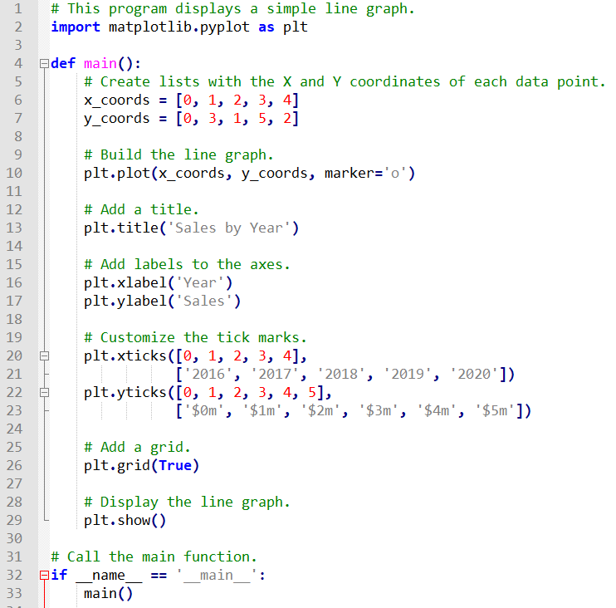
line_graph2.py

Slide 12
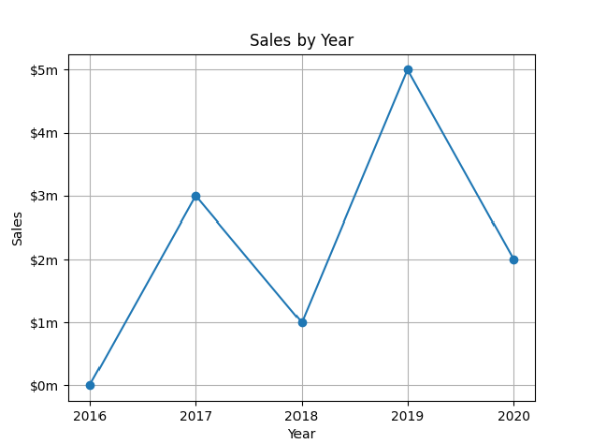
Output of linegraph2.py
Displayed by the title() function.
Displayed by the yticks() function.
Displayed by the ylabel() function.
Displayed by the xticks() function.
Displayed by the xlabel() function.

Slide 13
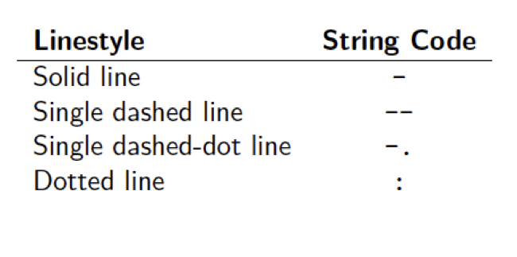
Plotting: linestyle
plt.plot([0,1,2,3,4], [9,4,5,2,3], marker='o', color='blue', linestyle=':')

Slide 14
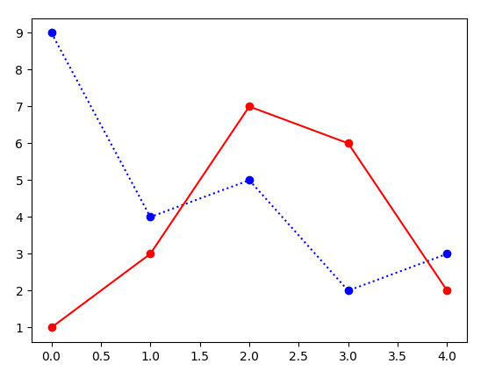
Plotting: multiple plots
plt.plot([0,1,2,3,4], [9,4,5,2,3], marker='o', color='blue', linestyle=':')
plt.plot([0,1,2,3,4], [1,3,7,6,2], marker='o', color='red', linestyle='-')

Slide 15
Plotting a Bar Chart (1 of 6)
Use the bar function in the matplotlib.pyplot module to create a bar chart.
The function needs two lists: one with the X coordinates of each bar’s left edge, and another with the heights of each bar, along the Y axis.

Slide 16
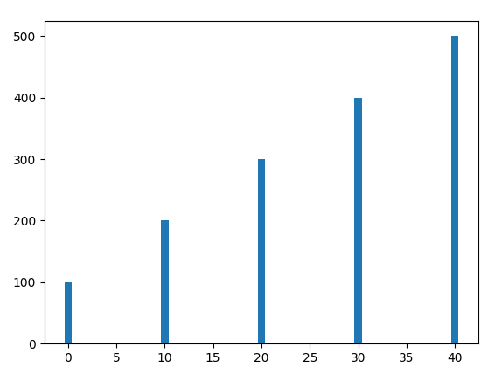
Plotting a Bar Chart (2 of 6)
left_edges = [0, 10, 20, 30, 40]
heights = [100, 200, 300, 400, 500]
plt.bar(left_edges, heights)
plt.show()

Slide 17
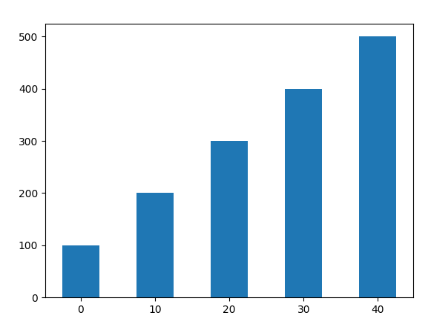
Plotting a Bar Chart (3 of 6)
The default width of each bar in a bar graph is 0.8 along the X axis.
You can change the bar width by passing a third argument to the bar function.
left_edges = [0, 10, 20, 30, 40]
heights = [100, 200, 300, 400, 500]
bar_width = 5
plt.bar(left_edges, heights, bar_width)
plt.show()

Slide 18
Plotting a Bar Chart (4 of 6)
The bar function has a color parameter that you can use to change the colors of the bars.
The argument that you pass into this parameter is a tuple containing a series of color codes.
Color Code | Corresponding Color
'b' | Blue
'g' | Green
'r' | Red
'c' | Cyan
'm' | Magenta
'y' | Yellow
'k' | Black
'w' | White

Slide 19
Plotting a Bar Chart (5 of 6)
Example of how to pass a tuple of color codes as a keyword argument: The colors of the bars in the resulting bar chart will be as follows:
The first bar will be red.
The second bar will be green.
The third bar will be blue.
The fourth bar will be white.
The fifth bar will be black.
plt.bar(left_edges, heights, color=('r', 'g', 'b', 'w', 'k'))

Slide 20
Plotting a Bar Chart (6 of 6)
Use the xlabel and ylabel functions to add labels to the X and Y axes.
Use the xticks function to display custom tick mark labels along the X axis
Use the yticks function to display custom tick mark labels along the Y axis.

Slide 21
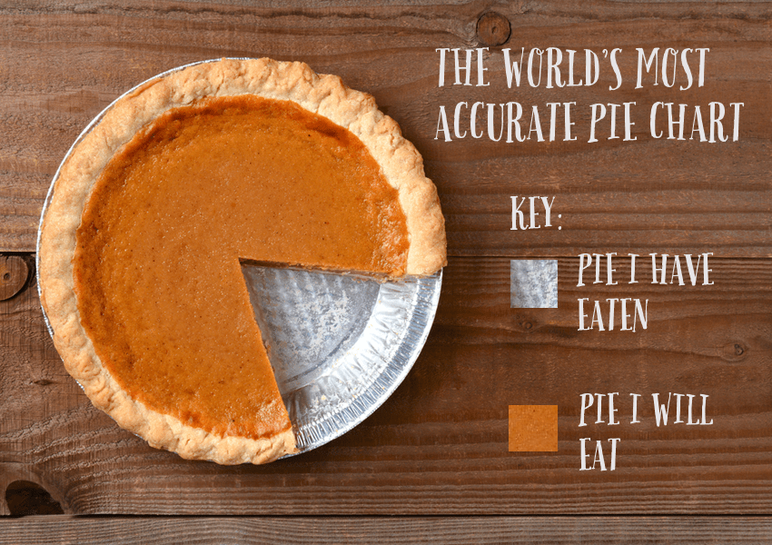

Slide 22
Plotting a Pie Chart (1 of 4)
You use the pie function in the matplotlib.pyplot module to create a pie chart.
When you call the pie function, you pass a list of values as an argument.
The sum of the values will be used as the value of the whole.
Each element in the list will become a slice in the pie chart.
The size of a slice represents that element's value as a percentage of the whole.

Slide 23
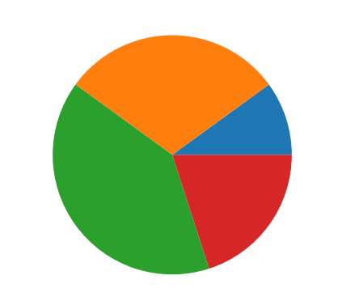
Plotting a Pie Chart (2 of 4)
Example
values = [20, 60, 80, 40]
plt.pie(values)
plt.show()

Slide 24
Plotting a Pie Chart (3 of 4)
The pie function has a labels parameter that you can use to display labels for the slices in the pie chart.
The argument that you pass into this parameter is a list containing the desired labels, as strings.

Slide 25
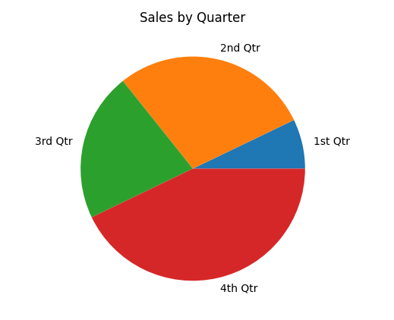
Plotting a Pie Chart (4 of 4)
Example
sales = [100, 400, 300, 600]
slice_labels = ['1st Qtr', '2nd Qtr', '3rd Qtr', '4th Qtr']
plt.pie(sales, labels=slice_labels)
plt.title('Sales by Quarter')
plt.show()

Slide 26
Plotting a Pie Chart
The pie function automatically changes the color of the slices, in the following order:
blue, green, red, cyan, magenta, yellow, black, and white.
You can specify a different set of colors, however, by passing a tuple of color codes as an argument to the pie function’s colors parameter:
When this statement executes, the colors of the slices in the resulting pie chart will be red, green, blue, white, and black.
plt.pie(values, colors=('r', 'g', 'b', 'w', 'k'))

Slide 27
Exercise
Write a program in Python that simulates the number of heads and tails that appear using a fair coin with:
10 flips
100 flips
1,000 flips
10,000 flips
100,000 flips
1,000,000 flips
Calculate the average and plot the results in a line chart, defining one curve of each output.

Slide 28
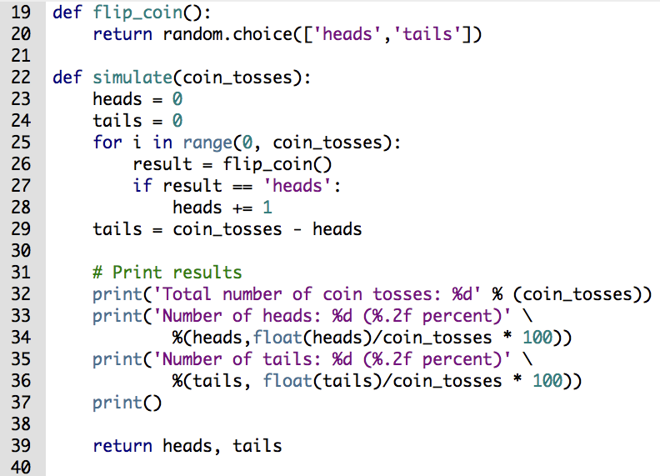
Exercise: perform simulation

Slide 29
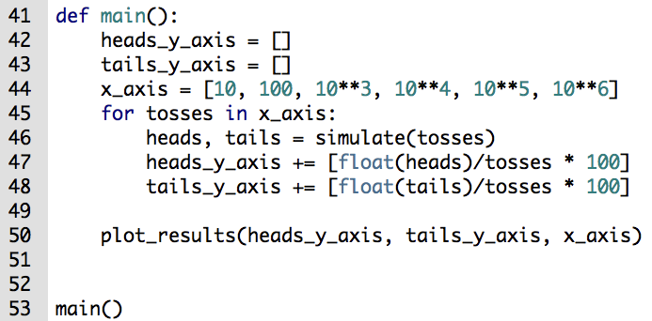
Exercise: save the plot data

Slide 30
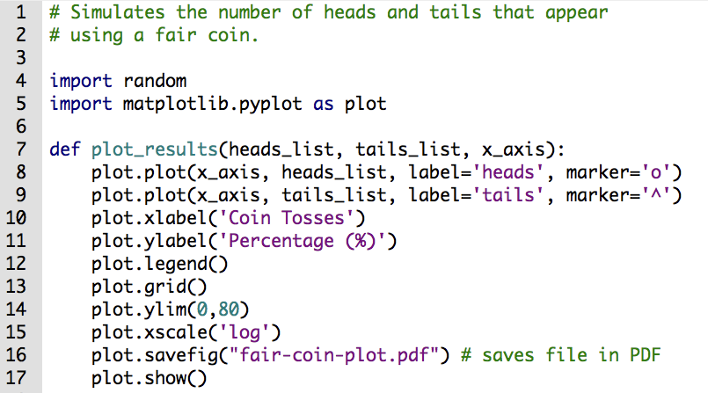
Exercise: plot the line chart

Slide 31
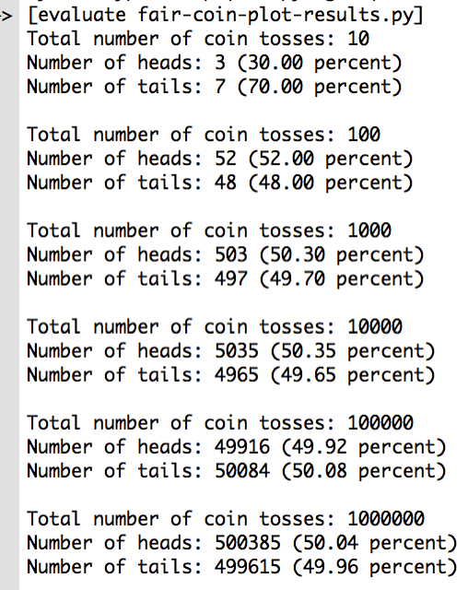
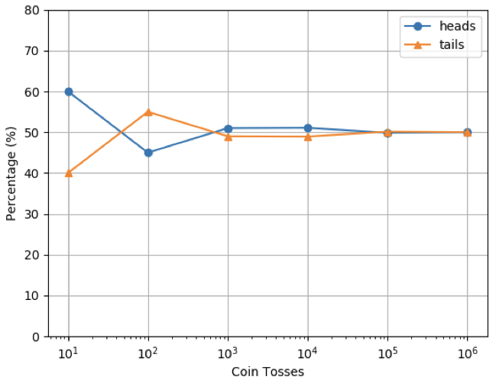
Exercise: line chart analysis

Slide 32
Plotting: using NumPy
NumPy is the fundamental package for scientific computing with Python.
NumPy provides:
N-dimensional array objects
Sophisticated functions
Tools for integrating C/C++ code
Linear algebra, trigonometry, Fourier transform, and random numbers

Slide 33
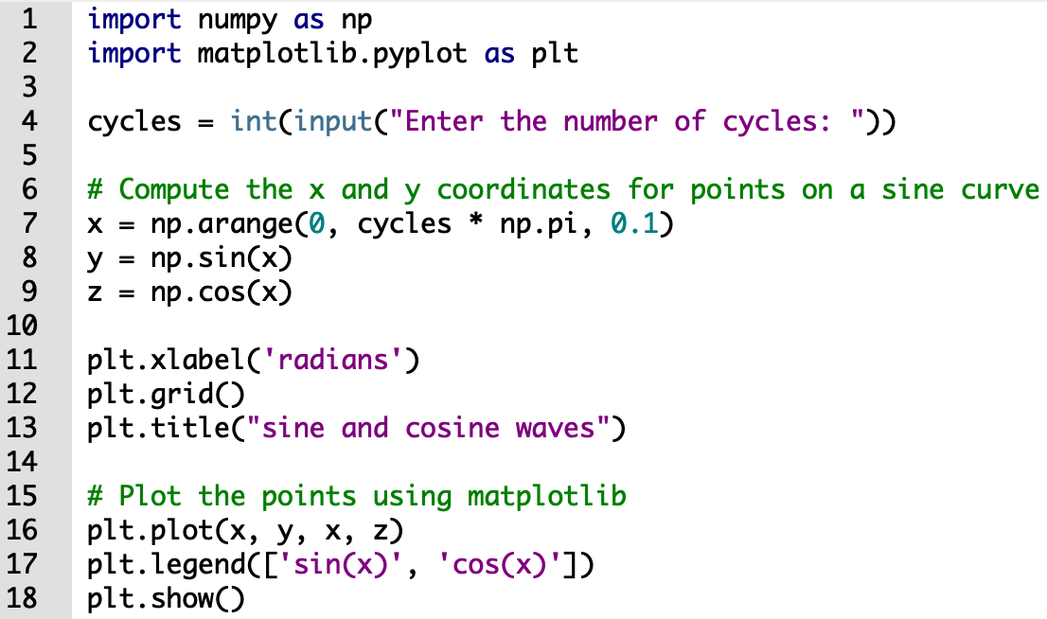
Plotting waves using NumPy
Using the NumPy sin() and cos() functions, we can plot the sine and cosine functions.

Slide 34
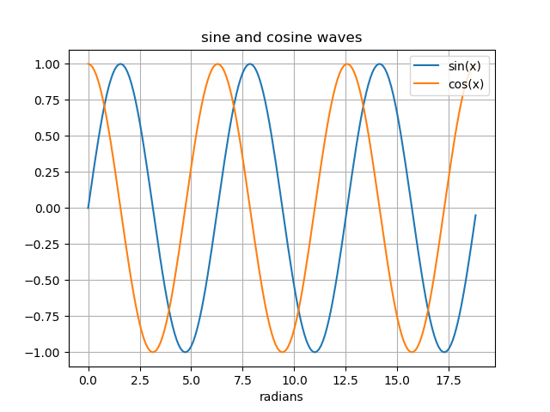
Plotting waves using NumPy
Using the NumPy sin() and cos() functions, we can plot the sine and cosine functions.

Slide 35
Plotting: Barnsley Fern Fractal
The mathematician Michael Barnsley described how to create fern-like fractal shape using repeated applications of a simple transformation on a point.
The transformation is called the Iterated Function System (IFS).
Write a program to draw a Barnsley Fern using a transformation of point.

Slide 36
Plotting: Barnsley Fern transformations
Start with the point (0,0) and randomly select one of the following transformations with the assigned probability:
Transformation 1 (85% probability)
x_{n+1} = 0.85x_{n} + 0.04y_{n} y_{n+1} = −0.04x_{n} + 0.85y_{n} + 1.6
Transformation 2 (7% probability)
x_{n}+1 = 0.2x_{n} − 0.26y_{n} y_{n}+1 = 0.23x_{n} + 0.22y_{n} + 1.6
Transformation 3 (7% probability)
x_{n}+1 = −0.15x_{n} − 0.28y_{n} y_{n}+1 = 0.26x_{n} + 0.24y_{n} + 0.44
Transformation 4 (1% probability)
x_{n}+1 = 0
y_{n}+1 = 0.16y_{n}
Notes:
Matplot has a built-in function to create scatterplots called scatter(). A scatter plot is a type of plot that shows the data as a collection of points. The position of a point depends on its two-dimensional value, where each value is a position on either the horizontal or vertical dimension.
Another commonly used plot type is the simple scatter plot, a close cousin of the line plot. Instead of points being joined by line segments, here the points are represented individually with a dot, circle, or other shape.

Slide 37
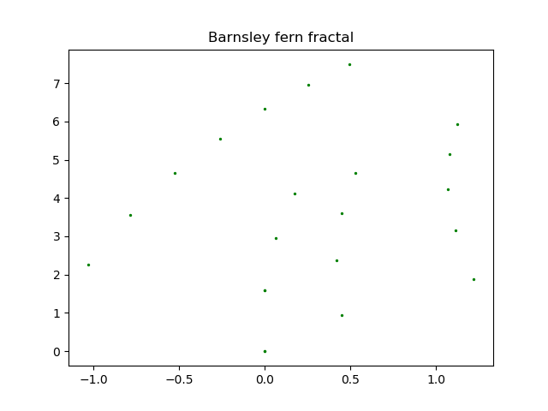
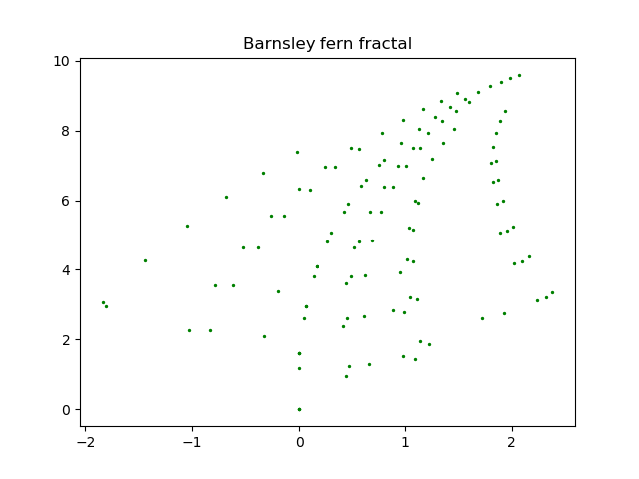
Plotting: Barnsley Fern iterations
10 iterations
100 iterations

Slide 38
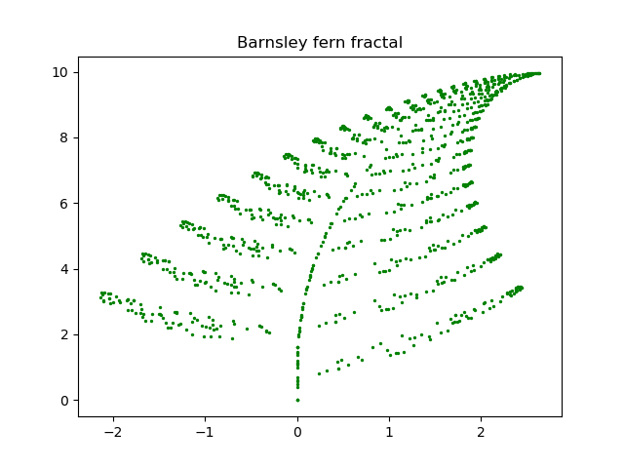
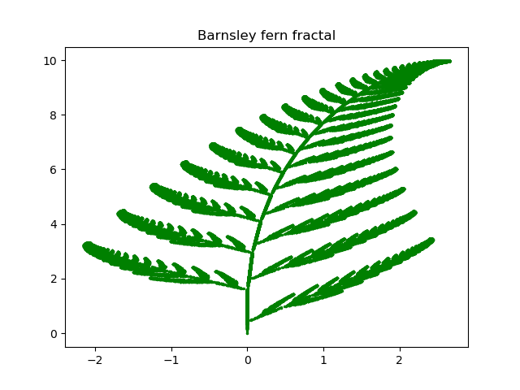
Plotting: Barnsley Fern iterations
1000 iterations
10000 iterations

Slide 39
References
Python plotting library: https://matplotlib.org/
PyPlot: https://matplotlib.org/tutorials/introductory/pyplot.html
NumPy: http://www.numpy.org/
Barnsley Fern: https://en.wikipedia.org/wiki/Barnsley_fern

