Slide 1
Algorithms and Recursion
Dr. Tim McGuire

Slide 2
What is an algorithm?
An algorithm is a finite sequence of steps that solves a problem.
It can be described in English or in pseudocode.
Pseudocode is an intermediate language between English and the implementation of the steps in code.
It is independent of the programming language
It is more general than a specific programming language

Slide 3
Algorithms
What are we interested in?
The computational complexity of our algorithm:
How much computing resources are needed to solve a problem?
How long (time) and how much memory (space) does it take?
We observe the behavior of algorithms as the input size grows

Slide 4
Some properties of algorithms
Input: An algorithm has input values from a specified set.
Output: An algorithm produces output values from a specified set. The output values are the solution.
Correctness: An algorithm should produce the correct output values for each set of input values.
Finiteness: An algorithm should produce the output after a finite number of steps for any input.

Slide 5
Maximum-Finding Algorithm
Find the maximum in the list:
4, 7, 3, 10, 9, 12, 6, 8, 32, 5, 2, 1
Notes:
7898741
max=7

Slide 6
Maximum-Finding Algorithm
Find the maximum of list: a₁, a₂, . . . , a_{n}
1: 2: 3: 4: 5: 6: 7: | max ← a₁ for i ← 2...n do if max < a_{i} then max ← a_{i} end if end for return max
Notes:
7898741
max=7

Slide 7
Activity
Does the maximum-finding algorithm have the desired properties of an algorithm?

Slide 8
The Searching Problem
Find 5 in the list:
4, 7, 3, 10, 9, 12, 6, 8, 32, 5, 2, 1
Notes:
7898741
max=7

Slide 9
The Searching Problem
Input: list of elements a₁, a₂, . . . a_{n} and a particular element x
Output: return the index in the list where x appears; if x is not in the list then return -1
Assume that all the list elements are unique.

Slide 10
Linear Search Algorithm
Input: a₁, a₂, ..., a_{n} and x
1: 2: 3: 4: 5: 6: 7: 8: 9: | i ← 1 while i ≤ n and x ≠ a_{i} do i ← i + 1 end while if i ≤ n then return i else return -1 end if

Slide 11
Linear Search Algorithm
Linear search can be slow: if x is not in the list or is toward the end, we have to check all (or most) of the elements in the list.
Informally, we can see that the running time is proportional to the number of elements in the list

Slide 12
Binary Search Example
Search for 19 in the list:
1 2 3 5 6 7 8 10 12 13 15 16 18 19 20 22
Compare 19 with the element roughly in the middle
1 2 3 5 6 7 8 10 12 13 15 16 18 19 20 22
Since 19 > 10, ignore the first half of the list
… 12 13 15 16 18 19 20 22
Since 19 > 16, ignore the first half of the list
… 18 19 20 22 Found!

Slide 13
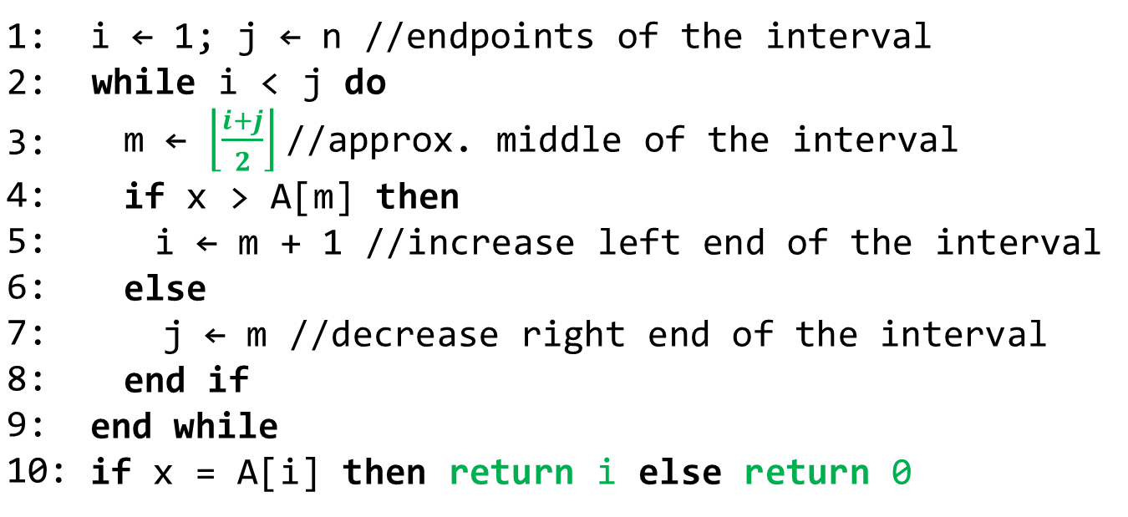
Binary Search Algorithm
Input: sorted list stored in array A[1 . . . n] and x
1: 2: 3: 4: 5: 6: 7: 8: 9: 10: | i ← 1; j ← n //endpoints of the interval while i < j do m ← $\left\lfloor \frac{i+j}{2}\right\rfloor$//approx. middle of the interval if x > A[m] then i ← m + 1 //increase left end of the interval else j ← m //decrease right end of the interval end if end while if x = A[i] then return i else return 0

Slide 14
Binary Search Algorithm
Let n be the size of the list
Every iteration of the while loop reduces the size of the search interval by a factor of 2
After about log₂n iterations, the search interval consists of just a single list element
The running time is proportional to the logarithm of the size of the list

Slide 15
The Sorting Problem
Input: list of elements a₁, a₂, . . . , a_{n} drawn from totally ordered set.
Output: list of elements b₁, b₂, . . . , b_{n} that is a rearrangement of the input list such that b₁ < b₂ < . . . < b_{n}.
Assume all the list elements are unique.

Slide 16
Bubble Sort Algorithm
Bubble sort makes multiple passes through a list.
Every pair of elements that are out of order are interchanged.

Slide 17
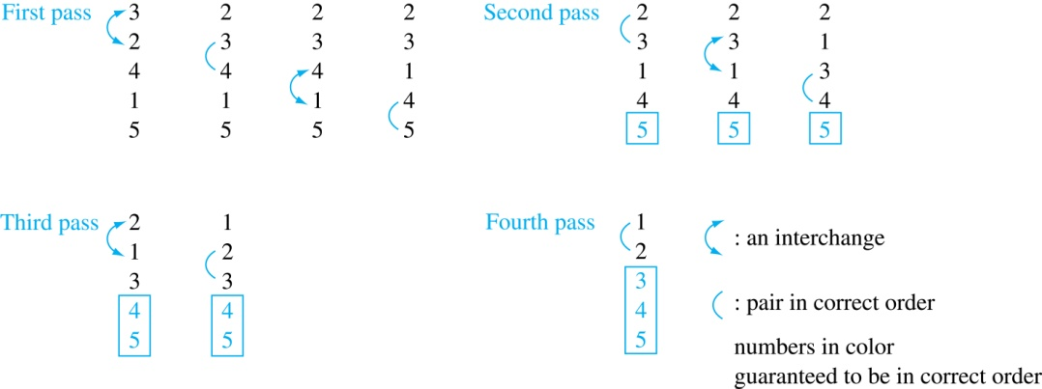
Bubble Sort
e.g. Steps of bubble sort with: {3, 2, 4, 1, 5}
At the first pass the largest element is put into the correct position
At the end of the 2nd pass, put the 2nd largest element in the correct position
In each subsequent pass, an additional element is put in the correct position

Slide 18
Bubble Sort Algorithm
Input: array A[1 ..n] of elements
1: 2: 3: 4: 5: | for i:=1 to n−1 for j:=1 to n−i if a_{j} > a_{j+1} then interchange a_{j} and a_{j+1} end for end for {a₁,…, a_{n} is now in increasing order}

Slide 19
Recursion

Slide 20


First, a Digression
Mathematicians and Telephones

Slide 21
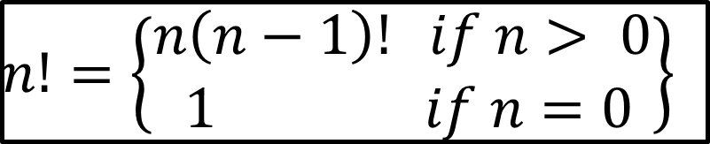
$$n!=\left\{\begin{matrix}n\left(n−1\right)! if n> 0 \\ 1 if n=0\end{matrix}\right\}$$

Slide 22
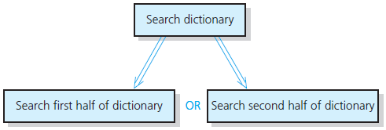
Recursive Solutions (1 of 3)
Recursion breaks problem into smaller identical problems
An alternative to iteration

Slide 23
Recursive Solutions (2 of 3)
A recursive function calls itself
Each recursive call solves an identical, but smaller, problem
Test for base case enables recursive calls to stop
Eventually, one of smaller problems must be the base case

Slide 24
Recursive Solutions (3 of 3)
Questions for constructing recursive solutions:
How to define the problem in terms of a smaller problem of same type?
How does each recursive call diminish the size of the problem?
What instance of problem can serve as base case?
As problem size diminishes, will you reach base case?

Slide 25
The Recursion Pattern
Classic example--the factorial function:
n! = 1· 2· 3· ··· · (n-1)· n
Recursive definition:
As a Python function:
# recursive factorial function
def fact(n):
if (n == 0): return 1 # base case
else: return n * fact(n - 1) # recursive case

Slide 26
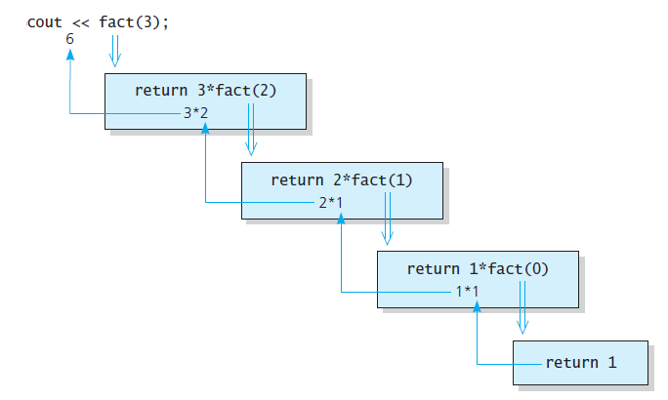
The Factorial of n
n = fact(3)
Source: Walls & Mirrors, by Carrano and Henry
Notes:
Run factorial program

Slide 27
Recursive Functions - Purpose
Recursive functions are used to reduce a complex problem to a simpler-to-solve problem.
The simpler-to-solve problem is known as the base case
Recursive calls stop when the base case is reached

Slide 28
Stopping the Recursion
A recursive function must always include a test to determine if another recursive call should be made, or if the recursion should stop with this call
In the factorial function, the test is:
if (n == 0):

Slide 29
Stopping the Recursion
Recursion uses a process of breaking a problem down into smaller problems until the problem can be solved
In the factorial function, a different value is passed to the function each time it is called
Eventually, the parameter reaches the value in the test, and the recursion stops

Slide 30
Challenges
What if you do not include a base case or get to the base case?
Infinite recursion (think of an infinite loop)
Each time the recursive call occurs, a new stack frame is created…
Eventually, you will run out of memory!
Stack Overflow

Slide 31
Rules for Good Recursive Function
One or more base cases
Always returns without further recursion
One or more recursive function calls
Must get closer to base case
Don‘t forget to use the result of your recursive call!

Slide 32
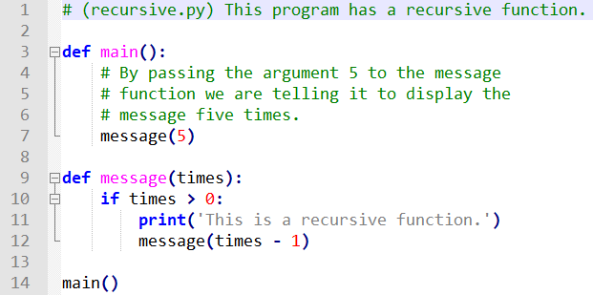
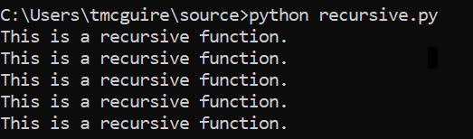
A Recursive Function

Slide 33
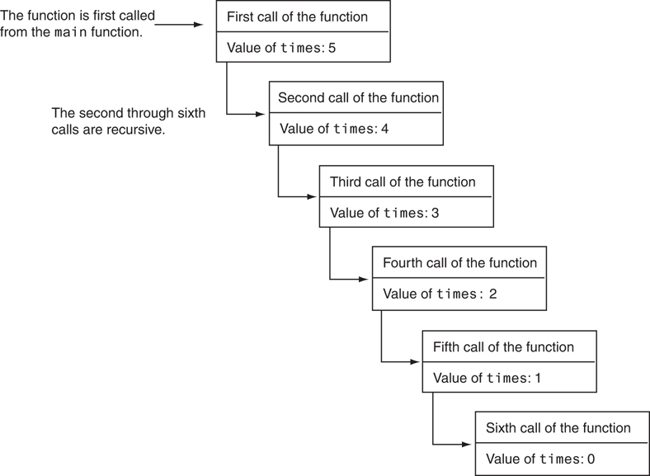
A Recursive Function
Six calls to the message function

Slide 34
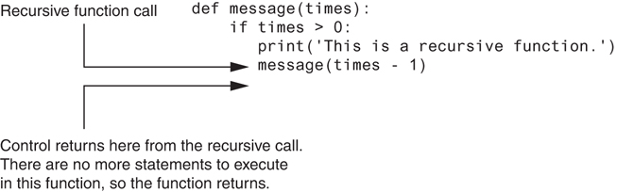
A Recursive Function
Control returns to the point after the recursive function call

Slide 35

Solving Recursively Defined Problems

Slide 36
Solving Recursively Defined Problems
The natural definition of some problems leads to a recursive solution
Example: Fibonacci numbers:
0, 1, 1, 2, 3, 5, 8, 13, 21, ...
After the starting 0, 1, each number is the sum of the two preceding numbers
Recursive solution:
fib(n) = fib(n – 1) + fib(n – 2);
Base cases: n <= 0, n == 1

Slide 37
Recursion example
Basis step: fib(0) = 0, fib(1) = 1
Inductive step: fib(n) = fib(n-1) + fib(n-2) for all n≥2
fib(2) = fib(1) + fib(0) = 1 + 0 = 1
fib(3) = fib(2) + fib(1) = 1 + 1 = 2
fib(4) = fib(3) + fib(2) = 2 + 1 = 3
fib(5) = fib(4) + fib(3) = 3 + 2 = 5
...

Slide 38
Recursive Algorithm: Fibonacci
1: 2: 3: 4: 5: 6: 7: 8: 9: 10: | function fib(n): if n = 0 then // stopping case return 0 else if n = 1 then // stopping case return 1 else return fib(n-1) + fib(n-2) // closer to stopping case end if end function

Slide 39

Recursively Defined Functions
Example
Suppose f is defined by:
f(0) = 3
f(n + 1) = 2f(n) + 3
What is f(3)?
Solution
f(3) = 2·f(2) + 3 f(2)? f(2) = 2·f(1) + 3 f(1)? f(1) = 2·f(0) + 3 f(0)? f(0) = 3 (basis) | f(3) = 2·21 + 3 = 45 f(2) = 2·9 + 3 = 21 f(1) = 2·3 + 3 = 9 f(0) = 3 (basis)

Slide 40
Recursively Defined Functions
Example:
Give a recursive definition of the function a^{n}
Solution
a¹ = a
a^{n} = a · a ^{n-1}

Slide 41
Recursive Algorithm: a^{n}
1: 2: 3: 4: 5: 6: 7: | function power(a, n): if n = 1 then // stopping case return a else return a * power(a, n-1) // closer to stopping case end if end function
A Recursive Function

Slide 42
Direct and Indirect Recursion
Direct recursion: when a function directly calls itself
All the examples shown so far were of direct recursion
Indirect recursion: when function A calls function B, which in turn calls function A

Slide 43
Examples of Recursive Algorithms (1 of 2)
Summing a range of list elements with recursion
Function receives a list containing range of elements to be summed, index of starting item in the range, and index of ending item in the range
Base case:
if start index > end index return 0
Recursive case:
return current_number + sum(list, start+1, end)

Slide 44
Examples of Recursive Algorithms (2 of 2)
# The range_sum function returns the sum of a specified
# range of items in num_list. The start parameter
# specifies the index of the starting item. The end
# parmeter specifies the index of the ending item.
def range_sum(num_list, start, end):
if start > end:
return 0
else:
return num_list[start] + range_sum(num_list,start + 1, end)

Slide 45
Finding the Greatest Common Divisor
Calculation of the greatest common divisor (GCD) of two positive integers
If x can be evenly divided by y, then
gcd(x,y) = y
Otherwise, gcd(x,y) = gcd(y, remainder of x/y)
Corresponding function code:
# The gcd function returns the greatest common
# divisor of two numbers.
def gcd(x,y):
if x % y == 0:
return y
else:
return gcd(y, x % y)

Slide 46
The Towers of Hanoi (1 of 5)
Mathematical game commonly used to illustrate the power of recursion
Uses three pegs and a set of discs in decreasing sizes
Goal of the game: move the discs from leftmost peg to rightmost peg
Only one disc can be moved at a time
A disc cannot be placed on top of a smaller disc
All discs must be on a peg except while being moved

Slide 47
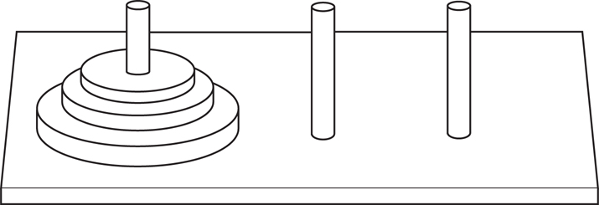
The Towers of Hanoi (2 of 5)
The pegs and discs in the Tower of Hanoi game

Slide 48
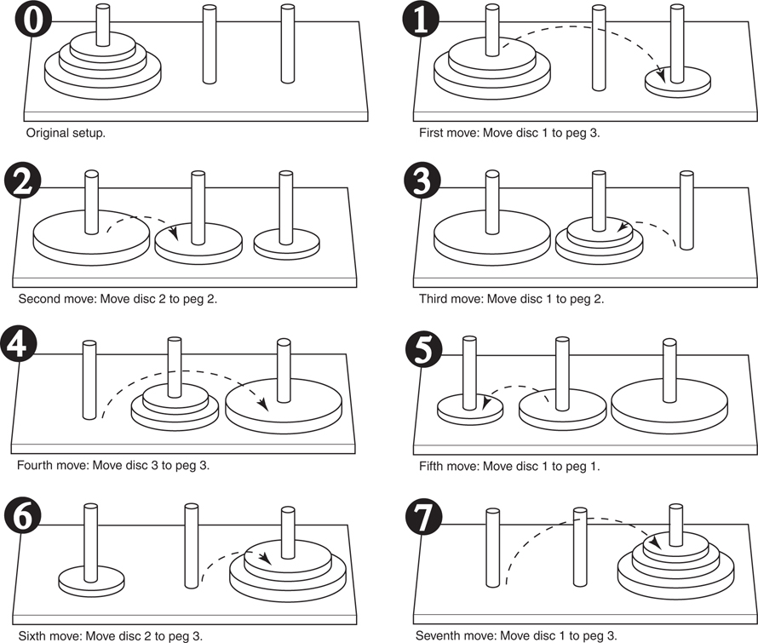
The Towers of Hanoi (3 of 5)
Steps for moving three pegs

Slide 49
The Towers of Hanoi (4 of 5)
Problem statement: move n discs from peg 1 to peg 3 using peg 2 as a temporary peg
Recursive solution:
If n == 1: Move disc from peg 1 to peg 3
Otherwise:
Move n-1 discs from peg 1 to peg 2, using peg 3
Move remaining disc from peg 1 to peg 3
Move n-1 discs from peg 2 to peg 3, using peg 1

Slide 50
The Towers of Hanoi (5 of 5)
# The moveDiscs function displays a disc move in
# the powers of Hanoi game.
# The parameters are:
# num: The number of discs to move.
# from_peg: The peg to move from.
# to_peg: The peg to move to.
# temp_peg: The temporary peg.
def move_disces(num, from_peg, to_peg, temp_peg):
if num > 0:
move_disces(num – 1, from_peg, temp_peg, to_peg)
print(‘Move a disc from peg’, from_peg, ‘to peg’, to_peg)
move_disces(num – 1, temp_peg, to_peg, from_peg)

Slide 51
Recursion versus Looping
Reasons not to use recursion:
Less efficient: entails function calling overhead that is not necessary with a loop
Usually a solution using a loop is more evident than a recursive solution
Some problems are more easily solved with recursion than with a loop
Example: Fibonacci, where the mathematical definition lends itself to recursion

Slide 52
End

