Slide 1
GUI Programming
Dr. Tim McGuire

Slide 2
Topics (1 of 2)
Graphical User Interfaces
Using the tkinter Module
Displaying Text with Label Widgets
Organizing Widgets with Frames
Button Widgets and Info Dialog Boxes
Getting Input with the Entry Widget
Using Labels as Output Fields

Slide 3
Topics (2 of 2)
Radio Buttons and Check Buttons
ListBox Widgets
Drawing Shapes with the Canvas Widget

Slide 4
Graphical User Interfaces (1 of 3)
User Interface: the part of the computer with which the user interacts
Command line interface: displays a prompt and the user types a command that is then executed
Graphical User Interface (GUI): allows users to interact with a program through graphical elements on the screen

Slide 5
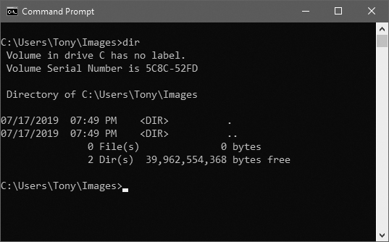
Graphical User Interfaces (2 of 3)
Command line interfaces
A command line interface

Slide 6
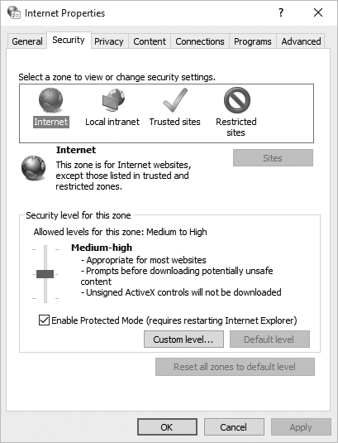
Graphical User Interfaces (3 of 3)
Dialog boxes: small windows that display information and allow the user to perform actions
Responsible for most of the interaction through GUI
User interacts with graphical elements such as icons, buttons, and slider bars

Slide 7
GUI Programs Are Event-Driven
In text-based environments, programs determine the order in which things happen
The user can only enter data in the order requested by the program
GUI environment is event-driven
The user determines the order in which things happen
User causes events to take place and the program responds to the events

Slide 8
Using the tkinter Module (1 of 3)
No GUI programming features built into Python
tkinter module: allows you to create simple GUI programs
Comes with Python
Widget: graphical element that the user can interact with or view
Presented by a GUI program

Slide 9
Using the tkinter Module (2 of 3)
tkinter widgets
Widget | Description
Button | A button that can cause an action to occur when it is clicked.
Canvas | A rectangular area that can be used to display graphics.
Checkbutton | A button that may be in either the “on” or “off” position.
Entry | An area in which the user may type a single line of input from the keyboard.
Frame | A container that can hold other widgets.
Label | An area that displays one line of text or an image.
Listbox | A list from which the user may select an item
Menu | A list of menu choices that are displayed when the user clicks a Menubutton widget.
Menubutton | A menu that is displayed on the screen and may be clicked by the user
Message | Displays multiple lines of text.
Radiobutton | A widget that can be either selected or deselected. Radiobutton widgets usually appear in groups and allow the user to select one of several options.
Scale | A widget that allows the user to select a value by moving a slider along a track.
Scrollbar | Can be used with some other types of widgets to provide scrolling ability.
Text | A widget that allows the user to enter multiple lines of text input.
Toplevel | A container, like a Frame, but displayed in its own window.

Slide 10
Using the tkinter Module
Programs that use tkinter do not always run reliably under many IDEs
For best results run them from operating system command prompt
Most programmers take an object-oriented approach when writing GUI programs
__init__ method builds the GUI
When an instance is created the GUI appears on the screen

Slide 11
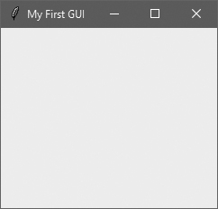
Example (1 of 6)
1 # This program displays an empty window. 2 3 import tkinter 4 5 class MyGUI: 6 def __init__(self): 7 # Create the main window widget. 8 self.main_window = tkinter.Tk() 9 10 # Display a title. 11 self.main_window.title('My First GUI') 12 13 # Enter the tkinter main loop. 14 tkinter.mainloop() 15 16 # Create an instance of the MyGUI class. 17 if __name__ == '__main__': 18 my_gui = MyGUI()

Slide 12
Display Text with Label Widgets (1 of 2)
Label widget: displays a single line of text in a window
Made by creating an instance of tkinter module’s Label class
Format: tkinter.Label(self.main_window, text = 'my text')
First argument references the root widget, second argument shows text that should appear in label

Slide 13
Display Text with Label Widgets (2 of 2)
pack method: determines where a widget should be positioned and makes it visible when the main window is displayed
Called for each widget in a window
Receives an argument to specify positioning
Positioning depends on the order in which widgets were added to the main window
Valid arguments: side='top', side='left', side='right'

Slide 14

Example (2 of 6)
self.label = tkinter.Label(self.main_window,
text='Hello World!')
self.label.pack()

Slide 15

Example (3 of 6)
self.label1 = tkinter.Label(self.main_window,
text='Hello World!')
self.label2 = tkinter.Label(self.main_window,
text='This is my GUI program.')
self.label.pack()

Slide 16

Example (4 of 6)
self.label1 = tkinter.Label(self.main_window,
text='Hello World!')
self.label2 = tkinter.Label(self.main_window,
text='This is my GUI program.')
self.label1.pack(side='left')
self.label2.pack(side='left')

Slide 17
Adding Borders to Labels
When creating a Label widget, you can use the borderwidth and relief arguments to display a border around the label
The borderwidth argument specifies the width of the border, in pixels
The relief argument specifies the border style

Slide 18

Example (5 of 6)
self.label = tkinter.Label(self.main_window,
text='Hello World',
borderwidth=1,
relief='solid'

Slide 19

Example (6 of 6)
self.label = tkinter.Label(self.main_window,
text='Hello World',
borderwidth=4,
relief='solid'

Slide 20
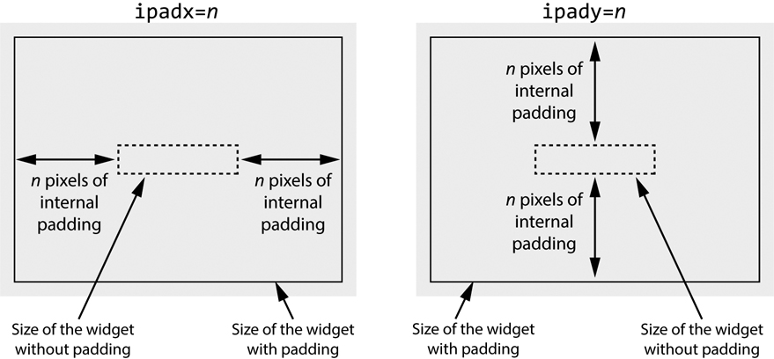
Internal Padding (1 of 3)
To add horizontal internal padding to a widget, pass the argument ipadx=n to the widget's pack method
To add vertical internal padding to a widget, pass the argument ipady=n to the widget's pack method

Slide 21
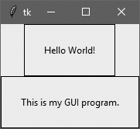
Internal Padding (2 of 3)
1 # This program demonstrates internal padding. 2 import tkinter 3 4 class MyGUI: 5 def __init__(self): 6 # Create the main window widget. 7 self.main_window = tkinter.Tk() 8 9 # Create two Label widgets with solid borders. 10 self.label1 = tkinter.Label(self.main_window, 11 text='Hello World!', 12 borderwidth=1, 13 relief='solid') 14 15 self.label2 = tkinter.Label(self.main_window, 16 text='This is my GUI program.', 17 borderwidth=1, 18 relief='solid') 19

Slide 22
Internal Padding (3 of 3)
20 # Display the Labels with 20 pixels of horizontal 21 # and vertical internal padding. 22 self.label1.pack(ipadx=20, ipady=20) 23 self.label2.pack(ipadx=20, ipady=20) 24 25 # Enter the tkinter main loop. 26 tkinter.mainloop() 27 28 # Create an instance of the MyGUI class. 29 if __name__ == '__main__': 30 my_gui = MyGUI()

Slide 23
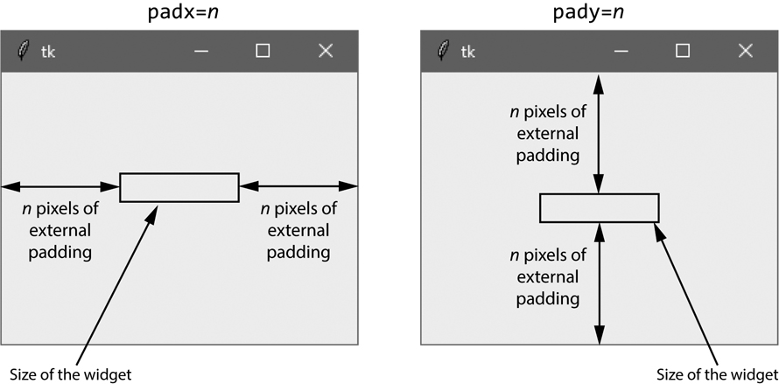
External Padding (1 of 3)
To add horizontal external padding to a widget, pass the argument padx=n to the widget's pack method
To add vertical external padding to a widget, pass the argument pady=n to the widget's pack method

Slide 24
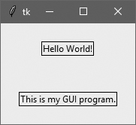
External Padding (2 of 3)
1 # This program demonstrates external padding. 2 import tkinter 3 4 class MyGUI: 5 def __init__(self): 6 # Create the main window widget. 7 self.main_window = tkinter.Tk() 8 9 # Create two Label widgets with solid borders. 10 self.label1 = tkinter.Label(self.main_window, 11 text='Hello World!', 12 borderwidth=1, 13 relief='solid') 14 15 self.label2 = tkinter.Label(self.main_window, 16 text='This is my GUI program.', 17 borderwidth=1, 18 relief='solid') 19 20 # Display the Labels with 20 pixels of horizontal 21 # and vertical external padding. 22 self.label1.pack(padx=20, pady=20) 23 self.label2.pack(padx=20, pady=20) 24 25 # Enter the tkinter main loop. 26 tkinter.mainloop() 27 28 # Create an instance of the MyGUI class. 29 if __name__ == '__main__': 30 my_gui = MyGUI()

Slide 25
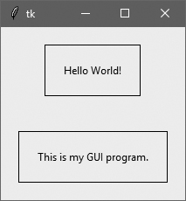
External Padding (3 of 3)
1 # This program demonstrates both internal and external padding. 2 import tkinter 3 4 class MyGUI: 5 def __init__(self): 6 # Create the main window widget. 7 self.main_window = tkinter.Tk() 8 9 # Create two Label widgets with solid borders. 10 self.label1 = tkinter.Label(self.main_window, 11 text='Hello World!', 12 borderwidth=1, 13 relief='solid') 14 15 self.label2 = tkinter.Label(self.main_window, 16 text='This is my GUI program.', 17 borderwidth=1, 18 relief='solid') 19 20 # Display the Labels with 20 pixels of horizontal 21 # and vertical external padding. 22 self.label1.pack(ipadx=20, ipady=20, padx=20, pady=20) 23 self.label2.pack(ipadx=20, ipady=20, padx=20, pady=20) 24 25 # Enter the tkinter main loop. 26 tkinter.mainloop() 27 28 # Create an instance of the MyGUI class. 29 if __name__ == '__main__': 30 my_gui = MyGUI()

Slide 26
Organizing Widgets with Frames (1 of 2)
Frame widget: container that holds other widgets
Useful for organizing and arranging groups of widgets in a window
The contained widgets are added to the frame widget which contains them
Example:
tkinter.Label(self.top_frame, text = 'hi')

Slide 27
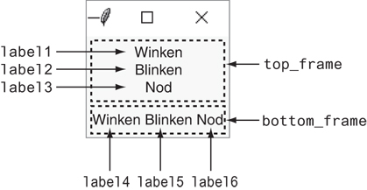
Organizing Widgets with Frames (2 of 2)
Arrangement of widgets

Slide 28
Button Widgets and Info Dialog Boxes (1 of 4)
Button widget: widget that the user can click to cause an action to take place
When creating a button can specify:
Text to appear on the face of the button
A callback function
Callback function: function or method that executes when the user clicks the button
Also known as an event handler

Slide 29
Button Widgets and Info Dialog Boxes (2 of 4)
Info dialog box: a dialog box that shows information to the user
Format for creating an info dialog box:
Import tkinter.messagebox module
tkinter.messagebox.showinfo(title,
message)
title is displayed in dialog box’s title bar
message is an informational string displayed in the main part of the dialog box

Slide 30

Button Widgets and Info Dialog Boxes (3 of 4)
# This program demonstrates a Button widget. # When the user clicks the Button, an info dialog box is displayed.
import tkinter
import tkinter.messagebox
class MyGUI:
def __init__(self):
# Create the main window widget.
self.main_window = tkinter.Tk()
# Create a Button widget. The text 'Click Me!'
# should appear on the face of the Button. The
# do_something method should be executed when
# the user clicks the Button.
self.my_button = tkinter.Button(self.main_window, \
text='Click Me!', \
command=self.do_something)
# Pack the Button.
self.my_button.pack()
# Enter the tkinter main loop.
tkinter.mainloop()
# The do_something method is a callback function
# for the Button widget.
def do_something(self):
# Display an info dialog box.
tkinter.messagebox.showinfo('Response', \
'Thanks for clicking the button.')
# Create an instance of the MyGUI class.
if __name__ == '__main__':
my_gui = MyGUI()

Slide 31
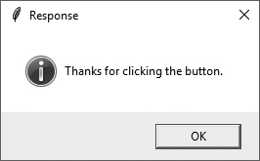
Button Widgets and Info Dialog Boxes (4 of 4)
The info dialog box displayed by the previous program

Slide 32
Creating a Quit Button
Quit button: closes the program when the user clicks it
To create a quit button in Python:
Create a Button widget
Set the root widget’s destroy method as the callback function
When the user clicks the button the destroy method is called and the program ends

Slide 33
Getting Input with the Entry Widget (1 of 2)
Entry widget: rectangular area that the user can type text into
Used to gather input in a GUI program
Typically followed by a button for submitting the data
The button’s callback function retrieves the data from the Entry widgets and processes it
Entry widget’s get method: used to retrieve the data from an Entry widget
Returns a string

Slide 34
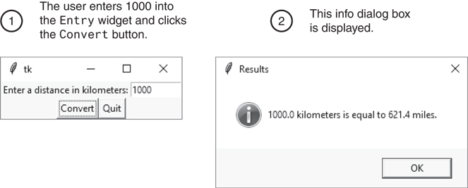
Getting Input with the Entry Widget (2 of 2)
The info dialog box

Slide 35
Using Labels as Output Fields (1 of 3)
Can use Label widgets to dynamically display output
Used to replace info dialog box
Create empty Label widget in main window, and write code that displays desired data in the label when a button is clicked

Slide 36
Using Labels as Output Fields (2 of 3)
StringVar class: tkinter module class that can be used along with Label widget to display data
Create StringVar object and then create Label widget and associate it with the StringVar object
Subsequently, any value stored in the StringVar object with automatically be displayed in the Label widget

Slide 37
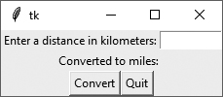
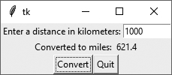
Using Labels as Output Fields (3 of 3)
Figure 13-26 The window initially displayed
The window showing 1000 kilometers converted to miles

Slide 38
Radio Buttons and Check Buttons (1 of 2)
Radio button: small circle that appears filled when it is selected and appears empty when it is deselected
Useful when you want the user to select one choice from several possible options
Radiobutton widgets: created using tkinter module’s Radiobutton class
Radiobutton widgets are mutually exclusive
Only one radio button in a container may be selected at any given time

Slide 39
Radio Buttons and Check Buttons (2 of 2)
IntVar class: a tkinter module class that can be used along with Radiobutton widgets
Steps for use:
Associate group of Radiobutton widgets with the same IntVar object
Assign unique integer to each Radiobutton
When a Radiobutton widgets is selected, its unique integer is stored in the IntVar object
Can be used to select a default radio button

Slide 40
Using Callback Functions with Radiobuttons
You can specify a callback function with Radiobutton widgets
Provide an argument command=self.my_method when creating the Radiobutton widget
The command will execute immediately when the radio button is selected
Replaces the need for a user to click OK or submit before determining which Radiobutton is selected

Slide 41
Check Buttons
Check button: small box with a label appearing next to it; check mark indicates when it is selected
User is allowed to select any or all of the check buttons that are displayed in a group
Not mutually exclusive
Checkbutton widgets: created using tkinter module’s Checkbutton class
Associate different IntVar object with each Checkbutton widget

Slide 42
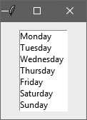
Listbox Widgets
A Listbox widget displays a list of items and allows the user to select one or more items

Slide 43
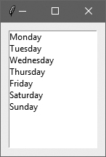
Example
1 # This program demonstrates a simple Listbox. 2 import tkinter 3 4 class ListboxExample: 5 def __init__(self): 6 # Create the main window. 7 self.main_window = tkinter.Tk() 8 9 # Create a Listbox widget. 10 self.listbox = tkinter.Listbox(self.main_window) 11 self.listbox.pack(padx=10, pady=10) 12 13 # Populate the Listbox with the data. 14 self.listbox.insert(0, 'Monday') 15 self.listbox.insert(1, 'Tuesday') 16 self.listbox.insert(2, 'Wednesday') 17 self.listbox.insert(3, 'Thursday') 18 self.listbox.insert(4, 'Friday') 19 self.listbox.insert(5, 'Saturday') 20 self.listbox.insert(6, 'Sunday') 21 22 # Start the main loop. 23 tkinter.mainloop() 24 25 # Create an instance of the ListboxExample class.
26 if __name__ == '__main__': 27 listbox_example = ListboxExample()

Slide 44
Specifying the Size of a Listbox
1 # This program demonstrates a simple Listbox. 2 import tkinter 3 4 class ListboxExample: 5 def __init__(self): 6 # Create the main window. 7 self.main_window = tkinter.Tk() 8 9 # Create a Listbox widget. 10 self.listbox = tkinter.Listbox( 11 self.main_window, height=0, width=0) 12 self.listbox.pack(padx=10, pady=10) 13 14 # Create a list with the days of the week. 15 days = ['Monday', 'Tuesday', 'Wednesday', 16 'Thursday', 'Friday', 'Saturday', 17 'Sunday'] 18 19 # Populate the Listbox with the data. 20 for day in days: 21 self.listbox.insert(tkinter.END, day) 22 23 # Start the main loop. 24 tkinter.mainloop() 25 26 # Create an instance of the ListboxExample class. 27 if __name__ == '__main__': 28 listbox_example = ListboxExample()
Default height = 10 (rows) and width = 20 (characters)
Setting height and width to zero lets tkinter set the listbox to the size needed to fit the contents

Slide 45
Selection Modes
Mode | Description
tkinter.BROWSE (This is the default mode) | The user can select one item at a time by clicking in the Listbox. Additionally, if the user clicks and drags the mouse inside the Listbox, the item that is currently under the cursor will be selected.
tkinter.EXTENDED | The user can select a group of adjacent items by clicking on the first item and dragging the mouse to the last item.
tkinter.MULTIPLE | Multiple items can be selected. When you click an unselected item, the item becomes selected. When you click a selected item, the item becomes unselected.
tkinter.SINGLE | The user can select one item at a time by clicking in the Listbox.

Slide 46
Retrieving the Selected Item(s) (1 of 2)
The curselection method returns a tuple containing the indexes of the items that are currently selected in the Listbox
If no item is selected, the tuple will be empty
If an item is selected and the selection mode is tkinter.BROWSE or tkinter.SINGLE, the tuple will contain only one element
If the Listbox's selection mode is tkinter.EXTENDED or tkinter.MULTIPLE, the tuple can contain multiple elements because those selection modes allow the user to select multiple items

Slide 47
Retrieving the Selected Item(s) (2 of 2)
Once you have the index of the selected item, you can use the get method to retrieve the selected item or items from the Listbox
The get method accepts an integer index as its argument and returns the item that is located at that index in the Listbox

Slide 48
Examples
self.listbox = tkinter.Listbox(self.main_window)
(etc…)
index = self.listbox.curselection()
tkinter.messagebox.showinfo(self.listbox.get(index))
self.listbox = tkinter.Listbox(self.main_window,
selectmode=tkinter.EXTENDED)
(etc…)
indexes = self.listbox.curselection()
for i in indexes:
tkinter.messagebox.showinfo(self.listbox.get(i))

Slide 49
Listboxes and Callback Functions (1 of 3)
You can optionally bind a callback function to a Listbox
When the user clicks an item in the Listbox, the callback function is immediately executed

Slide 50
Listboxes and Callback Functions (2 of 3)
Example callback function:
Assume listbox is a Listbox widget
You must provide a parameter to accept an event object as an argument
def show_item(self, event):
index = self.listbox.curselection()
item = self.listbox.get(index)
tkinter.messagebox.showinfo('Selected Item', item)

Slide 51
Listboxes and Callback Functions (3 of 3)
To bind the show_item function to the listbox widget:
Once done, the show_item function will execute whenever the user clicks an item in the listbox widget
self.listbox.bind('<<ListboxSelect>>', self.show_item)
The bind function is used to deal with events. We can bind functions/methods to an event just like we can bind these functions to a particular widget.
In this example, the event is the selection of a Listbox item.

Slide 52
Adding a Vertical Scrollbar to a Listbox
Create a frame to hold the Listbox and the scrollbar
Pack the frame
Create a Listbox inside the frame
Pack the Listbox to the left side of the frame
Create the vertical scrollbar inside the frame
Pack the scrollbar to the right side of the frame
Configure the scrollbar to call the Listbox's yview method when the slider knob is moved
Configure the Listbox to call the scrollbar's set method any time the Listbox is updated

Slide 53
Example (1 of 4)
# Create the main window.
self.main_window = tkinter.Tk()
# Create a frame for the Listbox and vertical scrollbar.
self.listbox_frame = tkinter.Frame(self.main_window)
self.listbox_frame.pack(padx=20, pady=20)
# Create a Listbox widget in the listbox_frame.
self.listbox = tkinter.Listbox(
self.listbox_frame, height=6, width=0)
self.listbox.pack(side='left')
# Create a vertical Scrollbar in the listbox_frame.
self.scrollbar = tkinter.Scrollbar(
self.listbox_frame, orient=tkinter.VERTICAL)
self.scrollbar.pack(side='right', fill=tkinter.Y)
# Configure the Scrollbar and Listbox to work together.
self.scrollbar.config(command=self.listbox.yview)
self.listbox.config(yscrollcommand=self.scrollbar.set)

Slide 54
Adding a Horizontal Scrollbar to a Listbox
Create a frame to hold the Listbox and the scrollbar
Pack the frame
Create a Listbox inside the frame
Pack the Listbox to the top of the frame
Create the horizontal scrollbar inside the frame
Pack the scrollbar to the bottom of the frame
Configure the scrollbar to call the Listbox's xview method when the slider knob is moved
Configure the Listbox to call the scrollbar's set method any time the Listbox is updated

Slide 55
Example (2 of 4)
# Create the main window.
self.main_window = tkinter.Tk()
# Create a frame for the Listbox and scrollbar.
self.listbox_frame = tkinter.Frame(self.main_window)
self.listbox_frame.pack(padx=20, pady=20)
# Create a Listbox widget in the listbox_frame.
self.listbox = tkinter.Listbox(
self.listbox_frame, height=0, width=30)
self.listbox.pack(side='top')
# Create a horizontal Scrollbar in the listbox_frame.
self.scrollbar = tkinter.Scrollbar(
self.listbox_frame, orient=tkinter.HORIZONTAL)
self.scrollbar.pack(side='bottom', fill=tkinter.X)
# Configure the Scrollbar and Listbox to work together.
self.scrollbar.config(command=self.listbox.xview)
self.listbox.config(xscrollcommand=self.scrollbar.set)

Slide 56
Adding Vertical and Horizontal Scrollbars to a Listbox (1 of 2)
Create the outer frame to hold the inner frame and the horizontal scrollbar
Pack the outer frame
Create the inner frame to hold the Listbox and the vertical scrollbar
Pack the inner frame
Create a Listbox inside the inner frame
Pack the Listbox to the left side of the inner frame
Create a vertical scrollbar inside the inner frame
Pack the scrollbar to the right side of the inner frame
Create the horizontal scrollbar inside the outer frame

Slide 57
Adding Vertical and Horizontal Scrollbars to a Listbox (2 of 2)
Pack the horizontal scrollbar to the bottom of the outer frame
Configure the vertical scrollbar to call the Listbox's yview method when the slider knob is moved
Configure the horizontal scrollbar to call the Listbox's xview method when the slider knob is moved
Configure the Listbox to call both scrollbar's set method any time the Listbox is updated

Slide 58
Example (3 of 4)
# Create the main window.
self.main_window = tkinter.Tk()
# Create an outer frame to hold the inner frame
# and the horizontal scrollbar.
self.outer_frame = tkinter.Frame(self.main_window)
self.outer_frame.pack(padx=20, pady=20)
# Create an inner frame for the Listbox and vertical scrollbar.
self.inner_frame = tkinter.Frame(self.outer_frame)
self.inner_frame.pack()
# Create a Listbox widget in the inner_frame.
self.listbox = tkinter.Listbox(self.inner_frame, height=5, width=30)
self.listbox.pack(side='left')
# Create a vertical Scrollbar in the inner_frame.
self.v_scrollbar = tkinter.Scrollbar(self.inner_frame, orient=tkinter.VERTICAL)
self.v_scrollbar.pack(side='right', fill=tkinter.Y)

Slide 59
Example (4 of 4)
# Create a horizontal Scrollbar in the outer_frame.
self.h_scrollbar = tkinter.Scrollbar(self.outer_frame, orient=tkinter.HORIZONTAL)
self.h_scrollbar.pack(side='bottom', fill=tkinter.X)
# Configure the Scrollbars and the Listbox to work together.
self.v_scrollbar.config(command=self.listbox.yview)
self.h_scrollbar.config(command=self.listbox.xview)
self.listbox.config(yscrollcommand=self.v_scrollbar.set,
xscrollcommand=self.h_scrollbar.set)

Slide 60
Drawing Shapes with the Canvas Widget (1 of 4)
The Canvas widget is a blank, rectangular area that allows you to draw simple 2D shapes.
You use the Canvas widget’s screen coordinate system to specify the location of your graphics.
The coordinates of the pixel in the upper-left corner of the screen are (0, 0).
The X coordinates increase from left to right
The Y coordinates increase from top to bottom.

Slide 61
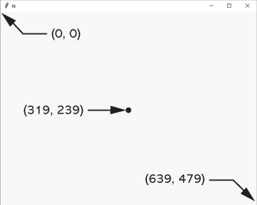
Drawing Shapes with the Canvas Widget (2 of 4)
Various pixel locations in a 640 by 480 window

Slide 62
Drawing Shapes with the Canvas Widget (3 of 4)
Creating a Canvas widget:
# Create the main window.
self.main_window = tkinter.Tk()
# Create the Canvas widget.
self.canvas = tkinter.Canvas(self.main_window, width=200, height=200)

Slide 63
Drawing Shapes with the Canvas Widget (4 of 4)
The Canvas widget has numerous methods for drawing graphical shapes on the surface of the widget.
The methods that we will discuss are:
create_line
create_rectangle
create_oval
create_arc
create_polygon
create_text

Slide 64
Drawing a Line (1 of 2)
Coordinates of
the line's ending
point
canvas_name.create_line(x1, y1, x2, y2, options…)
Coordinates of
the line's starting
point
Optional arguments

Slide 65
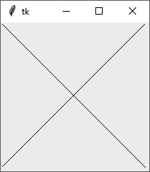
Drawing a Line (2 of 2)
1 # This program demonstrates the Canvas widget.
2 import tkinter
3
4 class MyGUI:
5 def _ _init_ _(self):
6 # Create the main window.
7 self.main_window = tkinter.Tk()
8
9 # Create the Canvas widget.
10 self.canvas = tkinter.Canvas(self.main_window, width=200,height=200)
11
12 # Draw two lines.
13 self.canvas.create_line(0, 0, 199, 199)
14 self.canvas.create_line(199, 0, 0, 199)
15
16 # Pack the canvas.
17 self.canvas.pack()
18
19 # Start the mainloop.
20 tkinter.mainloop()
21
22 # Create an instance of the MyGUI class.
22 if _ _name_ _ == '_ _main_ _':
23 my_gui = MyGUI()

Slide 66
Drawing a Rectangle (1 of 2)
Coordinates of
the lower-right
corner
canvas_name.create_rectangle(x1, y1, x2, y2, options…)
Coordinates of
the upper-left
corner
Optional arguments

Slide 67
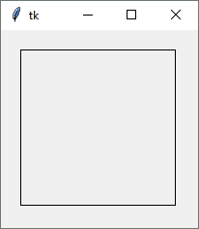
Drawing a Rectangle (2 of 2)
1 # This program draws a rectangle on a Canvas.
2 import tkinter
3
4 class MyGUI:
5 def _ _init_ _(self):
6 # Create the main window.
7 self.main_window = tkinter.Tk()
8
9 # Create the Canvas widget.
10 self.canvas = tkinter.Canvas(self.main_window, width=200,height=200)
11
12 # Draw two lines.
13 self.canvas.create_line(0, 0, 199, 199)
14 self.canvas.create_line(199, 0, 0, 199)
15
16 # Pack the canvas.
17 self.canvas.pack()
18
19 # Start the mainloop.
20 tkinter.mainloop()
21
22 # Create an instance of the MyGUI class.
23 my_gui = MyGUI()

Slide 68
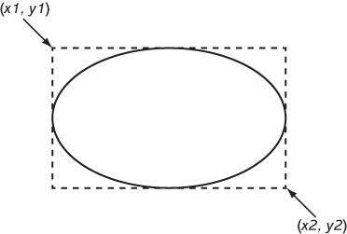
Drawing an Oval (1 of 2)
Coordinates of
the lower-right
corner of
bounding rectangle
canvas_name.create_oval(x1, y1, x2, y2, options…)
Coordinates of
the upper-left
corner of
bounding rectangle
Optional arguments

Slide 69
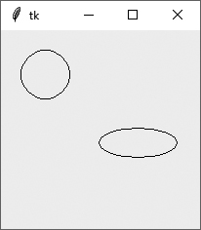
Drawing an Oval (2 of 2)
1 # This program draws a rectangle on a Canvas.
2 import tkinter
3
4 class MyGUI:
5 def _ _init_ _(self):
6 # Create the main window.
7 self.main_window = tkinter.Tk()
8
9 # Create the Canvas widget.
10 self.canvas = tkinter.Canvas(self.main_window, width=200,height=200)
11
12 # Draw two ovals.
13 self.canvas.create_oval(20, 20, 70, 70)
14 self.canvas.create_oval(100, 100, 180, 130)
15
16 # Pack the canvas.
17 self.canvas.pack()
18
19 # Start the mainloop.
20 tkinter.mainloop()
21
22 # Create an instance of the MyGUI class.
23 if _ _name_ _ == '_ _main_ _':
24 my_gui = MyGUI()

Slide 70
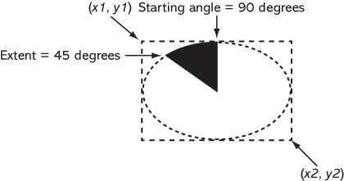
Drawing an Arc (1 of 2)
Coordinates of
the upper-left
corner of
bounding rectangle
Coordinates of
the lower-right
corner of
bounding rectangle
canvas_name.create_arc(x1, y1, x2, y2,
start=angle, extent=width,
options…)
Starting angle
Counter clockwise
extent of the arc
Optional arguments

Slide 71
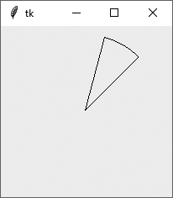
Drawing an Arc (2 of 2)
1 # This program draws an arc on a Canvas.
2 import tkinter
3
4 class MyGUI:
5 def _ _init_ _(self):
6 # Create the main window.
7 self.main_window = tkinter.Tk()
8
9 # Create the Canvas widget.
10 self.canvas = tkinter.Canvas(self.main_window, width=200,height=200)
11
12 # Draw an arc.
13 self.canvas.create_arc(10, 10, 190, 190, start=45, extent=30)
14
15 # Pack the canvas.
16 self.canvas.pack()
17
18 # Start the mainloop.
19 tkinter.mainloop()
20
21 # Create an instance of the MyGUI class.
22 if _ _name_ _ == '_ _main_ _':
23 my_gui = MyGUI()

Slide 72
Drawing a Polygon (1 of 3)
Coordinates of
the second vertex
canvas_name.create_polygon(x1, y1, x2, y2, …,options…)
Coordinates of
the first vertex
Optional arguments

Slide 73
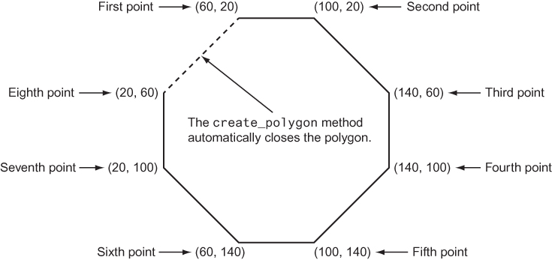
Drawing a Polygon (2 of 3)
self.canvas.create_polygon(60, 20, 100, 20, 140, 60, 140, 100,
100, 140, 60, 140, 20, 100, 20, 60)

Slide 74
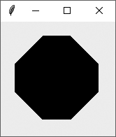
Drawing a Polygon (3 of 3)
1 # This program draws a polygon on a Canvas.
2 import tkinter
3
4 class MyGUI:
5 def _ _init_ _(self):
6 # Create the main window.
7 self.main_window = tkinter.Tk()
8
9 # Create the Canvas widget.
10 self.canvas = tkinter.Canvas(self.main_window, width=160, height=160)
11
12 # Draw a polygon.
13 self.canvas.create_polygon(60, 20, 100100, 140, 60, 140, 20, 100, 20, 60, 20, 140, 60, 140, 100,)
14
15
16 # Pack the canvas.
17 self.canvas.pack()
18
19 # Start the mainloop.
20 tkinter.mainloop()
21
22 # Create an instance of the MyGUI class.
23 if _ _name_ _ == '_ _main_ _’:
24 my_gui = MyGUI()

Slide 75
Displaying Text on the Canvas (1 of 2)
Text to display
canvas_name.create_text(x, y, text=text, options…)
Coordinates of
the text's insertion
point
Optional arguments

Slide 76
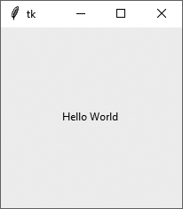
Displaying Text on the Canvas (2 of 2)
1 # This program draws a polygon on a Canvas.
2 import tkinter
3
4 class MyGUI:
5 def _ _init_ _(self):
6 # Create the main window.
7 self.main_window = tkinter.Tk()
8
9 # Create the Canvas widget.
10 self.canvas = tkinter.Canvas(self.main_window, width=160, height=160)
11
12 # Display text in the center of the window.
13 self.canvas.create_text(100, 100, text='Hello World')
14
15 # Pack the canvas.
16 self.canvas.pack()
17
18 # Start the mainloop.
19 tkinter.mainloop()
20
21 # Create an instance of the MyGUI class.
22 if _ _name_ _ == '_ _main_ _’:
23 my_gui = MyGUI()

Slide 77
Summary
This module covered:
Graphical user interfaces and their role as event-driven programs
The tkinter module, including:
Creating a GUI window
Adding widgets to a GUI window
Organizing widgets in frames
Receiving input and providing output using widgets
Creating buttons, check buttons, and radio buttons
Drawing simple shapes with the Canvas widget

Slide 78
End

