Slide 1

I 2 M
Image to Music
스피겔 크릴, 노승욱

Slide 2
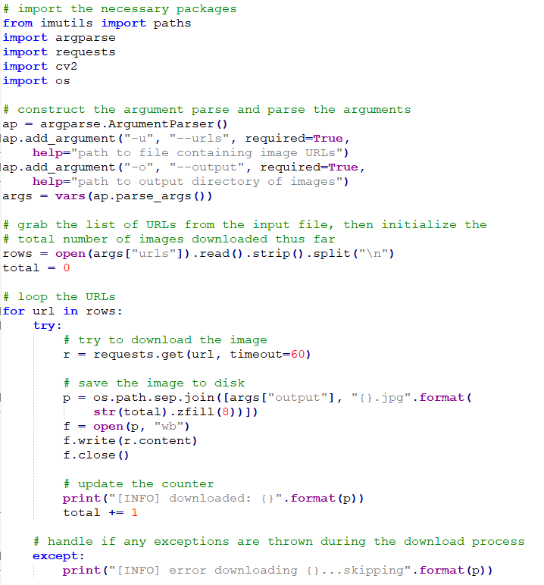
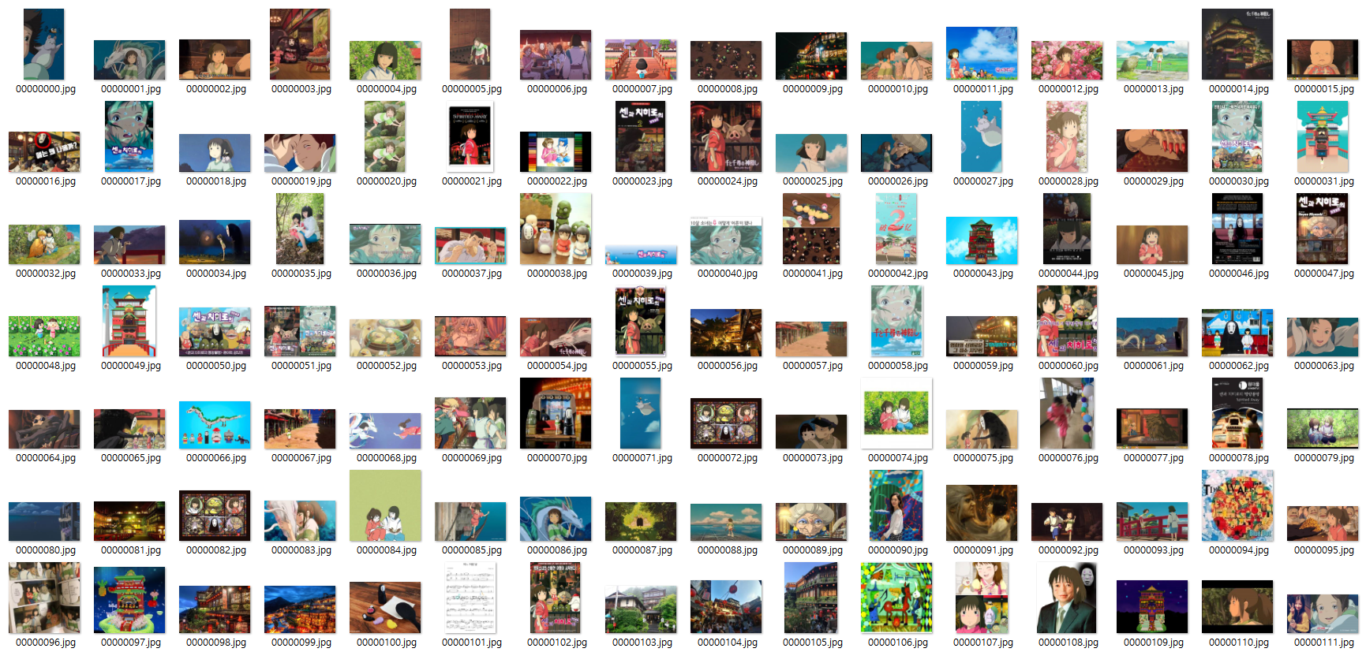
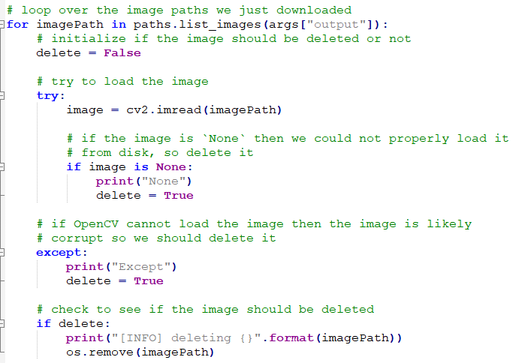
PART 1
Image crawling

Slide 3
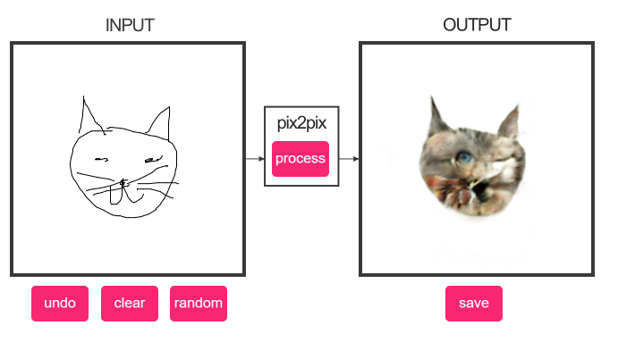
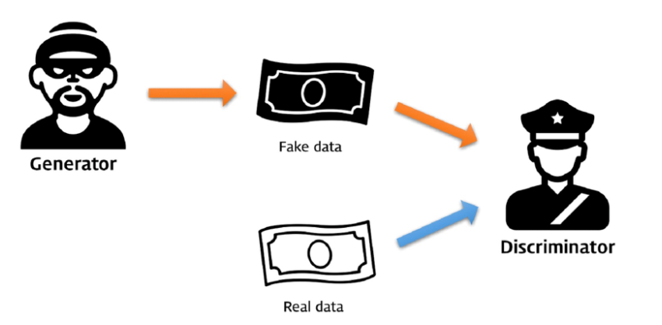
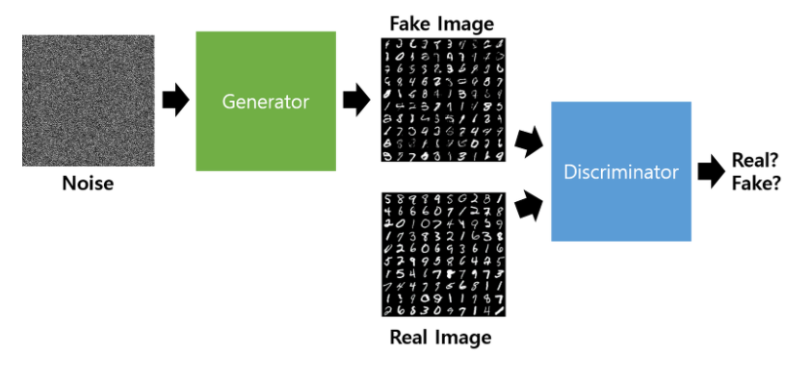
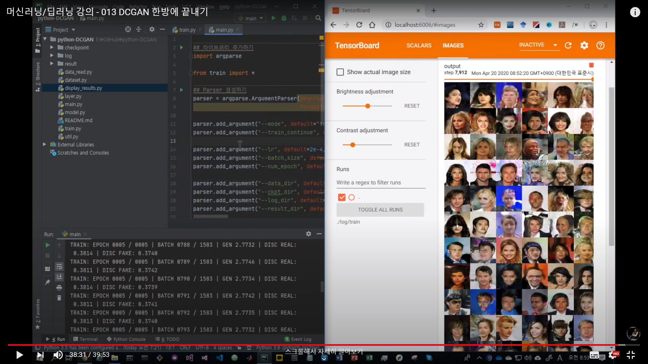
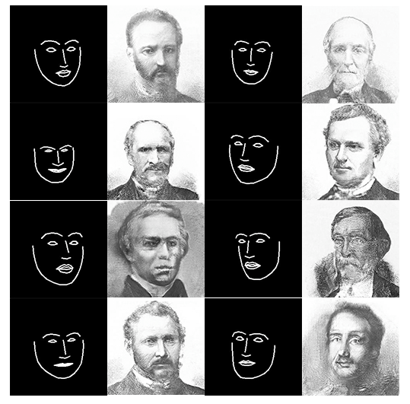
PART 1
Image Training

Slide 4
PART 1
division of roles by member
노승욱
스피겔 크릴
Implementing image recognition model to extract data from images
Implementing Magenta model for creating newly generated music
Creating MIDI files from output data of the image recognition model
Implementing UI for easy use

Slide 5

Thank You

