Slide 1
Opening Slide
pptxx md-to-pptx spike deck. This slide exercises title, body paragraph, and nested bullets.
- First-level bullet
- Second-level bullet (max nesting depth)
- Another first-level bullet
Notes:
Opening slide speaker note — plain title/body path.

Slide 2

Image Slide
A locally generated placeholder image with its attribution directive.
attribution: pptxx spike generator | cc0 | https://example.org/pptxx-spike/placeholder

Slide 3
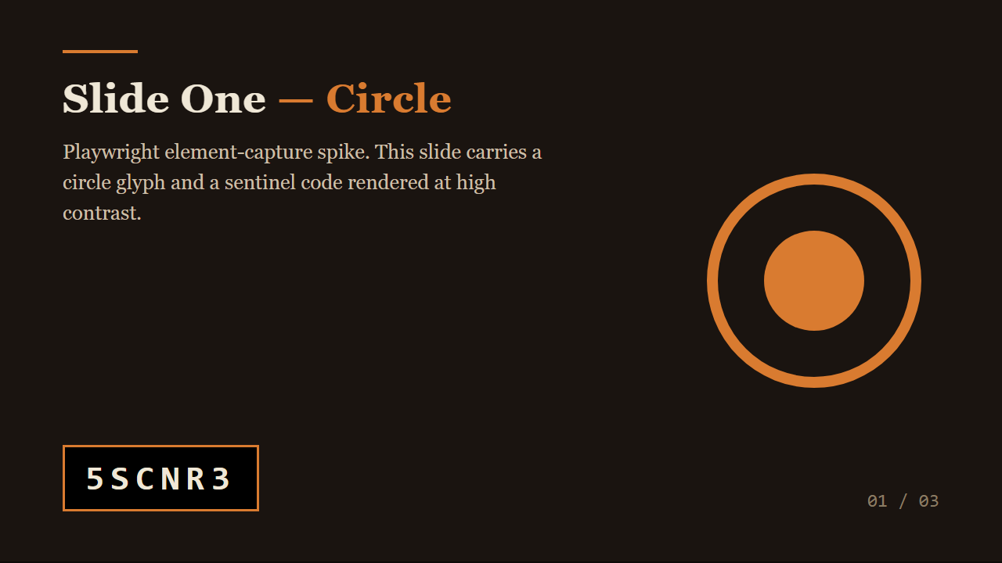
Diagram With Shot
Notes:
Diagram-with-shot slide — raster available, picture inserted.

Slide 4
Diagram Without Shot
Notes:
[diagram fallback — no raster for slide 99] No raster exists for slide 99. The exporter must fall back: keep only the title in the slide body and demote this description into the speaker notes.

