Slide 1
BPA Introduction May 2026

Slide 2
BPA Overview
Following is an overview of the different components that will support you as a Blueprint developer throughout your onboarding journey:
DAP – Dell Automation Platform – An orchestration tool that enables provisioning an infrastructure and updating it.
Blueprint – A declarative infrastructure definition, written in TOSCA format, saved as a YAML file.
Blueprint Assist – An AI tool that supports Blueprint generation, deployment and validation.
BPA Installation – BPA has an installation package for Linux or Windows and supports the common IDE types – Windsurf/VSC/Claude/etc.
Notes:
Query and perform operations from BP Assist chat
The LLM translates natural language intent into relevant tool call, This ensures AI agents can act reliably without direct access to raw APIs.

Slide 3
Prerequisites
A DAP instance – SaaS or on-prem
Windsurf/Claude/VSC IDE installation
BPA installation

Slide 4
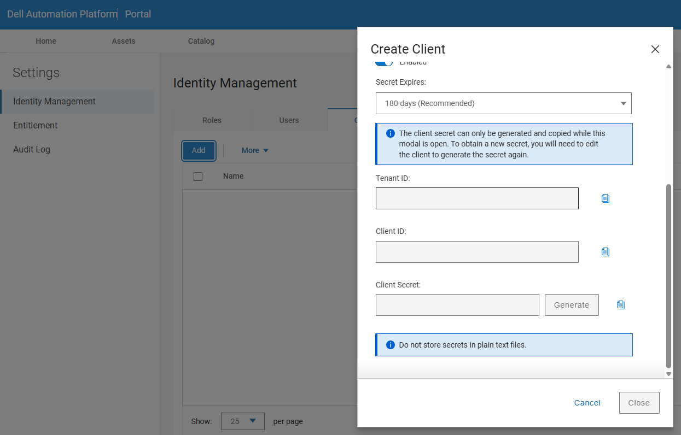
Obtaining client credentials from DAP
BPA - Add DAP client credentials

Slide 5
BPA CLI configuration
The BPA CLI can be configured via environment variables
or a config file at ~/.blueprint-assist/config.json.
Environment Variables
export DAP_ORCHESTRATOR_DOMAIN=“your-orchestrator.domain.com "
export DAP_TOKEN="eyJhbGci..."
Config File (~/.blueprint-assist/config.json)
{
"orchestrator_domain": "your-orchestrator.domain.com",
"token": "your-token"
}
Current Configuration
Your current config file at C:\Users\<UserName>\.blueprint-assist\config.json contains:
{
"diagnostician": {
"adapter": "devin"
}
}

Slide 6
BPA usage
In your IDE chat interface, request a blueprint generation, describing your solution.
In the case of an existing solution, add to the chat or to the context window the existing solution files like TF models, Helm chart, ansible playbooks, etc..
BPA will generate a Blueprint.
In the IDE chat, request to upload and deploy the Blueprint.
Once deployment was successful, verify the solution works as expected.

Slide 7
BPA Workflow
End-to-end BPA interaction flow
User-driven blueprint lifecycle
Describe
Generate
Deploy
Validate
Notes:
Full original explanation of BPA usage and IDE interaction steps.

Slide 8
Blueprint Structure
my-blueprint/
├── blueprint.yaml # Main blueprint definition
├── inputs.yaml # Input definitions (optional)
├── capabilities.yaml # Output definitions (optional)
├── infrastructure/
│ └── vsphere/
│ ├── inputs.yaml
│ ├── definitions.yaml
│ └── outputs.yaml
├── example_JSON_configs/ # Sample deployment inputs
│ └── deployment-inputs.json
├── CHANGELOG.yaml # Version history
├── README.md # Documentation
└── icon.png # Blueprint icon
Blueprint Directory Structure

Slide 9
Blueprint Structure continued
Core Blueprint Components
Metadata: name, version, description, author, license
TOSCA Structure: tosca_definitions_version, imports, dsl_definitions
Inputs: User-provided parameters
Node Templates: Infrastructure components
Capabilities: Output values for consumers
Relationships: Dependencies between nodes
Key Sections Explained
Imports: Load Dell types and required plugins
Inputs: Define parameters users provide at deployment time
Node Templates: Define infrastructure resources using plugin node types
Capabilities: Expose outputs for other blueprints to consume
Relationships: Define dependencies and connections between nodes
Core Components

Slide 10
Blueprint Core Components
Key structural elements of a blueprint
Defines execution and outputs
Core Components
Inputs
Nodes
Capabilities
Relationships
Inputs
Nodes
Capabilities
Relationships
Notes:
Full explanation of metadata, imports, node templates, and relationships.

Slide 11
Introduction to Blueprint Assist
AI-powered infrastructure deployment tool that simplifies blueprint creation and management for the Dell Automation Platform
Accelerated Development: Reduce blueprint creation time with AI assistance
Consistency: Ensure deployments follow best practices and standards
Knowledge Transfer: Learn from existing blueprints through reasoning and analysis
Flexibility: Support both signed and custom organizational blueprints
Multi-Platform: Deploy across on-premises, bare-metal, and Kubernetes
DAP Integration: Full lifecycle management from CLI or AI chat interface
What is Blueprint Assist?

Slide 12
Introduction to Blueprint Assist (BPA)
BPA Architecture
User → IDE → Skills → LLM → dap-bpa CLI → Blueprint Description → DAP Orchestrator
Core Components
Skills Engine: AI-powered engine processing natural language requirements
Knowledge Base: Repository of plugins, blueprints, and documentation
dap-bpa CLI: Command-line interface for all operations
IDE Integration: Seamless integration with development environments
Primary Use Cases
1. Infrastructure Deployment
2. Blueprint Analysis and Auditing
3. Blueprint Creation from Scratch
4. Template Reuse from Signed Blueprints
5. Custom Organization-Specific Blueprints
Key Value Propositions

Slide 13
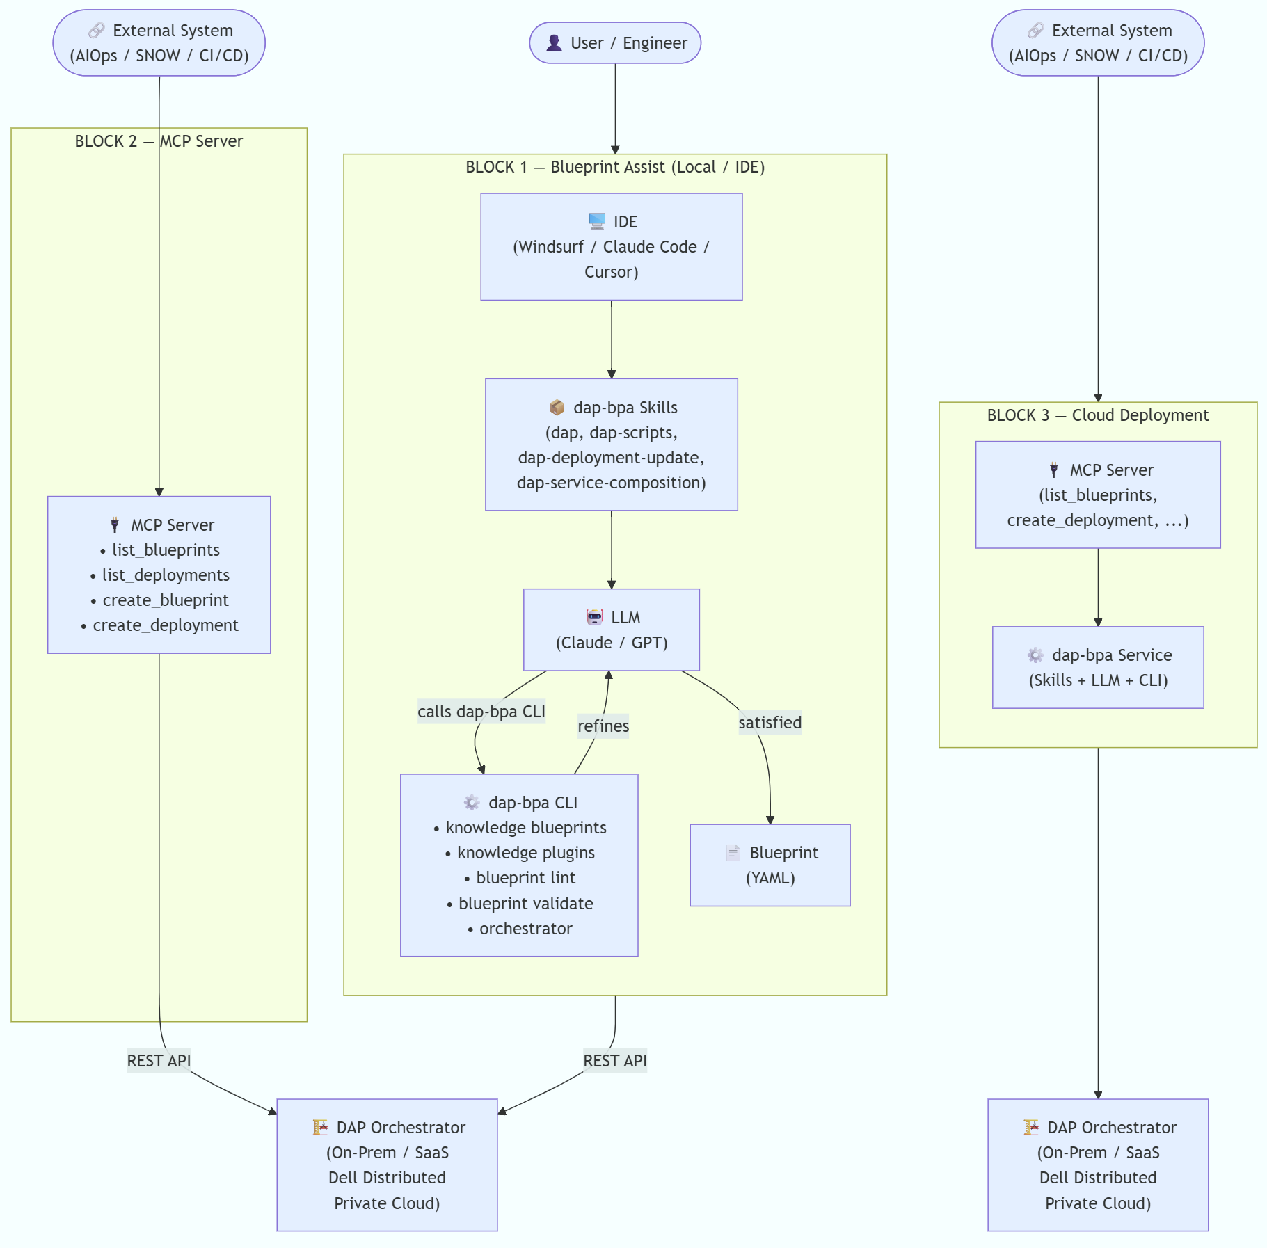
System Architecture Overview

Slide 14
BPA Architecture
High-level system interaction model
AI-driven orchestration flow
Key Value Propositions
User
IDE
Skills
LLM
CLI
DAP
Notes:
Detailed architecture explanation including components and use cases.

Slide 15
Building Blueprints - Phase 1: Planning
Purpose: What infrastructure will this blueprint deploy?
Scope: What components are included/excluded?
Target Environment: On-premises, Kubernetes, cloud?
Constraints: Budget, timeline, compliance requirements?
Dependencies: External systems or services required?
Research Existing Blueprints
dap-bpa knowledge blueprints find "storage"
dap-bpa knowledge blueprints find "network"
dap-bpa knowledge blueprints get vsphere-vm --include-files
Study Plugin Documentation
dap-bpa knowledge plugins list vsphere
dap-bpa knowledge plugins get vsphere dell.nodes.vsphere.Server
dap-bpa knowledge plugins docs vsphere
Create Blueprint Directory
mkdir my-blueprint
cd my-blueprint
mkdir -p infrastructure/vsphere
mkdir -p example_JSON_configs
Define Blueprint Requirements

Slide 16
Building Blueprints - Phase 2: Authoring
Simple Blueprint (single file): blueprint.yaml, example configs, changelog, readme, icon
Complex Blueprint (multi-file): Main blueprint with imports, separate inputs/capabilities/definitions files
Key TOSCA Elements - Imports
imports:
- dell/types/types.yaml
- plugin:vsphere-plugin?version= >=3.0.7.0,<4.0.0.0
DSL Definitions (Reusable Config)
dsl_definitions:
connection_config: &connection_config
username: { get_input: vsphere_username }
password: { get_secret: { get_input: vsphere_secret } }
Blueprint File Structure Options

Slide 17
Building Blueprints - Phase 2: Authoring continued
Node Templates
node_templates:
my_vm:
type: dell.nodes.vsphere.Server
properties:
connection_config: *connection_config
Intrinsic Functions
{ get_input: parameter_name }
{ get_secret: secret_name }
{ get_attribute: [node_name, attribute] }
{ concat: ["prefix-", { get_input: name }] }
Blueprint File Structure Options

Slide 18
Deployment Pipeline
Lifecycle from validation to execution
Ensures reliable deployment
Validation Steps
Deployment Steps
Monitoring
Lint
Validate
Upload
Deploy
Monitor
Notes:
Step-by-step CLI commands and monitoring explanation.

Slide 19
Building Blueprints - Phase 3: Validation & Deployment
Validation Steps
1. Local Linting: bpa blueprint lint --file blueprint.yaml
2. Node Validation: bpa blueprint validate my_vm --file blueprint.yaml
3. Create Example Configurations: JSON with deployment inputs
Deployment steps
Upload Blueprint:
dap-bpa orchestrator blueprints upload --file blueprint.yaml --id my-blueprint --revision 1.0.0
2. Create Deployment:
dap-bpa orchestrator deployments create --blueprint-id my-blueprint --inputs example_JSON_configs/deployment-inputs.json
3. Execute Installation:
dap-bpa orchestrator executions start <deployment_id> --workflow-id install
Monitor steps
dap-bpa orchestrator deployments get <deployment_id>
dap-bpa orchestrator events get <execution_id>
Validation Steps
Deployment Steps
Monitoring

Slide 20
Adding Skills to Blueprints
What are BPA Skills?
Skills map directly to DAP plugins and operational workflows
Provide node type knowledge, authoring guidance, documentation lookup
Natural-language activation in IDE
Skill Categories
Plugin Skills: dap-plugin-aws, dap-plugin-azure, dap-plugin-vsphere, dap-plugin-kubernetes, etc.
Workflow Skills: dap-deployment-update, dap-service-composition, dap-monitor
Authoring Skills: dap-blueprint-assist, dap-scripts, dap-sdd-guidelines
Using Skills
Skills are invoked through natural-language prompts:
"Help me create a vSphere VM blueprint"
"Add Kubernetes deployment to my blueprint"
Query Skills
dap-bpa skills list --detailed
dap-bpa knowledge plugins list kubernetes
dap-bpa knowledge plugins get kubernetes dell.nodes.kubernetes.Deployment
dap-bpa knowledge docs search "helm chart deployment"
dap-bpa knowledge blueprints find "kubernetes helm"
What are BPA Skills?
Skill Categories
Using Skills
Querying Skills via CLI

Slide 21
Skills Architecture
Principals
1. Modularity: Each skill encapsulates a specific capability
2. Composability: Skills can be combined to create complex deployments
3. Reusability: Skills can be reused across multiple blueprints
4. Independence: Skills can be developed, tested, and updated independently
5. Discoverability: Skills are easily discoverable and self-documenting
Patterns
Linear: Skill A → Skill B → Skill C → Skill D
Parallel: [Network, Storage] → Compute
Conditional: Skill A → (Condition?) → Skill B : Skill C
Skill Design Principals
Single Responsibility: Each skill has one clear purpose
Clear Interfaces: Well-defined input/output contracts
Fail Fast: Validate inputs early
Idempotency: Consistent results on re-execution
Observability: Logging and progress reporting\
Location
~/.blueprint-assist/skills/
Skills-Based Architecture Principles
Skill Composition Patterns
Skill Design Principles
Skill Files Location

Slide 22
Best Practices Summary
Blueprint Development
Use clear, descriptive names for node templates
Group related inputs using input_groups
Use dsl_definitions for reusable values
Separate complex blueprints into multiple files
Always lint before uploading
Validate node templates individually
Input Management
Provide default values where appropriate
Use display groups for better UX
Include helpful descriptions for all inputs
Use proper constraints for validation
Separate configuration from code
Documentation
Maintain comprehensive README files
Keep CHANGELOG.yaml updated
Document all parameters and their purposes
Include troubleshooting guides
Create example configurations
Blueprint Development
Input Management
Documentation

Slide 23
Best Practices Summary continued
Validation & Testing
Always lint before uploading
Validate node templates individually
Test with example configurations
Use monitor for end-to-end testing
Test in multiple environments
Skills Usage
Leverage existing skills before creating custom ones
Use natural-language prompts in IDE
Query knowledge base for node types and examples
Study plugin documentation before authoring
Use signed blueprints as starting points
Validation & Testing
Skills Usage

Slide 24
Resources & Next Steps
Recommended learning progression
Hands-on practice and scaling
Key Commands Reference
Next Steps
Learn
Practice
Build
Scale
Contribute
Notes:
Full list of commands, documents, and learning resources.

Slide 25
Resources & Next Steps
Key Commands
Blueprint Operations: bpa blueprint lint, bpa orchestrator blueprints upload
Knowledge Base: bpa knowledge blueprints find, bpa knowledge plugins list
Deployment Operations: bpa orchestrator deployments create, bpa orchestrator executions start
Next Steps
1. Complete hands-on workshop (Section 012)
2. Practice with signed blueprints
3. Build your first custom blueprint
4. Explore advanced features
5. Contribute to internal repository
Key Commands Reference
Next Steps

Slide 26
Materials
BPA releases
Short summary of Dell Automation Platform
Value that Dell Automation Platform Delivers at a high-level
A two-minute introduction to Dell Automation Platform
Dell Automation Platform Blueprint Quick Start Guide
Blueprint Developer's Guide
DAP frequently asked questions
In-depth technical review of Dell Automation Platform

