Slide 1
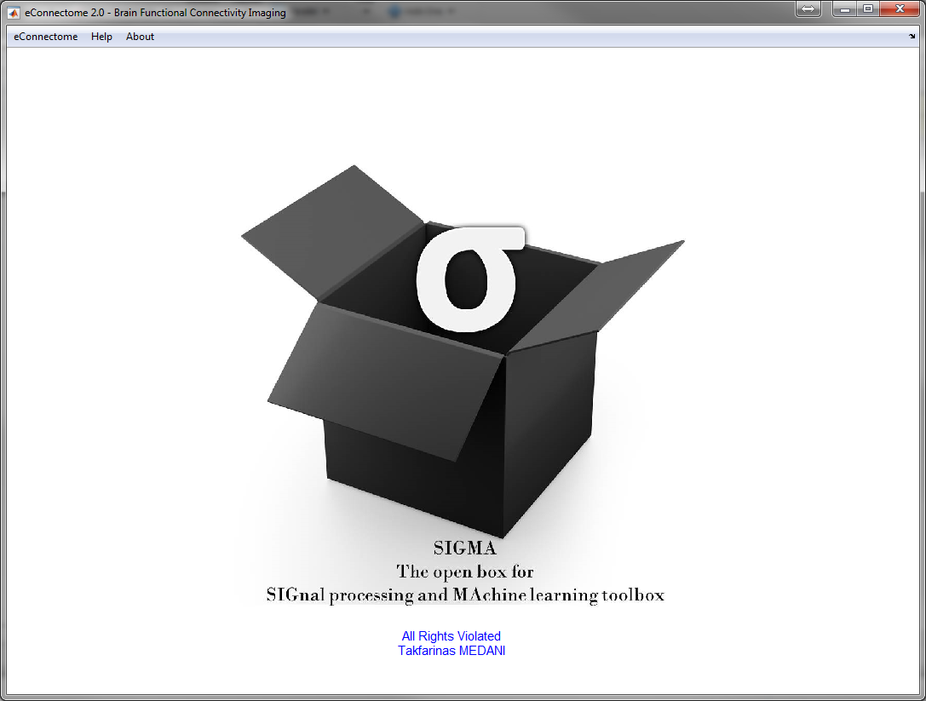
Logo and Name
SIGMA TOOLBOX
Notes:
Feature selection by Gram Schmidt orthogonalization.

Slide 2
General Organisation
SIGMA TOOLBOX
Features EXTRACTION
Features Extraction
Features Ranking
OFR
Data (EEG, …)
Selectedfeatures
Features
Learning/Classification
LOSO
LHSO
LOEO
Calibration
Selected features
Cross-validation
Prediction
Performance evaluation
ROC curves
Final model
VS
AUC vs Nb Features
AUC vs Nb calibration
Labels
Prediction
Performances measures
Notes:
Feature selection by Gram Schmidt orthogonalization.

Slide 3
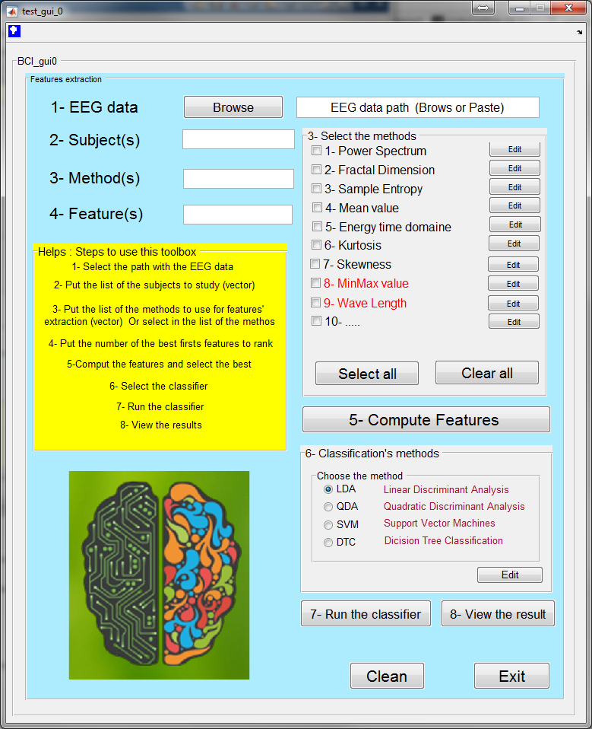
View of the toolbox gui (v0)
SIGMA TOOLBOX

