Slide 1
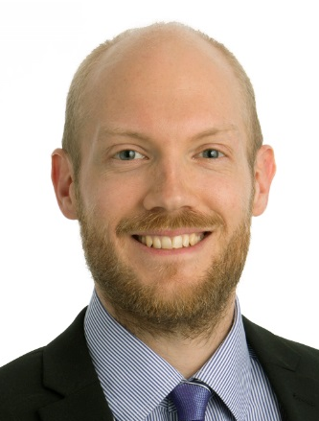
Professional Background
2016 – ff Sr Consultant, BearingPoint
2014 – 2016 Sr Consultant, Advectas
2011 – 2014 Consultant, Danske Bank
2010 – 2011 Sr Analyst, BearingPoint
Professional Focus
Examples of Projects
Information Management
Data Science / Advanced Analytics
Business Intelligence & Data Warehousing
Technology Advisory
Business and IT transformation
IT Due Diligence
Project Leader and Technology Adviser
For an overarching data quality/MDM and integration project including data marts for delivery from developers in India to the various Business Development departments for a major Nordic bank.
Team Leader
Team leader for the back-end developers related to a multi-million SEK data integration, pricing and forecasting solution for a large multinational company within the outsourcing industry.
Data Warehouse Architect
Architect for the back-end parts of a highly prioritized data warehousing/business intelligence solution involving the launch of a new savings product for a major Nordic bank. The solution was imperative for being able to follow up the results of the product launch.
Lead Developer
Lead developer for a prioritized business intelligence solution at a major Nordic bank, enabling the regional and office managers to get an overview of regional performance as well as their advisers’ performance. The project encompassed all the parts from requirements specification and data modeling to dashboard design.
Data Scientist
The project involved developing and updating predictive (scoring) models related to churn based on best-practices and up-to-date methodologies for a large media company. The resulting models performed very well with estimated savings from reduced churn of around 400 kEUR per year.
CRM Analyst
Performed various customer analyses involving statistical models in relation to the launch of a new strategy for a major Nordic bank. This included identifying customer preferences (market-basket analyses, next-best-offer solutions), finding the most profitable customers and branch locations etc.
Languages
Swedish: Native proficiency
English: Full professional proficiency
Danish: Professional working proficiency
Norwegian: Professional working proficiency
German: Elementary proficiency
Tobias Mejstad
Personal Background
Technical Skills
Summary
Programming
SAS (Macro), R, Python (pandas, scikit-learn, numpy), C#/.NET, Java, SQL, VBA, Batch programming, Shell/Bash scripting. Some Powershell and LaTeX.
Software
SAS (Base, Enterprise Guide, DI Studio, Enterprise Miner, Information Map Studio, Model Manager, BI Dashboard, Web Report Studio, Management Console)
IBM (InfoSphere DataStage, Data Manager, SPSS Modeler, SPSS Statistics, Cognos BI)
Oracle (SQL Developer, TOAD)
Microsoft (SQL Server, SSIS, SSRS, Visual Studio, Azure Machine Learning, Excel)
Other (RStudio, R Markdown, Jupyter, PyCharm, PostgreSQL, SQLite, QlikView, SSH, PuTTY, WinSCP, Cygwin, Git, TortoiseGit, Subversion, Gretl, Visual Rules, Logware, ProcessModel, Palisade’s Decision Tools etc.)
9+ years of work experience, from all of the Scandinavian countries
7+ years of consulting experience, chiefly within Data Science, Business Intelligence and Data Warehousing
Broad technical experience including several programming languages and software from SAS, Microsoft, IBM, Oracle etc.
Education/Certifications
M.Sc. Information Systems, highest honors, Lund University (Sweden)
B.Sc. Economics (finance/stats conc.), Lund University and Queen’s University (Canada)
Certs within SAS, C#, R, ITIL etc.
Industry Experience
Finance
FMCG
Logistics
Telecommunications
Outsourcing
Media

