Slide 1
Project Release Plan
6 October 2015
Athlatex
Christina Duran Daniel Urrutia
Sean McGrath Justin Wong
Tim Mertogul Jake Zidow

Slide 2
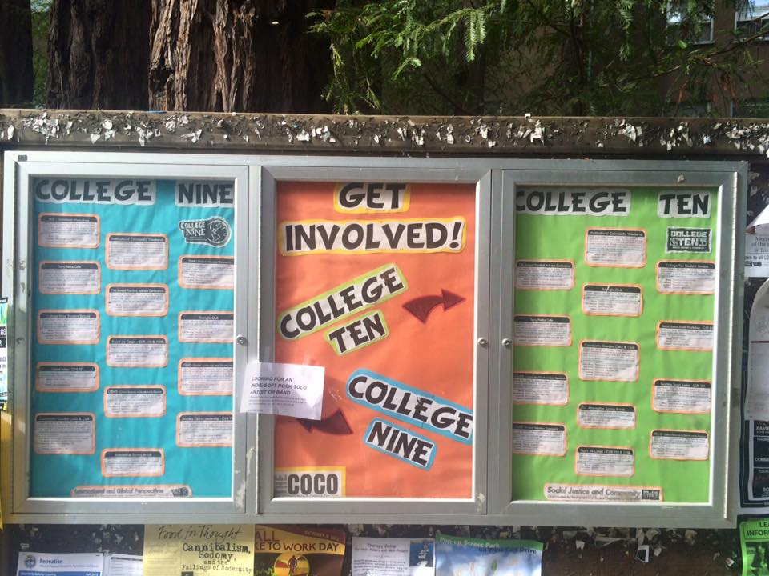

Project Release Plan
SlugLife

Slide 3
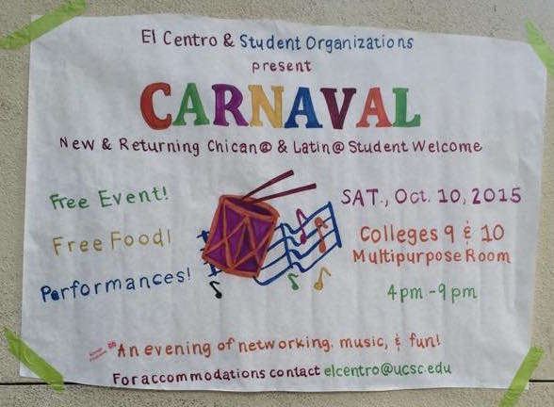

Slide 4
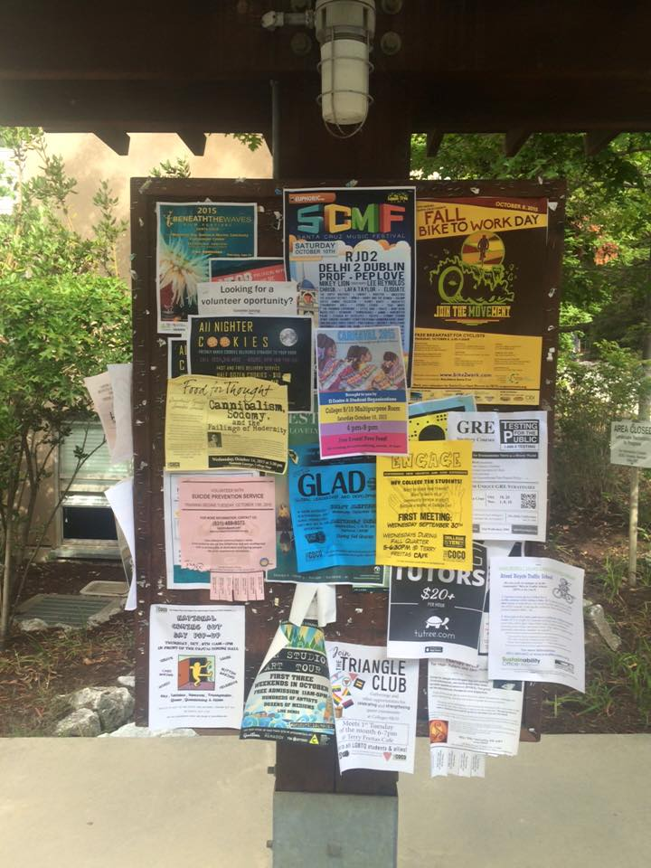
Sprint 1
Project Release Plan – User Stories
Post events
View events

Slide 5
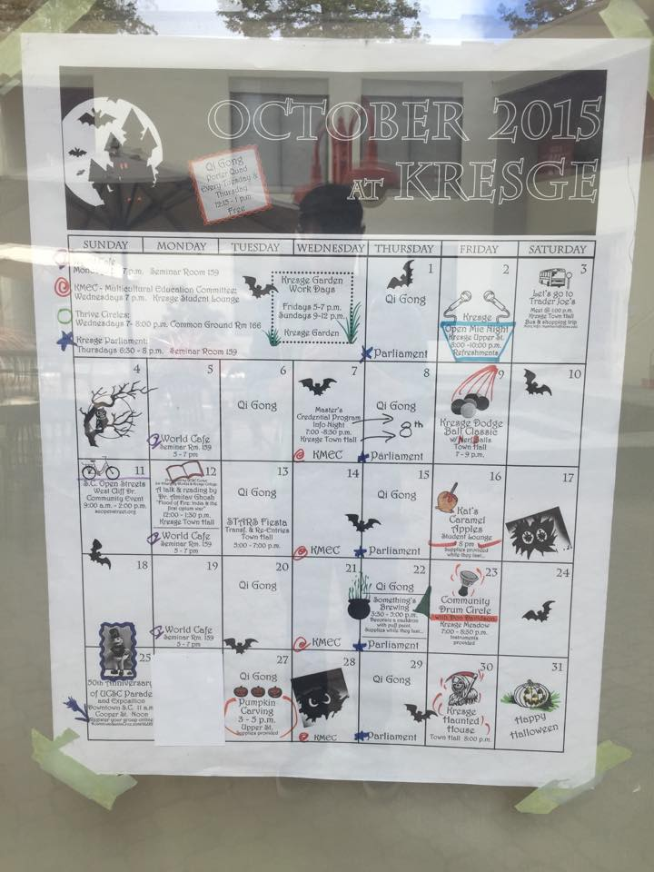
Sprint 2
Project Release Plan – User Stories
Upload pictures
Edit previous posts

Slide 6
Sprint 3
Project Release Plan – User Stories
Sort posts
Host verified administrator accounts
Developer tests

