Slide 1
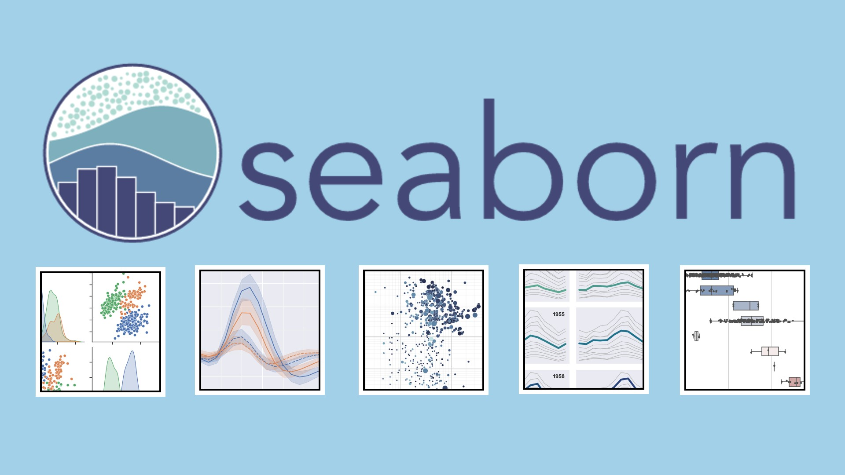
Further insight into
(aka. “How to code like you are a pro on Jupyter Notebook”)
A presentation by Phuc Hai Dang Nguyen

Slide 2
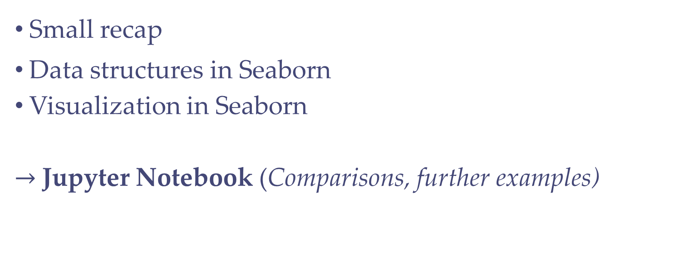
Content
Small recap
Data structures in Seaborn
Visualization in Seaborn
$→$Jupyter Notebook (Comparisons, further examples)

Slide 3
A small recap…

Slide 4
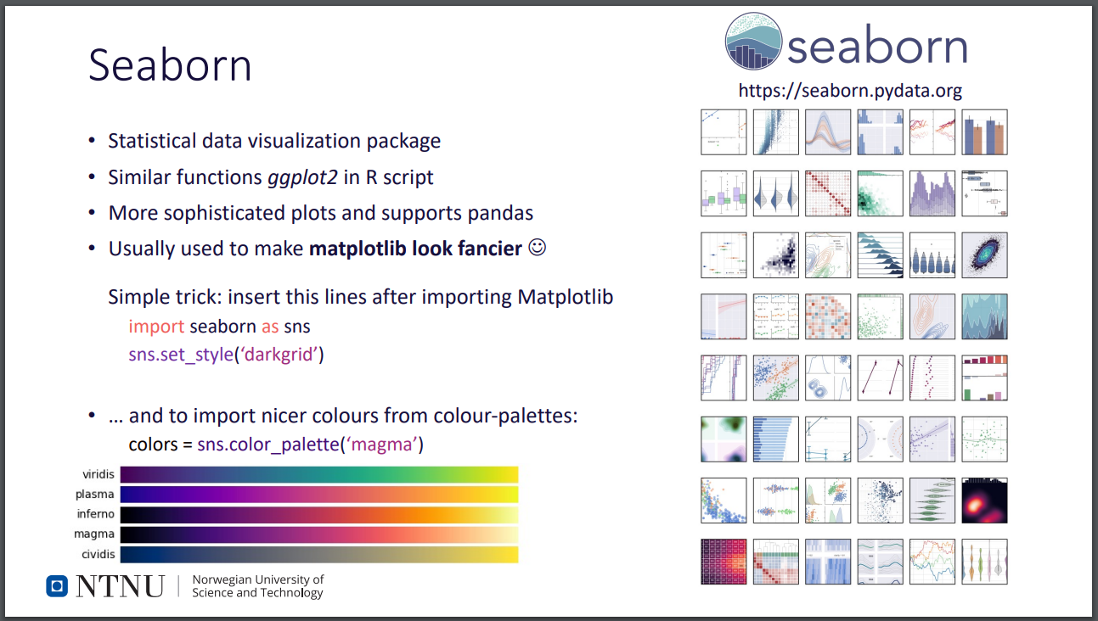

Slide 5
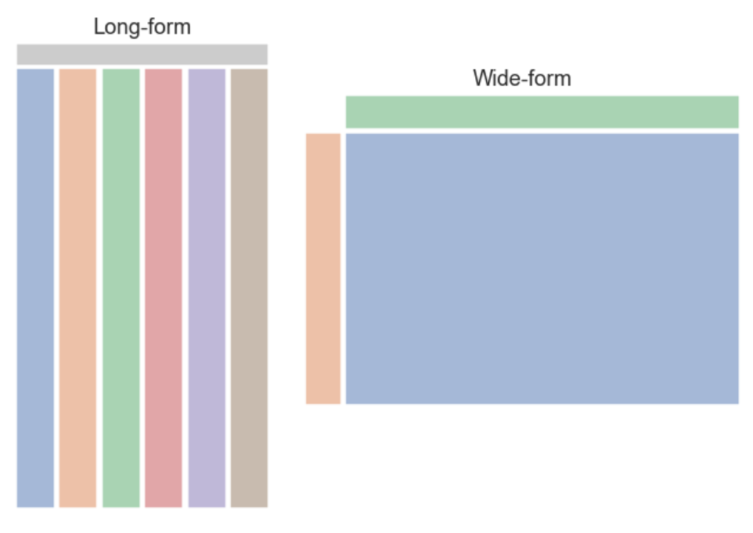
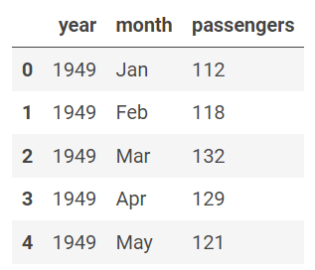
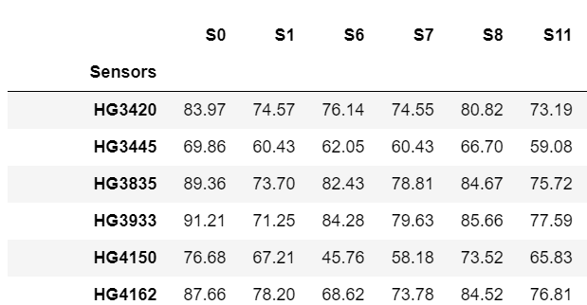
Data structures
https://seaborn.pydata.org/tutorial/data_structure.html

Slide 6
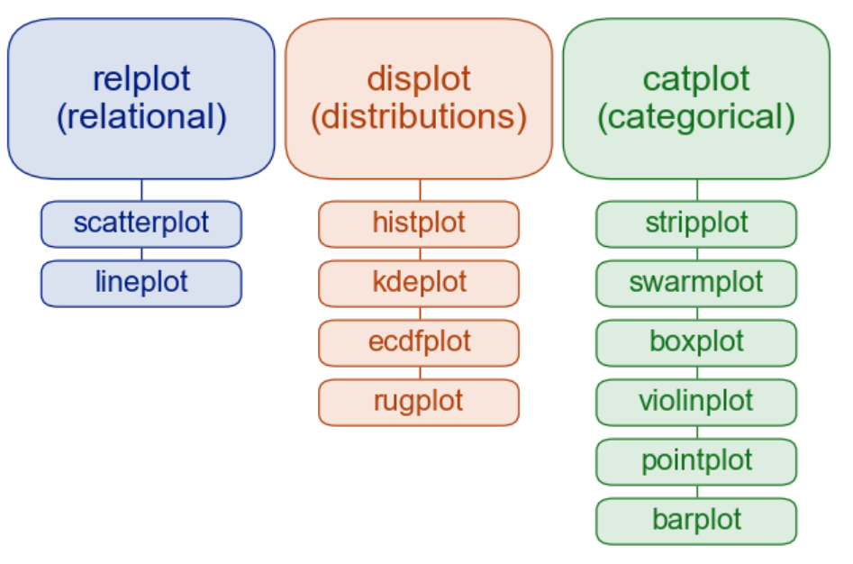
Visualization with Seaborn
https://seaborn.pydata.org/examples/index.html#
Notes:
https://seaborn.pydata.org/examples/index.html#

Slide 7
DIFFERENCE BETWEEN SEABORN VS MATPLOTLIB
Seaborn contains a few plots and patterns for data visualisation, while in matplotlib, datasets are visualised with the assistance of lines, scatter plots, pie charts, histograms, bar-graphs, etc. This is another difference between seaborn vs matplotlib.
Seaborn vs matplotlib is that seaborn is more agreeable in taking care of data frames in Pandas, while matplotlib is very much associated with Pandas and NumPy and goes about as a graphics package for Python data visualisation.
Seaborn vs matplotlib is that seaborn tries not to cover plots with the assistance of its default themes, while matplotlib is profoundly robust and customised.
Seaborn is considerably more organised and functional than Matplotlib and treats the entire dataset as a solitary unit. It isn’t so stateful, and in this manner, parameters are required while calling techniques like plot (), while Matplotlib acts productively with data arrays and frames. It regards the aces and figures as objects. It contains different stateful Application Programming Interface for plotting. Accordingly, plot () like strategies that can work without parameters is another difference between seaborn vs matplotlib
Notes:
https://www.jigsawacademy.com/blogs/ai-ml/seaborn-vs-matplotlib/

