Slide 1
18-758 Final project review
Team members: xxx
12 minute presentation,
followed by 6 minutes Q/A

Slide 2
Basic design
(6 minute presentation)

Slide 3
Basic design demo
Run transmitter software
Upload transmit signal to username demo
  Password demo
  To save class time, please ensure that this username is already hardcoded into a Tectia SFTP profile)
... Continue remaining presentation while waiting for received signal (see next slides) ...
Download received signal
Run receiver software

Slide 4
Basic transceiver design
(one slide)
Picture of basic transceiver, as currently implemented
Mark relevant design parameters in above picture (symbol rate, etc)

Slide 5
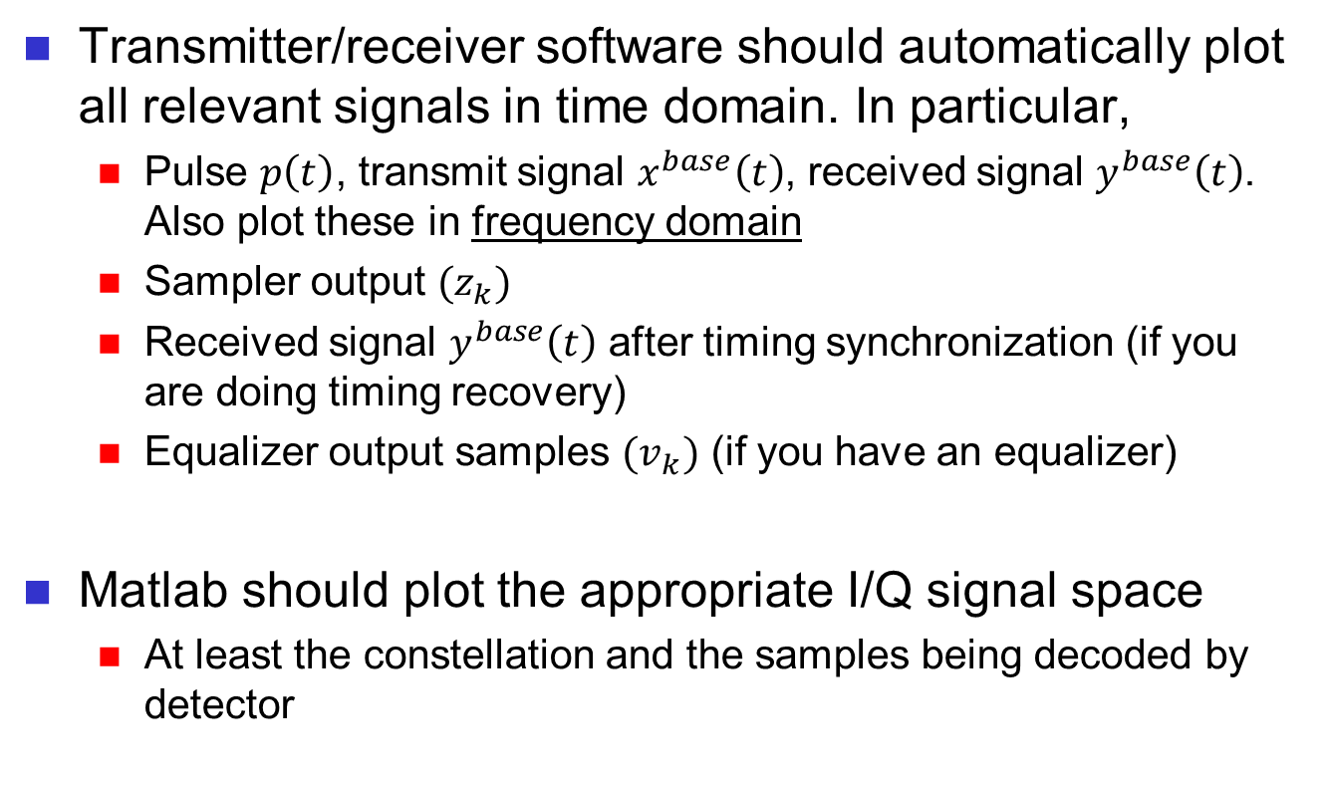
Basic design demo
(Matlab plots these during class demo)
Transmitter/receiver software should automatically plot all relevant signals in time domain. In particular,
  Pulse $p\left(t\right)$, transmit signal $x^{base}\left(t\right)$, received signal $y^{base}\left(t\right)$. Also plot these in frequency domain
  Sampler output ${(z}_{k})$
  Received signal $y^{base}\left(t\right)$ after timing synchronization (if you are doing timing recovery)
  Equalizer output samples ${(v}_{k})$ (if you have an equalizer)
Matlab should plot the appropriate I/Q signal space
  At least the constellation and the samples being decoded by detector

Slide 6
Basic design discussion
Show that the image has been successfully transmitted (i.e., specified BER guarantee is met) ...
... or ...
... Discuss why your basic transceiver does not work reliably

Slide 7
Advanced design:
Low-density parity check (LDPC) codes

Slide 8
Advanced design demo
Run transmitter software
Upload transmit signal to username demo
  Password demo
... Continue remaining presentation while waiting for received signal (see next slides) ...
Download received signal
Run receiver software

Slide 9
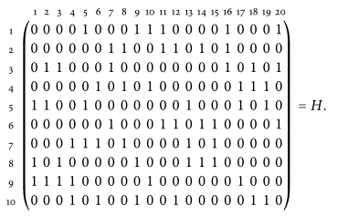
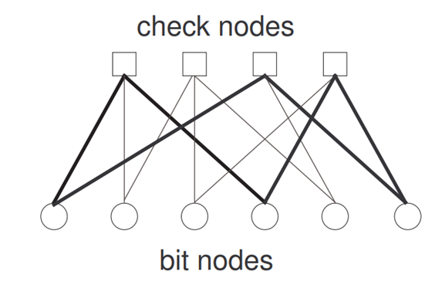
Advanced design motivation
LDPC codes are a family of error correction codes which have been shown to perform near to the Shannon limit
Utilize sparse matrices and iterative soft-decoding schemes
Active field of research involving efficient design of LDPC encoders and decoders
Tanner graph representation

Slide 10
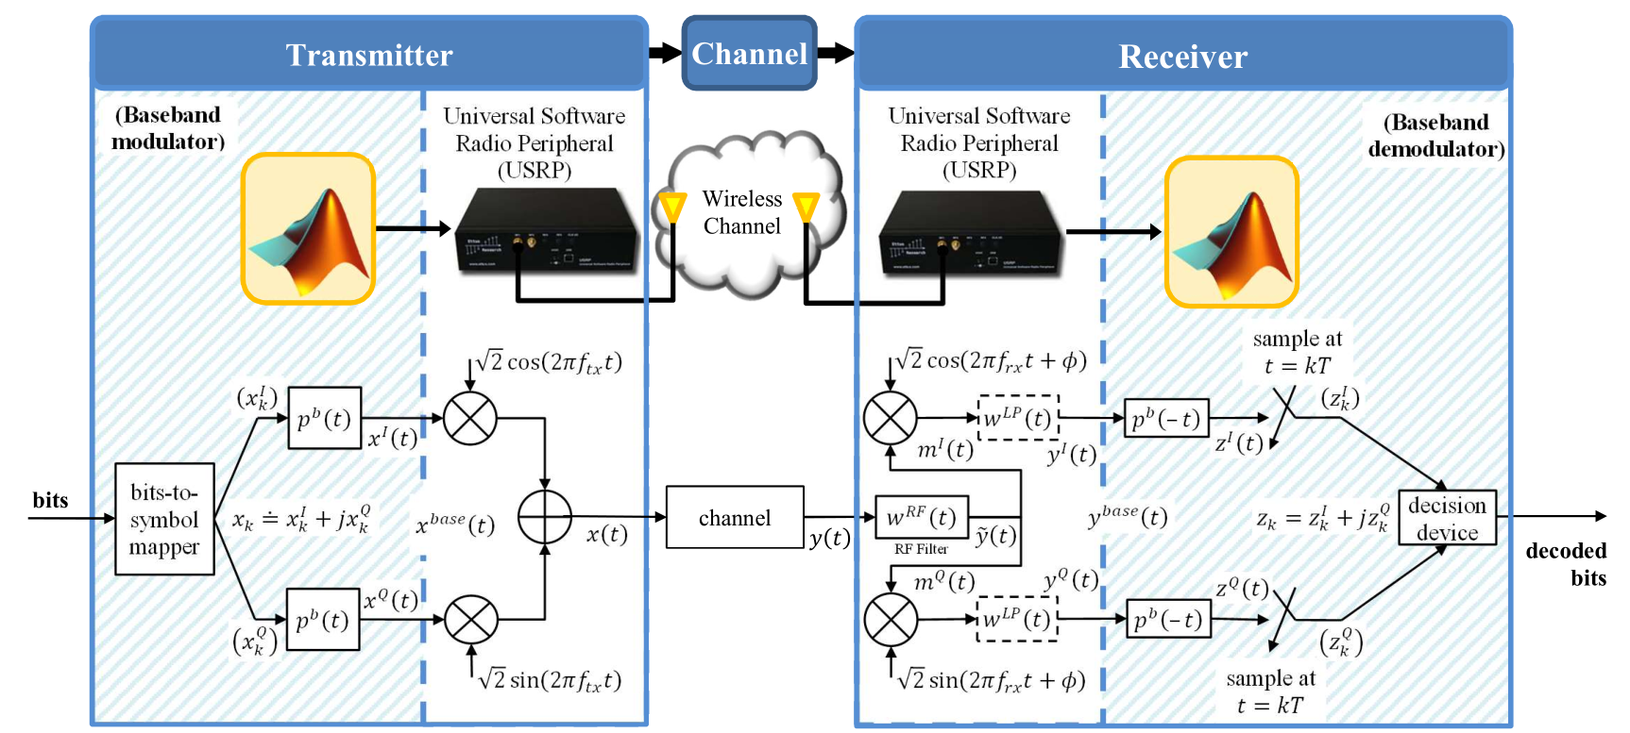
Advanced design in USRP project

Slide 11

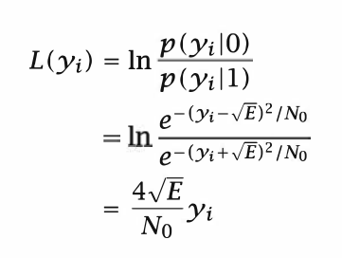
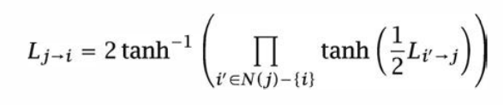

Advanced design idea
(one slide)
Encoding: back substitution with parity-check matrix:
Soft-decoding with Sum-Product message-passing algorithm for set number of runs/until the parity-check equations are satisfied
Modern Coding Theory by Richardson and Urbanke, page 437
Check node computing message to be sent back to associated variable/bit nodes
LLR calculation (middle equation used)
Variable node updates information based on newly-received data from check nodes
Contemporary Communications Systems by Proakis, Salehi, Bauch, page 498

Slide 12
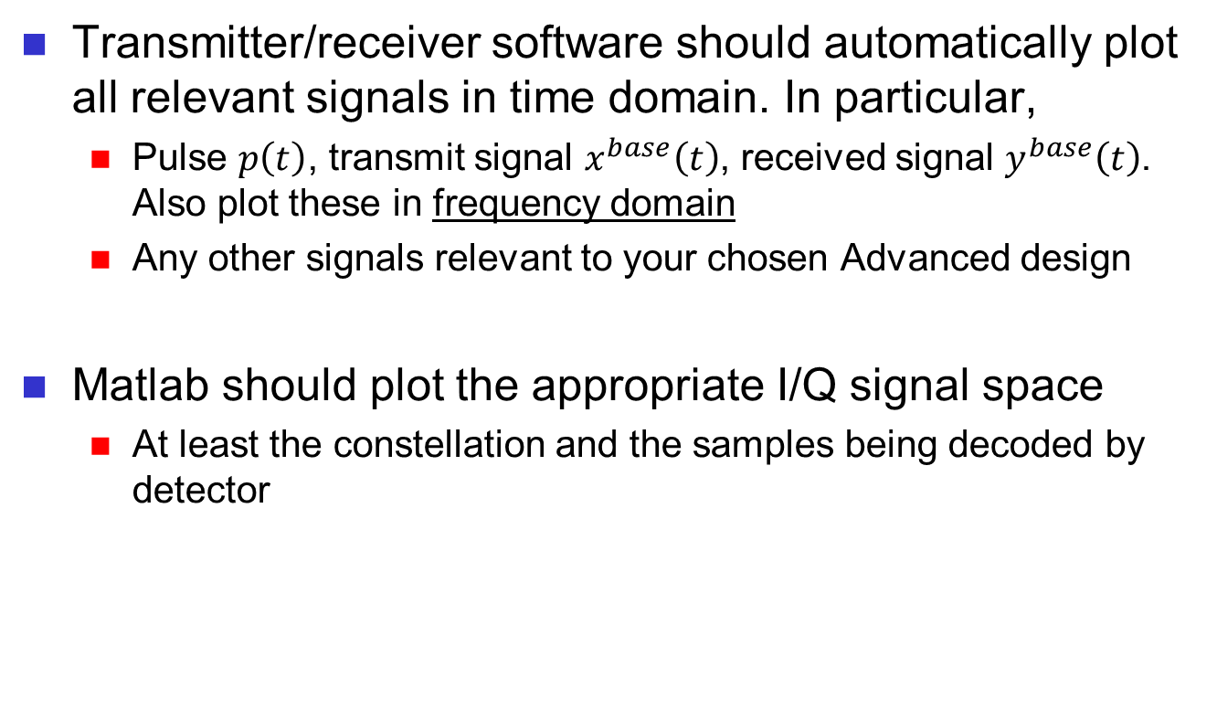
Advanced design demo
(Matlab plots these during class demo)
Transmitter/receiver software should automatically plot all relevant signals in time domain. In particular,
  Pulse $p\left(t\right)$, transmit signal $x^{base}\left(t\right)$, received signal $y^{base}\left(t\right)$. Also plot these in frequency domain
  Any other signals relevant to your chosen Advanced design
Matlab should plot the appropriate I/Q signal space
  At least the constellation and the samples being decoded by detector

Slide 13
Advanced design discussion
Show that the required number of bits have been transmitted within the specified BER guarantee ...
... or ...
... Discuss why your advanced transceiver does not work reliably

