Slide 1
18-758 Mid-project review
Team members: xxx
10 minute presentation in total

Slide 2
Basic design (5 minute presentation)

Slide 3
Basic design demo
Run transmitter software
Upload transmit signal
... Continue remaining presentation while waiting for received signal (see next slides) ...
Download received signal
Run receiver software

Slide 4
Current basic transceiver design
Picture of transceiver, as currently implemented
Explain it

Slide 5
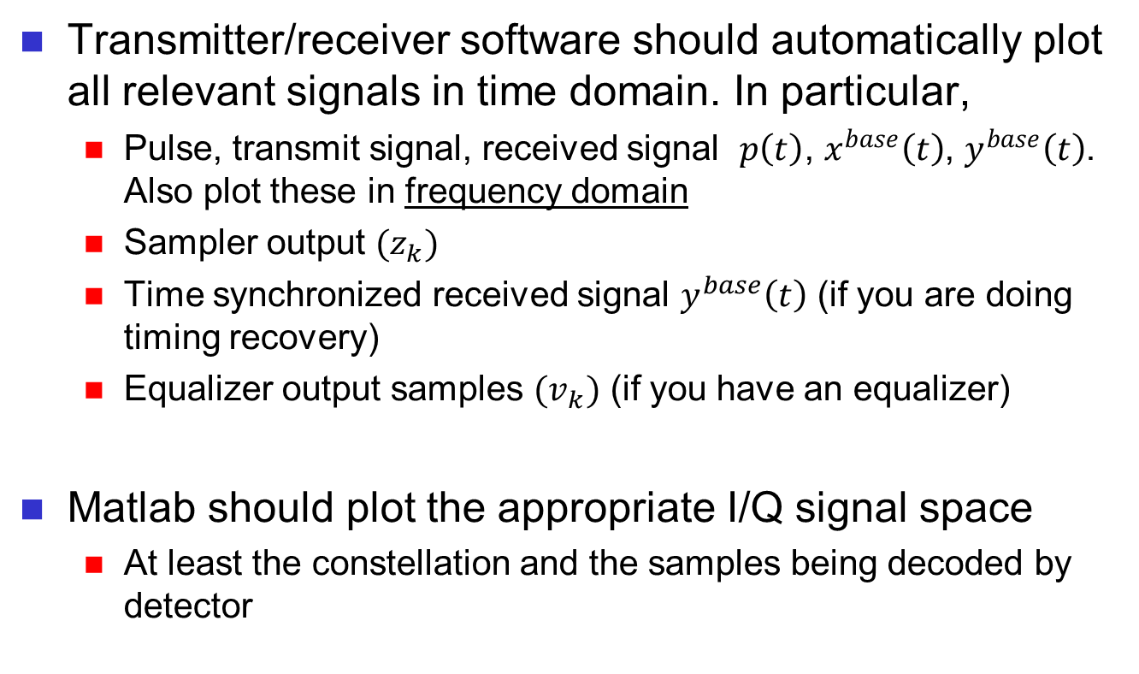
Basic design demo
Transmitter/receiver software should automatically plot all relevant signals in time domain. In particular,
Pulse, transmit signal, received signal $p\left(t\right)$, $x^{base}\left(t\right)$, $y^{base}\left(t\right)$. Also plot these in frequency domain
Sampler output ${(z}_{k})$
Time synchronized received signal $y^{base}\left(t\right)$ (if you are doing timing recovery)
Equalizer output samples ${(v}_{k})$ (if you have an equalizer)
Matlab should plot the appropriate I/Q signal space
At least the constellation and the samples being decoded by detector

Slide 6
Basic design discussion
Show that the 1101000101 bit pattern has been successfully transmitted (i.e., no errors) ...
... or ...
... Discuss why your basic transceiver does not work reliably

Slide 7
Advanced design (5 minute presentation)

Slide 8
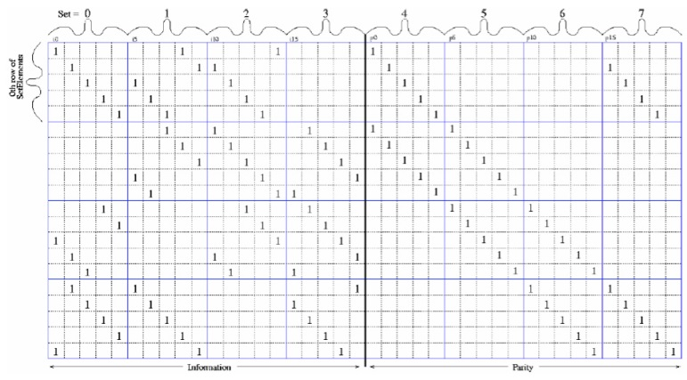
Low-Density Parity-Check Codes
Type of error correcting code that reaches near the Shannon limit on performance
Error correction codes equate to redundancy in the transmitted signal such that the receiver can correct some errors that occurred from transmission
Low-complexity decoding with ability to parallelize; used in WiMAX, 10 Gigabit Ethernet

Slide 9
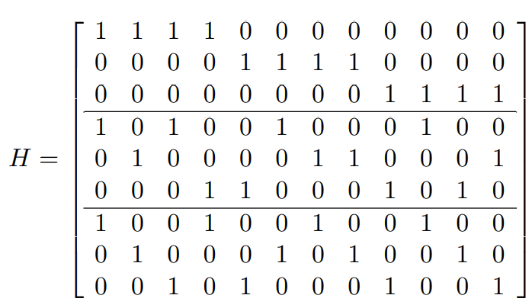
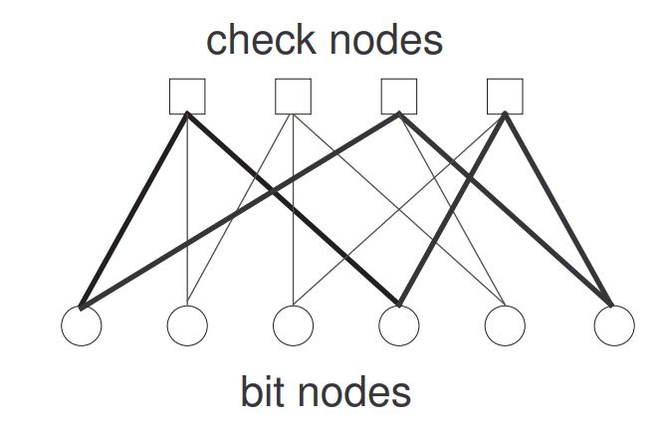
Advanced design idea
Represented as sparse matrices (most elements are zero) or sparse bipartite graphs (two disjoint, independent sets of vertices)
Each of M rows represents a linear parity-check constraint
Each of N columns represents a bit in block code
In Tanner graph, N bit nodes and M check nodes; edge exists if and only if element in matrix is a one

Slide 10
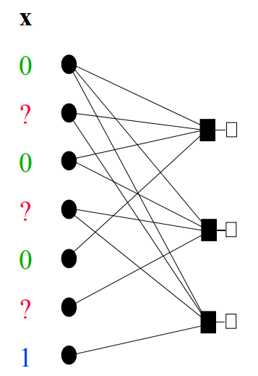
LDPC Algorithm Example
Parity
Variable nodes (bits)
Check nodes
Accumulate known bits
Delete known edges, nodes
Find degree-1 check node, forward parity
Delete check node, edge
Forward new bit value
Repeat

Slide 11
Advanced design in USRP project
Error correction with LDPC occurs following demodulation and prior to detection

