Slide 1

The MTOSI Simulator

Slide 2
MTOSI 1.x Highlights and Simulator Scope
Functional Domains
  Inventory Retrieval
  Inventory Update Notifications
  Active Alarm Retrieval
  Alarm Reporting
Transmission Technologies
  SONET/SDH, Asynch/PDH,
  DWDM,
  ATM, Frame Relay
  xDSL
Specification Style
  WSDL
  SOAP
  XML
Middleware Transport Mapping
  HTTP
  JMS

Slide 3
Simulator Overview
A Web Server simulating
a NMS exposing the “InventoryRetrieval” interface
Two clients:
  Thin client: using Web pages, useful for MTOSI beginners
  Rich client: using Java libraries, useful for MTOSI implementers
A tool to populate the NMS database using an XML input file
Source code available at the TMForum GForge repository
The simulated NMS server can be queried on the TMF lab machine at:
url: http://org.tmforum....

Slide 4
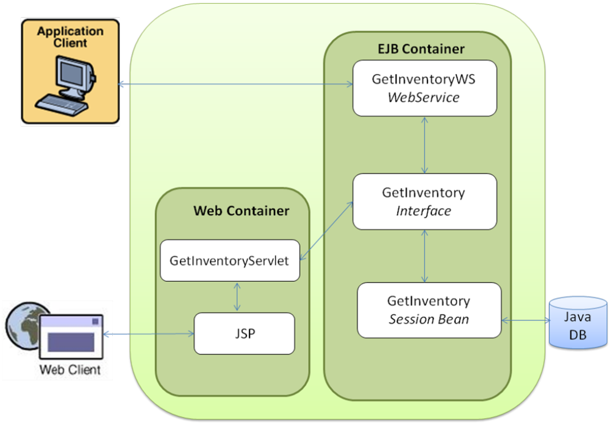
Run time architecture
MTOSI messages
Notes:
This picture shows the overall architecture of the Simulator
Several Java client(s) and Web client(s) can access the Simulator at the same time.
Say also a word about the MEP (Message Exchange Pattern) used in the demo:
RPC style (synchronous)
over HTTP

Slide 5
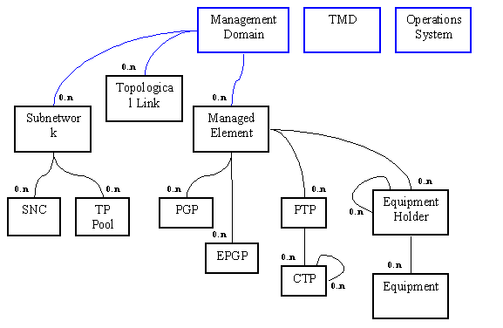
The MTOSI 1.1 Inventory Naming Schema
Notes:
This is the naming schema used in MTOSI 1.x
Insist on the following object classes and their respective positions in the tree since they will be shown in the demo:
ME
PTP
CTP
Subnetwork (synonym = MLSN)
SNC
TopologicalLink

Slide 6
Demonstration Scenario

Slide 7
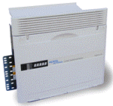
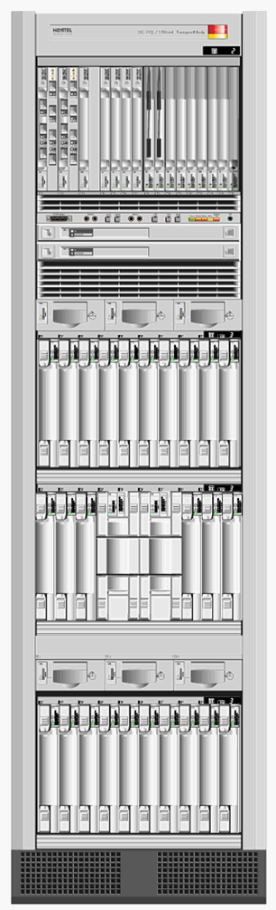
The Example Network
Domain: Networks/XdrEMS/Server1
7 PTP
6 CTP
27 PTP
7 CTP
5 PTP
4 CTP
20005
20005
19204
G11
19204
768
G11
768
G3
G5
G3
12
G5
11
12
11
G12
G12
G1
12
G1
12
OC
OC
-
-
192 4F
192 4F
OC
-
48 UPSR
OC
-
48 UPSR
BLSR
BLSR
11
11
G2
54016
G2
54016
G18
1 MD
4 ME
7 TL
5 MLSN
G18
12
12
11
11
G4
G6
G4
G6
G17
G17
19968
19968
DSM
DSM
DSM
430 PTP
8 CTP
Notes:
This example is taken from a real lab experiment
Although limited in terms of size and complexity it is rich enough to demonstrate the MTOSI getInventory features
The real lab environment had 5 MEs, but only 4 are available in the database.
The callouts bubbles show the numbers of instances available in the database (refer to the naming tree from the previous slide)
There is a singe domain named: “Networks/XdrEMS/Server1“

Slide 8
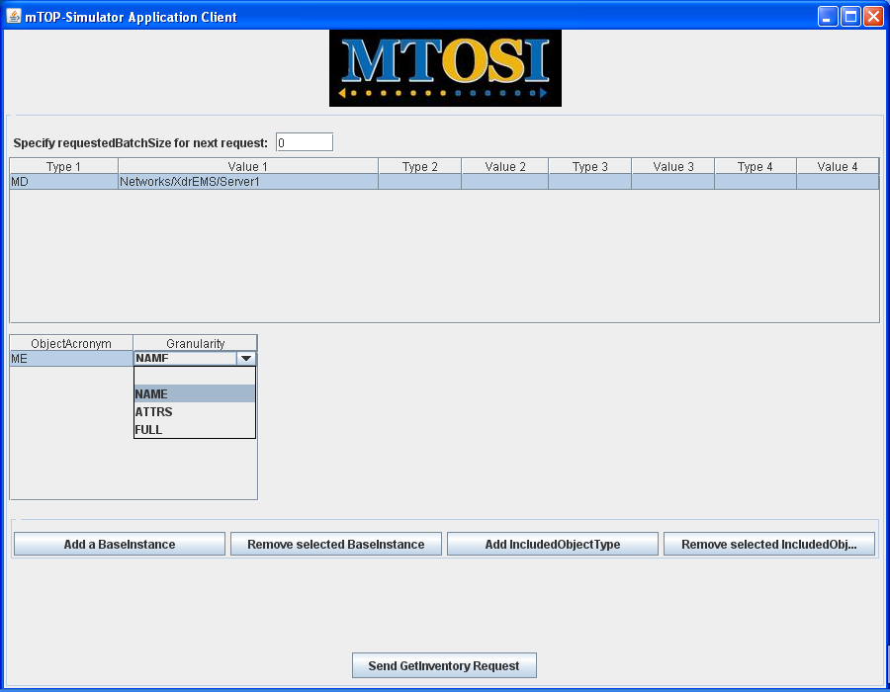
The Java GUI: Query the ME Names
Notes:
We assume that before the demo starts
The PopulateDatabase Server has been deployed (section 4.1 of the “mTOPSimulatorDocumentation.doc”),
The mTOP-Simulator Server has been deployed (section 4.2 of the “mTOPSimulatorDocumentation.doc”),
The database has been populated (section 5 of the “mTOPSimulatorDocumentation.doc”)
Start at the beginning of section 6.1, with the “ant run” command to start the GUI of the Java client.
Once the GUI is visible, enter the data as shown (MD name is “Networks/XdrEMS/Server1”):
Show the different panels of the GUI
Introduce the filter mechanism used in MTOSI 1.x (made of two parts: BaseInstance(s) and IncludedOjectType(s))
The “requestedBatchSize” parameter is used to control the size of the partial response (in terms of number of objects),
when left to “0” it means that a single response is expected.
The first request will collect all the MEs subordinates of the MD named “Networks/XdrEMS/Server1” and only their names will be returned.
Once ready click on the “Send GetInventory Request” button

Slide 9
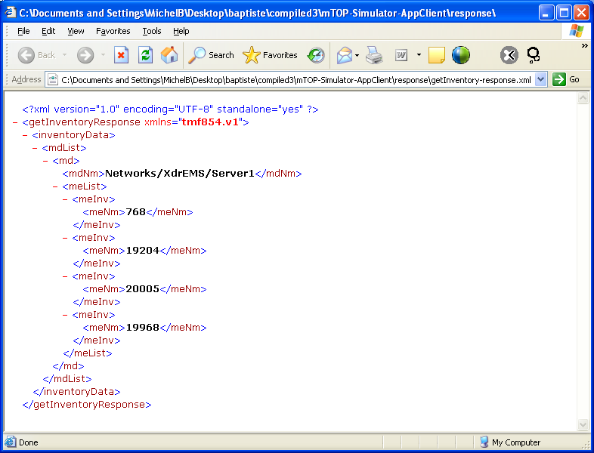

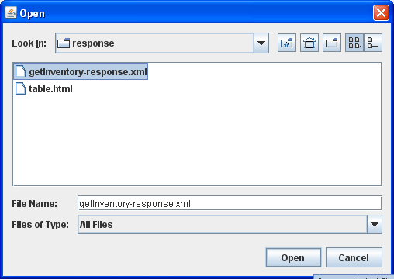
Response: Display the ME Names in XML
1
3
2
Notes:
Upon return, click on the “View Response” button
You can chose to display the response in XML format (this slide)
or in tabular format after some XSLT transform (see next slide)
For subsequent requests, you do not need to click every time on the “View Response” button: once the “Get Inventory Request” button is no more dark grey (meaning that the response is available) you just need to refresh the IE window.

Slide 10
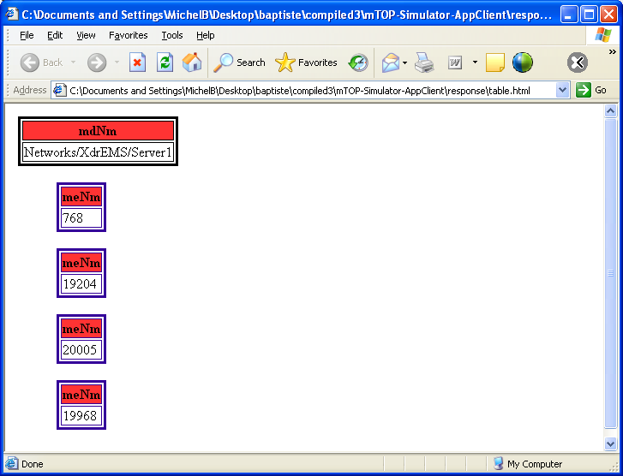
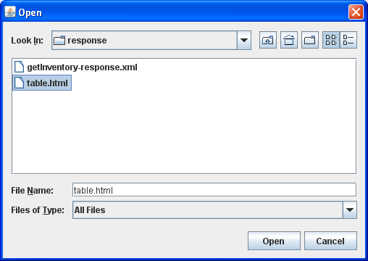
Response: Display the ME Names in Table Rep
1
3
2
Notes:
Same response displayed in tabular format

Slide 11
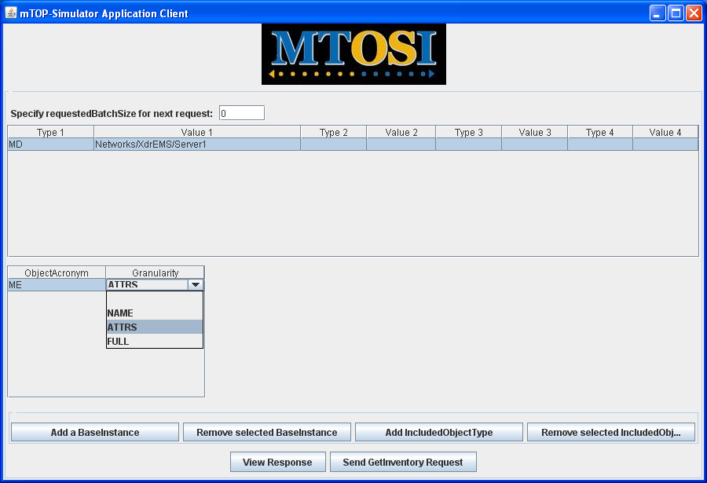
Query the ME Attributes
Notes:
Almost the same request, but this time we request the ME attributes

Slide 12
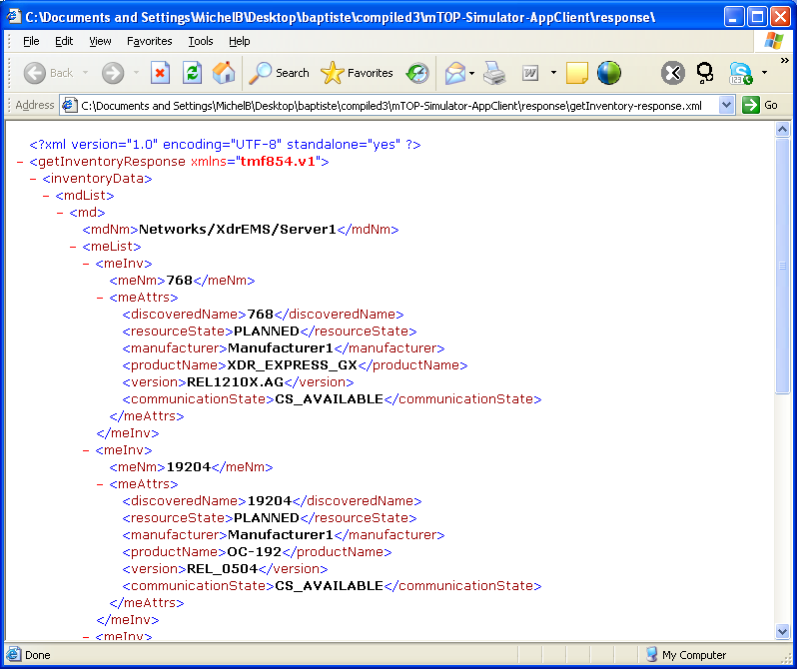
Response: Display the ME Attributes

Slide 13
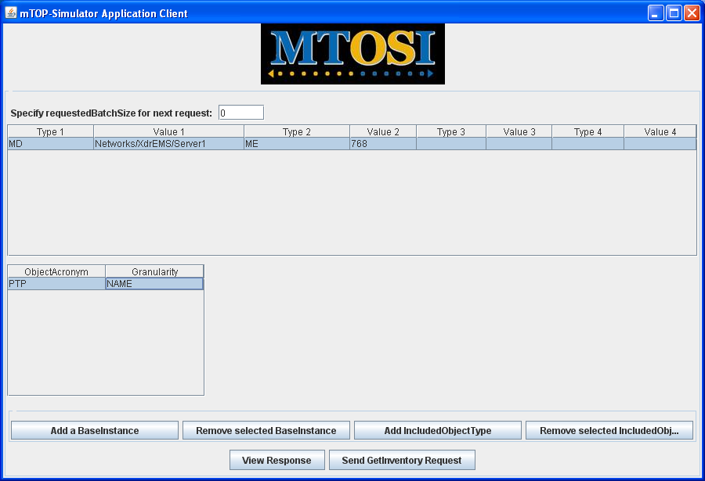
Query the Names of the PTP subordinate of ME 768

Slide 14
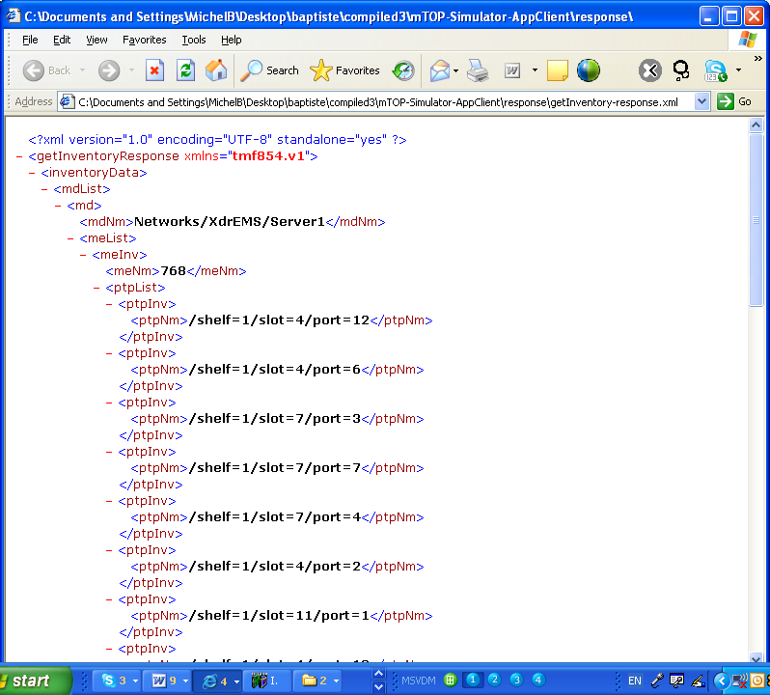
Response:
Display the 27 PTP Names subordinate of ME 768

Slide 15
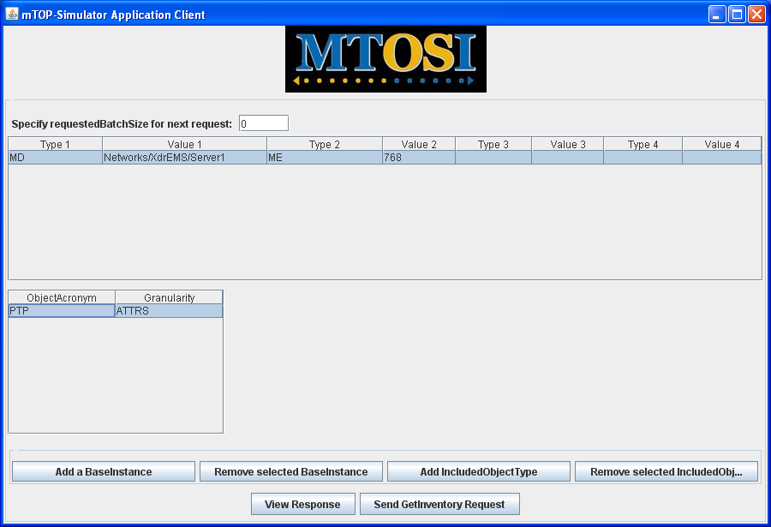
Query the Attributes of the PTP subordinate of ME 768

Slide 16
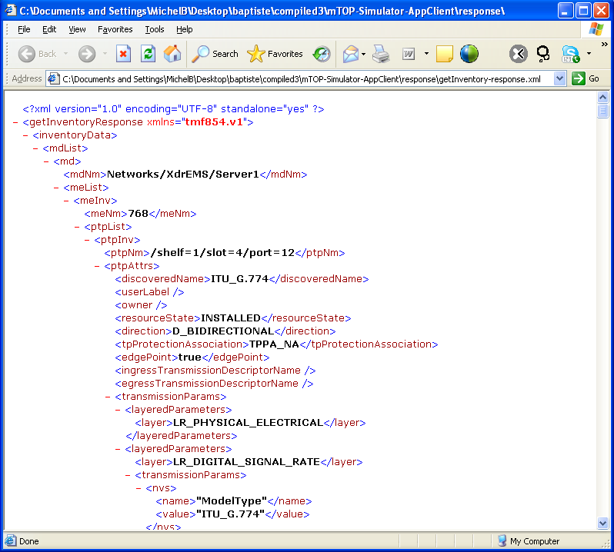
Response:
Display the 27 PTP Attributes subordinate of ME 768

Slide 17

Query with two IncludedObjectTypes:
ME 768 ATTRS and PTP ATTRS

Slide 18
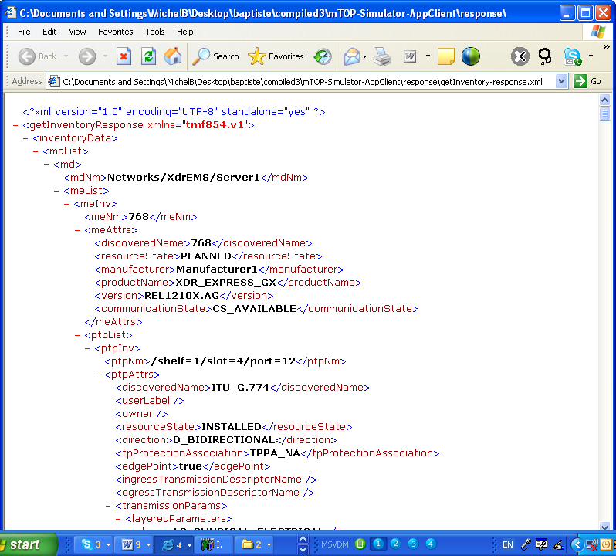
Response:
Display ME 768 Attributes and TP Attributes (XML)

Slide 19
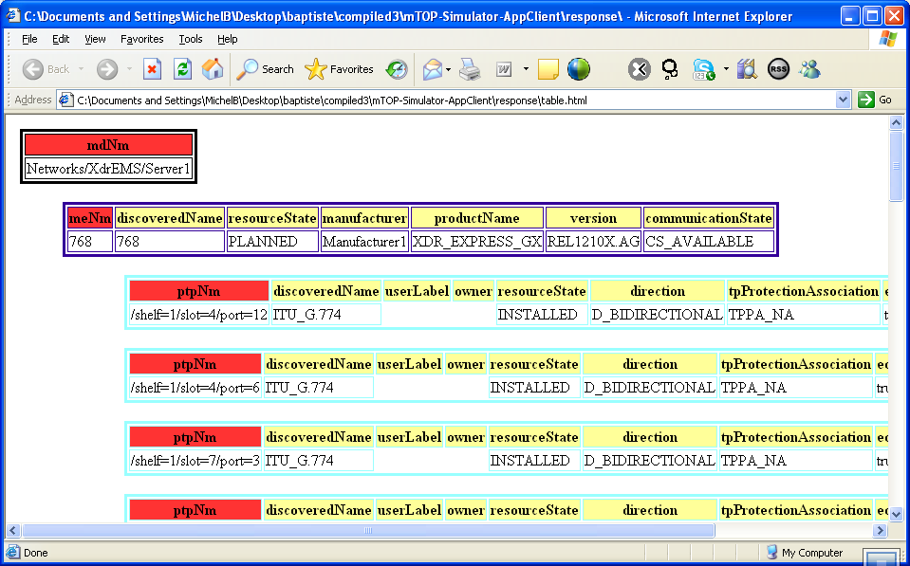
Response:
Display ME 768 Attributes and TP Attributes (Table)

Slide 20
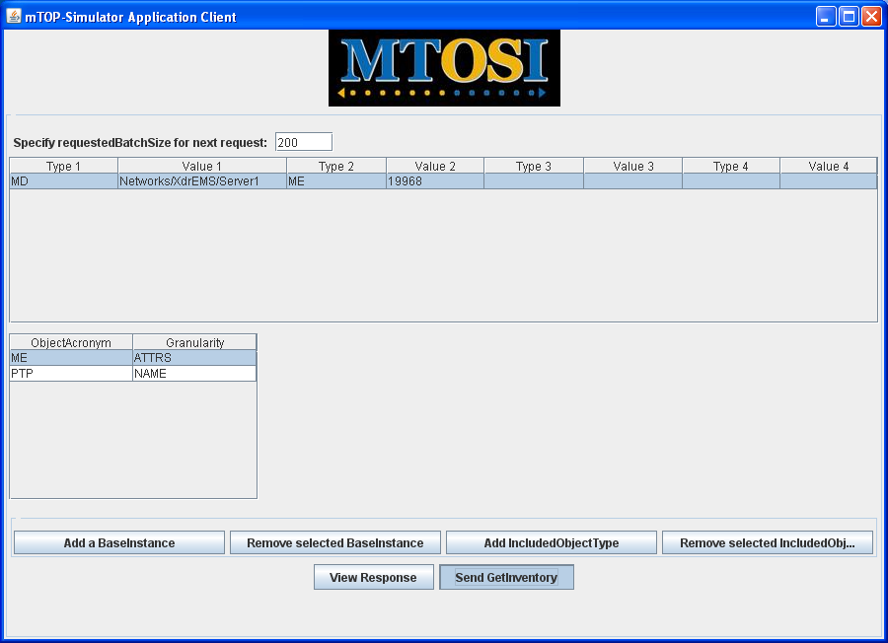
Query
Display the 430 PTP Attributes subordinate of ME 19968

Slide 21
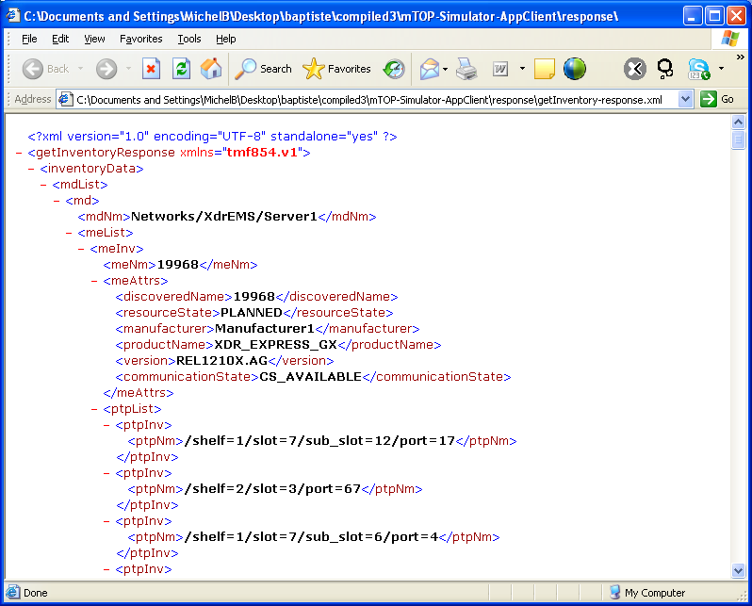
Partial Response 1:
Display PTP Names for 1-200

Slide 22
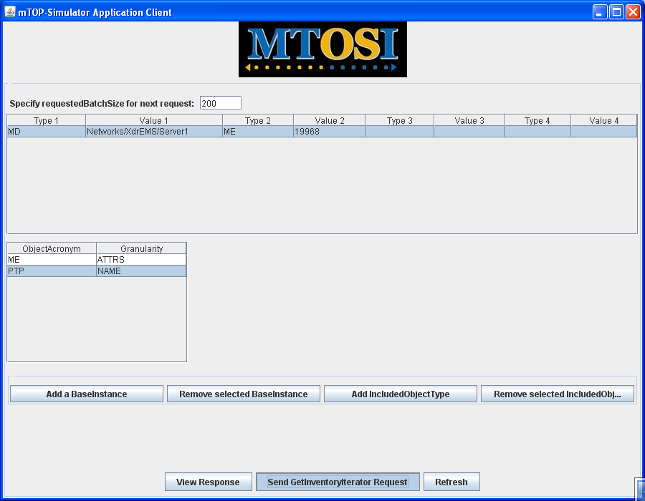
Query the next chunk: PTPs 201 – 400;
Using the getInventoryIterator request

Slide 23
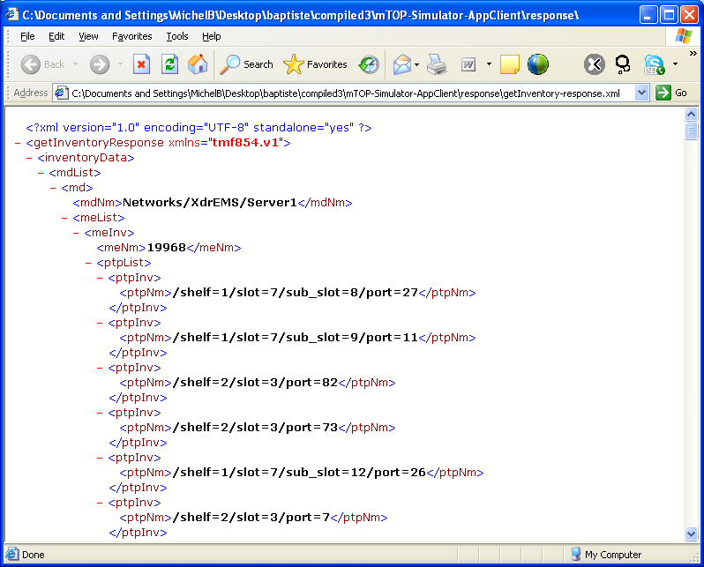
Partial Response 2:
Display PTP Names for 201-400

Slide 24
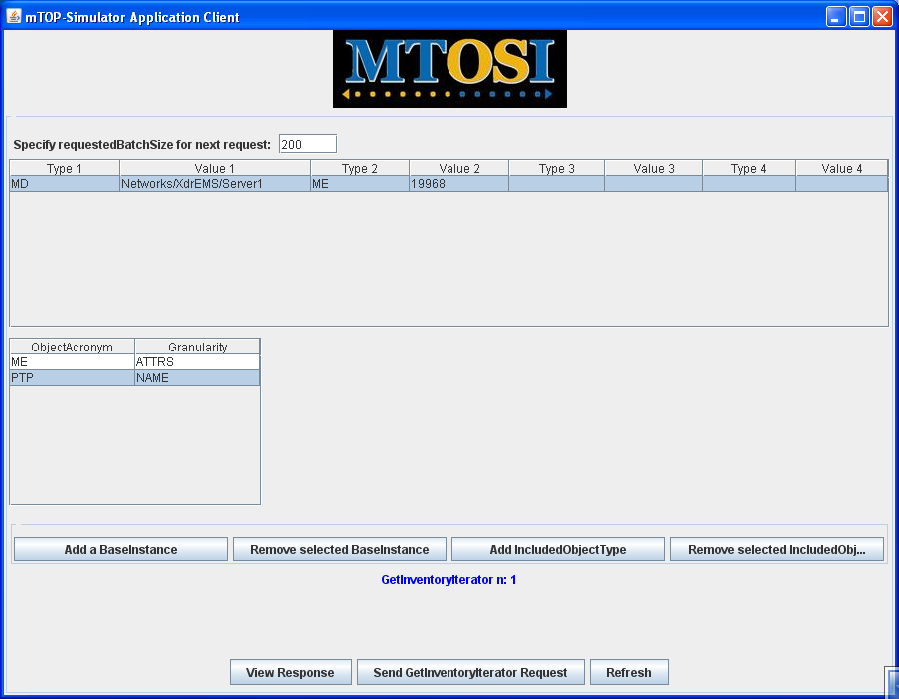
Query the last chunk: PTPs > 401;
Using another getInventoryIterator request

Slide 25
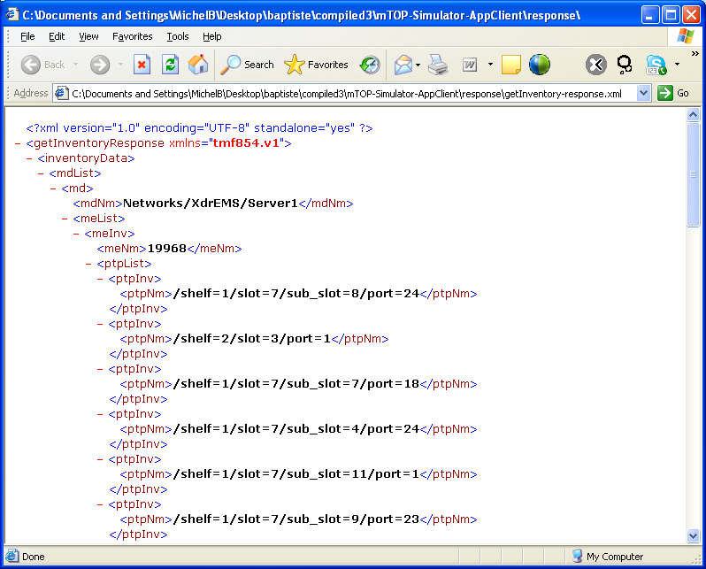
Partial Response Final:
Display PTP Names for 401-430

Slide 26
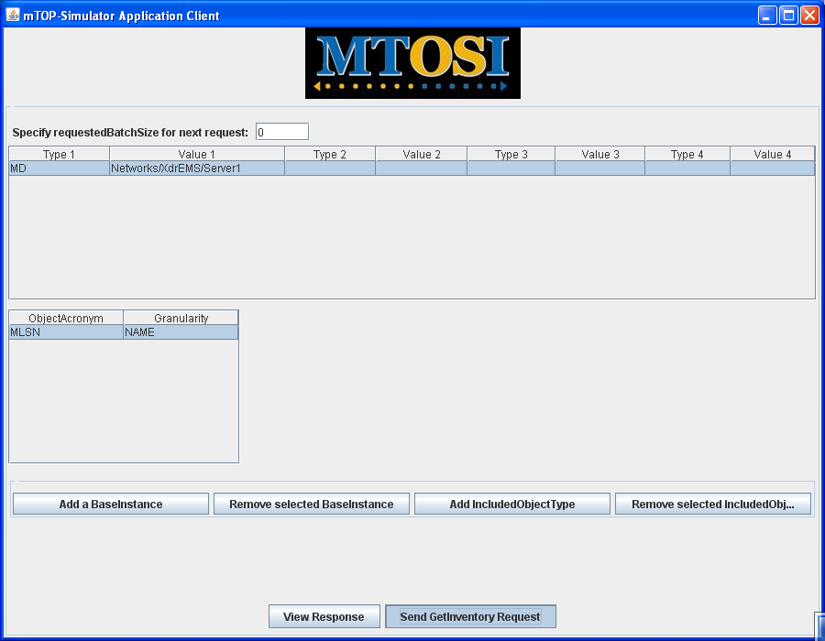
Query MLSN Names

Slide 27
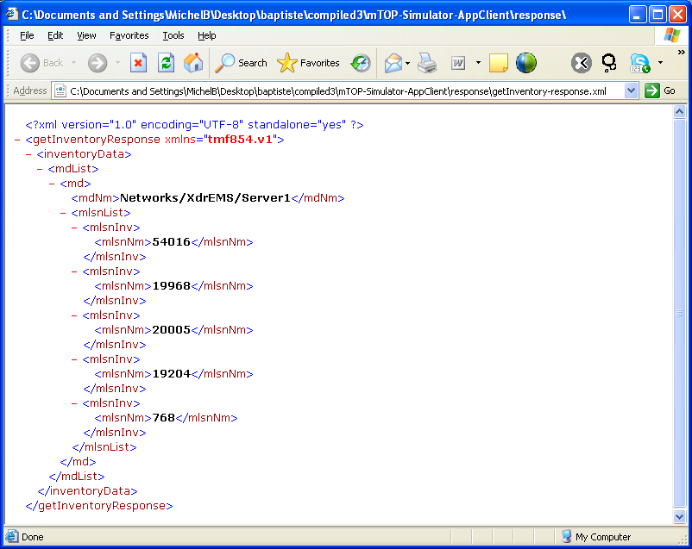
???

Slide 28

Query SNC Names for MLSN 768

Slide 29
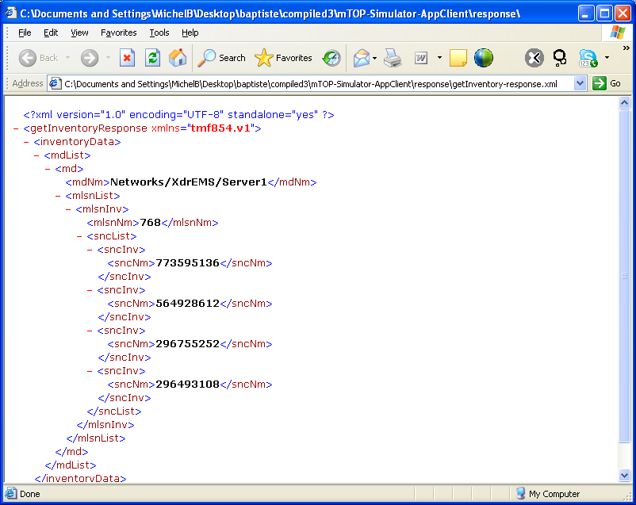
???

Slide 30
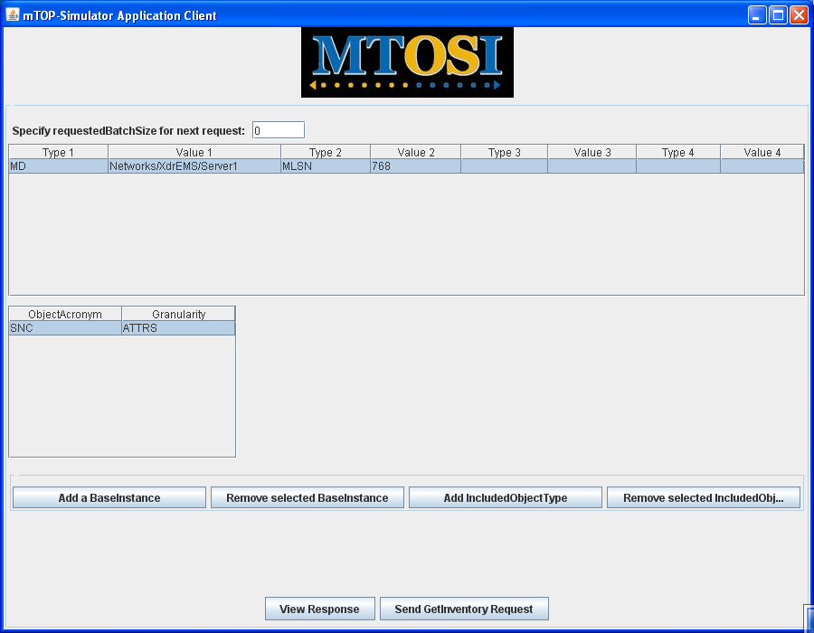
Query SNC Attrs for MLSN 768

Slide 31
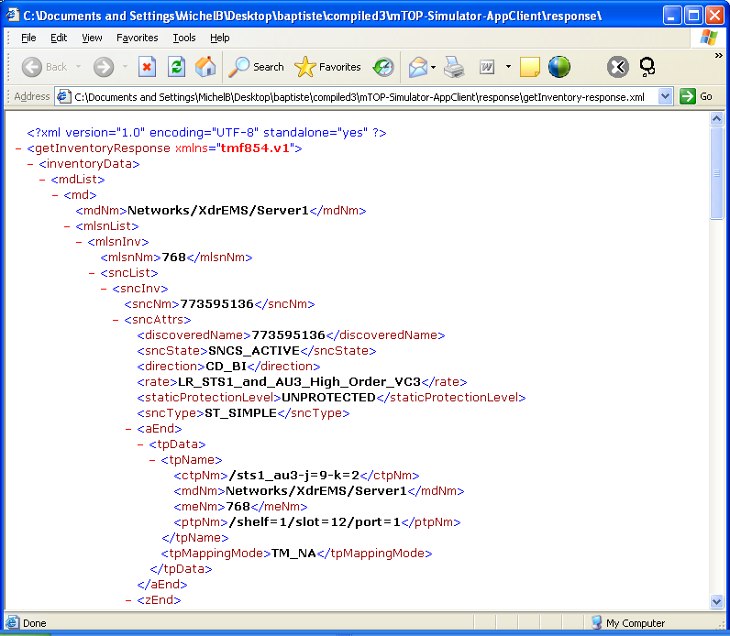
???

Slide 32
Complementary Slides

Slide 33
JEE5 Environment
Selection criteria for the environment:
  available without licence fees
  reasonable support for WSDL development/deployment
Candidates evaluated:
  Glassfish
  Axis
  JBoss
Selected: Glassfish (aka. Sun Application Server 9.0)
with the associated tools: netbeans, JavaDB, wsimport

Slide 34
Implement MTOSI Server: Development Steps
wsimport
InventoryRetrieval.wsdl - one java class per type
- stub server
Modify the generated classes to handle DB persistency (i.e. DB mapping) as entity beans
Implement the semantic of the Web Service (i.e. “getInventory”) as a session bean
Deploy

Slide 35
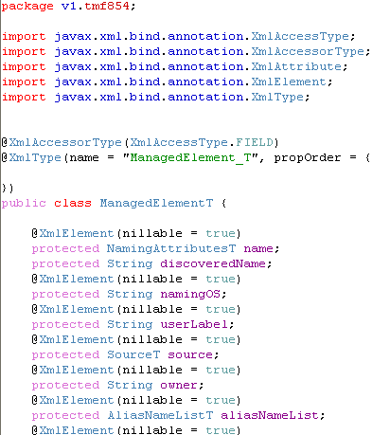
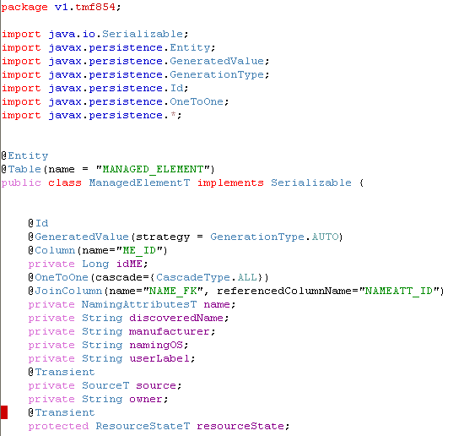
Example Class: ManagedElement_T

