Slide 1
Research SSU – “Doctors as data scientists” : a very basic introduction to handling and analysing large scale NHS data
WHY ?
Some Research SSUs require data analysis skills
All doctors will need to be “digitally aware” for the “Digital NHS”
Some doctors will lead research studies and publish papers using large scale data e.g. recruitment for & monitoring of clinical trials
WHAT ?
3 x 2 hour sessions over the 3 Research SSU weeks (worksheet on google docs site)
An introduction to some very simple computer coding – providing some key concepts in handling data from millions of patients,
Using R studio (an easy way of using the programming language R) *** but now called “posit”

Slide 2
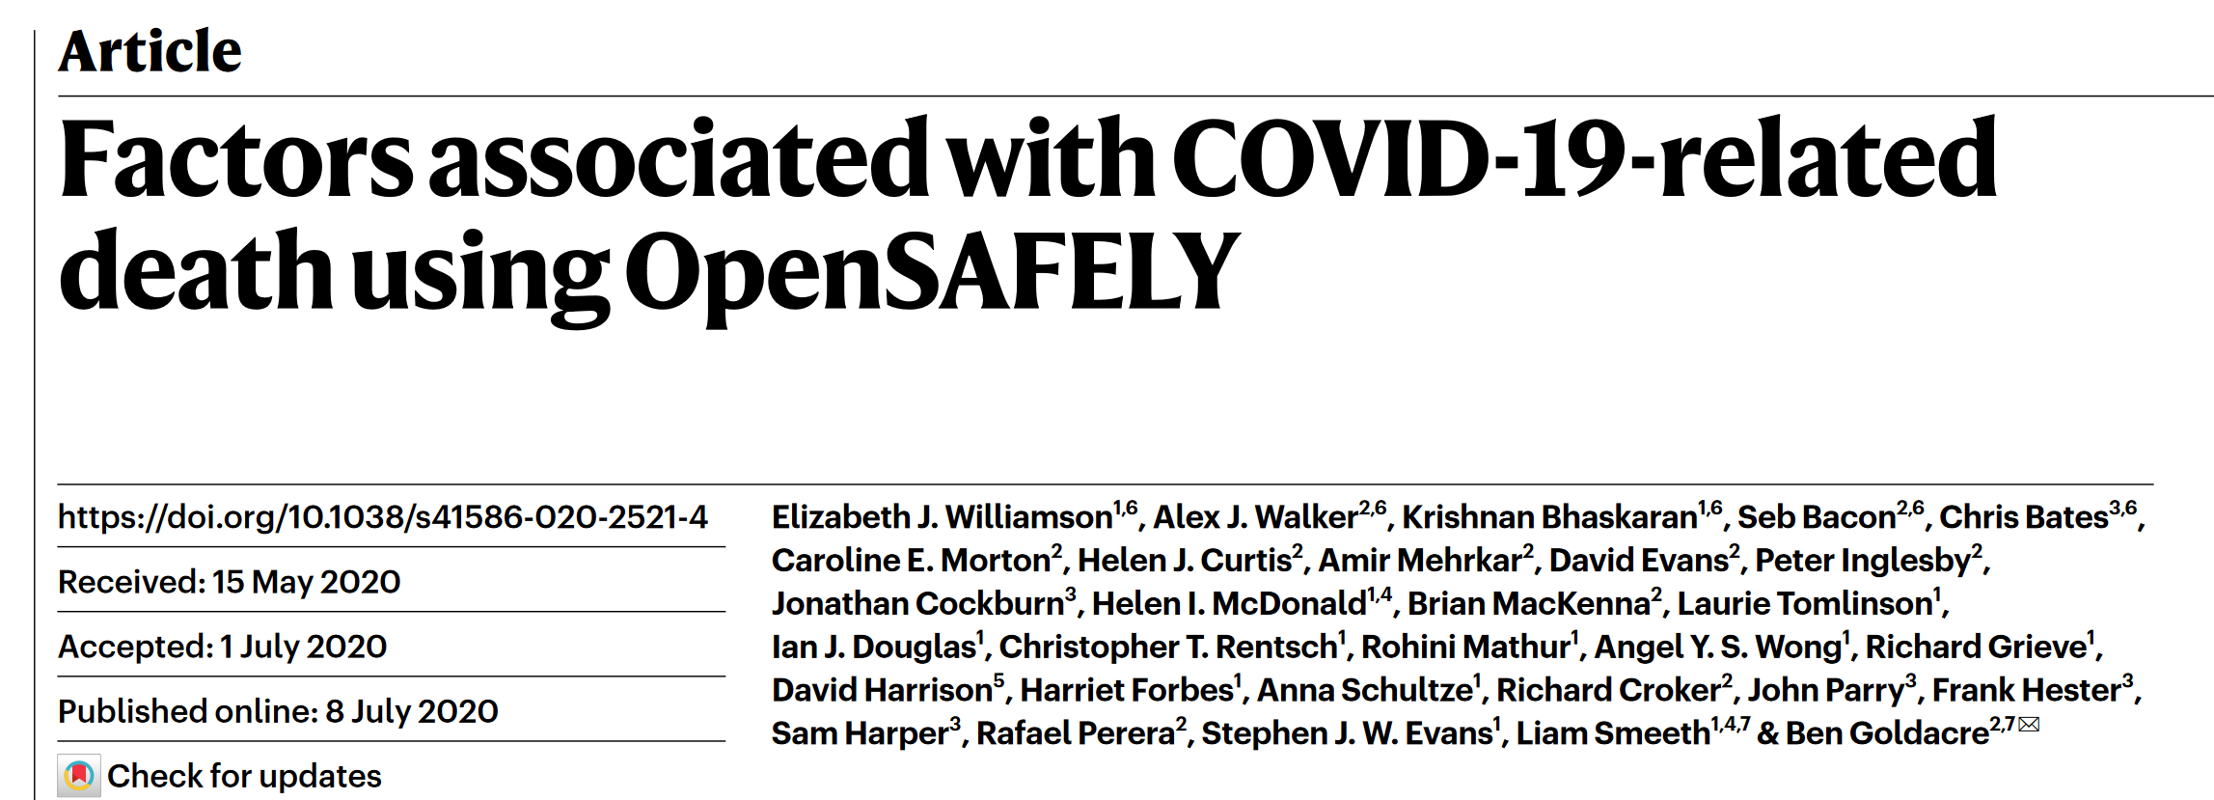
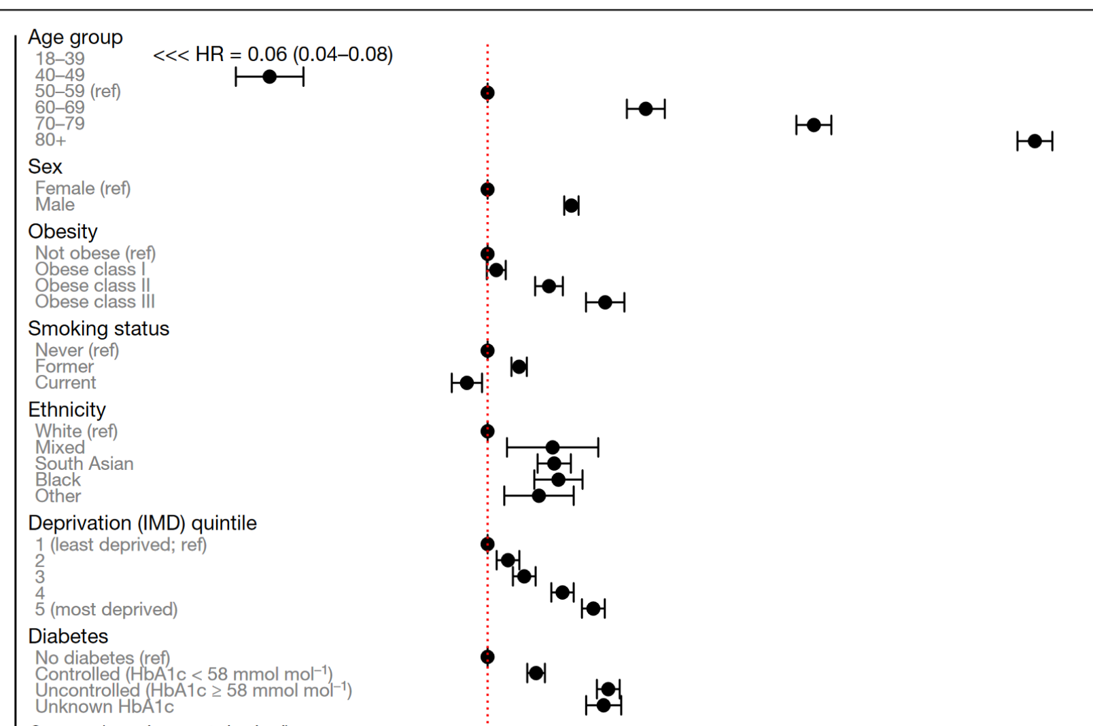
“Doctors as Data scientists”: if you have medical knowledge and data skills you will have many opportunities to perform world class research

Slide 3
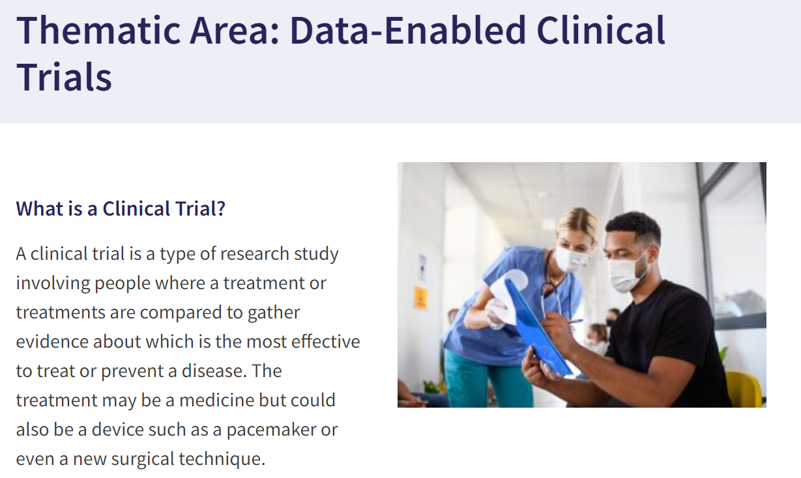
“Doctors as Data scientists”: Clinical trials will be faster and more economical if medical record data was used more effectively

Slide 4
“Doctors as Data scientists”
Intended learning outcomes:
By the end of the 3 sessions you will be familiar with some of the key basic ways of handling large amounts of patient data, using basic computer coding methods.
Be familiar with the R Studio/Posit interface – the windows based programme that allows you to work with the programming language “R” in a straightforward way.
Be introduced to electronic medical record data – the “CPRD” database of primary care records.
The sessions will
make your Research SSU a little easier (if it involves data analysis)
Provide you with some basic skills that could lead to opportunities to publish papers involving data already available from the NHS

Slide 5
“Doctors as Data scientists” : three core principles:
The assignment operator:
Simple but important commands including most important principle : assigning value to a “vector” using a back arrow
Person1_weight <- 65
Person1_height <-1.73
Person1_BMI <- Patient1_Weight / (Patient_height^2)
These 3 “vectors” are stored as R “objects” that you can then use for other operations
Introduction to functions() e.g.
Print(Patient1_BMI)
Paste(“my patient’s BMI is”, Patient1_BMI)
Print(Paste(“my patient’s BMI is”, Patient1_BMI))
Annotating code with #
#this hash sign means R will ignore this line but it will remind me what the code is doing

Slide 6
“Doctors as Data scientists” working in the R Studio :
Run R code from an R script file, using the “run” button, rather than direct from the “console”. Save your work in the R script file (also much easier to correct typos)
Import and work with a primary care patient data set.
Take a look at the patients data with several different functions()
Start to “data wrangle” – subset and organise the patient data using square brackets:
Dataframe_subset <- Dataframe[2,5]
Dataframe_subset <- Dataframe[,5]
Dataframe_subset <- Dataframe[,1:5]
Dataframe_subset <- Dataframe[,c(1:5, 7:9)]
Dataframe_subset <- filter(Data, patid, pracid, gender == “2”)
Questions as we go along – please add to your R script file:

