Slide 1
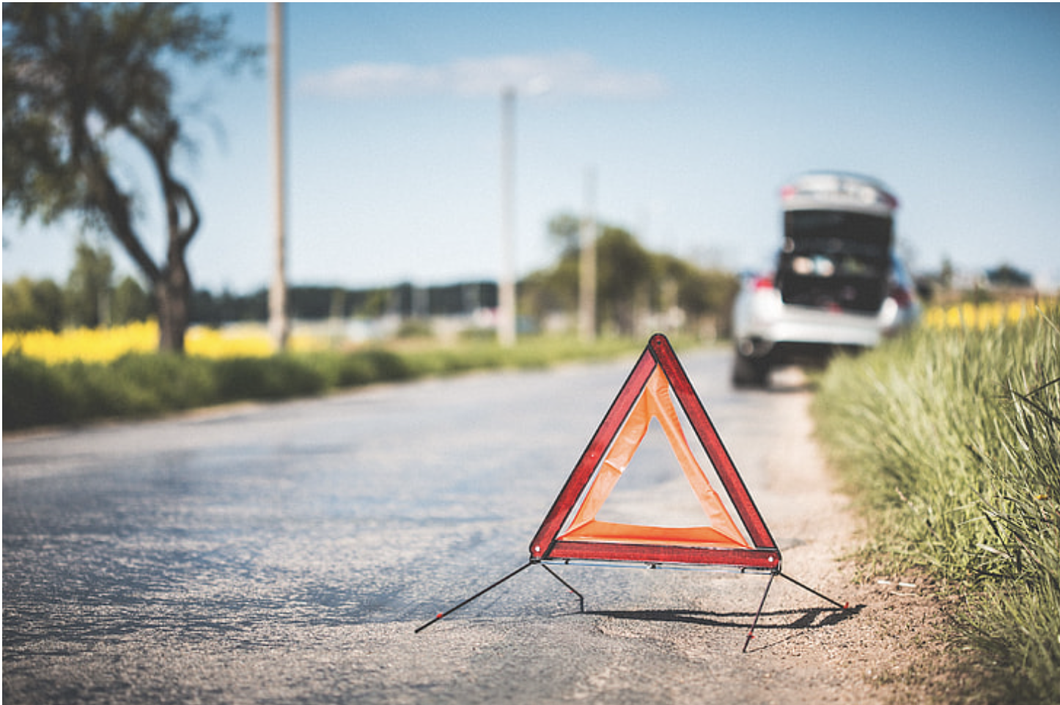


Predicting Severity of road accidents Elizabeth Kelley, Jack Wagner, Supriyo Ghosh, Tristan Freiberg
THE ERDŐS INSTITUTE
DATA SCIENCE BOOTCAMP, SPRING 2024
GitHub Repository

Slide 2
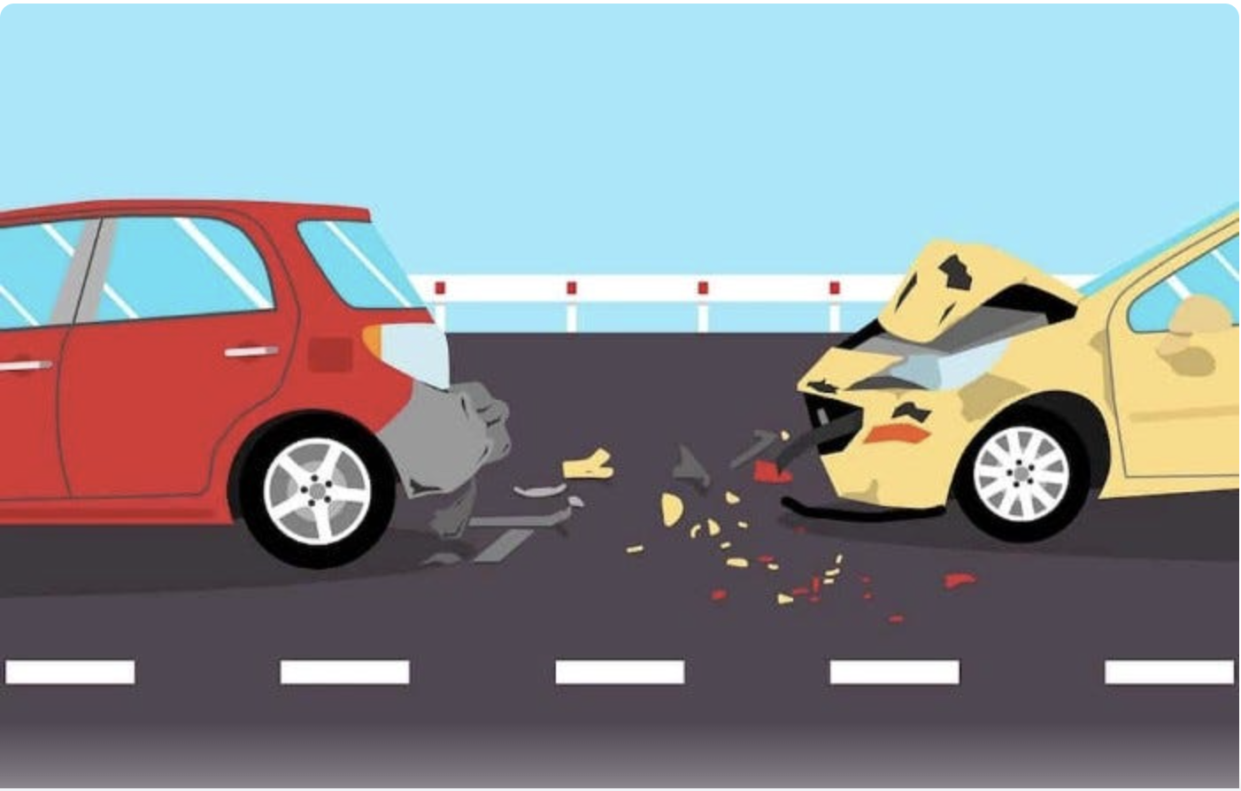
Introduction
Road accidents could be avoided or be less severe in certain conditions of the road

Slide 3
Data collection
We use the accident reports from QUEBEC AUTOMOBILE INSURANCE SOCIETY (SAAQ) for last 10 years.
Data from accident reports completed by police officers, including the time, severity of the accident as well as the type of vehicles involved.

Slide 6
Comparison

Slide 7
Conclusion

Slide 8
We thank the Erdős Institute for the opportunity and the support!

