Slide 1

GRAPH REPRESENTATION LEARNING
RANDOM WALKS, DEEPWALK
& NODE2VEC
Encoder-Decoder Framework • Factorization Methods • Biased Random Walks
Based on Hamilton (McGill, GRL Book) • Stanford CS224W • Chapter 3
Notes:
Welcome slide. Introduce the topic: learning vector representations of graph nodes. Mention the two key references.
1

Slide 2
Presentation Outline
Why Graph Representation Learning?
Node Embeddings — The Big Idea
The General Encoder-Decoder Framework
Shallow Embeddings & The Z Matrix
Factorization-Based Methods
From Factorization to Random Walks (The NLP Skip-Gram Inspiration)
DeepWalk — Algorithm & Math
node2vec — Biased Random Walks
p & q Parameters in Detail
Negative Sampling & Training Optimization
Putting Embeddings to Work (Downstream Tasks)
DeepWalk ≡ Matrix Factorization (The NetMF Proof)
Beyond Homogeneous Graphs: MetaPath2Vec
Core Limitations of Shallow Embeddings
Summary & What Comes Next: Graph Neural Networks (GNNs)
Notes:
2

Slide 3
Why Graph Representation Learning?
The Problem
The Solution
Ubiquity of Graph Data: Real-world data is naturally relational, spanning massive social networks, citation webs, biological protein interactions, and chemical structures.
The Feature Vector Bottleneck: Traditional Machine Learning models strictly require fixed-size, structured feature vectors as input.
The Discrete Structure Gap: Raw graphs are irregular, discrete topological structures with varying sizes, lacking a native coordinate space or standard vector representations.
Learning a Continuous Mapping: Automatically optimization of an encoder system to map discrete nodes into continuous, low-dimensional vector spaces ({R}^d).
Structural Preservation: Forcing the output vectors to mathematically capture both localized neighbor configurations and global network topology.
Downstream Compatibility: Providing optimized, numeric embeddings that serve as direct plug-and-play inputs for any statistical machine learning pipeline.
Downstream Applications
Node Classification Link Prediction Community Detection Graph Classification
Notes:
3

Slide 4
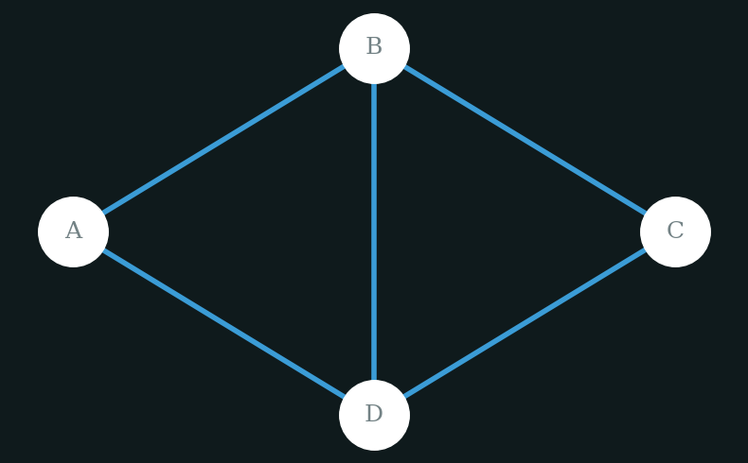
What is a node embedding?
A node embedding is a low-dimensional vector that encodes a node's position and neighborhood structure in the graph.
Original Graph
Embedding Space (d = 2)
B
[0.1, 0.9]
A
C
Encoder
[0.6, 0.4]
[0.4, 0.7]
D
[0.2, 0.7]
Key Idea: Similar nodes in graph → Close vectors in embedding space
Notes:
4

Slide 5
The Encoder Decoder Framework
All node embedding methods in this chapter follow one unified framework:
Graph G
ENCODER
Embeddings Z
DECODER
Similarity Score
Nodes, edges, adjacency matrix A
ENC : V → ℝᵈ
z_u, z_v ∈ ℝᵈ
DEC : ℝᵈ × ℝᵈ → ℝ⁺
DEC(z_u, z_v) ≈ S[u,v]
Methods differ along exactly 3 axes:
1
Decoder Function
2
Similarity Measure S
3
Loss Function ℓ
How similarity between embeddings is computed
(distance / dot-product / softmax)
What "similar" means in the graph
(adjacency / multi-hop / random walk probability)
How prediction error is measured
(MSE / cross-entropy / KL-divergence)
Notes:
5

Slide 6
The Encoder Decoder Framework
1. Graph G (The Input Data)
Represents the network structure as G = (V, E), where V is the set of nodes and E is the set of edges.
It is stored as an adjacency matrix A, where entry A[u, v] indicates a direct connection or edge weight between nodes u and v.
2. ENCODER (The Mapping Function)
A function with the signature: ENC : V → R^d
It takes a discrete node ID from the graph and maps it into a low-dimensional space.
Shallow Paradigm: In methods like DeepWalk and node2vec, the encoder is simply a direct lookup table pointing to a row in a coordinate matrix: ENC(v) = Z[v].
3. Embeddings Z (The Latent Space)
Consists of dense vectors z_u, z_v ∈ R^d, where the embedding size d is much smaller than the total number of nodes
(d ≪ |V|).
Stored globally as a massive parameter matrix Z, which acts as the learned geometric map of the network.
4. DECODER (The Reconstruction Engine)
A function with the signature: DEC : R^d × R^d → R⁺
It accepts a pair of embedding vectors (z_u, z_v) and processes them to predict a structural relationship from the original graph.
It can compute similarities using dot products (z_uᵀ z_v), Euclidean distances, or Softmax probabilities.
5. Similarity Score (The Optimization Goal)
The Core Objective: DEC(z_u, z_v) ≈ S[u, v]
It forces the decoder's predicted score to match the true graph similarity matrix S[u, v].
S can represent immediate direct neighbors (A), multi-hop paths (A²), or random walk probabilities.
Notes:
5

Slide 7
Shallow Embeddings & Z Matrix
Shallow Embedding Encoder
Key Properties
No neural network is used.
The encoder is simply a lookup table.
For every node v, one unique vector row is stored in matrix Z.
Getting the embedding = reading that row.
Transductive
Each node gets its own unique vector — no sharing
Unsupervised
No labels needed — pure structure drives learning
ENC(v) = Z[v]
Task-free
Embeddings learned once, used for many tasks
Z ∈ ℝ|V|×d — rows = nodes, cols = embedding dimensions
O(|V|)
Parameter count grows with number of nodes
Example (d = 2):
Node | dim₁ | dim₂
A | 0.2 | 0.8
B | 0.9 | 0.3
C | 0.1 | 0.7
Methods in this chapter: DeepWalk, node2vec, Laplacian Eigenmaps, GF, GraRep, HOPE
Notes:
6

Slide 8
Factorization-Based Methods — Table 3.1
SECTION 3.2
All shallow methods share the same encoder. They differ only in decoder, similarity measure S, and loss function.
Method | Decoder DEC(zᵤ, z_v) | Similarity S[u,v] | Loss Function
Laplacian Eigenmaps | ||zᵤ − z_v||² (Euclidean dist.) | General similarity | Σ DEC · S[u,v]
Graph Factorization | zᵤᵀ z_v (dot product) | A[u,v] (adjacency) | Σ ||DEC − S||² (MSE)
GraRep | zᵤᵀ z_v | A, A², A³... (multi-hop) | Σ ||DEC − S||²
HOPE | zᵤᵀ z_v | General overlap measures | Σ ||DEC − S||²
DeepWalk | Softmax( zᵤᵀ z_v) | p_G(v|u) uniform walk | −Σ S·log(DEC) cross-entropy
node2vec | Sigmoid( zᵤᵀ z_v) | p_G(v|u) biased walk | Negative Sampling loss
Random walk methods (DeepWalk, node2vec) use stochastic similarity — others use deterministic S.
Notes:
7

Slide 9
Laplacian Eigenmaps – The Spectral Connection
Core Idea
Inner-Product Methods
Push embeddings of similar nodes close together in ℝᵈ space.
GF, GraRep, HOPE use:
DEC(zᵤ, z_v) = ||zᵤ − z_v||²
DEC = zᵤᵀ z_v
L = Σ ||zᵤ − z_v||² · S[u,v]
+ MSE loss
The difference:
GF → S = A
GraRep → S = Aᵏ
HOPE → S = general
Intuition: If S[u,v] is large (nodes are similar), the squared distance must be small to keep loss low. The optimizer pulls similar nodes together.
Connection to Spectral Clustering:
L ≈ ||ZZᵀ − S||²
The optimal embeddings that minimize this loss are exactly the d smallest eigenvectors of the Graph Laplacian L (excluding the trivial all-ones eigenvector). This is why spectral clustering uses eigenvectors!
Solve via SVD on S
Notes:
8

Slide 10

Graph Factorization
Core Idea
Intuition & Scaling Mechanics
Vector Alignment Intuition: If two nodes share a direct edge (A[u,v] = 1), the optimizer forces their embedding vectors to align in the same direction, maximizing the dot product. If no edge exists (A[u,v] = 0), the vectors are driven to be orthogonal (perpendicular).
The Linear Edge Focus: Because it strictly targets the raw adjacency matrix A, it captures first-order proximity. This means it heavily optimizes for direct structural connections, but can miss hidden, deep community structures that span multiple steps or hops across the network.
The Decoder Function: Swaps out Euclidean distance for an inner product (dot product)
$$DEC\left(z_{u},z_{v}\right)=z_{u}^{⊤}z_{v}$$
First-Order Similarity Target: The ground-truth matrix S is defined strictly as the standard Adjacency Matrix
$$S\left[u,v\right]=A\left[u,v\right]$$
The Loss Function (MSE): Uses Mean Squared Error to measure global variance
$$L=\sum_{\left(u,v\right)∈𝒟}{{\left\|z_{u}^{⊤}z_{v}−A\left[u,v\right]\right\|}_{2}^{2}}$$
Notes:
8

Slide 11

GraRep — High-Order Neighborhood Multi-Hop Scaling
Core Idea
Global Low-Rank Matrix Factorization
The Micro-Community Intuition: If two nodes are not directly connected (A^1 = 0) but share dozens of mutual neighbors, the matrix multiplication A^2[u,v] or A^3[u,v] will yield a high value. GraRep forces their vectors to be similar based on this deep neighborhood overlap.
Deterministic Optimization: Instead of running slow stochastic gradient steps, this massive formulation can be solved directly and analytically using Singular Value Decomposition (SVD).
The Decoder Function: Retains the inner product framework to preserve geometric scaling properties
$$DEC\left(z_{u},z_{v}\right)=z_{u}^{⊤}z_{v}$$
High-Order Target Matrix: Replaces the basic adjacency matrix A with individual k-hop transition power matrices
$$S=\{A^{1},A^{2},A^{3},…,A^{k}\}$$
The Loss Function: Tracks distinct error matrices for each independent step sequence
$$L=\sum_{\left(u,v\right)∈𝒟}{{\left\|z_{u}^{⊤}z_{v}−A^{k}\left[u,v\right]\right\|}_{2}^{2}}$$
Notes:
8

Slide 12
RANDOM WALK EMBEDDINGS
DeepWalk • node2vec • Stochastic Similarity
Notes:
Transition from deterministic factorization methods to stochastic random walk methods.
9

Slide 13
What is a Random Walk?
A random walk on a graph = a sequence of nodes visited by randomly following edges.
1
3
7
5
9
3
7
Walk of length T = 7 starting from node 1
The Key Insight
Two Advantages
Inspired by Word2Vec / SkipGram from NLP:
NLP: words near each other in a sentence → similar vectors
Graphs: nodes co-occurring on short random walks → similar vectors
1. Expressivity: Captures both local and higher-order (multi-hop) neighborhood structure naturally.
2. Efficiency: Only trains on pairs that co-occurred — no need to consider all O(|V|²) pairs.
Notes:
10

Slide 14
Deep Walk – Algorithm and Math
Step 1
Run Walks
The Math
For every node u ∈ V, generate γ random walks of fixed length T. Each walk starts at u and moves to a random neighbor at each step.
Decoder (SoftMax):
DEC(zᵤ,z_v) = exp(zᵤᵀz_v)
─────────────────
DEC(zᵤ, z_v) = exp(zᵤᵀz_v)
Step 2
Collect Pairs
Σ exp(zᵤᵀzₖ)
For each walk, collect all co-occurring node pairs (u, v) within a context window. This builds the training dataset D.
≈ p_{G,T}(v | u)
Loss (Cross-Entropy):
Step 3
Optimize
L = Σ −log(DEC(zᵤ, z_v))
Minimize the cross-entropy loss over D using Stochastic Gradient Descent (SGD). Update embedding vectors in Z.
Bottleneck: computing the denominator
Σ exp(zᵤᵀzₖ) over all |V| nodes is O(|V|).
DeepWalk fixes this with Hierarchical Softmax → O(log|V|)
Notes:
11

Slide 15
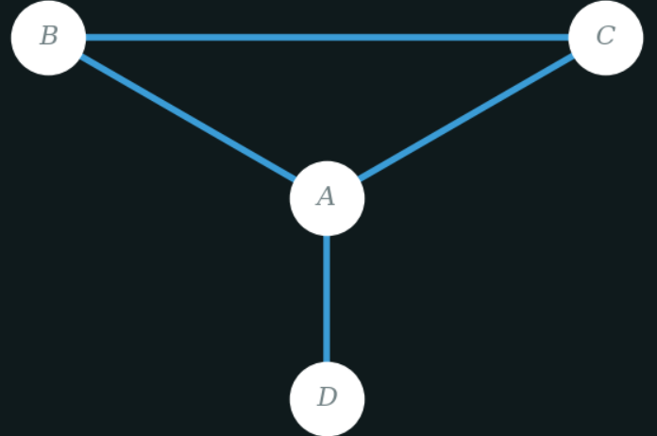
DeepWalk – Worked Example | Steps 1 & 2
Step 3 — Initial Embeddings
Step 1 — Random Walk
Start node: D
Walk length: 4
Walk sequence:
Graph Structure
A — B, C, D B — A, C C — A, B D — A only
Node | z1 | z2
A | 1.0 | 0.0
B | 0.0 | 1.0
C | -1.0 | 0.0
D | 0.5 | 0.5
D
A
B
C
2D embedding space (latent vectors)
Step-2: Context pairs (window size -2)
A : (A,D) (A,B) (A,C)
B : (B,A) (B,C) (B,D)
C : (C,B) (C,A)
D : (D,A) (D,B)
Optimize pair (D,A) this step
B
D
C
A

Slide 16
DeepWalk – Worked Example | Steps 4–8 (Softmax & Loss)
Step 4 — Softmax Decoder
Steps 5 & 6 — Exponentials & Denominator
p(v | u) = exp(zᵤᵀ zᵥ) / Σ exp(zᵤᵀ zₖ)
Node A
e^0.5 = 1.648
Node C
e^−0.5 = 0.606
Node B
e^0.5 = 1.648
Node D
e^0.5 = 1.648
Compute zDᵀ · zₖ for each node:
Denominator Σ = 1.648 + 1.648 + 0.606 + 1.648 = 5.550
A
(0.5)(1.0)+(0.5)(0.0)
= 0.5
B
(0.5)(0.0)+(0.5)(1.0)
= 0.5
Step 7
Probability
Step 8
Cross-Entropy Loss
C
(0.5)(−1.0)+(0.5)(0.0)
= −0.5
D
(0.5)(0.5)+(0.5)(0.5)
= 0.5
p(A | D) = 1.648 / 5.550
L = − log(0.297)
Note: zD = [0.5, 0.5] · zA = [1.0, 0.0]
= 0.297
= 1.214
29.7%
target: p(A|D) → 1.0

Slide 17
DeepWalk – Worked Example | Step 9 (SGD Update & Geometry)
Step 9 — SGD Embedding Update
Geometric Interpretation
θ_new = θ_old − η · ∂L/∂θ
(η = learning rate = 0.1)
BEFORE
AFTER
For positive pair (D, A) → push embeddings closer:
D
D
A
A
zD ← zD - η · zA zA ← zA - η · zD
BEFORE
AFTER
Embeddings of co-occurring nodes move closer in latent space after each SGD step.
zD
[0.5, 0.5]
[0.6, 0.5]
DeepWalk Learning Loop
zA
[1.0, 0.0]
[0.95, 0.05]
zD·zA
0.500
0.595
1 Generate random walks on the graph
2 Extract context pairs within window
p(A|D)
29.7%
~32.5%
3 Compute softmax probabilities
Loss L
1.214
~1.125
4 Compute cross-entropy loss
5 SGD: move co-occurring nodes closer

Slide 18
Node2vec – Biased Random Walks
node2vec builds on DeepWalk but introduces two hyperparameters p and q that control how the random walk explores the graph.
BFS-like Walk (high q, low p)
DFS-like Walk (low q, high p)
Explores local neighborhood.
Captures community structure.
Good for node classification.
Explores far-away regions.
Captures structural roles.
Good for link prediction.
Parameter Summary
Parameter | Name | Effect
p | Return Parameter | Controls likelihood of going back to previous node
q | In-Out Parameter | Controls BFS (large q) vs DFS (small q) exploration
Notes:
12

Slide 19
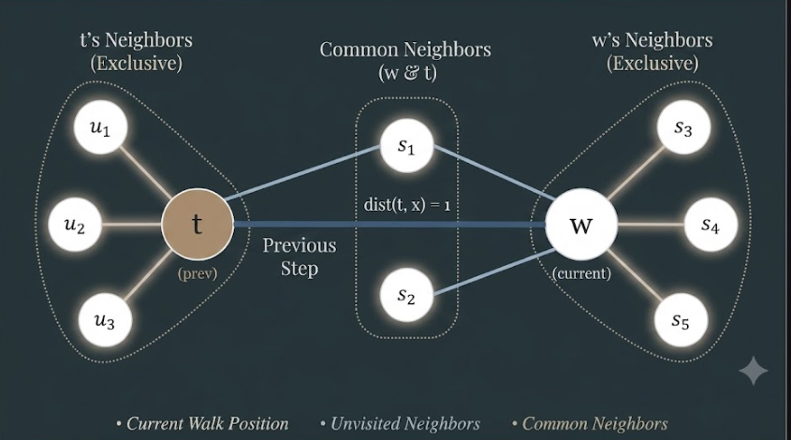
P&Q : Transition Probability Rules
The walker was at node t, moved to node w. Now at w, which neighbor x does it visit next?
Case | Target x | dist(t,x) | Unnorm. weight
Go back | x = t | 0 | 1/p
Neutral | x = s₁ (nbr of t) | 1 | 1
Explore | x = s₂ (not nbr of t) | 2 | 1/q
Node2Vec examines the distance dist(t,x) between the previous node t and a candidate node x. Based on this distance, it assigns transition probabilities using parameters p and q, enabling the random walk to balance between local exploration (BFS-like) and global exploration (DFS-like).
Walk Scenario
Intuitive Rules
Small p → 1/p large → loves returning → BFS-like (local)
Small q → 1/q large → loves exploring → DFS-like (global)
p=q=1 → standard DeepWalk (uniform walk)(common neighbour)
Weights are normalized → final transition probabilities for each edge.
Notes:
13

Slide 20
Node2vec – Full Algorithm
1
Pre-compute Probabilities
O(|E|)
For every edge (t,v,x) triplet, compute the p,q-based unnormalized transition weights and normalize them. Store these per-edge probabilities. This is done once before training.
2
Simulate Biased Walks
O(r·l·|V|)
For each node u, run r random walks of length l. At each step, use the pre-computed probabilities to choose the next node. This is 2nd-order Markov — the next step depends on both the current and previous node.
3
Optimize with SGD
O(r·l·|V|·d)
Collect co-occurring node pairs. Minimize the negative sampling loss using Stochastic Gradient Descent. Update the embedding matrix Z after each batch.
All 3 steps are individually parallelizable — runs in linear time O(|V|)
Notes:
14

Slide 21
Negative Sampling – How Node2vec Trains
Problem: The Softmax denominator Σ exp(zᵤᵀzₖ) over all |V| nodes makes each update O(|V|) — too slow for large graphs.
The Fix: Treat it as Binary Classification
Positive pair (u,v): v appeared in u's random walk → target = 1 | Negative pair (u,vₙ): vₙ is a random node not related to u → target = 0
The Negative Sampling Loss :
L = Σ −log(σ(zᵤᵀ z_v)) − γ · E[log(−σ(zᵤᵀ z_vₙ))]
Term 1 — Positive Pairs
Term 2 — Negative Samples
−log(σ(zᵤᵀz_v))
Pulls real walk-pairs closer.
If sigmoid→1: loss→0 (good)
If sigmoid→0: loss large (bad)
γ random nodes vₙ sampled from Pₙ(V)
Pushes random pairs apart.
γ = 5–20 in practice (vs all |V|)
Complexity per update: O(γ) not O(|V|)
Notes:
15

Slide 22
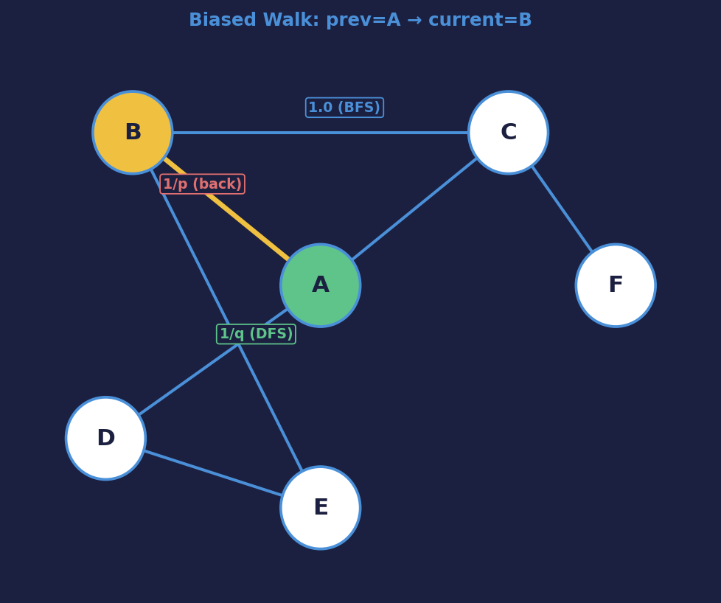
Node2Vec — Biased Random Walk & Transition Probabilities
Transition Probability Formula
π(t→v→x) = α(t, x) · w(v, x)
t = previous node, v = current, x = candidate next
Case
Condition
α value
Meaning
1
d(t,x) = 0 (x = t)
1/p
Return to previous node
2
d(t,x) = 1 (x~t & x~v)
1.0
Neighbor of both t and v
3
d(t,x) = 2 (x not near t)
1/q
Explore further away
Worked Example (p = 2, q = 0.5)
Previous node t = A, Current node v = B
Parameters p and q
Neighbor x
α(t,x)
Unnorm. weight
A (x=t, d=0)
α = 1/p = 1/2 = 0.5
0.5 × 1 = 0.50
p (return): Controls backtracking. p>1 → less backtrack; p<1 → more
C (d=1, shared)
α = 1.0
1.0 × 1 = 1.00
q (in-out): Controls DFS vs BFS. q>1 → BFS (local); q<1 → DFS (global)
E (d=2, far)
α = 1/q = 1/0.5 = 2
2.0 × 1 = 2.00
Sum = 3.50 → p(A|B) = 0.14, p(C|B) = 0.29, p(E|B) = 0.57

Slide 23
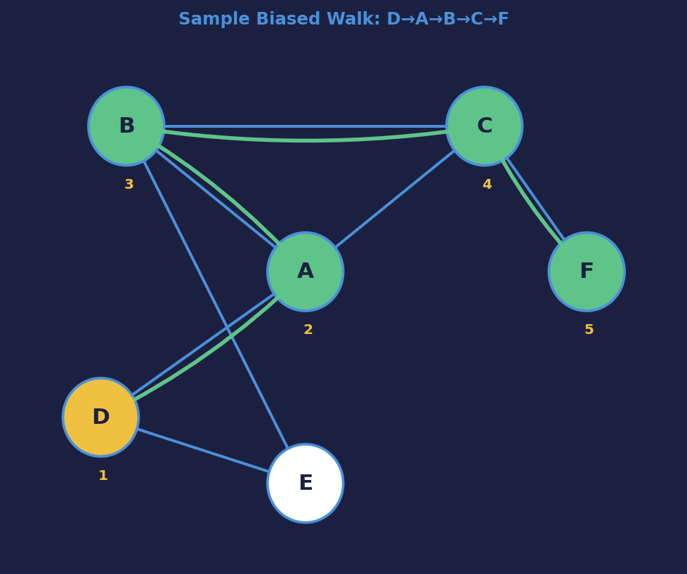
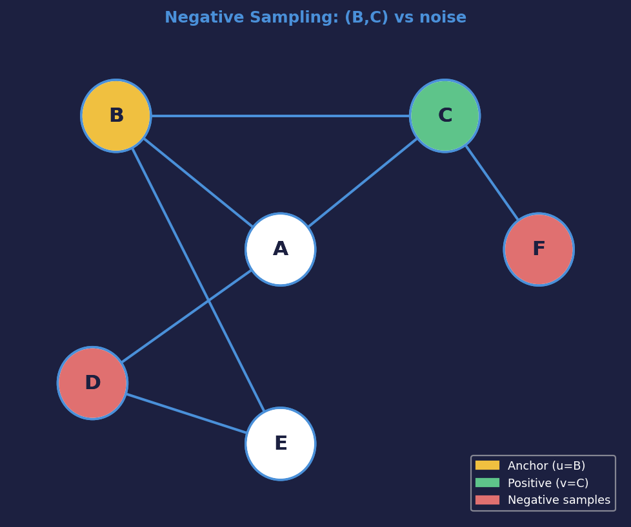
Node2Vec — Walk Execution, Context Pairs & Negative Sampling
Context Pairs (window = 2)
D: (D,A) (D,B)
A: (A,D) (A,B) (A,C)
B: (B,A) (B,C) (B,F)
C: (C,B) (C,F) (C,A)
F: (F,C) (F,B)
→ All pairs feed the
negative sampling loss
Neg. Sampling Loss (pair B,C)
Why Negative Sampling?
L = log σ(zB·zC) + Σ log σ(−zB·zNi)
Softmax Σ over ALL |V| nodes → O(|V|) per step
Walk Sequence (length = 5, p=2, q=0.5)
+ log σ(zB·zC) Positive: push B & C together
Neg. Sampling Only k random noise nodes → O(k) per step
D
A
B
C
F
+ log σ(−zB·zD) Noise node D: push B & D apart
k = 5–20 Much faster, empirically near-identical quality
Biased walk prefers DFS (q<1): goes D→A→B→C→F exploring far structure
+ log σ(−zB·zF) Noise node F: push B & F apart

Slide 24
Node2Vec — Embedding Update (Negative Sampling + SGD)
Initial Embeddings (2D)
Step-by-Step Update (pair B,C | noise D,F)
Node
z₁
z₂
Node
Before
Update
After
B
[0.6, 0.8]
zB
[0.6, 0.8]
+ 0.1·zC − 0.1·zD − 0.1·zF
[0.65, 0.80]
C
[0.7, -0.2]
zC
[0.7, −0.2]
+ 0.1·zB
[0.76, −0.12]
D
[-0.5, 0.3]
zD
[−0.5, 0.3]
− 0.1·zB
[−0.56, 0.22]
F
[0.1, 0.9]
zF
[0.1, 0.9]
− 0.1·zB
[0.04, 0.92]
A
[0.4, 0.5]
E
[-0.3, -0.6]
Dot products after update: zB·zC = 0.587 ↑ zB·zD = −0.517 ↓
z ← z − η · ∂L/∂z (η = 0.1)
Node2Vec Full Pipeline
1 Biased walks with p, q → balance BFS/DFS exploration
Positive pair gradient: zB ← zB + η·zC ; zC ← zC + η·zB
Neg. pair gradient: zB ← zB − η·zD ; zD ← zD − η·zB
2 Collect context pairs within sliding window
3 Negative sampling loss → O(k) not O(|V|)
4 SGD: push positive pairs closer, push negatives apart
5 Repeat → embeddings encode both local & global structure

Slide 25
Deep walk and node2vec – Side by Side
 | DeepWalk | node2vec
Walk type | Uniform random walk | Biased 2nd-order random walk
Parameters | Walk length T, context window | p (return), q (in-out), T, context
Similarity measure | p_G(v|u) unbiased | p_G(v|u) biased by p,q
Optimization | Hierarchical Softmax → O(log|V|) | Negative Sampling → O(γ)
BFS/DFS | Fixed — neither pure | Interpolates between both
Graph structure captured | Local communities | Both communities + structural roles
Both are shallow embedding methods with inner-product decoder — they share the same encoder Z.
Notes:
17

Slide 26
LINE — Large Scale Information Network Embeddings
LINE (Tang et al., 2015) combines two encoder-decoder objectives without using long random walks.
Objective 1: First-Order
Objective 2: Second-Order
Preserve direct edges (1-hop).
Preserve 2-hop neighborhood profiles.
DEC(zᵤ,z_v) = σ(−zᵤᵀz_v)
DEC = Softmax(zᵤᵀz_v)
Similarity: S[u,v] = A[u,v]
(direct adjacency only)
Similarity: A² (shared neighbors)
Loss: KL-divergence
If Alice and Bob are directly connected → push their embeddings close.
Nodes sharing many neighbors → similar embeddings, even without a direct edge.
LINE = DeepWalk-inspired but without random walks, explicitly reconstructing 1st and 2nd order adjacency.
Notes:
18

Slide 27
DEEPWALK ≡ MATRIX FACTORIZATION (QIU ET AL., 2018)
A stunning theoretical result: DeepWalk's random walk training is secretly solving a matrix factorization problem!
The Target Matrix S_DW:
S_DW = log[ vol(V)/T · (Σ Pᵗ, t=1..T) · D⁻¹ ] − log(b)
vol(V)
Total sum of all node degrees
Pᵗ
t-step walk matrix (like powers of A)
P = D⁻¹A
Random walk transition matrix
b
Negative sampling rate constant
DeepWalk implicitly factorizes a random-walk-based similarity matrix, causing nodes that frequently appear together in random walks (often from the same community) to obtain similar embeddings.
Z⊤Z ≈ S_DW
Notes:
19

Slide 28
Why not just Factorize S_DW Directly?
If we can compute S_DW analytically, why run random walks at all?
Direct Factorization
DeepWalk / Random Walks
Pros:
Mathematically exact solution
Deterministic — no randomness
Cons:
Must compute and store |V|×|V| matrix
1 million nodes → 10¹² entries
Completely infeasible in memory
Pros:
Never builds full |V|×|V| matrix
Updates one embedding row at a time
Scales to millions of nodes
The Insight:
DeepWalk implicitly approximates the exact matrix factorization — without ever computing the matrix!
DeepWalk still stores the final embedding matrix $Z$, but unlike matrix factorization methods it never constructs or stores the huge similarity matrix $S_{DW}$. Instead, random walks and SGD implicitly learn $Z$directly, making the method memory-efficient and scalable to very large graphs.
Notes:
20

Slide 29
NODE2VEC IN PRACTICE — PYTORCH GEOMETRIC
PyTorch Geometric (PyG) provides a ready-to-use Node2Vec module. Here is the minimal setup:
from torch_geometric.nn import Node2Vec
model = Node2Vec(
data.edge_index, # graph structure (adjacency list)
embedding_dim=128, # d = size of each node vector
walks_per_node=10, # γ = walks starting from each node
walk_length=20, # T = length of each walk
context_size=10, # sliding window size
p=1.0, # return parameter
q=1.0, # in-out parameter
num_negative_samples=1 # γ negative per positive
)
z = model() # get all node embeddings after training
p=q=1 → uniform DeepWalk | p<1 → BFS-like | q<1 → DFS-like | z = final embedding matrix Z
Notes:
21

Slide 30
FROM NODE EMBEDDINGS TO GRAPH EMBEDDINGS
So far we have embeddings for individual nodes. How do we embed an entire graph G into one vector z_G?
Approach 1: Sum / Average
Approach 2: Virtual Node
Add a special fake node S connected to every node in the subgraph.
Train node embeddings normally with node2vec.
Then simply aggregate all node vectors:
z_G = Σ z_v (or average)
Simple and fast.
Used for molecular graph classification
(Duvenaud et al.) — each atom = node,
molecule = graph → predict properties.
S
Virtual
Node
When node2vec runs, the virtual node S
interacts with every real node.
Its embedding z_S naturally encodes the
whole subgraph structure.
Notes:
22

Slide 31
Limitations Of Shallow Embeddings
Despite their success, ALL methods in this chapter (DeepWalk, node2vec, GF, GraRep...) share three fundamental flaws.
1
No Parameter Sharing
O(|V|) parameters
O(|V|) parameters
Each node gets its own unique independent embedding vector. No information is shared between connected nodes during encoding. This is statistically inefficient and the number of model parameters grows as O(|V|) — unmanageable for massive graphs.
2
Ignores Node Features
Structure only — no features
Structure only — no features
These methods only use graph topology (node IDs and edge paths). They completely ignore rich external node attributes — like user profiles on social networks, text content on paper citation graphs, or chemical properties of atoms.
3
Transductive — Cannot Generalize
No inductive capability
No inductive capability
Embeddings can only be generated for nodes present during training. If a new user joins a network after training, you cannot compute their embedding without re-running the entire training procedure from scratch.
Solution: Replace shallow encoder with Graph Neural Networks (GNNs) — covered in Part II of the book.
Notes:
23

Slide 32
What Comes Next – Graph Neural Networks
Graph Neural Networks (GNNs) solve all three limitations of shallow embeddings:
✓
No Parameter Sharing
→
GNNs share parameters across all nodes through message-passing. Every node aggregates information from its neighbors using the same learnable weights.
✓
Ignores Node Features
→
GNNs take node features (text, attributes, etc.) as explicit inputs. The encoder becomes: ENC(v) = f(A, X) where X contains feature vectors.
✓
Transductive
→
GNNs are inductive — the encoder function f works on any graph structure. New nodes can get embeddings immediately by running the learned encoder on them.
Next step: Chapter 5 of Hamilton's GRL Book — The Graph Neural Network Model
Notes:
24

Slide 33
SUMMARY — ALL METHODS AT A GLANCE
SUMMARY
Method | Decoder | Similarity S | Walk? | Key Strength
Laplacian Eigenmaps | ||zᵤ−z_v||² | General | No | Links to spectral clustering / Laplacian eigenvectors
Graph Factorization | zᵤᵀz_v (dot) | A (1-hop) | No | Simple, O(|E|) scalable adjacency factorization
GraRep | zᵤᵀz_v | A,A²,A³... | No | Captures multi-hop structure explicitly
HOPE | zᵤᵀz_v | General overlap | No | Handles directed + general similarity measures
DeepWalk | Softmax | p(v|u) uniform | Yes (uniform) | Scalable; hierarchical softmax; NLP-inspired
node2vec | Sigmoid (neg. samp.) | p(v|u) biased | Yes (p,q bias) | BFS/DFS trade-off; negative sampling; most flexible
Green = random walk methods | Blue = factorization methods
Notes:
26

Slide 34
KEY EQUATIONS — QUICK REFERENCE
REFERENCE
Encoder (Shallow Embedding)
Random Walk Decoder (DeepWalk)
ENC(v) = Z[v] Z ∈ ℝ|V|×d
DEC(zᵤ,z_v) = exp(zᵤᵀz_v) / Σexp(zᵤᵀzₖ)
Decoder (Inner-Product)
Cross-Entropy Loss (DeepWalk)
DEC(zᵤ, z_v) = zᵤᵀ z_v
L = Σ −log(DEC(zᵤ, z_v))
Reconstruction Goal
Negative Sampling Loss (node2vec)
DEC(ENC(u), ENC(v)) ≈ S[u,v]
L = Σ −log(σ(zᵤᵀz_v)) − γ·E[log(−σ(zᵤᵀz_vₙ))]
Loss (MSE — GF/GraRep/HOPE)
Matrix Factorization Unification
L = Σ ||zᵤᵀz_v − S[u,v]||²
Z⊤Z ≈ S_DW = log[vol(V)/T · ΣPᵗ · D⁻¹] − log(b)
Matrix Form (Eq. 3.9)
L ≈ ||ZZᵀ − S||²
Notes:
27

Slide 35
KEY TAKEAWAYS
Node embeddings map graph structure into low-dimensional vectors, enabling standard ML on graphs.
All shallow methods follow one framework: Encoder → Embeddings → Decoder → Similarity → Loss.
Factorization methods (Lap. Eigenmaps, GF, GraRep, HOPE) use deterministic similarity matrices S.
DeepWalk uses random walks + softmax decoder + hierarchical softmax to scale to large graphs.
node2vec adds biased walks (p,q parameters) to interpolate between BFS and DFS exploration.
Qiu et al. (2018) proved: DeepWalk is secretly factorizing a specific log-transformed matrix S_DW.
All shallow methods share 3 flaws: no parameter sharing, no features, transductive — GNNs fix these.
Notes:
28

Slide 36
REFERENCES
[1] Hamilton, W.L. (2020). Graph Representation Learning. McGill University (GRL Book), Chapter 3.
[2] Leskovec, J. & Kanatsoulis, C. (2025). CS224W: Machine Learning with Graphs, Lecture 2. Stanford University.
Thank You
Notes:
29

