Slide 1
Brighter Myanmar
PHP Course

Slide 2
HTML
Hyper Text Mark-up Language

Slide 3
Bootstrap
CSS Framework

Slide 4
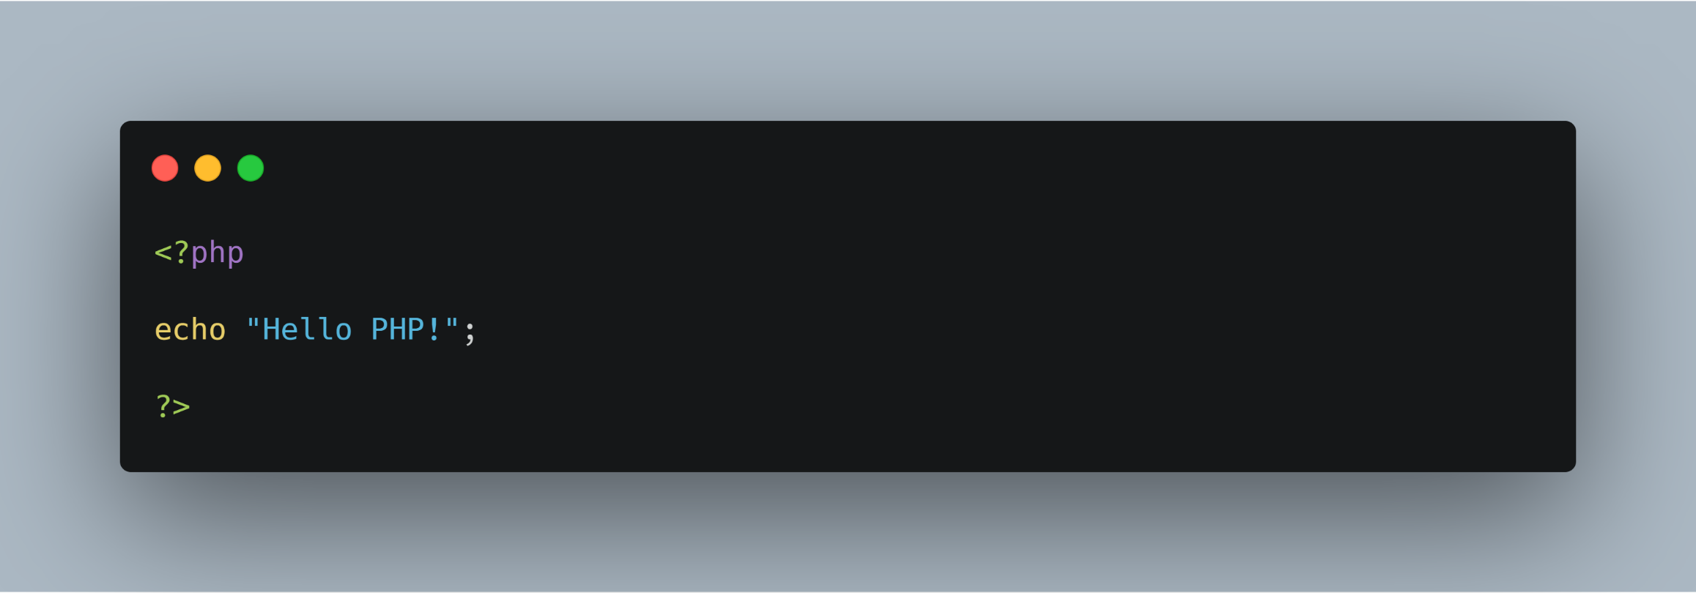
PHP

Slide 5
PHP Concept
Variable
Data Types
Array
Operators
Condition
Loop
Function

Slide 6
Membership Project
GET and POST Method
Session
Cookie
Input Handing

Slide 7
Database(CRUD)
Create (Insert)
Read (Select)
Update (Edit)
Delete

Slide 8
Object-Oriented Programming(OOP)
Class
Properties
Method
Constructor
Destructor
Inheritance
Access Modifier

Slide 9
Laravel
Route
Controller
Model
Middleware
Seeder
Eloquent
Relationship
Much more….

Slide 10
MVC Framework
Tools (Git, Github, Gitlab, etc..)
Command line (Window, Linux)

