Slide 1
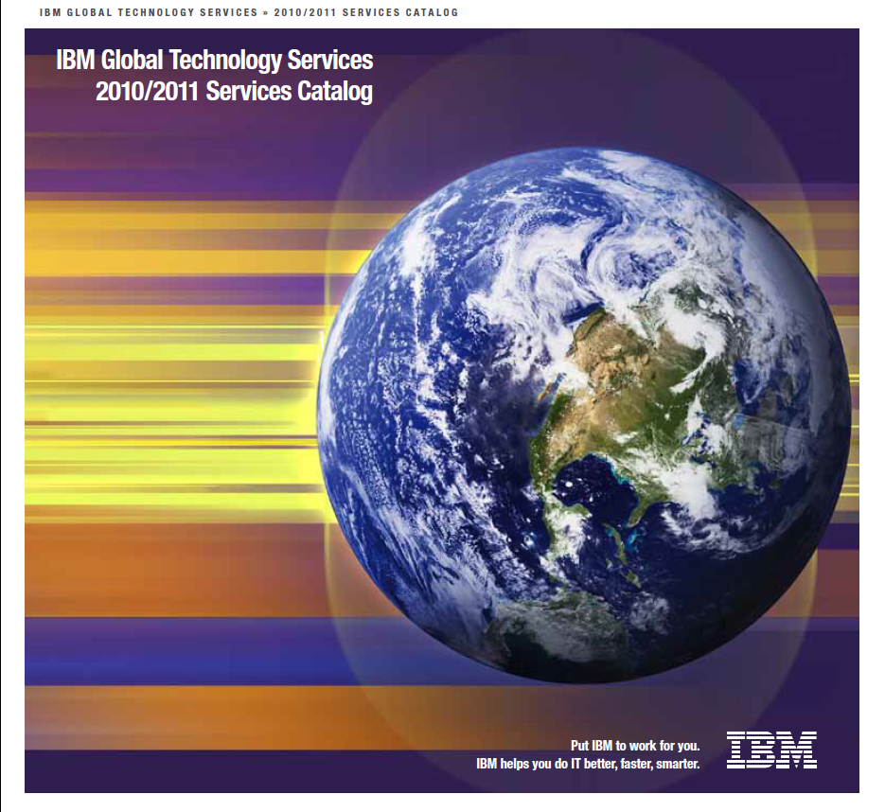
IBM Global Technology Services
2010/2011 Services Catalog
Put IBM to work for you.
IBM helps you do IT better, faster, smarter.

Slide 2

Installing Servers and Storage

Slide 3

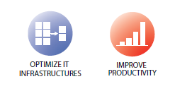
IBM Server Implementation and Migration Services for Power Systems
Implements IBM Power Systems, IBM System X and IBM System z servers
Includes assistance with planning hardware and software implementation
Offers an IBM global delivery model

Slide 4

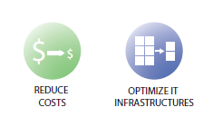
IBM Server Optimization and Integration Services
Consolidate and virtualize the number of servers in the infrastructure and lower total cost of ownership.
Secure the server environment and provide a more flexible and responsive IT infrastructure
Improve operational efficiencies and response times

Slide 5

IBM Storage Optimization and Integration Services
Services for global insight, transformation strategy, storage architecture and design
Consistent methodology and process for optimizing the storage environment to address customers business needs.

Slide 6


IBM

