Slide 1
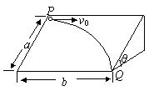
题目
陝西省西安鐵一中2010屆高三上學期期中考試
如圖所示，光滑斜面長為L，寬為W，傾角為θ。一物塊沿斜面上方頂點P水平射入，而從右下方頂點Q離開斜面，求物塊入射的初速度為多少？
L
W

Slide 2
觀察/考什麼？
Gravity
Slope
Velocity
L
W
Notes:
How gravity affect the velocity and acceleration an object on a slope?

Slide 3
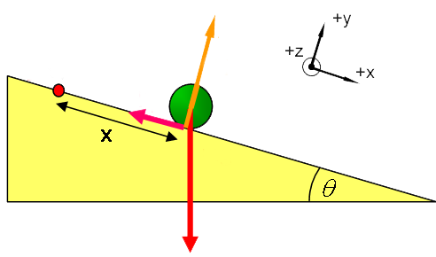
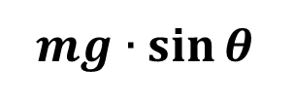
Theory: Gravity & Force Component
$$mg∙\sin{θ}$$
mg
Notes:
Mg sin theta

Slide 4
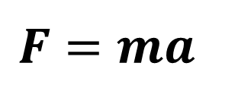
Theory: force and acceleration
$$F=ma$$

Slide 5
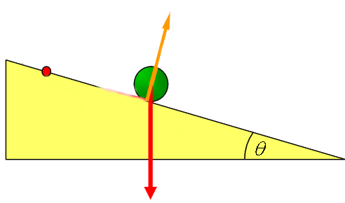
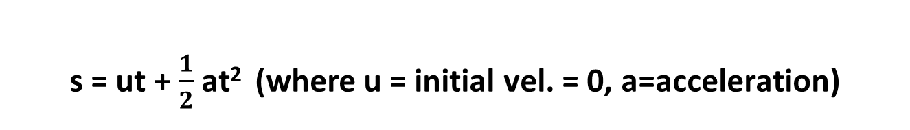
Theory: velocity and displacement
s = ut + $\frac{1}{2}$ at² (where u = initial vel. = 0, a=acceleration)

Slide 6
Theory: velocity & vector
v₀
v₁
v₂
L
v₃
W

Slide 7
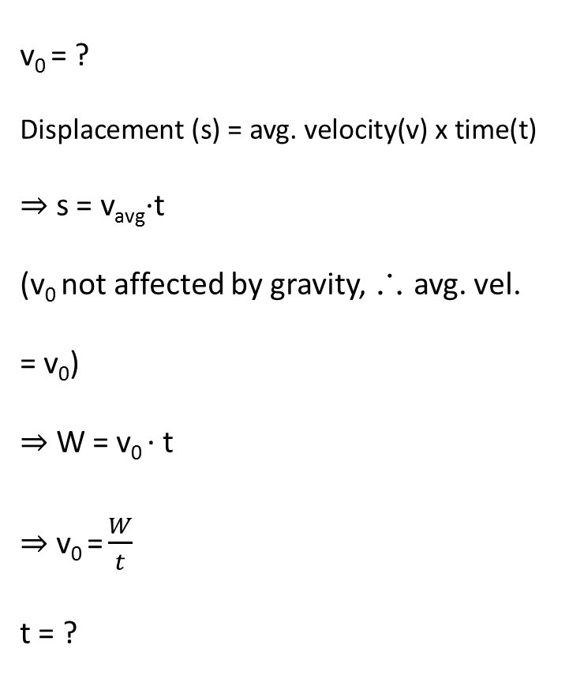
Solution Explanation (1)
v₀ = ?
Displacement (s) = avg. velocity(v) x time(t)
⇒ s = v_{avg}·t
(v₀ not affected by gravity, ∴ avg. vel. = v₀)
⇒ W = v₀ · t
⇒ v₀ = $\frac{W}{t}$
t = ?
L
W

Slide 8

Solution Explanation (2)
L
W
t = ?
s = ut + $\frac{1}{2}$ at² (where u = initial vel. = 0, a=acceleration)
⇒L = (0)t + $\frac{1}{2}$ (a)t²
⇒t = $\sqrt{\frac{2L}{a}}$ a = ?

Slide 9

Solution Explanation (3)
F = ma
⇒ (mg sinɵ) = (m) · (a)
⇒ a = g sinɵ
v₀ = $\frac{W}{t}$, where t = $\sqrt{\frac{2L}{a}}$ and a = g sinɵ
v₀ = W $\sqrt{\frac{g\sin{θ}}{2L}}$

Slide 10
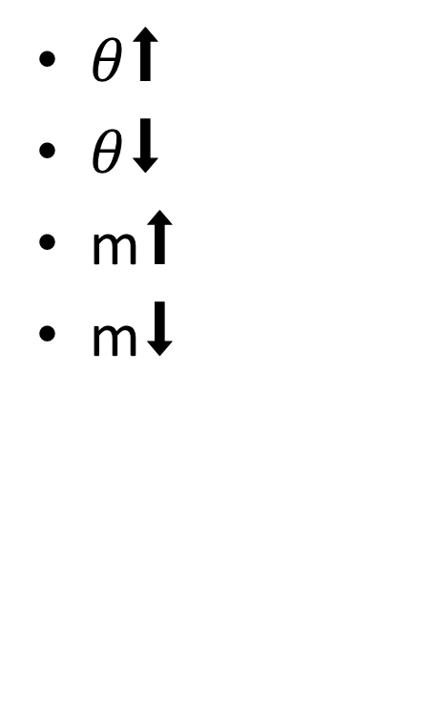
Extended Learning
$θ$⬆
$θ$⬇
m⬆
m⬇
L
W

Slide 11
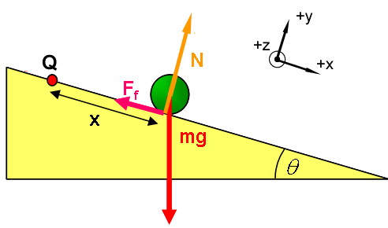
Real World Problems
What if there is Friction (not smooth)?
Sliding?
Spherical object?
Rolling?
Moving Path?
L
W

