Slide 1

Contemporary Photo Album

Slide 2

This photo album contains sample pages to get you started.
To add your own pages, click the Home tab, then click the New Slide gallery.

Slide 3


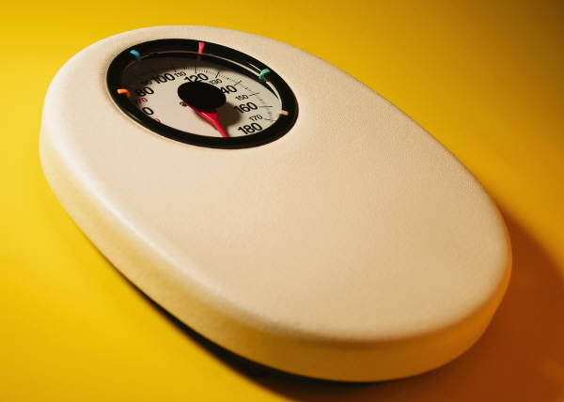
Choose a layout…
…then click the placeholders to add your own pictures and captions.

Slide 4
On the Picture Tools | Format tab, you can create your own frames and make picture corrections such as adjusting contrast and brightness or cropping the picture for just the right look.

Slide 5
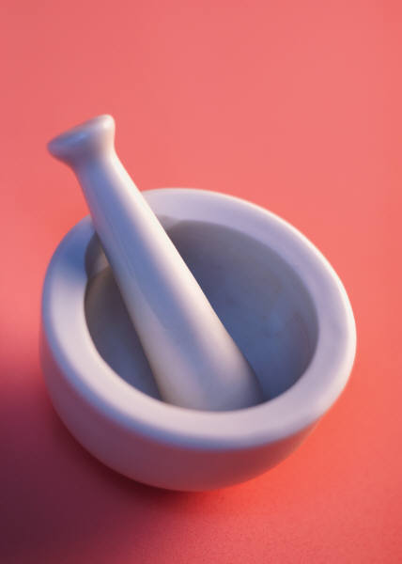
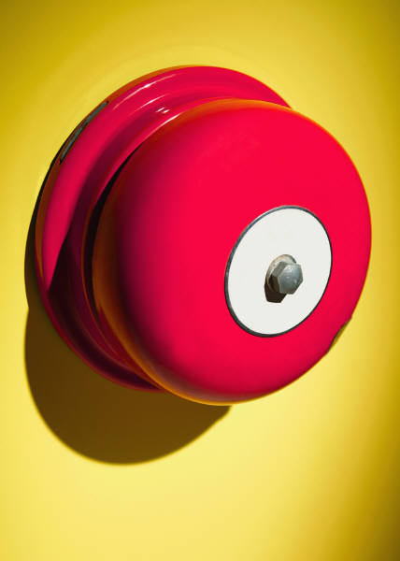
Picture Quick Styles give you great looking “frames” in a single click.

Slide 6




Slide 7




