Slide 1


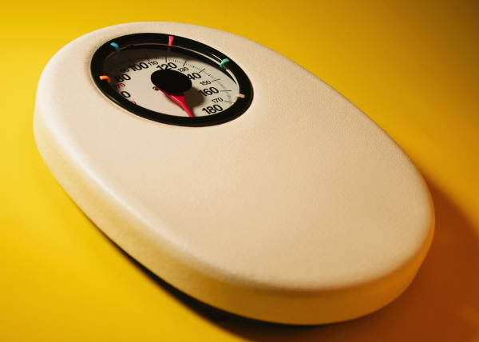
Choose a layout…
…then click the placeholders to add your own pictures and captions.

Slide 2

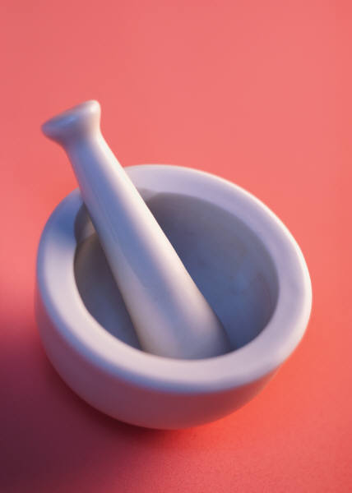
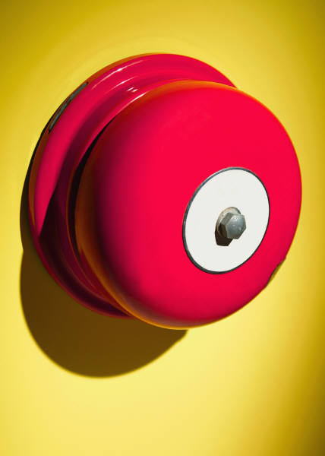
Picture Quick Styles give you great looking “frames” in a single click.

Slide 3

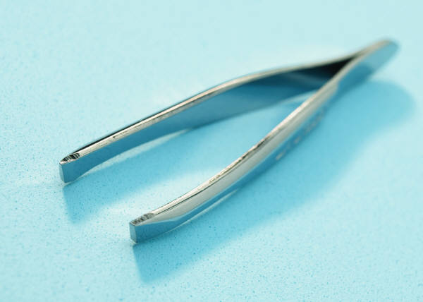
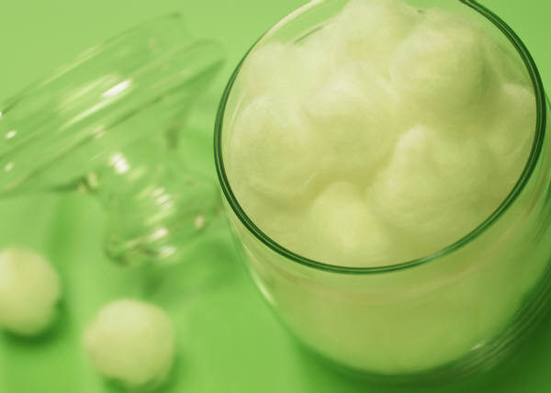

Slide 4
Choose a layout…
…then click the placeholders to add your own pictures and captions.

Slide 5
Picture Quick Styles give you great looking “frames” in a single click.

Slide 7
Choose a layout…
…then click the placeholders to add your own pictures and captions.

Slide 8
Picture Quick Styles give you great looking “frames” in a single click.

Slide 10
Choose a layout…
…then click the placeholders to add your own pictures and captions.

Slide 11
Picture Quick Styles give you great looking “frames” in a single click.

Slide 13
Choose a layout…
…then click the placeholders to add your own pictures and captions.

Slide 14
Picture Quick Styles give you great looking “frames” in a single click.

Slide 16
Choose a layout…
…then click the placeholders to add your own pictures and captions.

Slide 17
Picture Quick Styles give you great looking “frames” in a single click.

