Slide 1



Rethinking
Computer Science
Education
Deepak Kumar
Bryn Mawr College
dkumar@brynmawr.edu
Bryn Mawr College

Slide 2
Agenda
Enrollments are down ~50% since 2000-01
Interest in CS has sharply declined
Gender gap has grown (fewer women)
CS Curricula have inherent and explicit biases that deter people from CS
The context of computing has changed
Current efforts to redesign CS1/CS2 curricula.
Bryn Mawr College

Slide 3
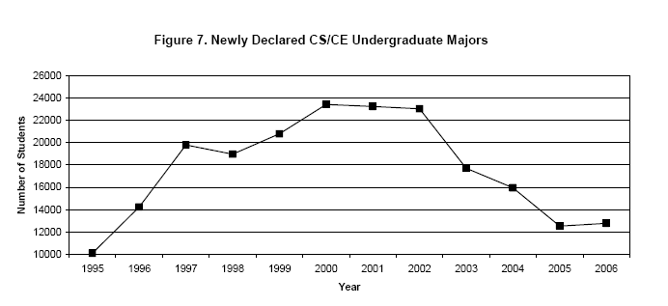
Crisis: Enrollment
Enrollments in Computer Science
(PhD-granting Programs)
From: CRA Taulbee Survey Report 2005-06, March 6, 2007.
Bryn Mawr College

Slide 4
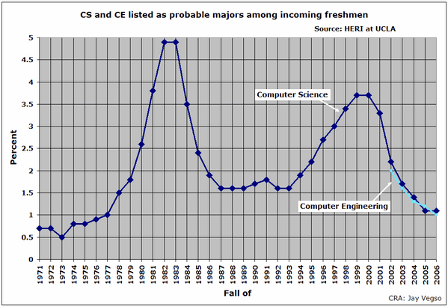
Crisis: Interest in CS
Freshman interest in Computer Science has been declining.
From: Low Interest in CS and CE Among Incoming Freshmen, CRA Bulletin, 2/6/2007.
Bryn Mawr College

Slide 5
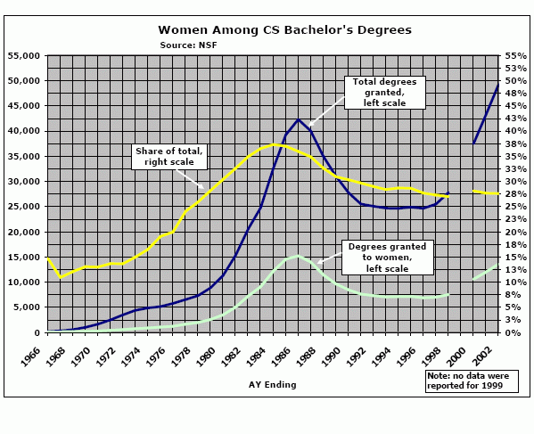
Crisis: Gender
From: Computer Science Bachelor’s Degrees Granted to Women, CRA Bulletin, April 5, 2006.
Bryn Mawr College

Slide 6
Why so few women?
Female disinterest is not genetic, nor accidental, nor inherent to computer science.
Largely due to three factors:
  Early childhood gender socialization (home)
  A combination of adolescence, peer relationships, computer game design, and secondary school social pressures
  Female orientation towards (and concerns about) computing are different from the design of most computer science curricula
From: Unlocking the Clubhouse: Women in Computing, Margolis & Fisher, MIT Press 2002.
Bryn Mawr College

Slide 7
Inherent & explicit biases…
In CS there is an inherent obsession for finding the most efficient procedures, or creating the fastest computers. This naturally appeals to the male stereotype.
CS Curricula have been designed to “invite” only those students who can survive the challenge.
Bryn Mawr College

Slide 8
An Appeal?
“Whereas in the past we created obstacles to reduce the number of CS majors, today we must recruit students to have the workforce needed to meet the challenges and opportunities of information technology in this century. We should take advantage of the reduced pressures from the dip in enrollments to revamp our curriculum.”
Prof. David Patterson, President of the Association for Computing Machinery,
in Communications of the ACM, March 2006.
Bryn Mawr College

Slide 9
Exhibit A
“Whereas in the past we created obstacles to reduce the number of CS majors, today we must recruit students to have the workforce needed to meet the challenges and opportunities of information technology in this century. We should take advantage of the reduced pressures from the dip in enrollments to revamp our curriculum.”
Prof. David Patterson, President of the Association for Computing Machinery,
in Communications of the ACM, March 2006.
Bryn Mawr College

Slide 10

Exhibit B
A CS1 programming assignment.
Bryn Mawr College

Slide 11
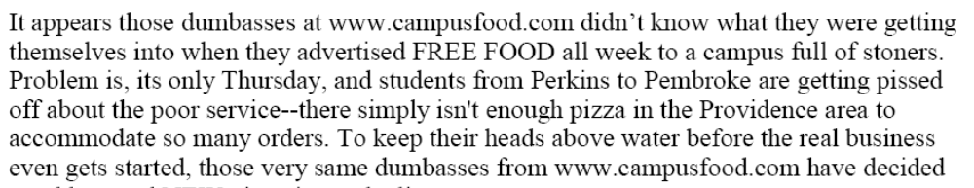
Exhibit B
Bryn Mawr College

Slide 12
Myths?
CS has a nerd image
CS degree leads to high stress and low job prospects
CS has no positive impact on the world
Bryn Mawr College

Slide 13
But…
Salary.com/CNN Money Best Jobs in America reported Software Engineer as the #1 job.
Additionally the job of Computer/IT Analyst appears at #7.
From: Tara Kalwarski, Daphne Mosher, Janet Paskin and Donna Rosato, 50 Best jobs in America, Money Magazine, May 1, 2006.
Bryn Mawr College

Slide 14
Just so you know…
Software Engineer
College Professor
Financial Advisor
Human Resources Manager
Physician’s Assistant
Market Research Analyst
Computer/IT Analyst
Real Estate Appraiser
Pharmacist
Psychologist
!!
From: Tara Kalwarski, Daphne Mosher, Janet Paskin and Donna Rosato, 50 Best jobs in America, Money Magazine, May 1, 2006.
Bryn Mawr College

Slide 15
Back to the crisis…
“While it is true that economy has forced the issue, Computer Science curriculum has never been attractive. It is designed for the sole purpose of producing software engineers.”
“We should aim for more outcomes from a Computer Science curriculum. Programming is only part of the story.”
—Mark Guzdial
Bryn Mawr College

Slide 16
The context of computing
“I think there is a world market for about five
Computers.”
— Unconfirmed remark attributed to Thomas J. Watson (Chairman of the
Board of International Business Machines), 1943.
“Today, there are more computers than people on your campus.”
— Deepak Kumar, 2007.
Bryn Mawr College

Slide 17
Curriculum Design Patterns
Participate in freshman seminars
Multiple entry-points
Lost of interdisciplinary electives
Humanizing core courses
Design of everyday lecture artifacts
Breaking rigid boundaries
Less is more in every course
Flexibility in designing a major/minor
Majors in emerging disciplines
Diversify faculty course load distribution
From: Patterns of Curriculum Design, Douglas Blank and Deepak Kumar,
Informatics Curricula and Teaching Methods, Edited by Lillian Cassel and Ricardo Reis, Kluwer Academic Press, 2003.
Bryn Mawr College

Slide 18
Rethinking CS Curricula
To attract more students to computing we need to create more on-ramps (entry points) into the curriculum.
Make the curriculum requirements more flexible.
(GeorgiaTech’s Threads model, for example)
Create several CS1 courses to attract students with diverse interests in computing: web, multi-media, games, freakanomics, robotics…
Bryn Mawr College

Slide 19



IPRE
IPRE: Institute for Personal Robots in Education
Goals: To explore the use of personal robots
People: Tucker Balch, Douglas Blank, Mark Guzdial, Deepak Kumar
Website: www.roboteducation.org
Partners:
Bryn Mawr College

Slide 20
IPRE’s CS1 Initiative
Design personal robots for teaching CS1.
Let the needs of the curriculum drive the design of the robot.
Contextualize learning in the real world.
Make programming a social activity.
Bryn Mawr College

Slide 21
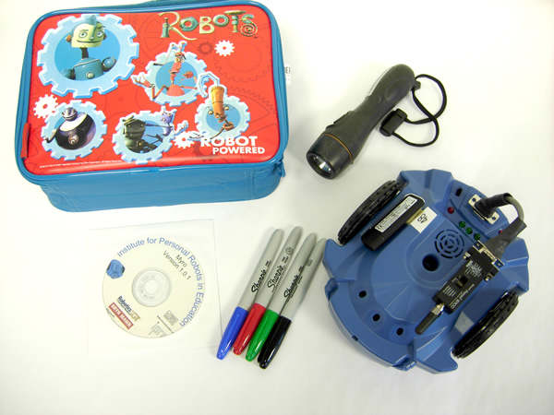
A Personal Robot Kit
3 Light sensors
2 IR proximity sensors
2 Line sensors
Stall sensor
Speaker
3 LEDs
2 motors
Bluetooth wireless
Myro Python Module
Bryn Mawr College

Slide 22
Myro: Background
Based on our work on Pyro: Python Robotics
Basic robot features are abstracted and made independent of underlying hardware and drivers.
Sensing: reports values in user-selected units (e.g., range: mm, cm, inches, robot).
Motor commands are abstracted independent of robot’s drive mechanism: translate, rotate, etc.
Easy to program all kinds of behaviors and control paradigms that will run on any robot.
See: Blank, Kumar, Meeden, Yanco: The Pyro Toolkit for AI and Robotics AI Magazine, Spring 2006.
Bryn Mawr College

Slide 23
Myro: Features
Simple, easy to use API even for non-programmers.
Seemlessly integrated with standard Python.
Plans to work with MSRS and .NET (will support multiple languages).
Design driven by curricular goals.
Bryn Mawr College

Slide 24
Myro: Example
# Avoiding Obstacles
from myro import *
initialize(ask(“What port?”))
# program settings...
cruiseSpeed = 0.6
turnSpeed = 0.5
def main():
while True:
L, R = getIR()
if L:
turnRight(turnSpeed)
elif R:
turnLeft(turnSpeed)
else:
forward(cruiseSpeed)
Bryn Mawr College

Slide 25
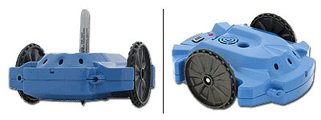
CS1:Course Contents
Chapter 1 The World of Robots
Chapter 2 Robots: Personal or Otherwise
Chapter 3 Building Brains
Chapter 4 Sensing the World
Chapter 5 Making Decisions
Chapter 6 Behaviors
Chapter 7 Control Paradigms
Chapter 8 Making Music
Chapter 9 Communication
Chapter 10 Artificial Intelligence
Chapter 11 Computing & Computation
Chapter 12 Games: Soccer anyone?
Chapter 13 Social Robots & Entertainment
Chapter 14 Swarms
Chapter 15 Robot Ethics
Chapter 16 Smart Appliances
Bryn Mawr College

Slide 26
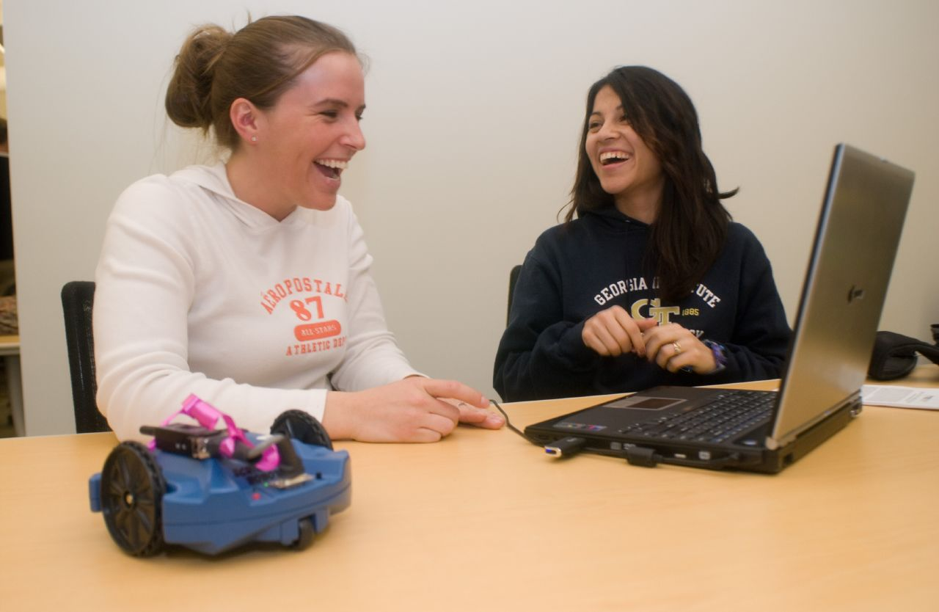
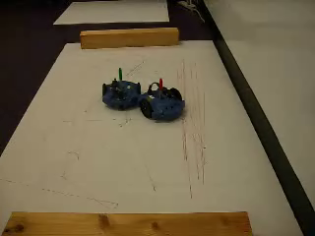
Programming as a social activity
This is Video#1
Bryn Mawr College

Slide 27
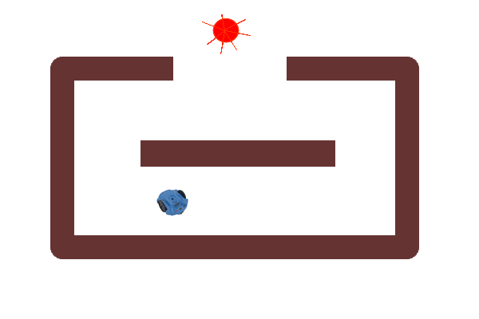

A CS1 Assignment…
Corral Exiting/Escape
Imagine a corral (an enclosed area with maze like partitions and an entrance) with a light source at the entrance (as shown in the figure to the right). Given the robot's position, can we design a behavior that will enable the robot to exit the corral?
This is video#2
Bryn Mawr College

Slide 28
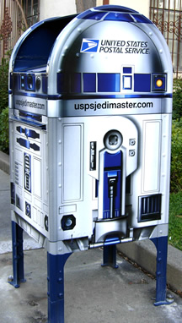
Comments?
For more information see www.roboteducation.org
Or e-mail: dkumar@brynmawr.edu
Bryn Mawr College

Slide 30
Bryn Mawr College

