Slide 1
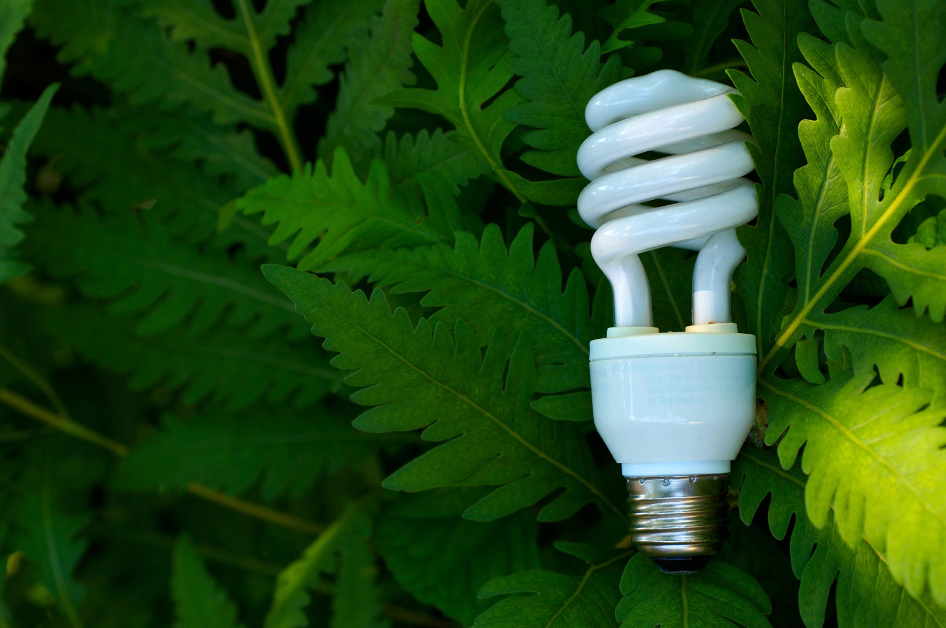
Energy saving light bulb

