Slide 1
Computer Science
It’s more than programming
Eric Lantz

Slide 2
Computer science is no more about computers than astronomy is about telescopes.
Edsger Dijkstra

Slide 3
What is Computer Science?
Computer Science is a science of abstraction - creating the right model for a problem and devising the appropriate mechanizable techniques to solve it. - A. Aho and J. Ullman
Study of the theory and application of computation

Slide 4
History
In the 1820’s Charles Babbage began work on an Analytical Engine. a mechanical device to perform calculations specified on cards
Mathematician Ada Lovelace wrote the first program for the (never built) machine to calculate the Bermoulli numbers

Slide 5
From Wikipedia:
Prior to the 1920s, the term computer referred to a human clerk that performed calculations.
Early researchers in what came to be called computer science, such as Kurt Gödel, Alonzo Church, and Alan Turing, were interested in the question of computability: what things can be computed by a human clerk who simply follows a list of instructions with paper and pencil, for as long as necessary, and without ingenuity or insight?
Part of the motivation for this work was the desire to develop computing machines that could automate the often tedious and error-prone work of a human computer.
During the 1940s, as newer and more powerful computing machines were developed, the term computer came to refer to the machines rather than their human predecessors.

Slide 6
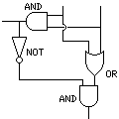
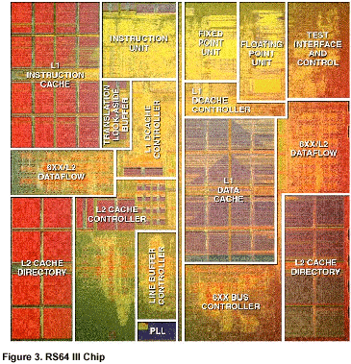
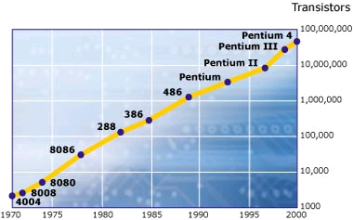
Architecture
Designing logic circuits
Memory
Processor design
Parallel processing
Communication between units

Slide 7
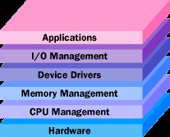
Operating Systems
Methods for solving problems dealing with software interactions
Processor sharing
Memory allocation
Communication
between programs
Devices
File system

Slide 8
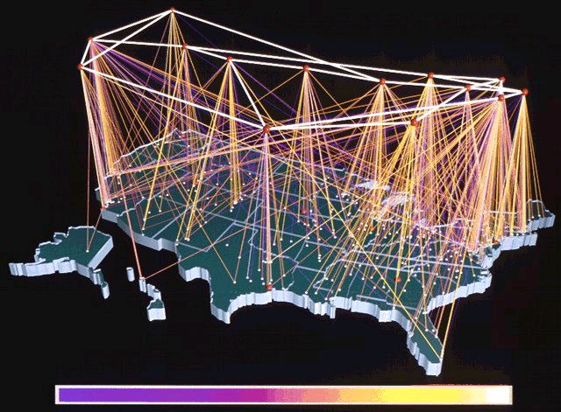
Networks
How do you move data quickly from one side of the globe to another?
Protocols
(TCP/IP)
Reliability
Scalability
Security
applet

Slide 9
Databases
Storing large amounts of data
How to retrieve it efficiently?
How to store it efficiently?
How to answer questions about complex relationships?
What should you put in a convenience store next to the diapers?

Slide 10
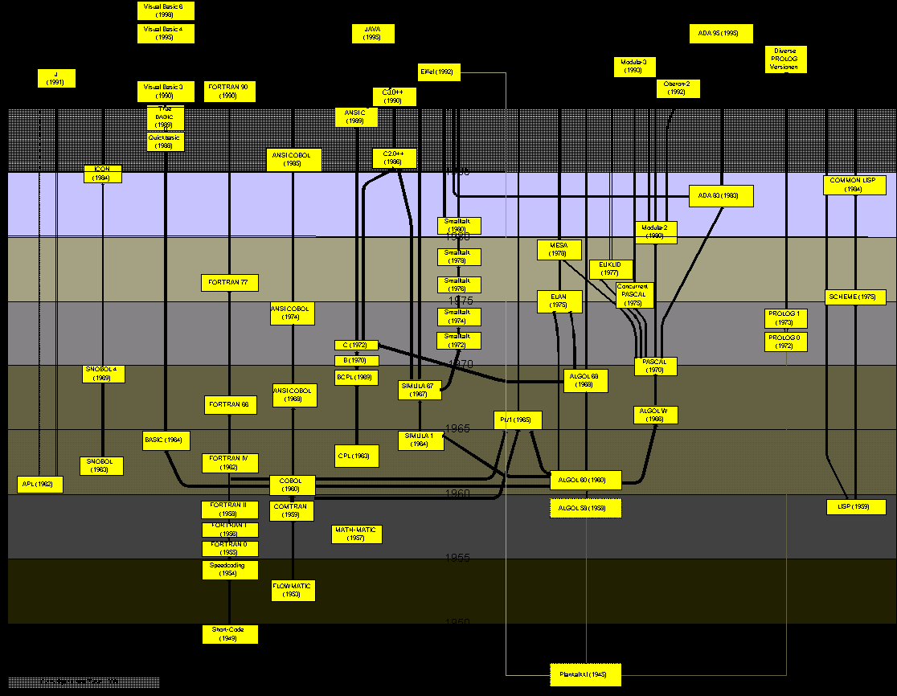
Programming Languages
Properties of languages: types, control flow, syntax and semantics
Expressivity
Portability
Compilers / Speed

Slide 11
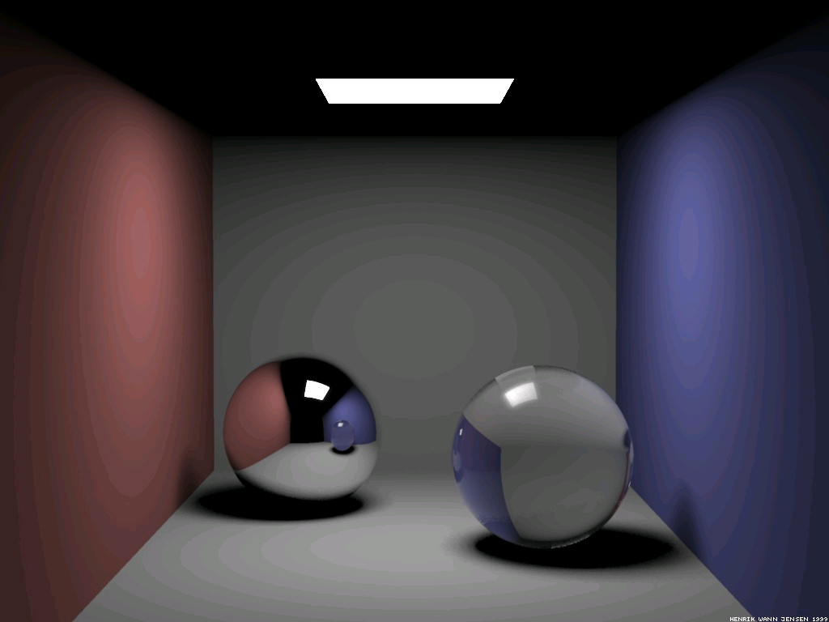

Graphics
How do we represent the real world on a flat screen?
Modeling light, texture, curves
Visualizing data
Animation

Slide 12
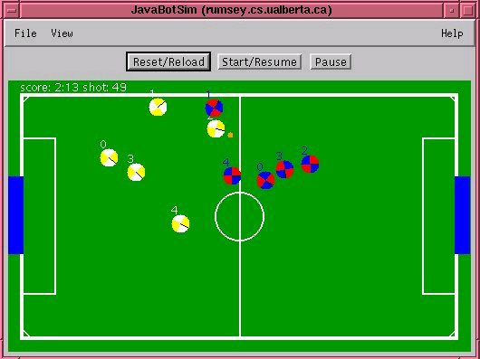
Artificial Intelligence
Computer vision
Machine learning
  Formulating rules or models to tell things apart
Game Playing
Expert systems
Neural Network example

Slide 13
Algorithms and Data Structures
Basis for most CS disciplines
What is the best way to sort a list? Search through it?
Doing things the right way can mean the difference between it finishing in your lifetime or during your lunch break.
Analyzing best/worst/average case tradeoffs
Traveling Salesperson

Slide 14
Theory
What is computable? What is not?
Power of Turing machines
P vs NP
Computational complexity
Cryptography
Quantum computing

Slide 15
Other fields
Natural Language Processing
Human-Computer Interaction
Software Engineering
Formal Methods
Robotics
Scientific Computation

