Slide 1
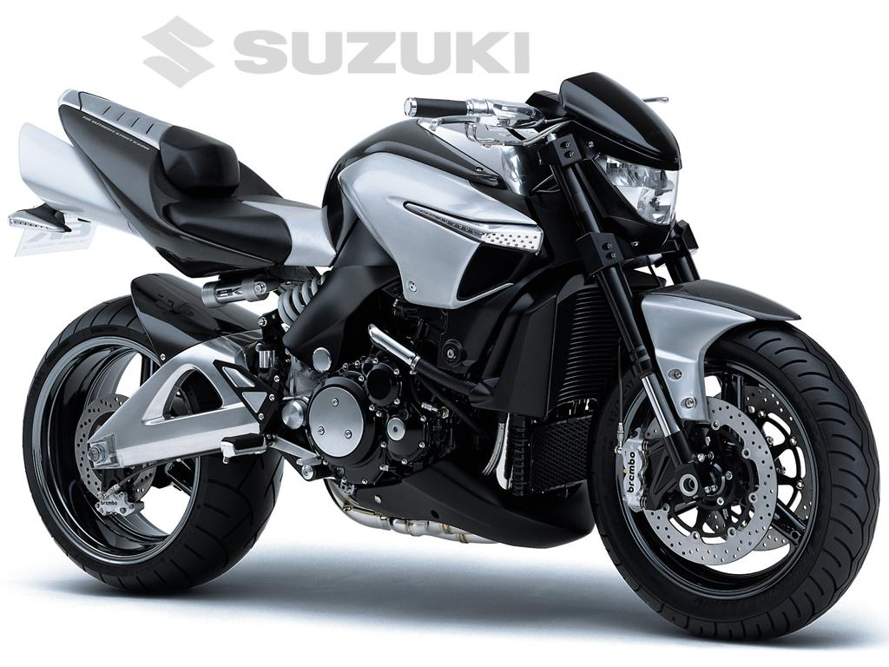
Suzuki B-King 2012

