Slide 1
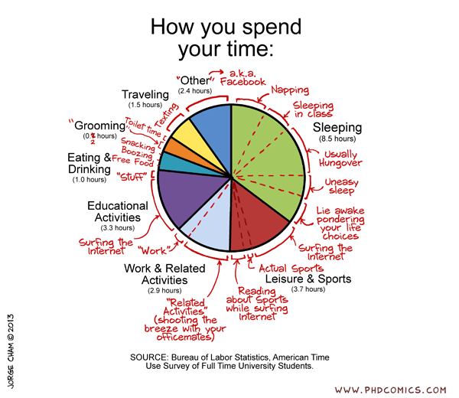
Time Use Example
Article: https://www.nbcnews.com/data-graphics/men-do-housework-women-still-do-more-rcna216748
Data: https://www.bls.gov/tus/
Source. Activity was designed by Dr. Chris Malone for a summer workshop at USCOTS 25

Slide 2
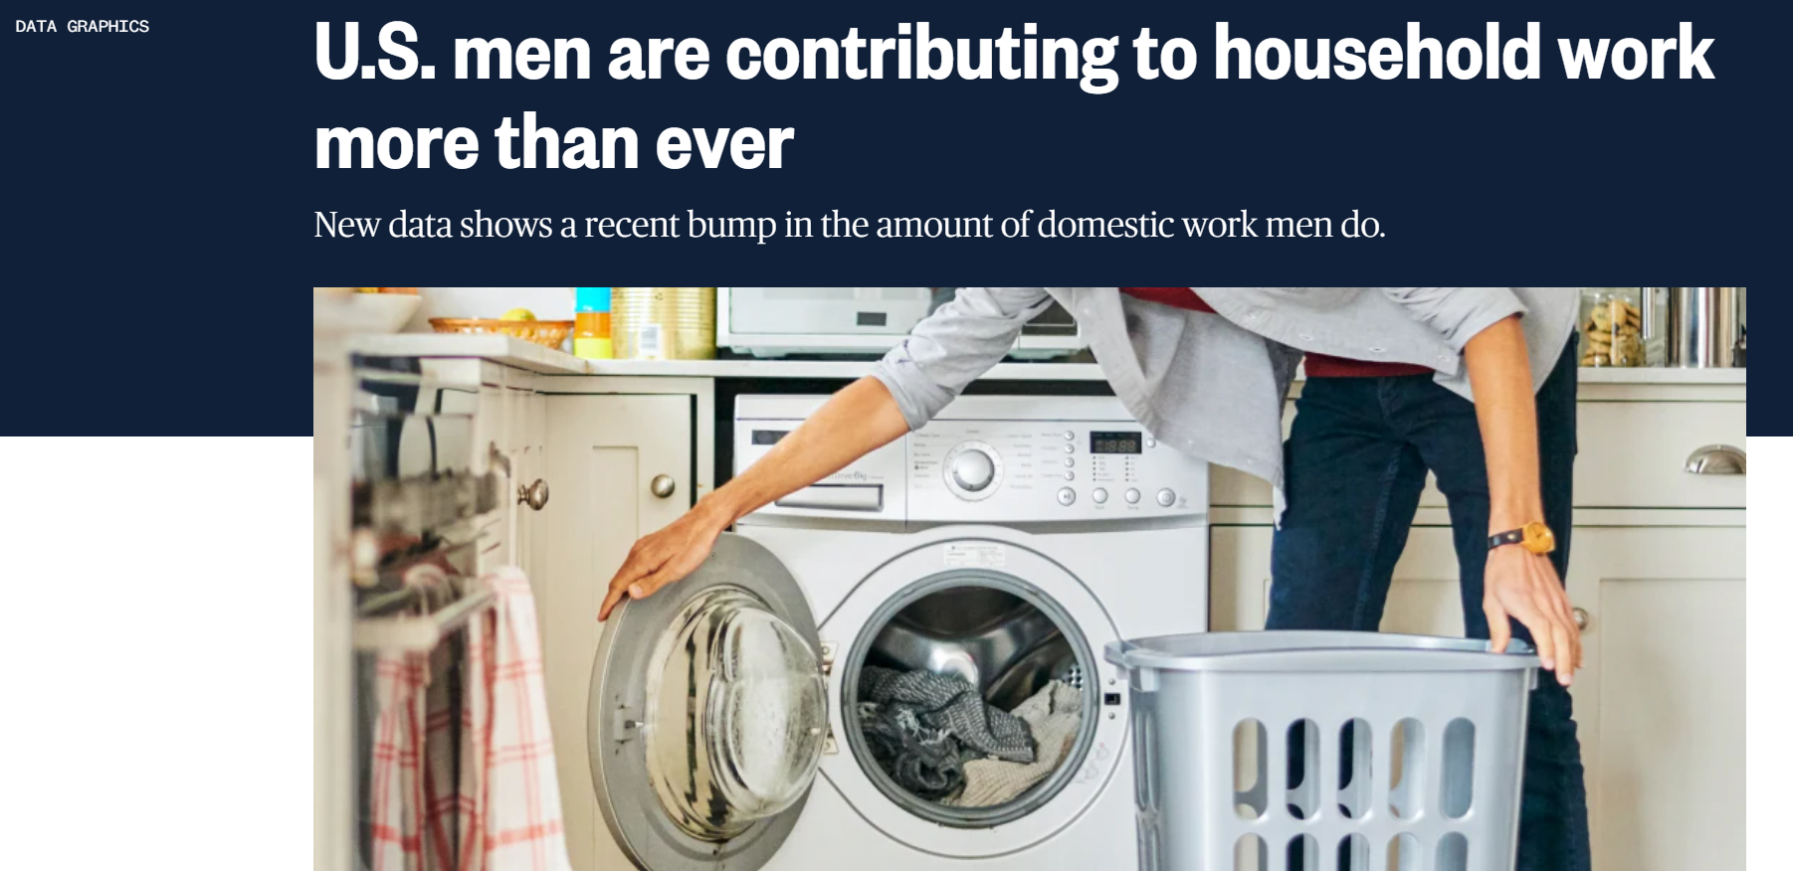


Slide 3
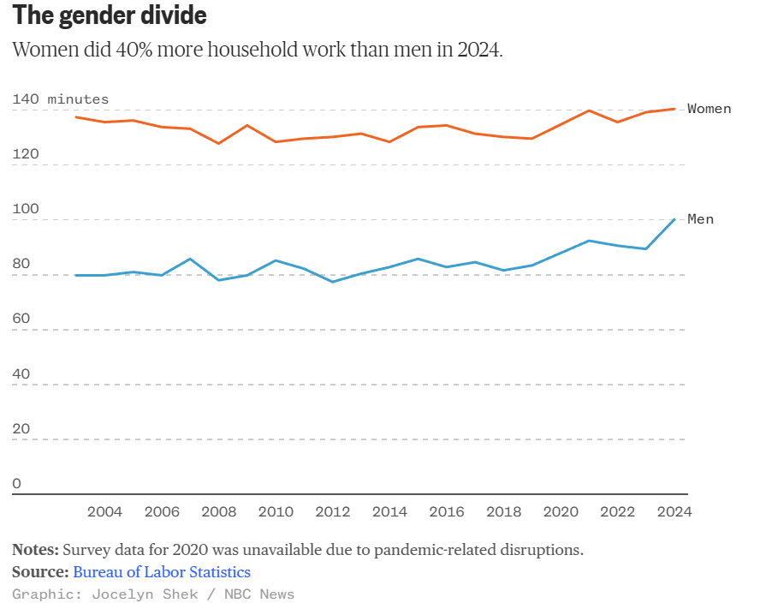
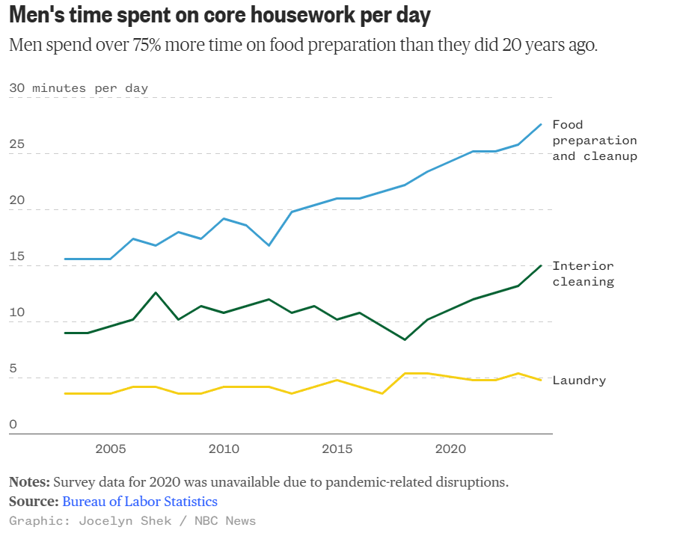
Gender Divide
Men Time Spent

Slide 4
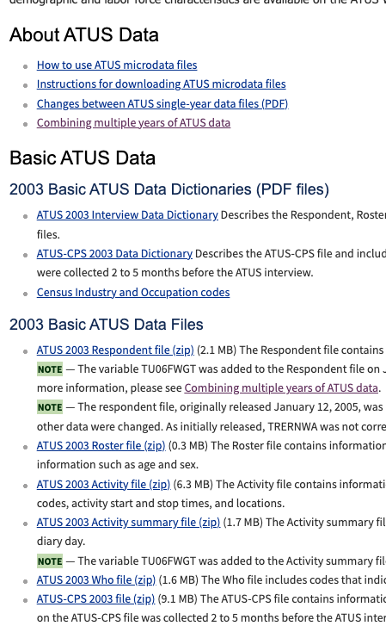
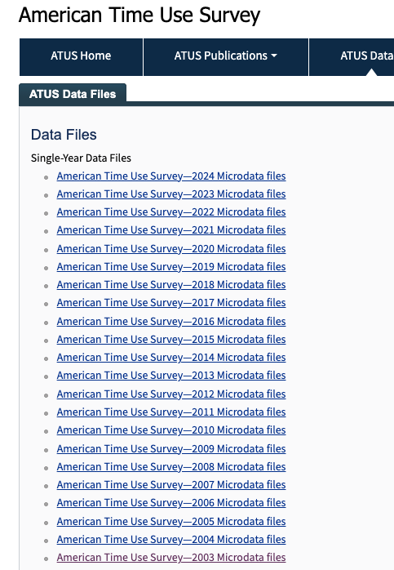
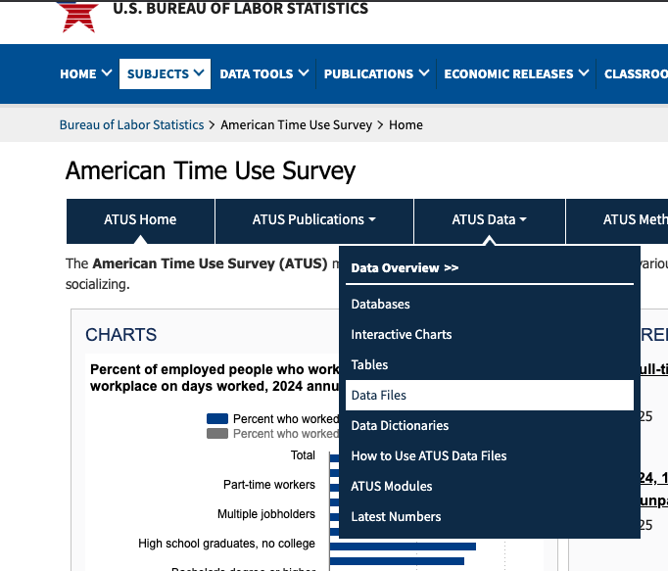
Where to get the data?
https://www.bls.gov/tus/

Slide 5
Lab 4.1
Download and unzip files for 2003-2024
Add a new notebook for downloading and unzipping. Name it appropriately.
Inspect the various URLs and identify the pattern
Use f-strings to create lists of URLs, one for each file type across all years.
In a separate cell for each file type, implement the Python code for downloading and unzipping the files.
  Use try/except to catch any errors
  Use print statements to track progress

