Slide 1
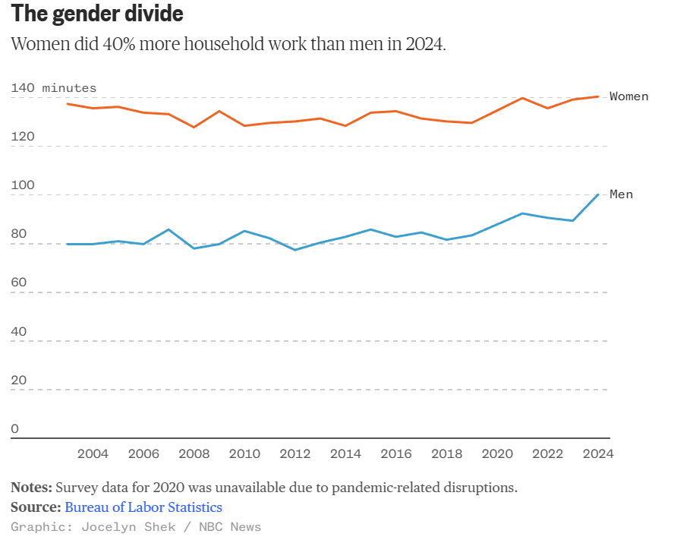
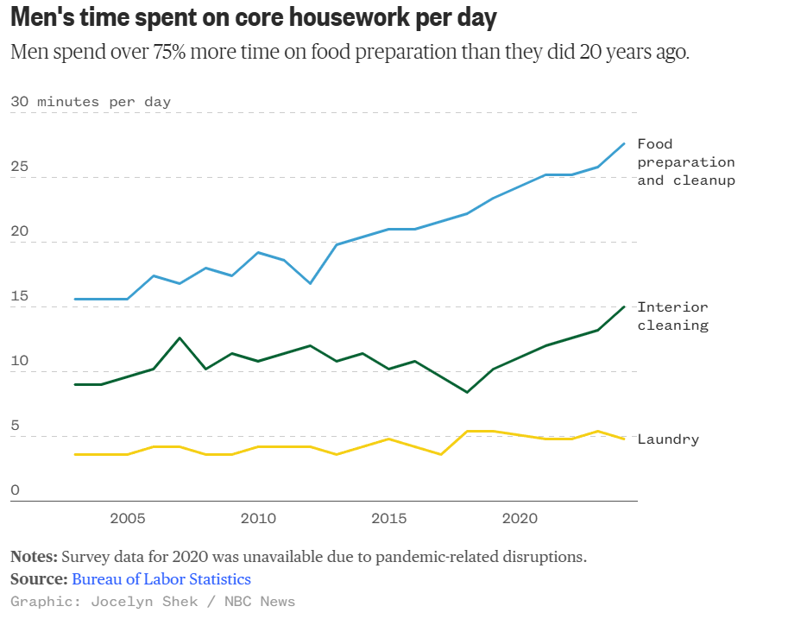
Gender Divide
Men Time Spent

Slide 2
The Gender Divide and Men Time Spent
Over Time
Over Time

Slide 3
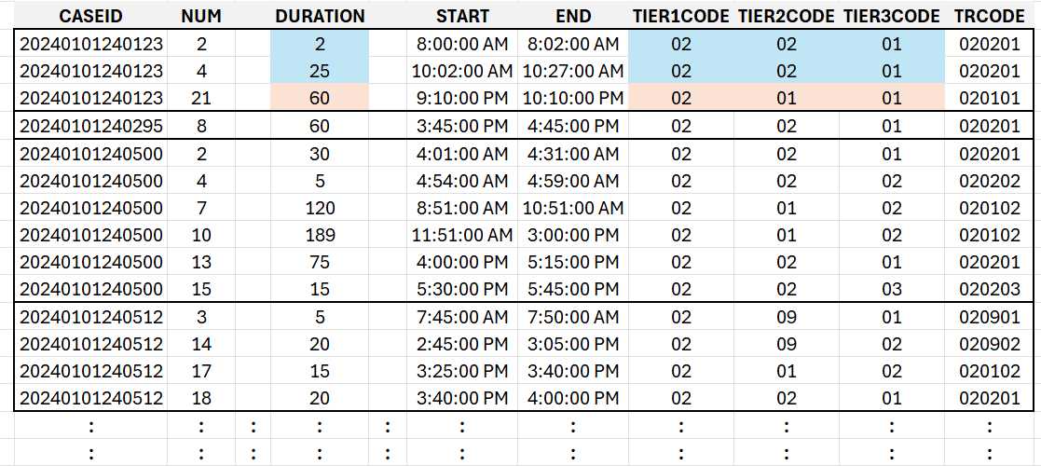
Time Use – Activity Files Over Years
2003
Need
the
YEAR!
2022
2023
Add
the
PATH
as
needed
2024

Slide 4
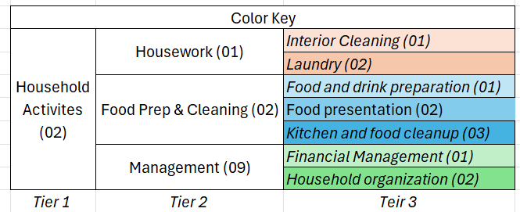
Men Time Spent

Slide 5
Lab 4.2
Explore columns, combine, and manage categories
Perform a column exploration to identify and fix problems with column names across the years.
Read, adjust columns, and UNION the yearly activity files.
Write the master activity file as a CSV formatted file.
Consider the graphs and activity files and answer the following
  What aggregations will need to be performed? Think about the units of the axis etc.
  Now consider the structure of the activity table. What does a case/row represent? How can this be aggregated? HINT: It might take multiple rounds of aggregation.
For each plot, map out a strategy for transforming the data into the form needed for each plot.

