Slide 1
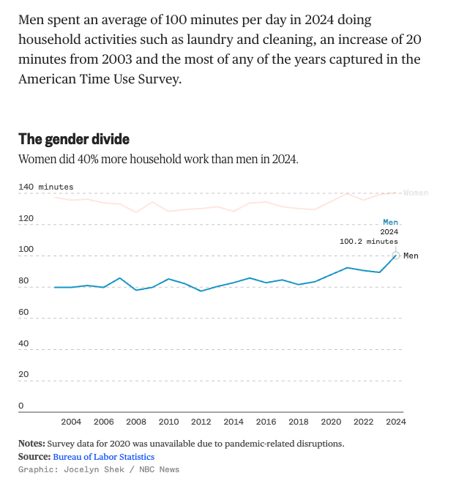
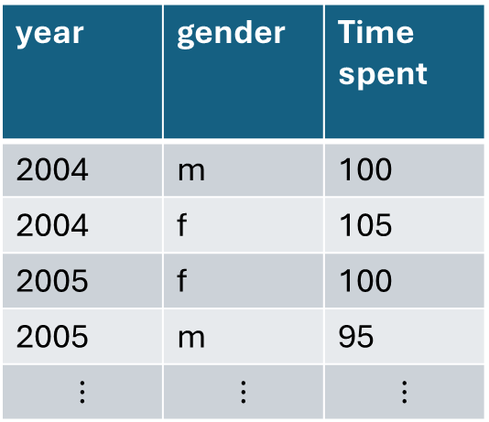
year | gender | Time spent
2004 | m | 100
2004 | f | 105
2005 | f | 100
2005 | m | 95
$$⋮$$ | $$⋮$$ | $$⋮$$
Average ??? on ??? per ???
grouped by (???, ???)
Average ??? on ??? per ??? grouped by
(???, ???)
Graphical Spec.
Geometry: ???
Var ? → Aes. ?
Var ? → Aes. ?
Var ? → Aes. ?

Slide 2
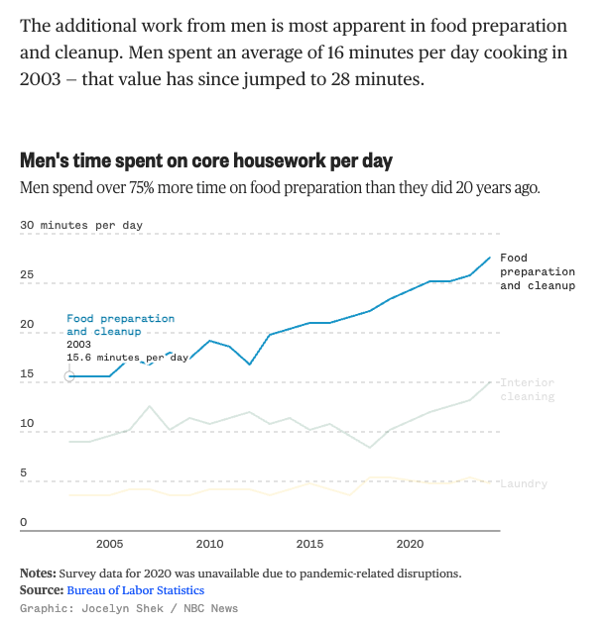
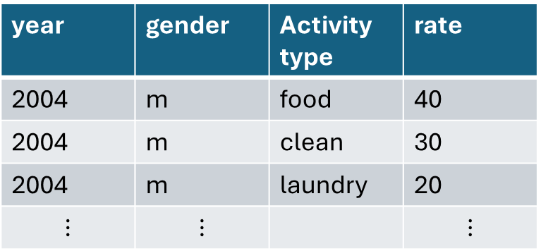
year | gender | Activity type | rate
2004 | m | food | 40
2004 | m | clean | 30
2004 | m | laundry | 20
$$⋮$$ | $$⋮$$ |  | $$⋮$$
Average ??? on ??? per ??? over
(???, ???)
Average ??? on ??? per ??? over
(???, ???)
Graphical Spec.
Geometry: ???
Var ? → Aes. ?
Var ? → Aes. ?
Var ? → Aes. ?
Average ??? on ??? per ??? over
(???, ???)

