Slide 1
Optimization of Routing a Pipeline Between a Reservoir and a Water Treatment Plant
Tyler Mindrum

Slide 2
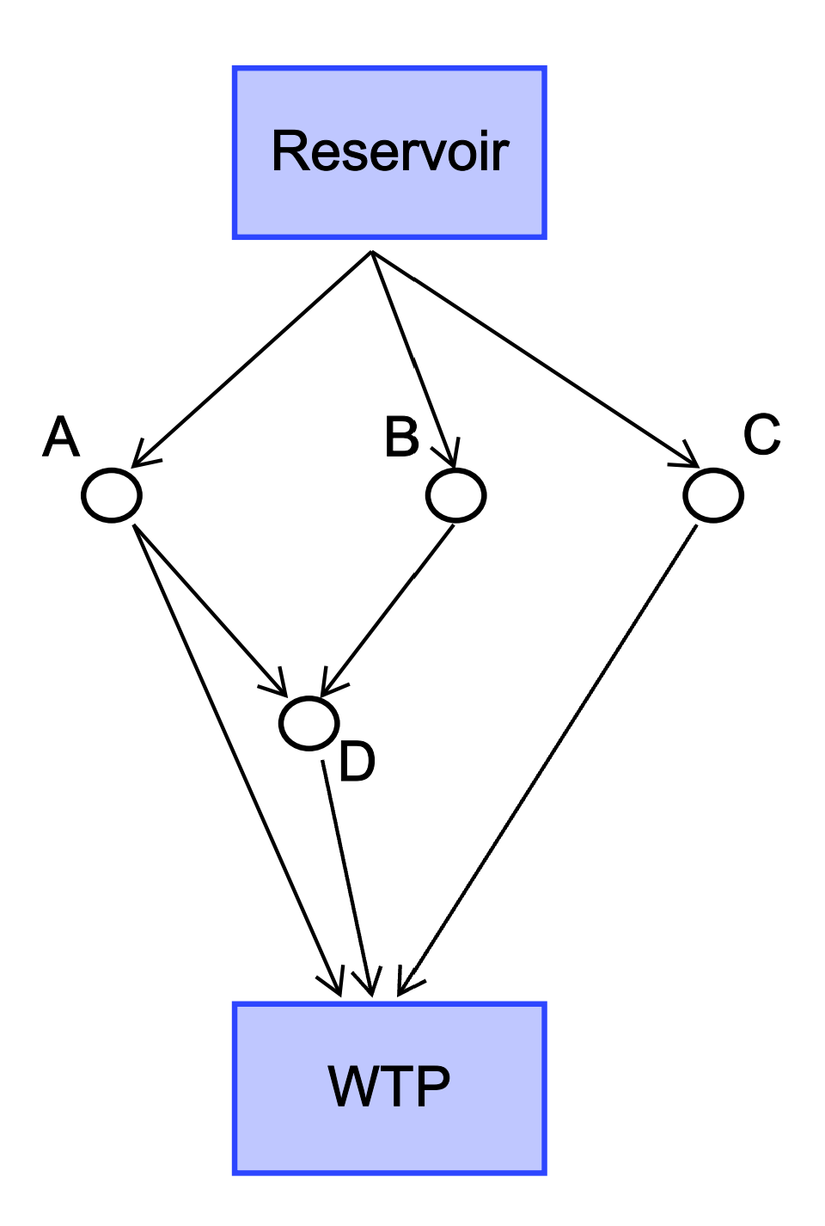
Problem Overview
Purpose
Problem Formulation
  Objective Function
  Dimensions
  Decisions
  Constraints
Method

Slide 3
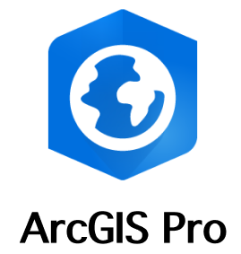
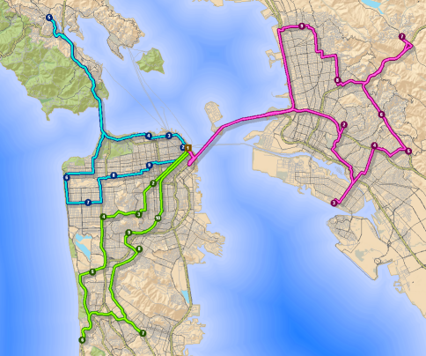
ArcGIS Pro
Widely used in consulting firms
More common than GAMS
Makes visualization easier
Easy way to manage lots of data
(ESRI)
Notes:
Photo from ESRI

